Slide 1
Index Velocity Best Practices ADVMs
Victor Levesque
USGS FISC - Tampa
Notes:
This presentation is an attempt to refresh everyone’s memory about ADVMs. This is not meant to be a substitute for the OSW training. This is the first in a series of Index Velocity related webinars that will hopefully help us all understand ADVMs a little better.

Slide 2
Overview
Configuring SonTek ADVMs
Servicing SonTek ADVMs
Use of the Internal Data Recorder
Beam Checks
Data to Transmit and Store
Quality Assurance of Data
Common Problems

Slide 3
Configuring the Instrument
Use SonUtils (v4.20)
Initial Setup
Use Theoretical Flow Disturbance Estimate for Cell Begin and Blanking Distance
Use Beam Check Signal Intensities for Cell End
Refine the Setup
Use multi-cell velocity data to verify and check for flow disturbance for Cell Begin
Use multi-cell velocity data to verify and check for appropriate Cell End
Notes:
Use SonUtils (v4.20 as of 2009/01/20) for configuring and servicing your Argonaut. It has many advantages over ViewArgonaut, including enhanced Beam Check and ability to record all commands sent to the Argonaut.

Slide 4
Configuring the Instrument
Theoretical Flow Disturbance for Cell Begin and possibly Cell End
Structure turbulence must be considered when establishing start of sample volume
b = c(dx)^{0.5}
b -- lateral distance from pier centerline to edge of wake zone
d -- pier width
x -- distance to upstream face of pier
c -- factor for pier shape
0.62 - round nosed
0.81 – rectangular nosed
d
x
b
Notes:
Remember if you are between piers on a bridge, make sure you make the same consideration for the piers near the cell end of the range-averaged cell

Slide 5
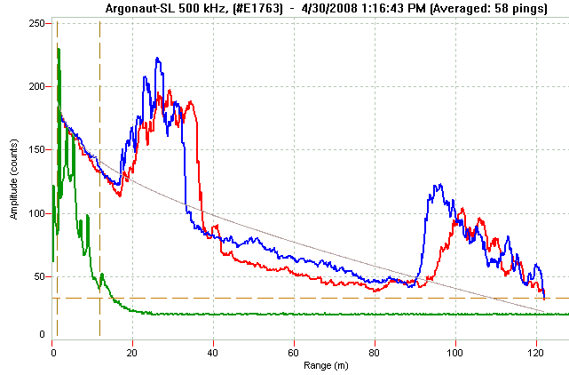
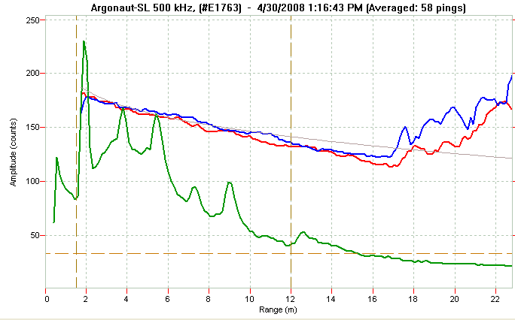
Configuring the Instrument
Cell Begin Marker
Initially Use Beam Check for Setting Cell End
Remember that scatterers in the water will change over time affecting signal strength.
Cell End Marker
Instrument Noise Floor Marker
Decay Curve
Notes:
First graph show a beam check for initial setup considerations. Note the dashed lines and realize what they represent. This is one of the advantages of using Beam Check in SonUtils. The vertical dashed lines represent the range-averaged Cell Begin and Cell End. The horizontal dashed line represents the instrument noise (aka instrument noise floor), near, at, or below, the instrument cannot detect the received signal.
Decay curve is based on instrument frequency and salinity. Difference between decay curve and measured amplitude should be 20 counts or less. Differences greater than 20 counts may just indicate a natural variation in scattering material, but can also indicate interference from boundaries in the water. (from SonTek SonUtils Help Manual)

Slide 6
Configuring the Instrument
Use SonUtils and SI units (meters)
Set Blanking Distance (BD) = Cell Begin (CB)
Enable Profiling Mode (ProfilingMode Yes)
Choose Cell Size (CS) and Number of Cells (Ncells) to at least equal Cell End (CE)
Example: CB = 1 meter => BD = 1 meter
CE = 11 meters based on Beam Check
CS = 1 meter and Ncells = 10
So multi-cell data starts at 1 meter and ends at
CS * Ncells + BD = 1 * 10 + 1 = 11 meters
Notes:
Example for 1.5 MHz SonTek-SL. Recommend always setting Ncells = 10

Slide 7
Configuring the Instrument
Special Considerations for XR and SW
Enable Dynamic Boundary Adjustment (DynamicBoundaryAdjustment Yes)
XR uses non-vented pressure sensor to set CE
Pressure sensor is affected by atmospheric pressure changes and temperature changes. Pressure sensor can drift or fail over time
SW uses vertical beam level (distance) to set CE
Note: CE = Cell End
Notes:
CE = Cell End
Make sure you reset the pressure sensor prior to installing the instrument. Do this in SonUtils by typing; resetpressoffset
A prompt will require that you enter a depth (if in air = 0). I would make it a point to find out what depth the Argonaut-XR is at and use your stage data as an indicator if pressure changes over time. Also, you should consider setting the pressure to a value greater than zero even if in air, to possible prevent the cell end from being adjusted beyond the water surface. The XR cell end is only adjusted in 0.3 foot increments (verbal communication with Craig Huhta/SonTek).

Slide 8
Configuring the Instrument
Enable Power Ping (PowerPing Yes)
1.5 MHz and 3 MHz systems
What about Sample Interval (SI) and
Averaging Interval (AI)?
Notes:
Power ping improves Signal-to-Noise ratio (SNR) and decreases velocity standard deviation, while only slightly increasing power consumption. Only available on Argonaut systems with frequencies of 1.5 and 3 MHz

Slide 9
Configuring the Instrument
Averaging Interval (AI)
What do you want to measure and what are the flow conditions?
Rapidly changing flow may require shorter averaging interval
General rule Increased averaging time => lower velocity standard deviation
Recommend 60 seconds AI and SI during discharge measurements
Notes:
No easy answer for selecting averaging interval. Understand the site and the flow.
Not a straight forward answer, as each site is different, and data end results may also be different. So ask what is the final product I am trying to report? Daily Q? Short term flow variations?
Discharge measurements and the index velocity instrument need to sample the same window of time. One recommended method for doing this is to set AI and SI to 60 seconds during discharge measurements. This AI and SI will often allow the best synchronization with discharge measurement times.

Slide 10
Configuring the Instrument
Sampling Interval (SI)
900 seconds maximum for tidally affected sites
Could be as short as 60 seconds
SI >= AI
Notes:
Sampling interval is the time between each averaging interval.
The sampling interval must be chosen so that the data will be able to reproduce the flow signal you are trying to measure.
Nyquist frequency = ½ of the sampling frequency => sampling rate (frequency) >= 2 * the highest frequency present in the sample

Slide 11
Configuring the Instrument
Example: Steady state stream with backwater affects
AI = 600 seconds
SI = 900 seconds
Note: Actual settings may vary
Remember that if stream is flashy, shorter AI and SI may be required to measure the peak
Make sure you have enough battery and solar capacity to meet power demands
May or may not change averaging interval during discharge measurements
Notes:
These are just general guidelines. Actual settings will vary. During calibration of the index-to-mean velocity relation it is recommended to change to a shorter measurement interval during discharge measurements. Example: AI = SI = 60 seconds
Make sure you will have enough battery and solar capacity. Power (Watts) = Current (Amps) * Voltage (P = I * E). Power requirements of equipment are in specification sheets from the manufacturer. Solve for current “I” for each piece of equipment at the site. Then figure out how much time the equipment will be on every hour. Multiply I * hours = Amp*Hours (battery capacity is reported in these units). Figure out how much sunlight will illuminate the solar panel (if so equipped) during a typical day. Estimated amount of current (“I”) the solar panel will provide: I = P/E => I * hours Amp*Hours the solar panel provides. Make sure that the solar panel provides enough Amp*Hours to be greater than the equipment Amp*Hours. Make sure you have enough battery reserve for cloudy/overcast days and night time operation.

Slide 12
Configuring the Instrument
Example: Tidally affected flow
AI = 60 - 780 seconds
SI = 60 to 900 seconds
Set AI = SI = 60 seconds during discharge measurements
Data times are extremely important
Notes:
Tidal sites could have a wide range of averaging and sampling intervals. I use 240 seconds averaging and 900 seconds sampling during normal long-term data collection (with SDI-12 control from data logger). I change to 60 seconds averaging and sampling intervals during discharge measurements to more accurately synchronize index-velocity data with discharge measured mean channel velocity (internal data recorder – Deploy). Can easily fill missing values while the Argonaut is self-deployed using the 60 second data
Remember when synchronizing index velocity and discharge measured mean channel velocity that the time recorded by the internal recorder is the start-time of the measurement.
Time synchronization is critical to achieving a good index-to-mean velocity rating. All sensor/recorder times need to be synchronized before making discharge measurements, and throughout routine data collection.
Additionally, data times are important to understand when you are synchronizing discharge data with index velocity data. In SonTeks, the data time in the internal recorder is the start time of the measurement interval.

Slide 13
Configuring the Instrument
Example: Unsteady flow due to seiche in small tributary of a larger river
What are you trying to measure? Daily flow? Short term fluctuations?
AI = 60 to 780 seconds
SI = 60 to 900 seconds
Set AI = SI = 60 seconds during discharge measurements
Data times are extremely important
Notes:
If you want to measure daily flows longer AI times might be okay. Remember you will want to have the Argonaut measuring most of the time to be able to provide a good estimate of average flow (Example: AI = 240 seconds and SI = 300 seconds, or AI = 480 s and SI = 600 s). If stream is a small basin with flashy hydrograph characteristics, your SI will have to be shorter to measure the true peak of an event.

Slide 14
Configuring the Instrument
Discharge measurements
AI = 60 seconds
SI = 60 seconds
Set StartTime (ST) hh:mm:ss
Set StartDate (SD) YYYY/MM/DD
Record Internally (disable SDI12 communication)
Deploy (leave Molex plug connected)

Slide 15
Collect Some Data

Slide 16
Evaluate the Configuration
Use Multi-cell data to evaluate flow disturbance
Notes:
Evaluating the data can also be done in the NWIS data base. That is why it is important to store all data in NWIS/ADAPS. It is especially encouraged that the multi-cell data also be stored in ADAPS. So if a problem with the range-averaged cell is detected, the multi-cell data will be readily available to possibly fill in the continuous record. In addition to the multi-cell velocity data, the internal recorded data also provides an enormous amount of additional QA data that further enhance the review of data.
Use multi-cell data to evaluate Cell Begin and Cell End. This is a movie. Space-bar to show the movie window, then use mouse to click in screen to start the movie (about 1 minute).

Slide 17
Evaluating the Configuration
Notes:
These are 60 second data recorded internally during a discharge measurement. There is some more noise in the velocity data.
However, when you average the 60 second data for the duration of the discharge measurement, the velocity noise will decrease.
60 second index velocity data allows a more accurate average value of index velocity as compared to measured mean channel velocity,
and it makes it easier to synchronize the index velocity data with the discharge measured mean velocity data.

Slide 18
Evaluating the Configuration
More obvious way to see flow disturbance is with plot of index velocity and mean velocity from measurements.
Notes:
One good way to evaluate the cell begin (CB and BD) and the cell end (CE and Ncells and CS) is to perform regression analysis on all multi-cell data (BD, Ncells, and CS) and the range-averaged cell (CB and CE). It appears that Cell 1 has some flow disturbance, and since the BD and CE are equal, that indicates there is likely a bias in the range-averaged cell. As a minimum, CB and BD should be increased by the cell size (CS).
You then can use the multi-cell data (you can average cells together to get one value) to develop a regression, and then adjust your range averaged cell CB and CE to bracket the same area of the good multi cell data.

Slide 19
Servicing ADVMs
Notes:
Here is an example of a field form for servicing an index velocity sensor. It was created in Microsoft Publisher and can be modified. I would suggest adding a Pressure and Level reading down near the Compass fields. This form can be requested in electronic form.
To get the Argonaut to display heading, pitch, and roll, type; compass cont in the command line of SonUtils. To stop just press the <enter> key.
To get the Argonaut to display Pressure, just type; sensor cont in the command line of SonUtils.
Could shorten the number Stage fields to make room for other fields.

Slide 20
Servicing ADVMs with SonUtils
Record a beam check (50 pings minimum)
Example: stationID_YYYYMMDD.bmc
Download ADVM internal data
Open a log file (click File in menu bar, open log file)
Example: stationID_YYYYMMDD.log
Record instrument and watch date and time before changing (use a form)
Change AI and SI if necessary
Change StartDate (SD) and StartTime (ST)
Deploy ADVM
Close log file
Notes:
Use a field form for an ADVM service visit. Make sure you have an accurate watch time. Make sure you have up-to-date firmware (v11.8 – Jan 2009)
1. Record a beam check (write down the file name). These files will be archived with any ADVM internal data.
2. Download the internal recorder data. Rename the file to make a unique filename after downloading. Write down the file name. Consider formatting the internal recorder if necessary. The raw data files will be archived on the WSC server.
3. Open a log file to record commands and responses from the ADVM.
Show System, Show Configuration, Show SetUp, Show previous Deploy. Look at the responses as they scroll across the screen. There should be a copy of the latest system, configuration, and set up in the gage shelter.
4. Record watch date and time and ADVM date and time on field sheet. Change date and time if necessary. Record time of reset and time Zone/datum used.
Set time in SonUtils by typing; time hh:mm:ss in the command line, then press <enter> at appropriate time. Times do drift in the ADVMs.
Date can be changed by typing: date YYYY/MM/DD in the command line and pressing the <enter> key
5. Change AI and SI if making measurements.
6. Add comments concerning the site. Type; comment in the command line, press <enter>, then you have three lines of 60 characters to type in to the internal recorder. You must press <enter> until you see “>” in the command window (one press for each line of comments).
7. Type Deploy in the command line (for internal recording only) leave Molex connector plugged together. Type SDI12 ON for SDI 12 deployment (ADVM controlled by data logger). Unplug Molex connector for SDI12 control and communication.
8. Watch the display to make sure deployment will start at proper date and time.
9. Disconnect the DB-9 connector from the computer.
10. Close the log file (click File, then Close Log File).

Slide 21
Use the Internal Recorder
Valuable data set
Use ViewArgonaut for data review
Select Processing
Open an Argonaut file
Look for anomalies in the data
Check all available parameters
Check internal beam checks (DIAG) tab on menu bar
Look at signal strengths for each beam
Look at multi-cell velocity data
Notes:
The internal data recorder provides valuable data that can help identify good, marginal, and bad data.
Get used to what good data looks like. It will make it easier to identify anomalies.
Change views to see all different data that are available for review.
Compare velocity Range-averaged cell with velocity multi-cell data. They should be similar in shape. Look for noise in multi-cell data to determine if the multi-cell data is a good measure of velocity.
Look at X velocity (downstream/upstream velocity if properly aligned) and Y velocity (cross-stream velocity if properly aligned).
Y velocity data should be near zero, if it isn’t near zero then does it follow the pattern of the X velocity? Look at Z-velocity (XR only), it should be near zero. If not, think what might cause this to occur.
Look at pitch, roll, and heading to see if instrument has changed orientation or compass has malfunctioned.
Check pressure sensor and temperature.
Check Cell End. It should not change. If it does, and this is an SL, it indicates that the signal strengths in the range-averaged cell decreased to within 5 counts, and the Argonaut automatically reduces the Cell End (CE) to keep the signal strengths 5 counts above the instrument noise (aka noise floor).
Cell End will change normally for XR and SW instruments if Dynamic Boundary Adjustment is enabled (it should be enabled) and the water level changes.
Change view of lower graph on left axis to Beam signal strengths, and select the right axis to view Instrument Noise. Rescale both axes to be the same range. Look at the signal strengths and make sure the beam signal strengths are greater than the Instrument noise level. Make sure instrument noise level stays the same over time. A change in Instrument noise over time likely indicates a failing instrument.
Look at multi-cell velocity data and look for excessive noise in each velocity cell. This will help you determine if the range-averaged cell velocity might be biased by flow disturbance.

Slide 22
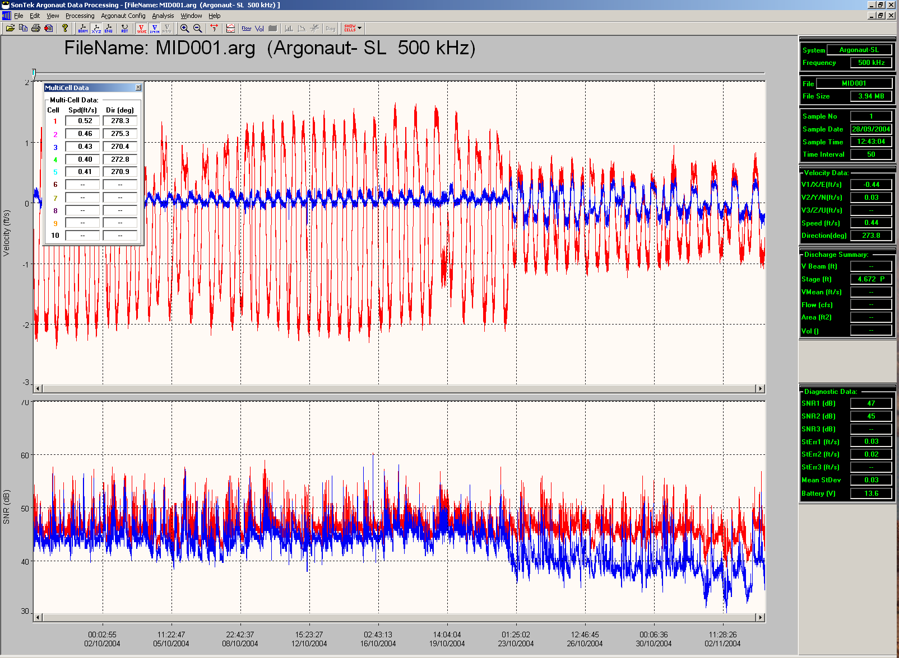
Velocity and SNR
Added QA
Additional backup source
Added understanding of site hydraulics over time
XYZ components
Notes:
Internal recorder data is necessary for a thorough review of the velocity data.

Slide 23
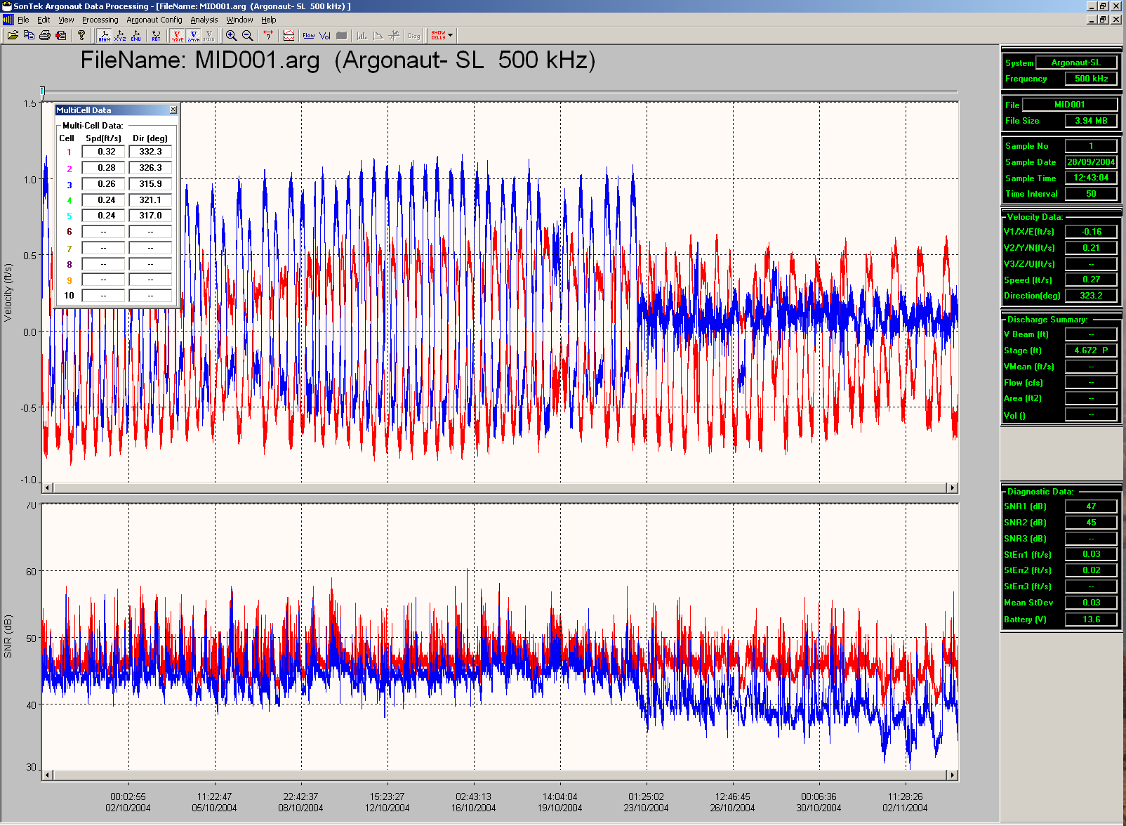
…Ability To See Different Velocity Components
Problem identified as Beam 2 issue
Beam components
Notes:
It appears only one beam was affected, but it still affects the velocity.

Slide 24
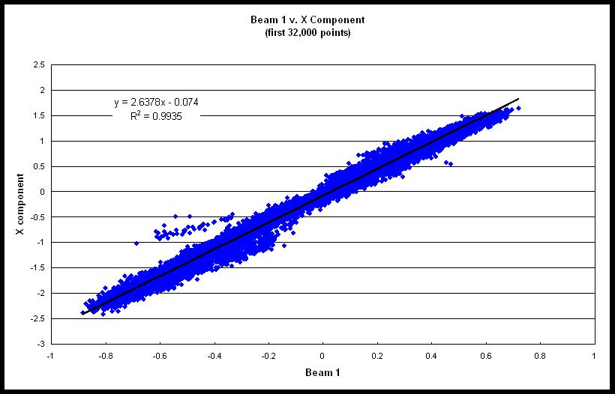
X/Beam 1 Relationship
Notes:
Can use individual beam velocity to establish a relation with good X velocity data and good beam velocity data.
It would be best to estimate the X velocity using discharge measured mean velocity.

Slide 25
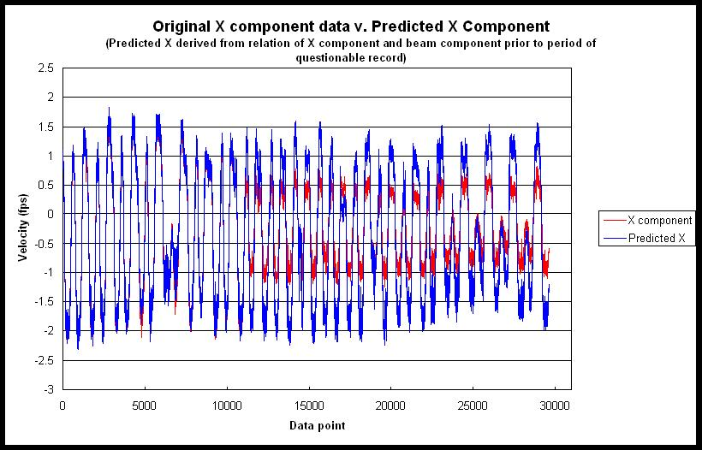
Notes:
Then a correction could be applied to the beam velocity to estimate the true X velocity (downstream/upstream).

Slide 26
Using the Internal Recorder
Review the data after every site visit
Range-averaged cell velocity (X,Y, and Z)
Compare multi-cell to range-averaged velocity
Signal amplitude and instrument noise
ADVM temperature
Everything else
Plot questionable record and add to review folder
Recommend storing internal data in ADAPS
Notes:
You must review the data in order to understand if the ADVM is operating correctly. I recommend taking a quick look at the data in the field (use ViewArgonaut), and then a more thorough review after returning to the office.
Evaluating the data can also be done in the NWIS data base. That is why it is important to store all data in NWIS/ADAPS. It is especially encouraged that the multi-cell data also be stored in ADAPS. So if a problem with the range-averaged cell is detected, the multi-cell data will be readily available to possibly fill in the continuous record. In addition to the multi-cell velocity data, the internal recorded data also provides an enormous amount of additional QA data that further enhance the review of data.
Y and Z velocity should be near zero. Watch for changes in Y and Z velocity as X changes and as water level changes.
Compare multi-cell data to range averaged velocity data to make sure that the range-averaged cell is not measuring in a region of disturbed flow.
Make sure signal amplitudes do not show a trend over time. This indicates beam fouling or possible electronics failure.
Look at cell end and pressure for XRs and Cell end beam signal strengths to make sure the cell end is not changing over time or during events. Remember that the SL will reduce the cell end if either beam signal strength decreases to within 5 counts of the instrument noise.
Look at ADVM temperature. This value is critical to accurately measure velocity (remember the speed of sound?)
Look at heading, pitch, and roll. Can help determine if the instrument has moved.

Slide 27
XR bio-fouling on Beams 2 and 3
Notes:
Plot the Internal Recorder Data
3 MHz XR with biological fouling at a tidally affected site. When at the site, a beam check would have also revealed the fouled beams.
You can notice that there is a change in the magnitude of the negative velocity as the beam SigAmp (signal amplitude) decrease. These are only one part of what to look at in the data. I’ll discuss other parameters in the QA section. Many times, signal amplitudes will tell you most of what you need to know about the data.
An important note; If you did not have such a long data set from the internal recorder (say you only had Dec 3 – Dec 24) and you were not familiar with what good velocity data looks like, you may think that this data looks okay. That’s why it is necessary to look at long-term data of velocity to look for trends. Use Hydra, and get in to the habit to plot 1 – 3 months for a big picture view of the data. Trends can often be more easily seen with longer-term data.

Slide 28
XR Pressure Sensor Failure
Notes:
Plot the Internal Recorder Data
3 MHz XR with a pressure sensor failure. Cell End is affected. Velocity data is questionable.

Slide 29
Beam Checks
Record every site visit
Record 50 pings minimum
Average the pings together
Transfer and store on WSC server
Notes:
Beam check signal strengths should be similar and show a decreasing level as distance increases.
Always do a beam check as it can indicate if a beam is affected (which will bias velocity data) and you might be able to correct the problem before you leave the site.

Slide 30
Beam Checks
Cell Begin Marker
Initially Use Beam Check for Setting Cell End
Remember that scatterers in the water will change over time affecting signal strength.
Cell End Marker
Instrument Noise Floor Marker
Decay Curve
Notes:
Note the dashed lines and realize what they represent. This is one of the advantages of using Beam Check in SonUtils. The vertical dashed lines represent the range-averaged Cell Begin and Cell End. The horizontal dashed line represents the instrument noise (aka instrument noise floor), near, at, or below, the instrument cannot detect the received signal.
Decay curve is based on instrument frequency and salinity and initial average signal strength of both beams. Difference between decay curve and measured amplitude should be 20 counts or less. Differences greater than 20 counts may just indicate a natural variation in scattering material, but can also indicate interference from boundaries in the water. (from SonTek SonUtils Help Manual)

Slide 31
Beam Checks
Notes:
What to look for in beam checks.

Slide 32
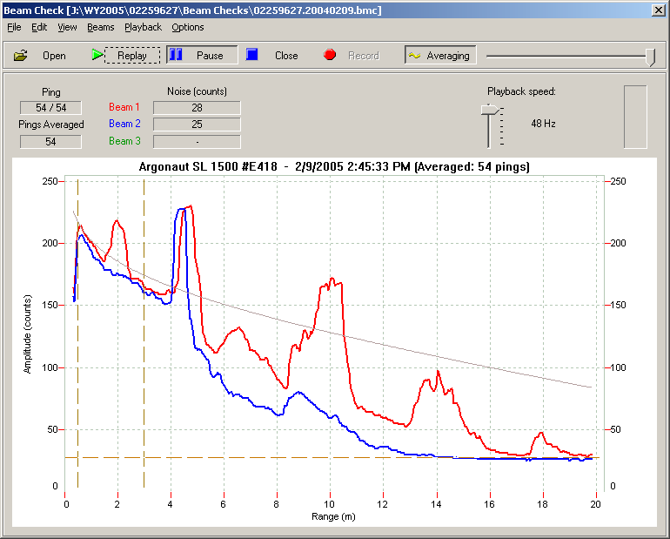
Beam Checks—What To Look For
Obstructions in the sample volume

Slide 33
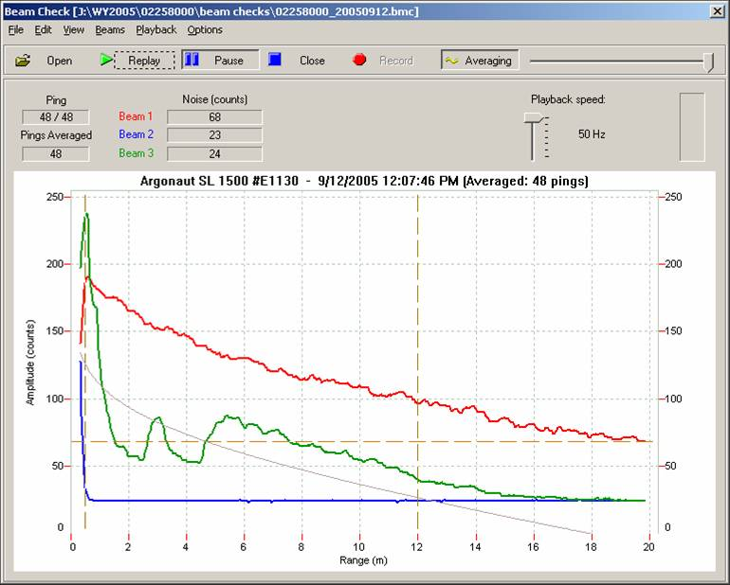
Beam Checks—What To Look For
Dead beam

Slide 34
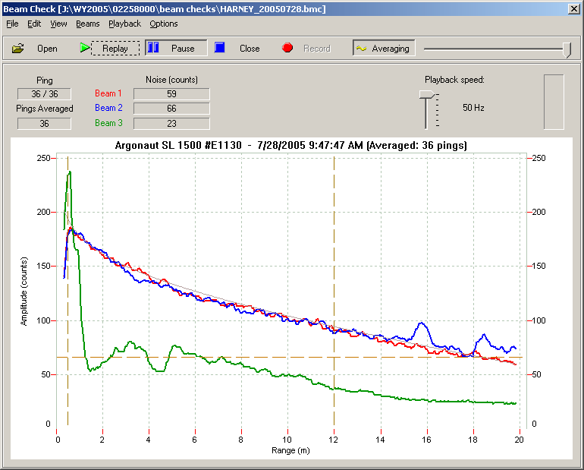
Beam Checks—What To Look For
Possible reflection off of the bed or surface

Slide 35
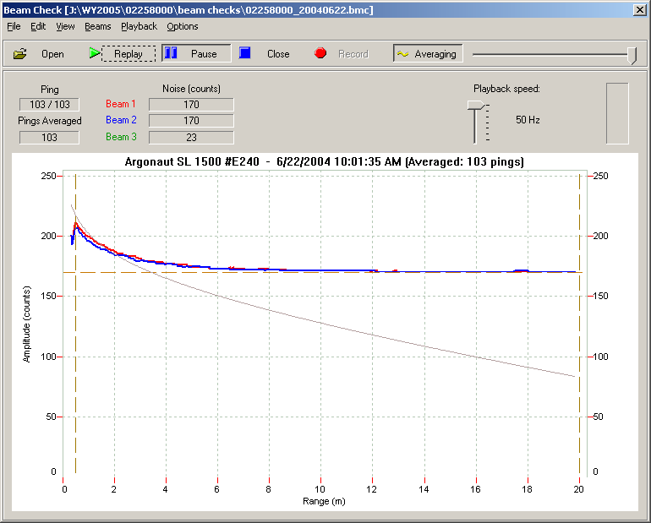
Beam Checks—What To Look For
Hardware issues—high noise floor

Slide 36
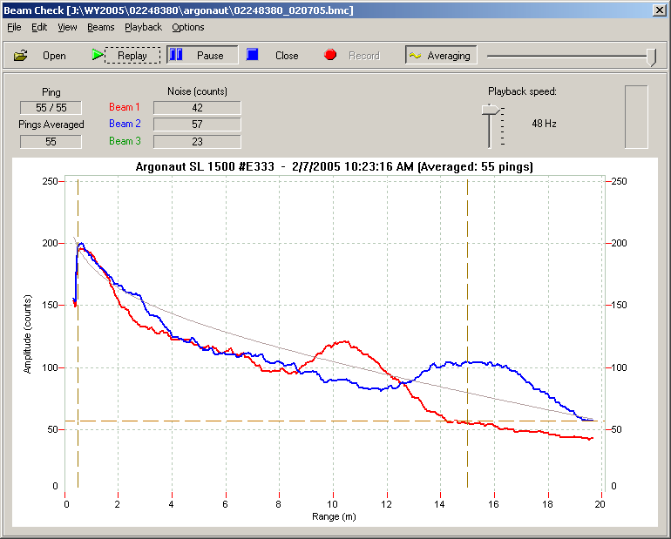
Beam Checks—What To Look For
Fouled transducers

Slide 37
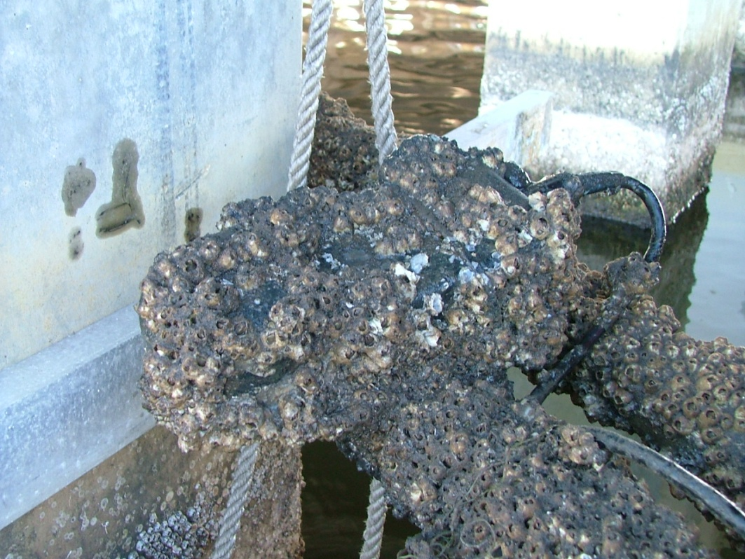
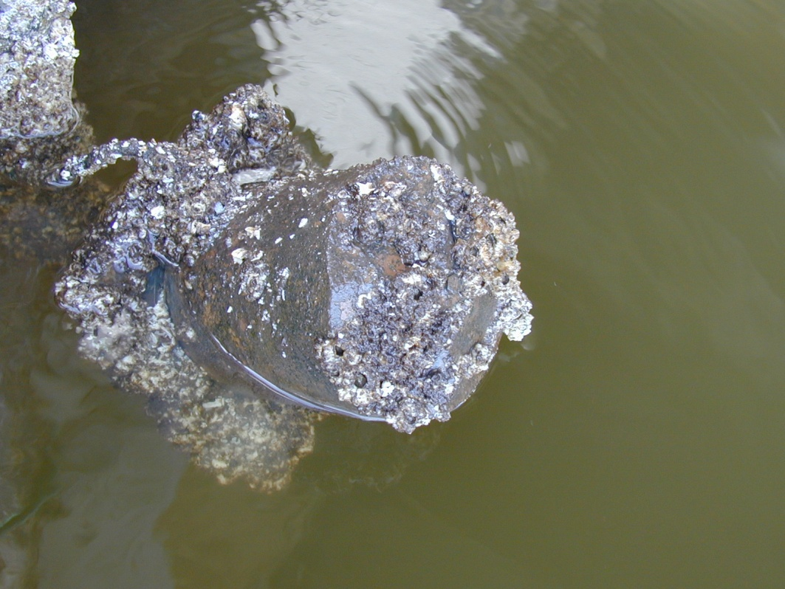
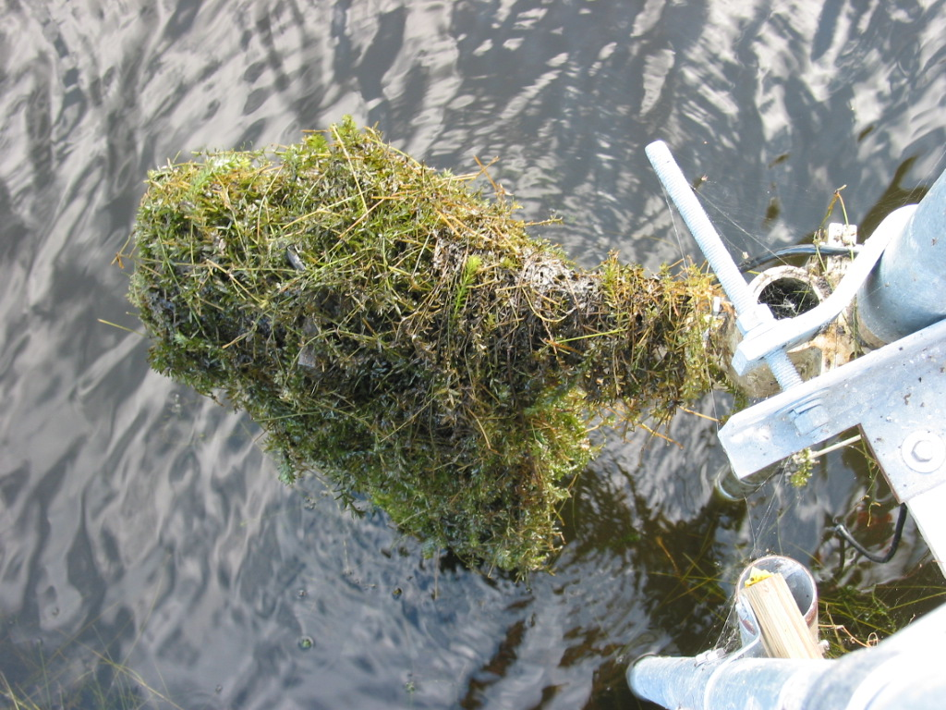
Fouled Transducers

Slide 38
Data to Transmit and Store
Minimum
ADVM Temperature
Cell End
X velocity
Y velocity
Average signal to noise ration
Ideally in addition to above data
Mean pressure if applicable
Level if applicable
Archive all Argonaut internal data according to WSC data archival plan
00055 Stream velocity, feet per second
72149 Stream velocity, meters per second
72168 Stream velocity, tidally filtered, feet per second
72169 Stream velocity, tidally filtered, meters per second
99237 Acoustic Doppler Velocity Meter signal to noise ratio
99238 Location of Acoustic Doppler Velocity Meter cell end, feet
99239 Acoustic Doppler Velocity Meter standard deviation, data element specified in data descriptor
99240 Acoustic Doppler Velocity Meter standard error of velocity, feet per second
99241 Location of Acoustic Doppler Velocity Meter cell end, meters
99242 Acoustic Doppler Velocity Meter standard error of velocity, centimeters per second
99968 Acoustic signal strength, units specified in data descriptor
Notes:
SDI 12 output order from SonTek Argonauts
ADVM Temperature
Mean pressure (XR and new SL 500 and 1500 kHz)
Level (SL and SW)
Cell End
X velocity
Y velocity
Z velocity
Average signal-to-noise ratio
Flow (not usually used by USGS)

Slide 39
Common Problems
Beam Check hangs during recording
Communication to internal recorder fails
PowerPing disabled
No multi-cell data measured
Argonaut-XR pressure sensor drift or failure
Beam fouling – No beam checks
Sensor not level
Cell End set too long
Cell Begin set too short
Internal clock never checked or reset
Internal recorder data not reviewed
Notes:
Beam check hangs – try using an USB to comm. port (DB-9) connector. Try using a slow connection in beam check (under options in beam check window menu, uncheck force high speed connection)
Communication to internal recorder fails – try connecting computer to same power supply as the Argonaut (may reduce noise)
Try using a slower baud rate to recover the internal data (19200 might work, but will take longer). Use Argonaut DOS Utility software SONREC to connect to internal recorder. Might have to use a lower baud rate to transfer data.
PowerPing disabled. Enable it if the Argonaut is a 1.5 MHz or greater frequency system.
No multi-cell data measured – set up Argonaut to collect multi-cell data.
Pressure sensor drift or failure – drift might be able to be compensated if you know true depth of XR. Failure requires replacement, but multi-cell data can be used to substitute for a depth-averaged range cell.
Beam-fouling – data not reviewed, beam checks not recorded and archived or reviewed.
Sensor not level – can affect Level measurement as stage increases or depending on distance to water surface. SW and XR sensor not level may lead to one beam measuring above the water surface.
Cell end set too long – make sure that cell end is conservative in case scatterers change over time, or CE set too close to a boundary (cell end should be set to be a minimum of 10 percent of the total range to the boundary.

Slide 40
Common Problems
Poor Index-to-Mean Velocity Relation
Stage affected velocity profile
Try multiple-linear regression
Poor site selection
Streambed instability
Unstable horizontal flow distribution
Improper instrument selection or configuration
XR or SW instead of SL
Cell begin and cell end not set properly
Notes:
Make sure you measure over the complete range of flows and flow conditions before using multiple linear regression.
Streambed stability will affect horizontal flow distribution and will likely change the index-to-mean velocity relation.
Unfortunately, many times this will only be realized after many calibration measurements. Tidal sites could realize it as little as two independent sets of 7-hour measurements (a quarter of a tide cycle).
Location might be better indexed using an up-looking velocity sensor.
Make sure cell begin and cell end are set properly. Use beam checks and multi-cell data to verify or refine the range-averaged cell begin and cell end.

Slide 41
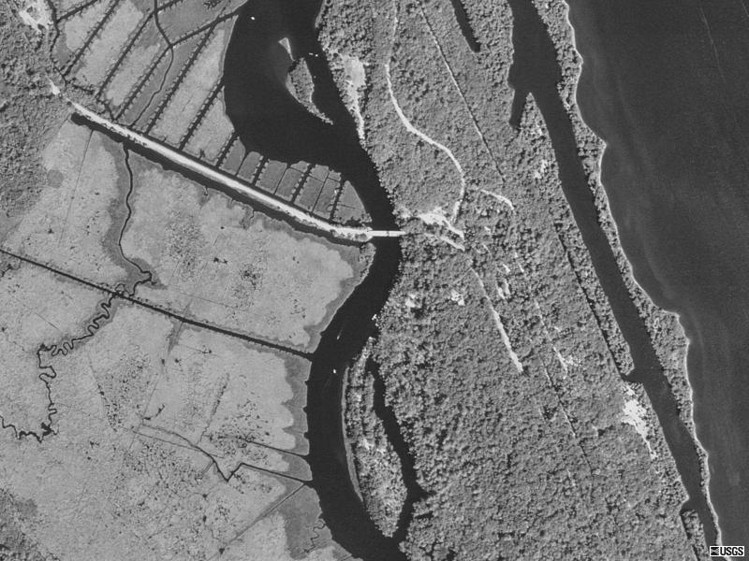
Flood tide
Tomoka River at Ormond Beach Gage
Ebb tide
Notes:
Poor site selection or improper equipment selection?

Slide 42
Second SonTek SL
SonTek XR
Original SonTek SL

Slide 43
Site Selection
Keep in mind
Fundamental question– will we be able to index the mean channel velocity over the range of flows at the selected site?
Keys for a successful site
Stable stream bed
Well mixed flow will have long-term stable vertical velocity profiles and horizontal flow distributions
Stable profiles and distributions allow us to create index-velocity ratings
Notes:
Index meters such as ADVMs and AVMs are good tools but not magic ---not every site can be indexed
Keep in mind the Fundamental Question--- think about ways to pick the most optimal site and the best way to instrument that site
Stable stream bed will help make stable velocity profiles and horizontal flow distributions.
A shifting stream bed can make for a very difficult to impossible index-to-mean velocity relation.

Slide 44
Reconnaissance of Potential Sites
Other Tools
Temporary ADVM
Aerial Photos, Charts, and Maps
Flow conditions recon with an ADCP
Velocity profiles
Depths
Shoals
Structures
Notes:
Sometimes the only way to determine if you have a bad site is to collect data and evaluate the index-to-mean relation. However, that does not mean you should avoid reconnaissance. It can save a lot of time and energy in the long term.

Slide 45
Common Problems
Wrong firmware on instrument
Use v11.8 for all Argonaut-SL, SW, and XR
Contact USGS Hydroacoustics
Wrong software
SonUtils v4.20
ViewArgonaut v3.62
Poor Equipment Mounts
Allow pitch and roll adjustment
Minimize dissimilar metals
Allow sensor to be replaced in exact position
Notes:
These versions are the most recent available as of January 2009.

Slide 46
Sensor Installation Documentation

Slide 47
Document and Archive Everything
/flalssr003/
ds
measurements (discharge and velocity)
WY2003
WY2004
WY2005
data logger
(work/temporary)
ds.archive
sta #
02243960
sta #
sta #
data logger
etc.
etc.
adcp
argonaut
flowtracker
aquacalc
(station #_mmddyy)
archive
WY2003
WY2004
02243960_040602.ckg
02243960_040602.bmc
02243960_040602.log
02243960_040602.arg
(See note below for file type explanation.)
02243960_040602_000w.000
02243960_040602_000w.001
02243960_040602_000r.001
02243960_.wrc
2421.020406152212.txt
02243960.237.dis 02243960.237.wad02243960.237.ctl
02243960.237.dat 02243960.237.sum02243960.237.ckg
.aqu
(station #. measurement #)
Notes:
Your WSC should have an electronic filing protocol for transferring and storing all forms of electronic data. Be familiar with it and use it.

Slide 48
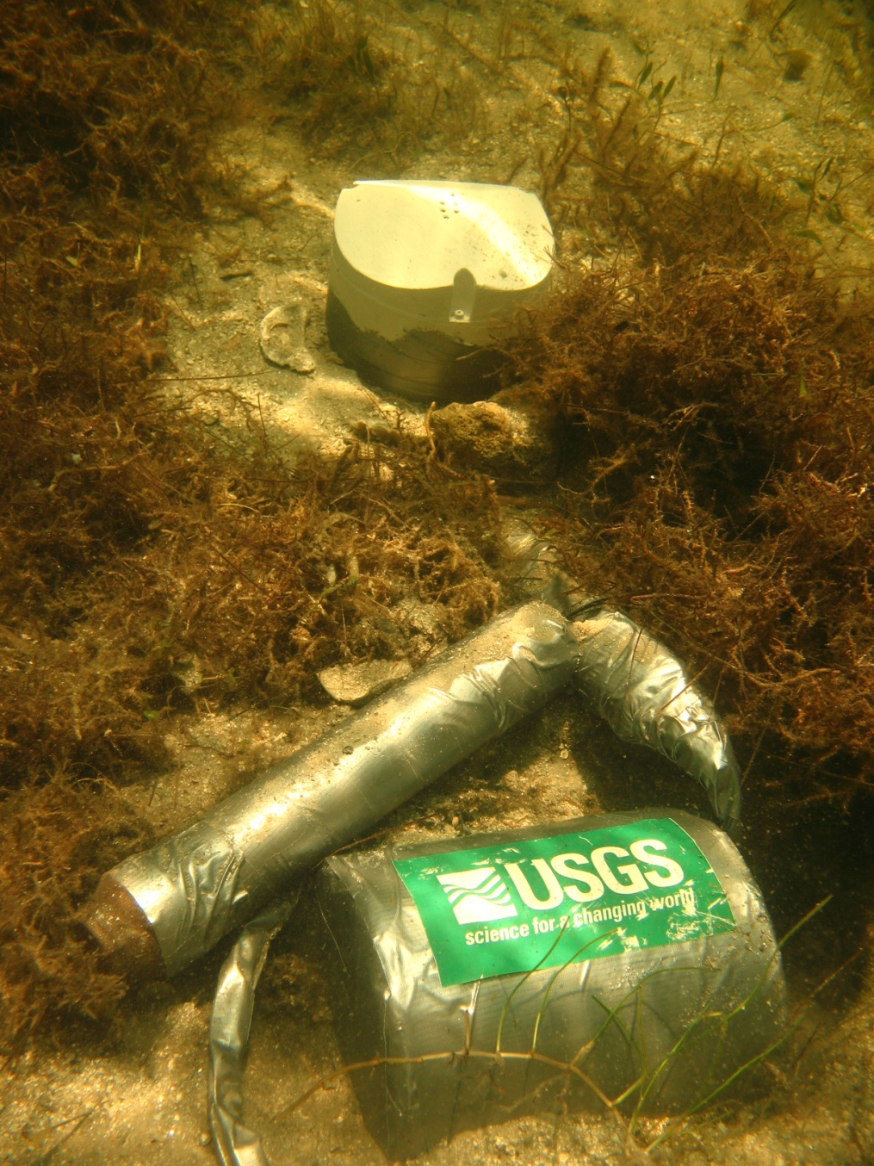
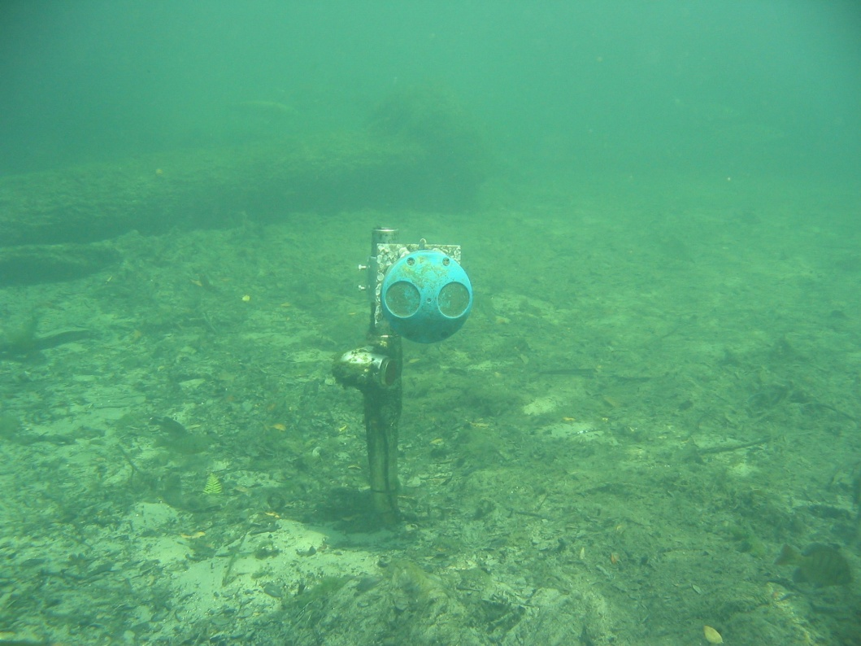
Questions?

