Slide 1
What’s New in Hydroacoustics
The latest in equipment, policies, procedures, and common issues
May 2011

Slide 2
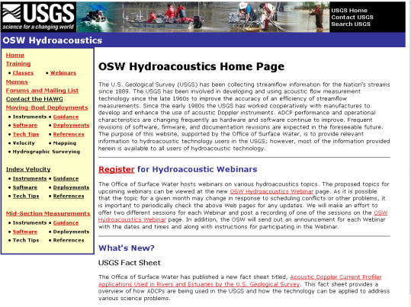
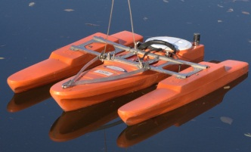
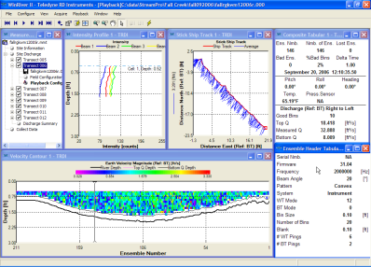
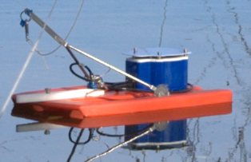
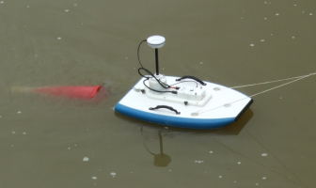
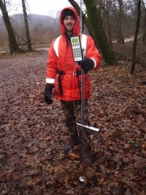
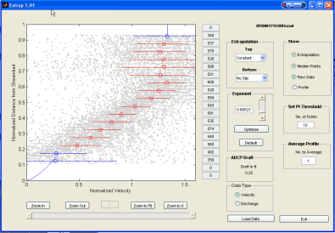
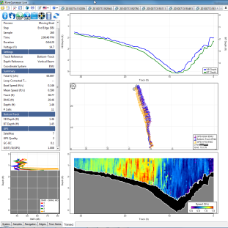
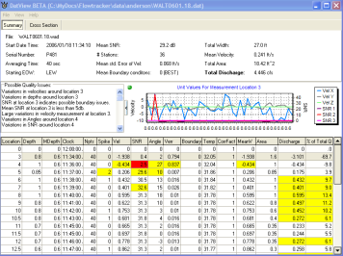
Overview
Hydroacoutics.usgs.gov
Moving Boat ADCP Measurements
  Good Technique
  Instruments and Software
  Processing
Mid-Section Measurements
  ADCP – Software Status
  OTT – ADC
  SonTek – FlowTracker ADV

Slide 3

OSW Hydroacoustics Website
http://hydroacoustics.usgs.gov
Info on
  Training
  Memos
  Forum
  Mailing list
  Software
  Tips
  Other guidance

Slide 4
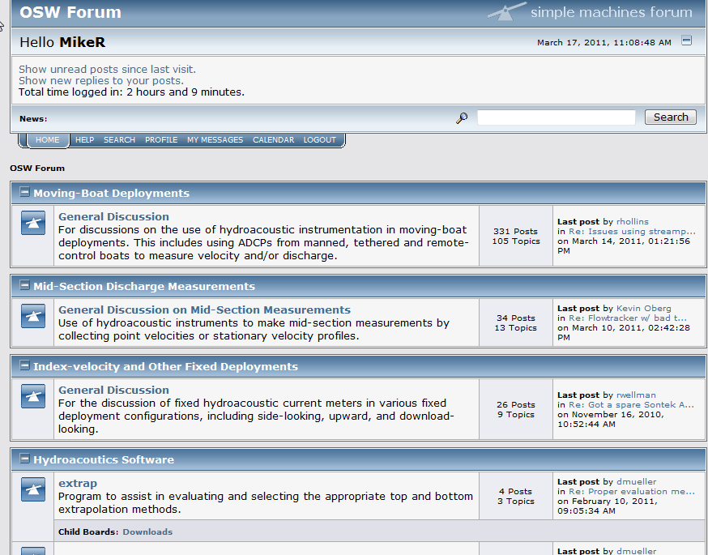
Hydroacoustics OSW Forum
http://hydroacoustics.usgs.gov/forum
Ask
Search
Read
Answer
Software

Slide 5
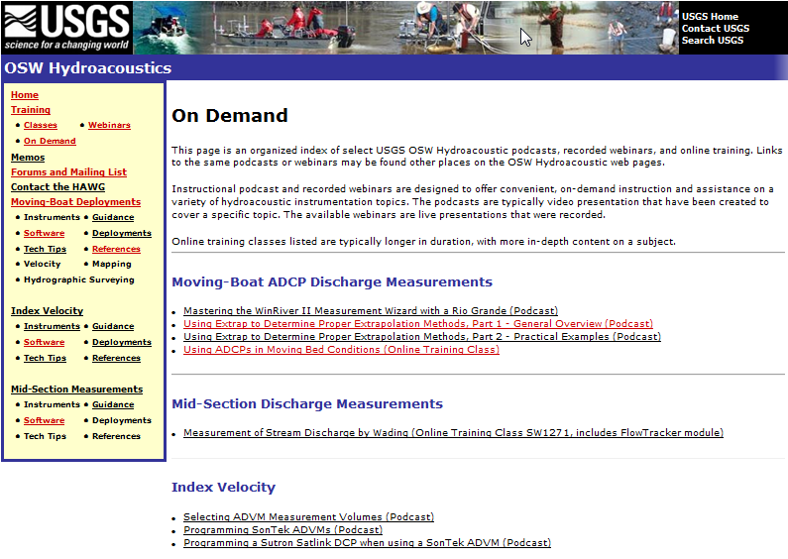
New - On Demand Section under Training

Slide 6
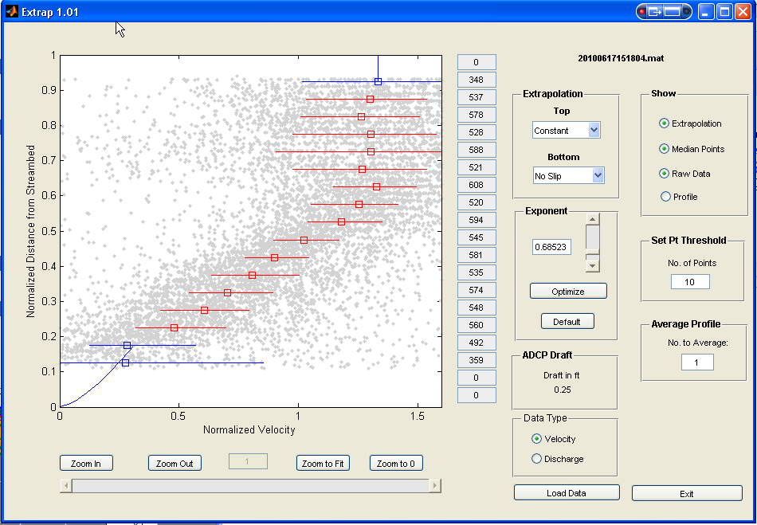
Extrap
USGS Software to visualize profile for entire transects (Works with SonTek and TRDI)

Slide 7
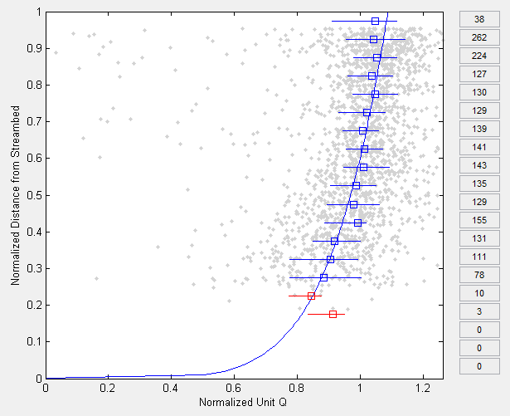
Extrap - Displayed Data
Gray dots: Normalized data for each depth cell in the transect.
Blue squares: Median value for data falling in 5% increments of normalized depth.
Blue line: Extrapolation fit to data based on selected parameters (extrapolation and exponent)
Blue horizontal lines: Limits of the middle 50% of the data in the normalized depth increment.
Numbers:
Number of points in each normalized depth increment.
Red:
The number of data points in normalized depth increment are below the threshold limit. Data are not used in fitting the extrapolation.

Slide 8
Applying Extrap
Look at a few transects (all if necessary)
Select a single “best fit” for the whole measurement
Consider the noise (width of whiskers)
Don’t over analyze
Use Optimize only when it makes sense when combined with hydraulic knowledge
Consider the effect on total discharge
Should not take a significant amount of time
Extrapolation methods and exponent values different from 1/6th must be entered into ADCP software for final processing of the discharge.
See Podcasts on hydroacoustics.usgs.gov for more

Slide 9
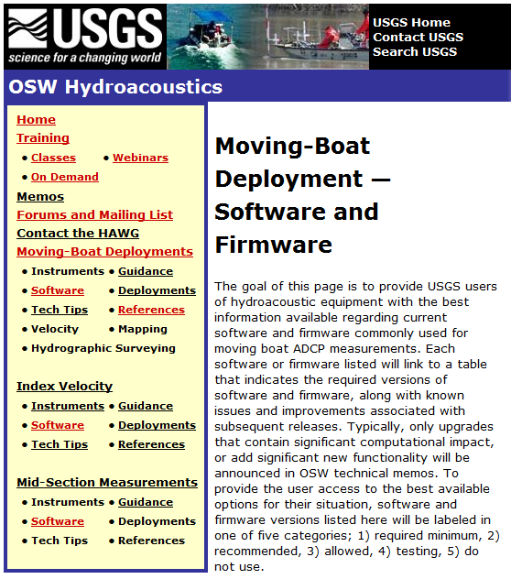
New Software Firmware
Status Pages
Software and firmware listed with tables that indicate required versions, along with known issues and improvements associated with subsequent releases
Typically, only upgrades that contain significant computational impact, or add new functionality will be announced in OSW technical memos
Versions have one of five categories; 1) required minimum, 2) recommended, 3) allowed, 4) testing, 5) do not use.

Slide 10
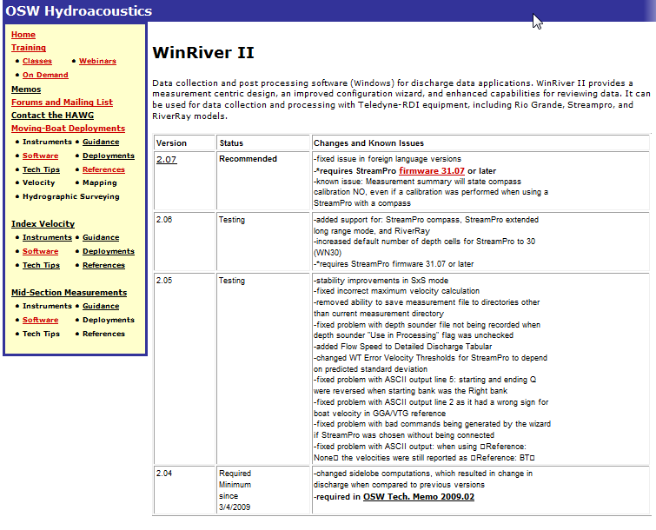
WinRiver II Status Example

Slide 11
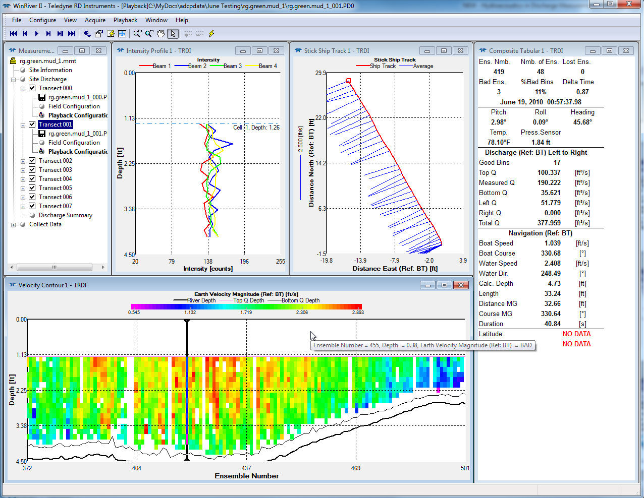
WinRiver II
Version 2.07 recommended
  Required with StreamPro firmware 31.07 or greater
  Required for RiverRay
Version 2.04 Min Required

Slide 12
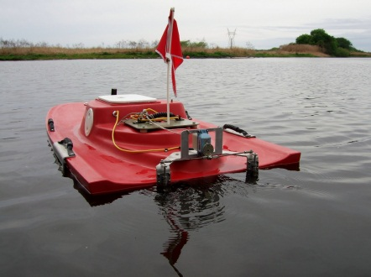
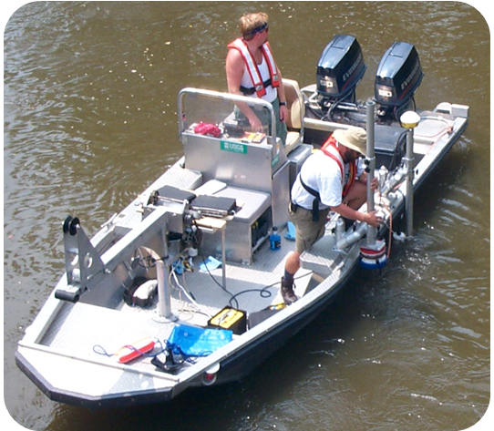

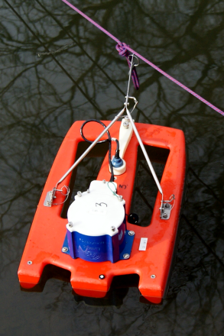
Good Field Procedures
Setup Deployment
  Attach safety line to ADCP
  Do NOT attach tether rope to yourself our around your body
Measure ADCP draft
  Distance from center of transducers to water surface (SonTek = distance from btm)
  Account for roll on manned boat
Measure and record independent water temperature and
salinity
  Policy: All acoustic instruments must have independent temp check (within 2 degrees C)
Notes:
A temperature error of 4º C or salinity error of 12 ppt will result in a 1% velocity error
The instrument must have an accurate temperature sensor and must be configured for the correct salinity
Rule of thumb: Specific conductance generally below
5000 uS/cm should not significantly affect C

Slide 13
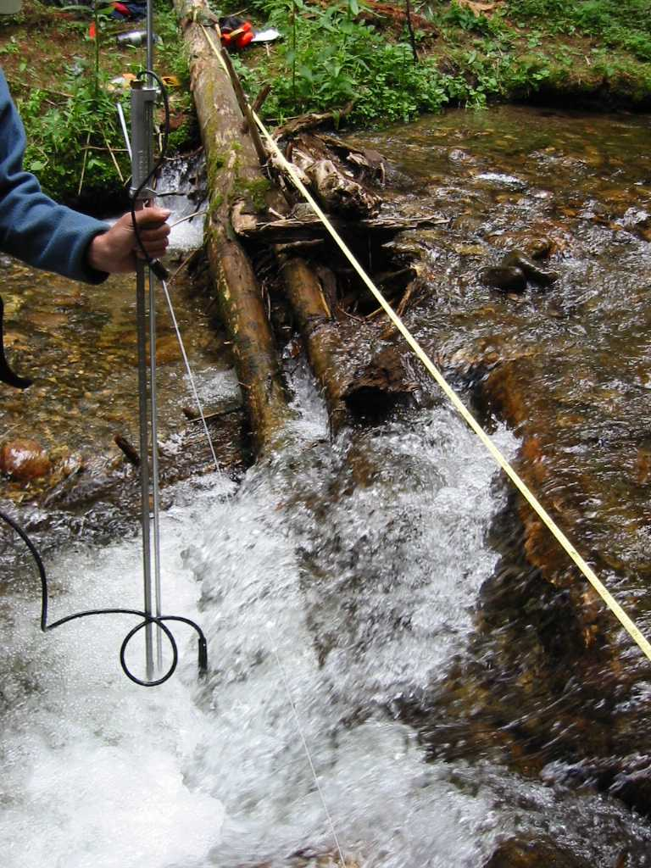
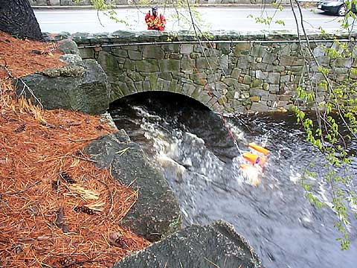
Measurements - Technique
Good site selection – the best way to improve your measurements!

Slide 14
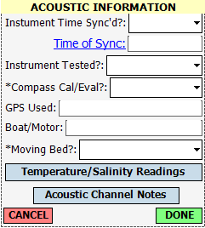
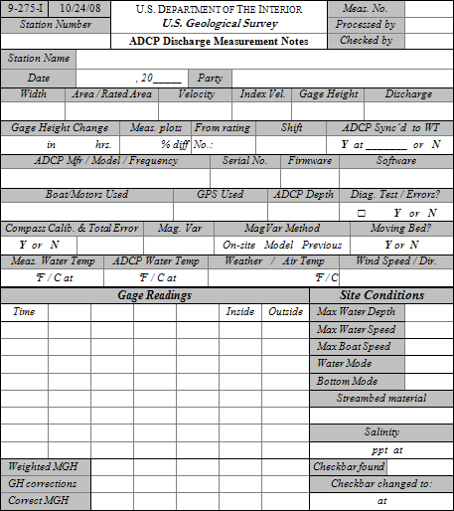
Field Notes- SWAMI and Paper
Necessary info on the current paper form will be documented in SWAMI and stored in NWIS, either in the SWAMI XML or SiteVisit
  Offices should have local policy on taking and storing notes
Available from the HIF

Slide 15
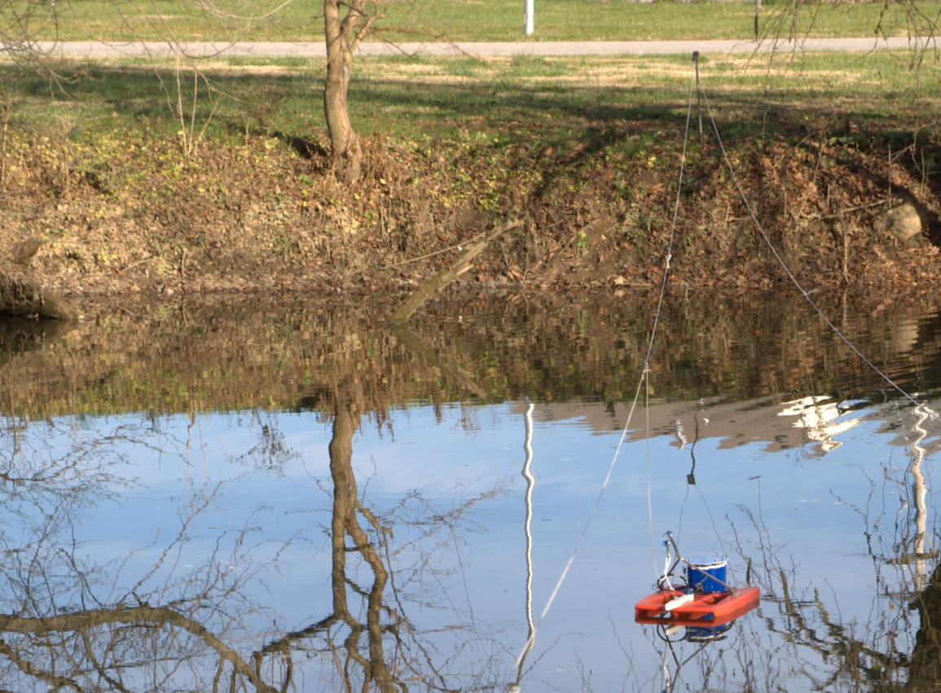
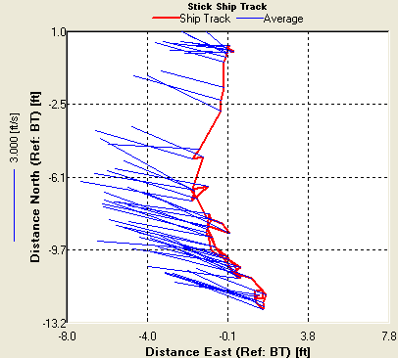
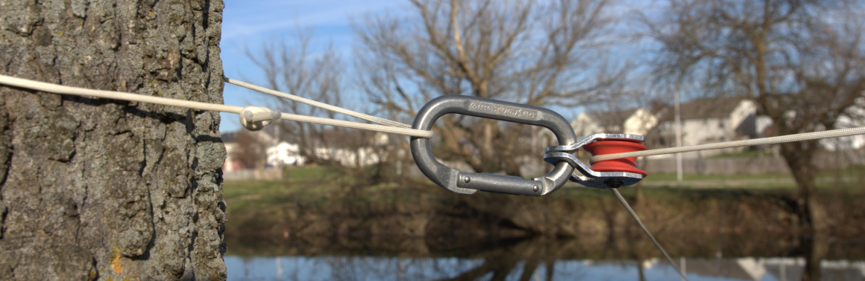
Smooth/Consistent Motion
Operating/moving the boat smoothly and consistently is very important for quality measurements (more important than going slow)
Careful setup and deployment (lines and pulleys can make it easier to be consistent)
Sometimes you need to move across the stream faster to maintain speed and direction
Make more transects to increase sample time

Slide 16
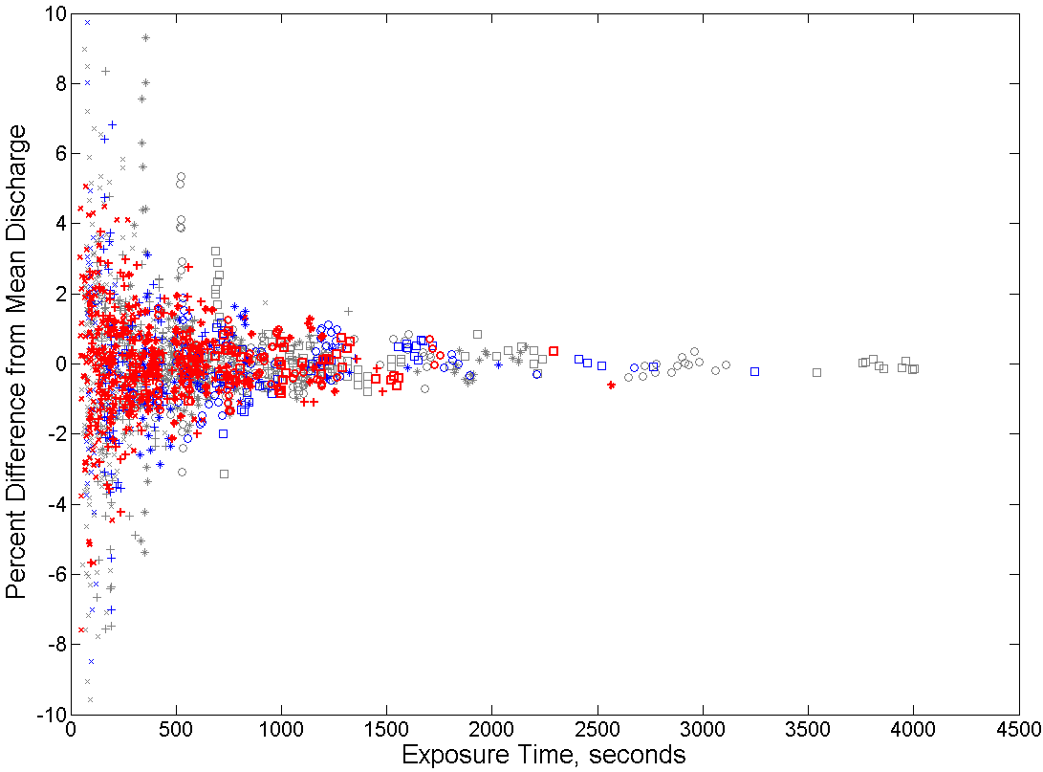
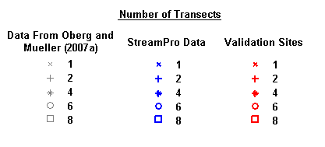
Exposure Time Policy is Coming
Possible policy – For steady flows, exposure time must be ≥ 720 s (12 min) & minimum of 2 transects
Notes:
Discuss the concept

Slide 17
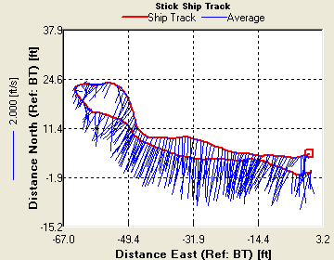
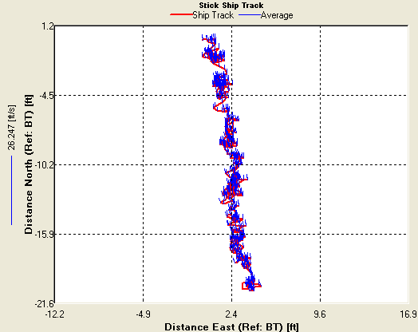
Moving Bed Tests
Loop Method: preferred MB test – IF you have a calibrated/accurate compass AND can maintain bottom track
Stationary MB test: Pick location most likely to have moving bed, do multiple when in doubt, minimum required MB Test (Use when no compass, or compass errors)
If there is any doubt in one method collect an additional test with the other method
Use GPS or loop method if a moving bed exists. For instruments without a compass or when there are compass errors, do multiple stationary moving bed tests
Always use LC or SMBA for corrections

Slide 18
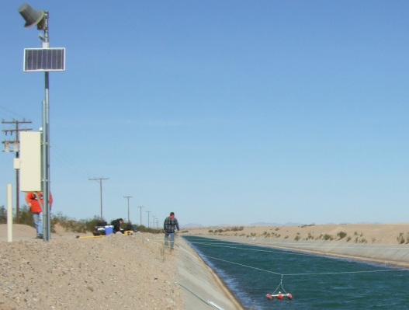
Processing Data in the Field
Most ADCP measurement processing should be completed before leaving measurement site
  Determine and correct for moving bed (SMBA or LC)
  Examine profile (Extrap)
  If measurement is off of the rating more than expected a check measurement should be made
  To make a check measurement - change as much as practical (if possible: meter, cross-section, mode, draft, method, recalibrate compass)
  Backup data – If using M9/S5
  download any missing data from ADCP
  (Direct connect cable to ADCP is fastest)
Possible exceptions: Collecting
data over tidal cycles or special projects
Notes:
Slide content description
Data quality assurance
Intended Message
Check the field data quality prior to leaving the field
Material
Prior to leaving the field site, conduct a preliminary data quality assurance review. It is intended as a quick check in the field to determine whether or not the data is suitable for the computation of discharge.
It consists of two procedures.
The first procedure involves checking the quality of each individual transect.
The second procedure involves checking the overall integrity of the discharge measurement, which consists of a minimum of 4 valid transects all within 5% of their average. This must be done before leaving the site.
The first procedure involves checking that each transect has been set-up and conducted in keeping with the procedures and criteria listed in Section 4.0 Field Set-up and Operations above. The major points include:
- Field computer set-up includes latest WinRiver software and correct file naming conventions.
- Site selection in keeping with standards. Criteria specific to ADCP are listed in Appendix A.
- Comprehensive Survey Notes, taking particular care to record unusual conditions such as high winds.
- Appropriate WinRiver settings and ADCP Configuration for the site conditions.
- Recording of ADCP transducer depth, temperature, salinity and gauge heights.
- Diagnostic, Compass Calibration and Moving Bed files conducted and recorded.
- Measurement of left and right bank distances (not estimated).
-Appropriate boat speed and track.
- Less than 10% bad ensembles, 10% lost ensembles and 25% bad bins.
- More than 25% of Measured Q over the Total Q.
Reference
Procedures For Conducting ADCP Discharge Measurements , section 4.0

Slide 19
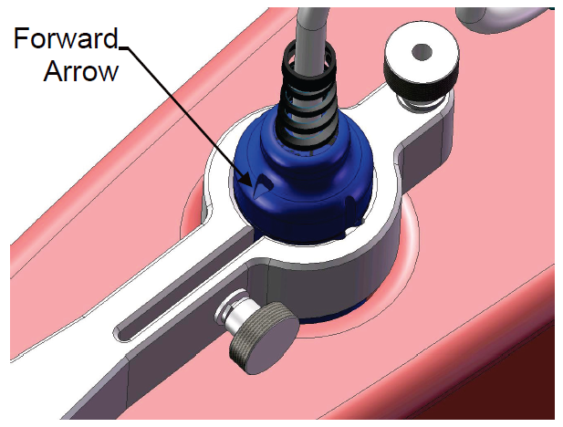
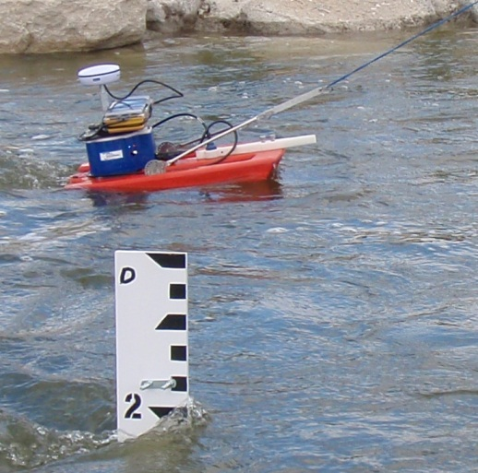
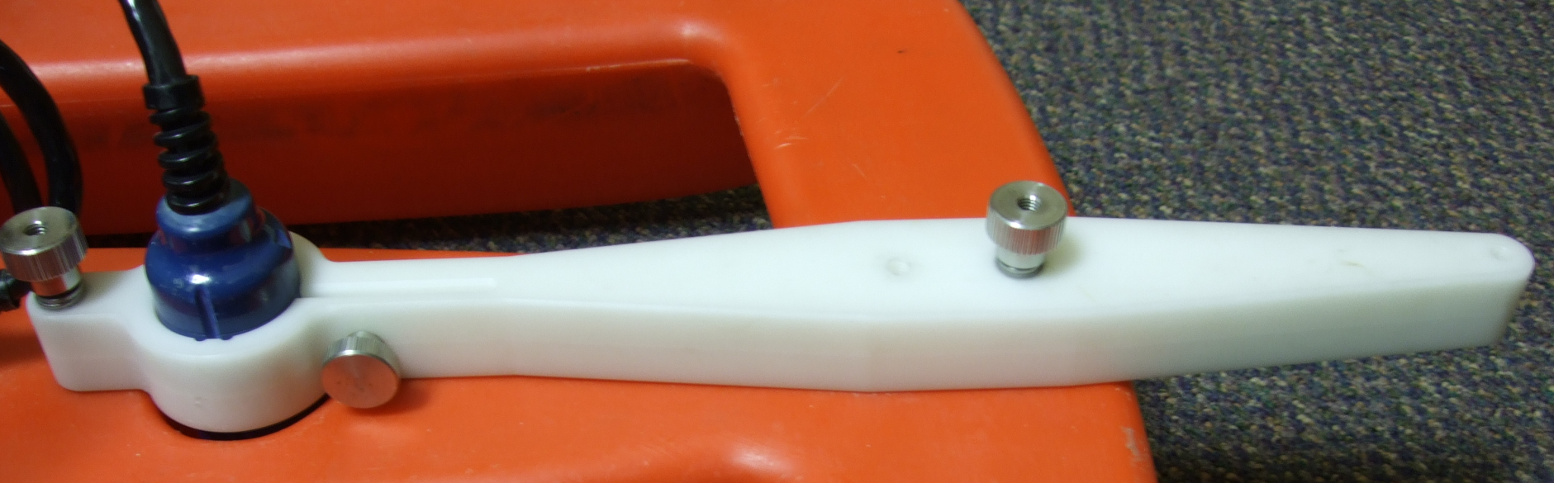
StreamPros with a Compass
Advantages
  Correct velocity directions, widths, areas, etc
  Better QA/QC of data (viewing)
  Can correct for moving bed using Loop method (LC.exe)
  Potential to use GPS
Compass in electronics housing so transducer must be in known alignment
Place transducer in grooves so that arrow on top point to the front of boat

Slide 20
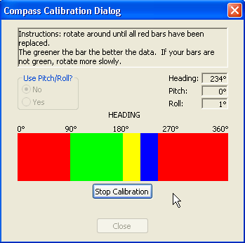
StreamPro Single Tilt Calibration
Execute compass calibration in WRII
Use Pitch/Roll No
Slowly rotate the boat 360 degrees
There are 12 squares that change colors as you rotate
The more Green they are the better
Go slower if they are yellow or red
Evaluation does at the end of calibrations

Slide 21
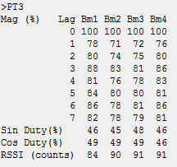
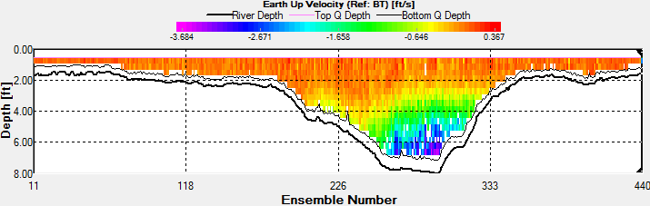
StreamPro Site Specific Acoustics Interference
PT3 test results RSSI do not decrease to 15% or less by lag 3
High error and vertical velocities that increase with depth
Notes:
The StreamPro is more susceptible to interference issues than the Rio Grande primarily because of the cable between the sensing head and the electronics. The longer that cable is, the more susceptible the system will be. The other challenging aspect of interference is that everything is relative. All else being equal, sites with higher backscatter characteristics will be less susceptible to data degradation from interference than sites with low backscatter characteristics. There is no substitute for human judgment in this area.
Interference in ADCPs can take two forms. The first, and more benign form, is that it will increase the background noise level at a site. This form of interference is indicated by the RSSI values in the PT3 test. A typical StreamPro in a clean environment will have RSSI values on the order of 50 – 70. The RSSI values are not calibrated or normalized to any particular value, so there will be significant differences between beams and between sensors. Elevated values merely indicate higher levels of background noise in a system or at a site rather than an issue with the StreamPro hardware. Data collected at a site should be reliable as long as the RSSI of the collected data is 10-20 counts or more above the background noise level. Normally, as the signal strength drops below that threshold the correlation will decrease and when it drops low enough the data will be flagged bad which is expected and desired behavior. The negative impact of this type of interference is that range will be reduced and data is more likely to be marked bad.
The second form interference can take is that of elevated correlation. The PT3 test receives without transmitting; normally as time passes the background noise should change and the signal will decorrelate. If it does not, the system cannot tell when the data is erroneous. Correlation at a site with favorable interference characteristics will typically decay to 15% or less by lag 3. High correlation values at longer lags does not necessarily mean the data is unreliable, it simply means that the system cannot determine whether or not it is reliable. As noted above, if the intensity of the profile data is 10-20 counts or more above the PT3 RSSI level the data should be reliable.
When interference is present, reasonable values for the WT Up and WT Error thresholds should be adequate to screen out erroneous data. Threshold values of 0.5 m/sec (approximately 1.6 ft/sec) for both WT Up and WT Error worked nicely in the data I reviewed, and the data remaining after applying those threshold values corresponded closely to the 10 count RSSI margin I discussed above.

Slide 22
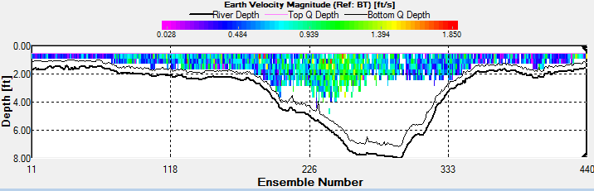
StreamPro Site Specific Acoustics Interference
StreamPro more susceptible, largely due to cable between transducer and electronics
Lower backscatter sites more susceptible
Reasonable values for the WT Up and WT Error thresholds can usually screen out erroneous data – but may screen out a significant amount of data

Slide 23
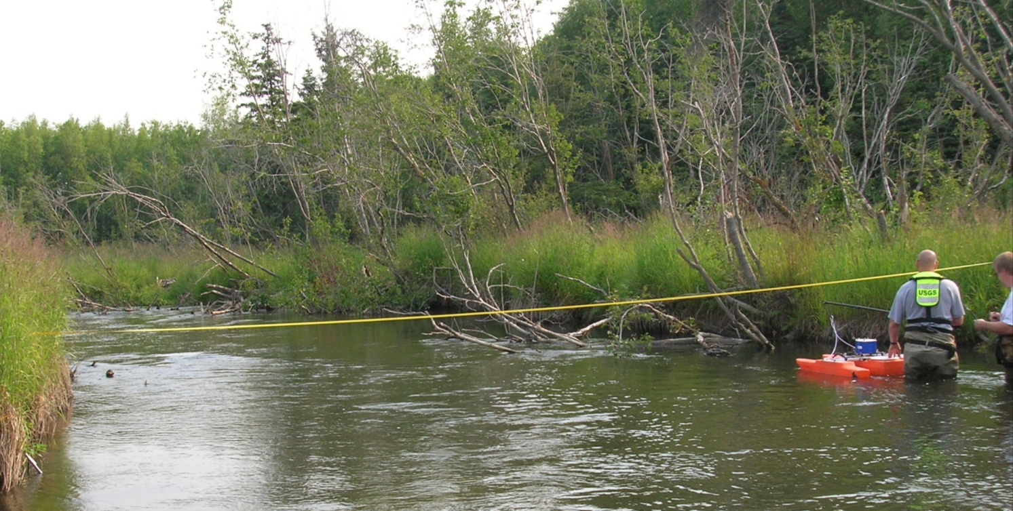
Guidance for Wading Measurements
Do NOT Wade with StreamPro’s or other shallow water ADCPs!
  ADCP beams may impinge on hydrographer or sample the flow disturbance caused by the hydrographer
  It is difficult to wade across channel while keeping the StreamPro motion smooth and steady

Slide 24
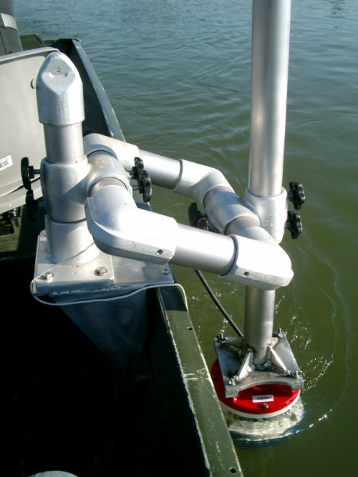
Rio Grande Water Modes
(In Priority Order)
Too fast, too deep, too turbulent
Dynamic Conditions
Mode 5 or 11 (often need to try both)
  Low instrument noise
  Small bins
  Limited application
Mode 12
  High-ping rate
  Small bins
  Potential errors in dynamic conditions
Mode 1
  Robust mode
  Highest instrument noise
  Limited bin sizes

Slide 25
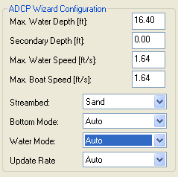
Wizard Configuration RG WM12
Secondary Depth
  If not zero, shallowest depth needed to profile
  Will attempt to configure bin size to get at least 3 good bins in this depth
  Only use when you MUST profile in this depth (suggest always initially leaving this at zero, then adjust if necessary after reviewing min depth on summary page)
Max Water Speed
Max Boat Speed

Slide 26
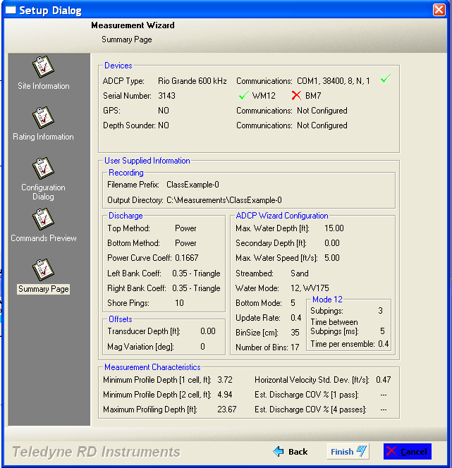
WinRiver II Wizard - Summary Page
Water and bottom modes configured
Minimum profile depth
Maximum profile depth
Estimate of the horizontal standard deviation (Water modes 1 and 12 only).
NOTE: This summary page does not reflect any user commands entered on the previous screen.
Notes:
Point out Devices is Instrument capabilities and not selected configuration

Slide 27
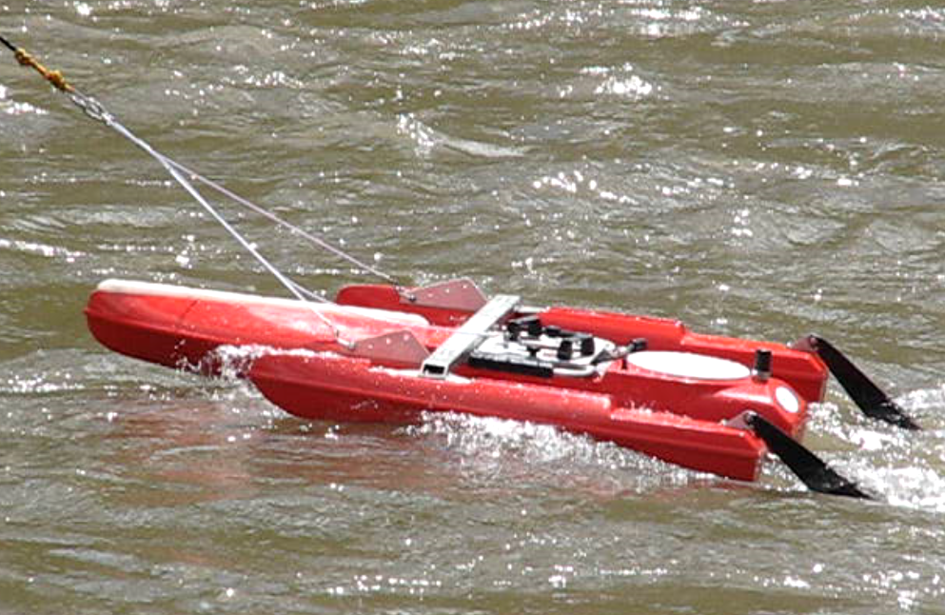
OceanScience High Speed Tethered Boat
Designed for high speed (>15 ft/sec)
OSW has two for TRDI Rio Grande
Also available for SonTek M9/S5

Slide 28
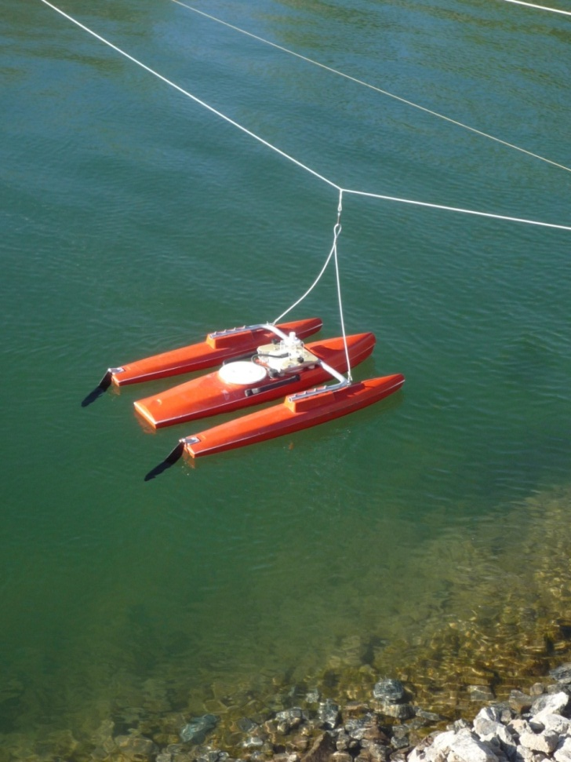
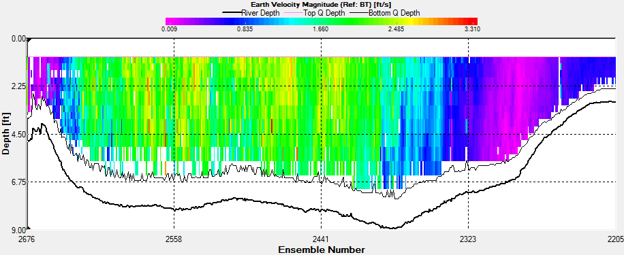
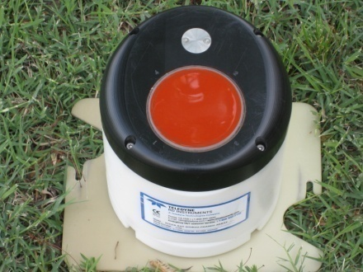
TRDI – RiverRay
Flat face Phased array - 600 kHz
30-degree beams (larger unmeasured area)
Uses WinRiver II
Integrated float
Built-in Bluetooth
Dynamic configuration
Profiling range
1.8 – 130 ft
Latest firmware
44.12

Slide 29
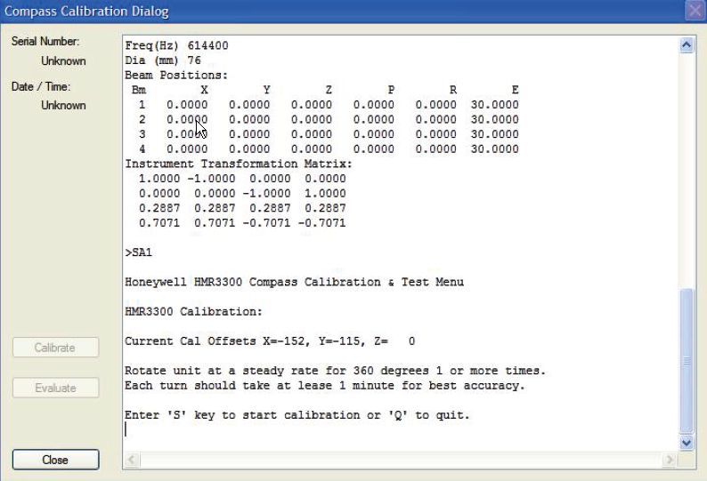
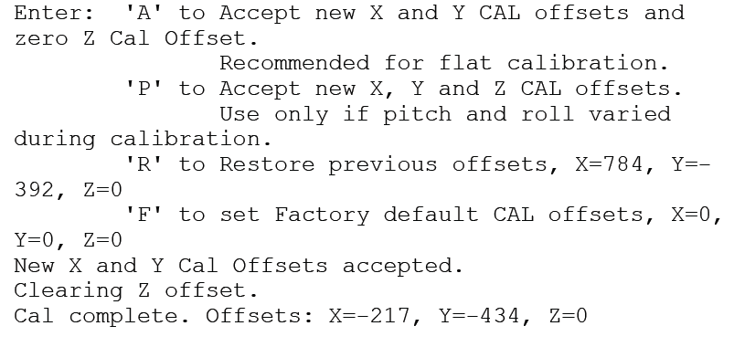
RiverRay - Compass Calibration
Acquire… Execute compass calibration
Follow instructions on screen
  “S” to start and being slowly rotating
If completed with out pitch roll X and Y offsets should < 200, if so press A to accept
>200 press R to reset and retry calibration

Slide 30
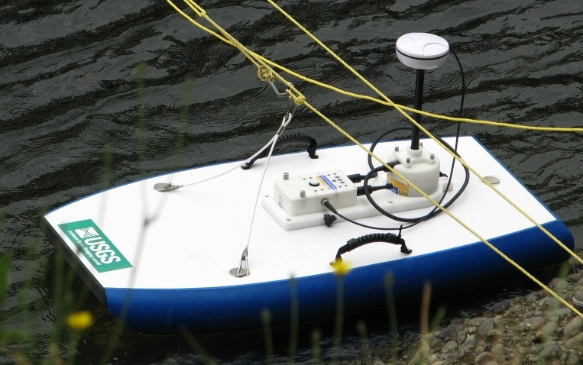
SonTek M9/S5
(PCM) Power-Communications Module (with GPS) and wireless radio
GPS Antenna
ADCP

Slide 31
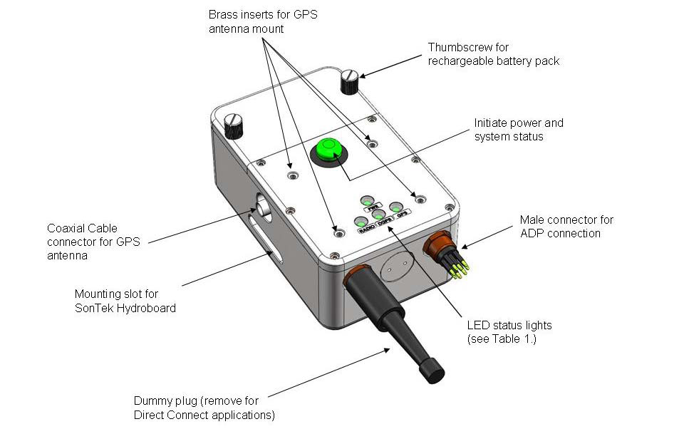


Power, Communications, GPS
Powers ADCP and radio
Either PCM option can com with GPS
  Differential GPS or
  RTK GPS
Dummy plug must be in place to use wireless
In boat, place Battery compartment away from ADCP
RTK Base Station

Slide 32



Hydroboard Options
Short (without white
line recalled)
Long (all recalled)

Slide 33


OceanScience
Better in high velocities, but also bigger and heavier
Larger boat above has worked well in > 15 ft/sec

Slide 34
M9/S5 Firmware and Software
Firmware 1.5 (latest)
  Recording on PC / Handheld
  Loop test
  Mid-section method
  Includes SmartPulse HD (introduced in 1.0)
Software 2.5 (latest)
  Loop test and correction (LC built in software)
  Ability to identify:
    Invalid bottom track
    Track reference changes
    Water track frequency and mode
  Water temp / speed of sound correction
  Bug fixes on discharge summary report
If you have problems, try using SonTek supplied equipment (USB to Serial adapter, and/or, Parani 1000 Bluetooth to serial.)
Routinely Format ADCP recorder

Slide 35

RiverSurveyor Compass Calibration
Multi-tilt calibration that requires two complete circles while pitching and rolling the ADCP and boat significantly.
A calibration with minimal pitch and roll is acceptable if only minimal pitch and roll is experienced during the measurement, such as on a manned boat.
Rotate ACDP through
two complete circles,
slowly, while varying the roll and pitch angles as much as possible.
Notes:
RiverSurveyor
The RiverSurveyor compass calibration is a multi-tilt calibration that requires two complete circles while the pitching and rolling the ADCP and the boat significantly.
A calibration with minimal pitch and roll may be acceptable if only minimal pitch and roll is experienced during the measurement, such as on a manned boat. However, even in this situation pitching and rolling the boat as much as possible will improve the calibration.
Click Start and rotate ADCP through two complete circles, slowly, while varying the roll and pitch angles as much as possible.

Slide 36

Example of Compass Calibration
Notes:
This video shows the compass calibration of a RiverSurveyor M9 mounted on a Hydroboard. Two complete circles should be made with this pitching and rolling motion.

Slide 37

Compass Calibration Results
Generally the results should say “Pass”, but the Score is often less than excellent if the pitch and roll were minimal.
The calibration score has two parts
  M is magnetic distortion which should be very low (less than 10), this may not be the case if there is minimal pitch and roll
  Q is a calibration score which should be very high, 8 or 9 (scale 1-10)
If Loop or GPS data look odd, recalibrate compass regardless or results!
Notes:
Compass Calibration
After completing two complete rotations press the Stop button.
The calibration routines will calculate a calibration score and provide brief comments on the results of the calibration.
Generally the results should say “Pass”, but the Score is often less than excellent if the pitch and roll were minimal.
The calibration score has two parts:
M is the magnetic distortion which should be very low (less than 10)
Q is a calibration score which should be very high on a scale of 1-10

Slide 38


Transducer Depth
Draft is the measured distance from the bottom flat transducer (vertical beam) to the water surface
Can be measured by first measuring the distance from the ADCP bottom flat transducer to the bottom of the hydroboard, then place in water and measure the distance from the bottom of the hydroboard to water surface and add these two distances together

Slide 39


LC Moving-Bed Test in RS Live

Slide 40

Watch Status Icons
Displays current status information
Blue is generally best
Yellow – caution – (Note Yellow Feet = bad bottom track and will use previous boat speed for 9 samples)
Red – Bad – when feet turn red = bad BT and depth

Slide 41

Watch SNR Profiles
If beams separate, lower transducer

Slide 42



Setting Extrapolations
Power / Power
  Default
  Change exponent
    Must change for both top and bottom
Constant / Power
  Set top “Method” to constant
  Set top “Cells to use” to “Only Use”
  Set top “cells” to 1
Constant / No Slip
  Set top “Method” to constant
  Set top “Cells to use” to “Only Use”
  Set top “cells” to 1
  Set bottom “Cells to use” to “Only Use”
  Set bottom “cells” to 2 or 1
  (generally recommend 2)

Slide 43

Processing Toolbox – Thresholds
Composite Tracks (default on)
When checked substitutes other available track reference if selected reference is bad. Example: If BT is selected for reference, but is bad for a profile, the GPS data will be used for the reference (and plotted with BT data)
When reviewing, it is good to disable, to view shiptrack with only valid data (No GPS data plotted as BT data)

Slide 44



Track Reference
Determine best track reference
Look at ship track plot for any irregularities
  Uncheck composite tracks to verify reference not substituted
  Typically check composite tracks for final Q

Slide 45

Review Track Reference Time Series
VTG
VTG
VTG
VTG
VTG
1 MHz BT
1 MHz BT
3 MHz BT
View if/when track references are being substituted
Area for any samples with track reference
“0-Invalid” will not have a measured discharge (exception – when BT is the ref and <9 invalid in a row, the previous good BT will be used)

Slide 46


Significant Bad Bottom Track
Ref: BT
Composite Track Off
No Q or width Computed when Track Ref Invalid (Boat speed = 0)
Ref: BT
Composite Track On
VTG used when BT invalid
Shiptrack has VTG data plotted with Bottom-Track (Blue)
This measurement had moving bed and good GPS data, so VTG or GGA should be used for track reference

Slide 47


Determine Best Depth Reference
Look at VB depth and BT Beam Depth on a time series plot… make sure they are plotted at the same scale
Will substitute with alternate reference if selected reference not available (not an option)

Slide 48







RS Live Mobile
Loop Method
NEW
Almost everything in PC software is also in mobile Software
Must have Bluetooth PCM
Some reported issues of locking up after loop

Slide 49
Midsection ADCP Measurements
Uses – When you can’t bottom track or get valid GPS and Ice covered streams
Teledyne-RDI
  WinRiver II SxS
  StreamPro Handheld SxS
  SxS Pro
SonTek M9 and S5
  RiverSurveyor Stationary Live
  RiverSurveyor Stationary Live Mobile (On phone with Bluetooth PCMs)

Slide 50

TRDI SXS Pro
Simplified UI over previous TRDI SxS software
Can process data collected with WRII SxS or StreamPro handheld SxS
More stable
Must buy
license for
each ADCP
used for
collection

Slide 51

SxS Pro

Slide 52

RiverSurveyor Stationary Live
PC and Mobile version
Simple UI
Released
version
doesn’t yet
work for ice
measurements

Slide 53

RiverSurveyor Stationary Live

Slide 54
Use of the RiverRay and SonTek S5/M9
Make comparison measurements for the range of conditions you intend to use the instrument
  Water velocities
  Streambed type
  Flow depths
  Turbulence
  Sediment concentration
You can then use the instrument if there are no significant deviations from the comparison measurements
  Consistent biases are of particular concern
If a check measurement is indicated, use a different instrument
Document and submit comparisons to OSW to assist in finalizing the evaluation of these instruments. https://collaboration.usgs.gov/wg/oswha/Testing/default.aspx

Slide 55



Ott ADC
6 Mhz acoustic frequency
2-beam ADCP – with single bin
Integrated pressure sensor for depth (0-5 m)
Handheld recorder/interface
Ott ADC

Slide 56

OTT Review Software
Individual Vertical Profile
The graph on the right had side gives the data for individual vertical profiles. Click on the up and down buttons next to the Vertical field to view different vertical profiles
Q / Vertical
Bars show relative discharge. Click on the bars to show the % discharge of the specific vertical in relation to the whole discharge.
Depth
The triangles indicate the positions of verticals that have associated warning information. To view warning details, click on a triangle. The information appears in a small pop-up window

Slide 57

FlowTracker Fast Flow
FlowTracker maximum velocity = 14.7 ft/sec
  When flow perpendicular
  Maximum velocity that can be measured in the direction of a transducer is only 3.7 ft/sec
  Velocities towards or away from the transducers > 3.7 ft/sec will cause erroneous velocities
  Can occur in fast, turbulent flow with angles
  Typically appears as velocities with wrong magnitude and sign
Notes:
The FlowTracker is only capable of measuring at the manufacturer’s maximum-velocity specification of 4.5 m/s if the flow is perpendicular to the transmitting transducer face and the hardware is configured to measure velocities only in a range of ± 4.5 m/s. If the water velocity exceeds this range, it will report erroneous velocities. The receiving transducers can measure a velocity range of only ± 1.15 m/s; because of the geometric arrangement of the transmitting and receiving transducers, a velocity of 4.5 m/s flowing perpendicular to the transmitting transducer face results in a velocity towards a receiving transducer of 1.15 m/s. A velocity component directly toward or away from the receiving transducers larger than 1.15 m/s will cause errors even when the total velocity magnitude is below the maximum.

Slide 58



SonTek/YSI FlowTracker QC Tests
Bucket test – new/repaired instruments or failed QCTest
Auto QCCheck – With Each Measurement

Slide 59

FlowTracker Issues
Use of DatView
  For questionable measurements or where SonTek software highlights a possible issue.
  Issues highlighted by SonTek software should be explained or discussed on the measurement note.

Slide 60

Questions?

