Slide 1
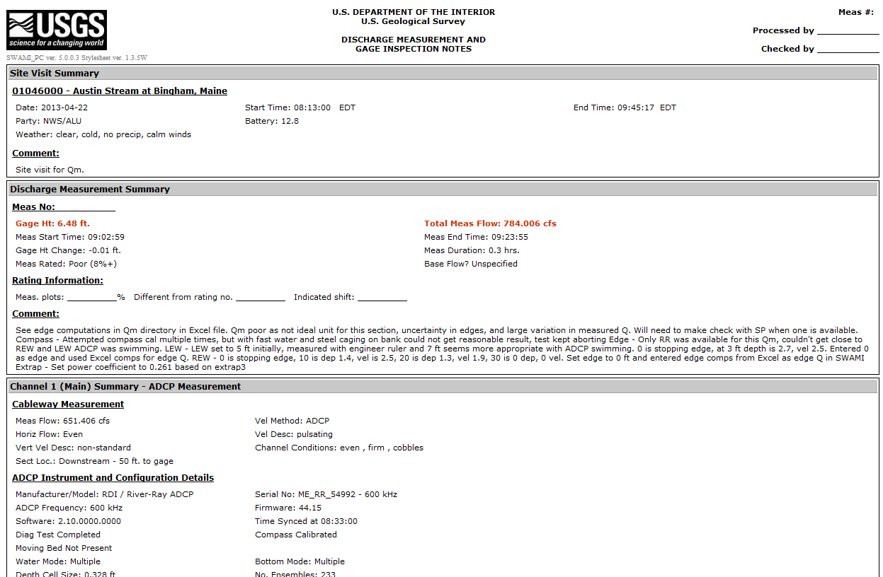
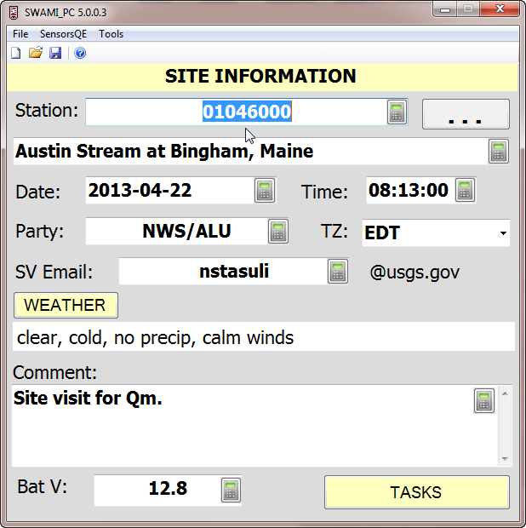
SWAMI with Acoustics
Nick Stasulis and Joel Dudley
Maine Office – New England WSC
Burl Goree
Ruston – LA WSC
Webinar Presented:
May 21 and 30, 2013
Notes:
-Introductions – Myself, Burl and Joel
-Mute phones
-Use chat for questions – Burl will monitor
-Time for questions at end of webinar
-Though the announcement said the webinar will be 1 hour we may need additional time to cover all of the material I have to present. When putting the presentation together it seemed that much of the ‘extra’ material related to handling of files and style sheets was worth the extra time. I am hoping to finish in no more than an hour and a half.
-This webinar is being recorded, and will be available on the OSW hydroacoustics website
-Please enter the number of participants at each location in the chat window
-In this webinar we will discuss the test version of SWAMI, version 5.0.0.3. While the version discussed here is technically a test version, the imports we will discuss have been through significant use. We felt it was best to show the most recent version, though new versions, with added functionality, are constantly in development.

Slide 2
Topics
What is SWAMI and Current Usage
SWAMI Setup/Configuration Files
Staging/Importing Acoustic Measurements
Loading SWAMI files into SiteVisit
Viewing SWAMI files – with style sheets and in SiteVisit
Archiving ‘paperless’ measurement files
Help/Resources

Slide 3
What is SWAMI? (Surface WAter Measurement and Inspection)
Field application to record all aspects of a Surface Water site visit
Used on PDA or Windows XP/7/8 device (SWAMI and SWAMI_PC)
Used to record sensor readings, site observations, and allows for direct collection of AA/pygmy measurements
Used to record notes associated with acoustic measurements (ADCPs and acoustic point-velocity meters) and allows for import of associated acoustic data
Outputs data to a HydroML file, which can be loaded into Site Visit via drag-and-drop or the loader.

Slide 4
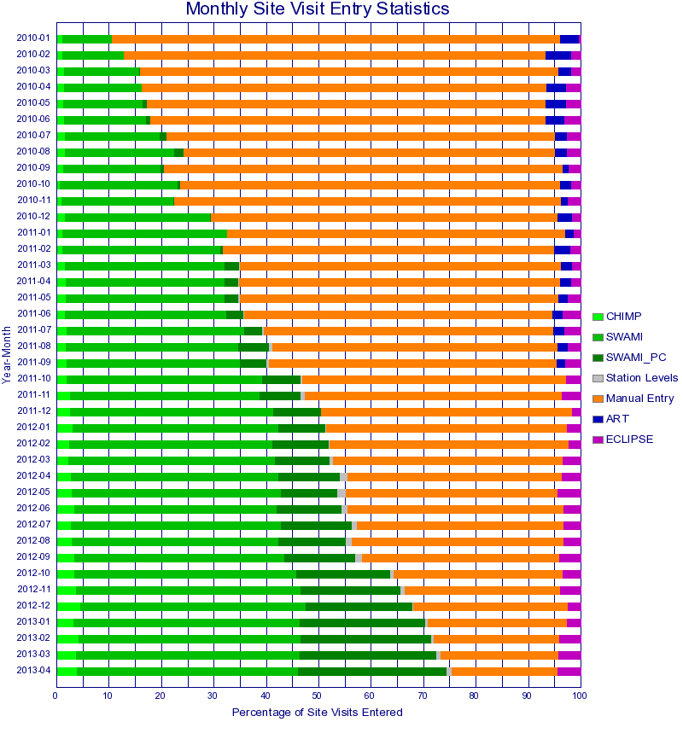
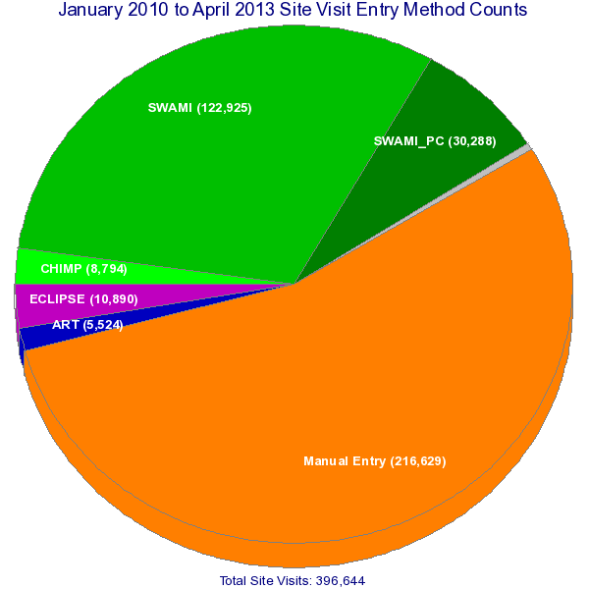
Notes:
Now, let’s look over some recent statistics on usage of SWAMI in the USGS overall. First, here is a pie chart that shows the entry method of all site visits from January 2010 to April 2013. You will notice that in that time frame, manual entries dominate the entry method. Other methods, primarily SWAMI and SWAMI_PC, account for the majority of the remaining site visits. As you can see here, use of SWAMI during this time frame was much greater than SWAMI_PC. [Click]
Let’s look at the same time period in another way, broken down by month. When we look at the data by month, we notice the manual entries accounted for 80% of the site visits in January 2010, a number that has steadily decreased down to around 20% currently. This representation of the data also shows that while SWAMI and SWAMI_PC accounted for less than 10% of the site visits in January 2010, they now account for around 70% of all site visits.
One more observation here is the growth of SWAMI_PC from October 2011 to today. While SWAMI use seemed consistent during this period, use of SWAMI_PC increased by 20-30%. These usage statistics only further highlight the need for consistent use of SWAMI across the board, including acoustics.

Slide 5
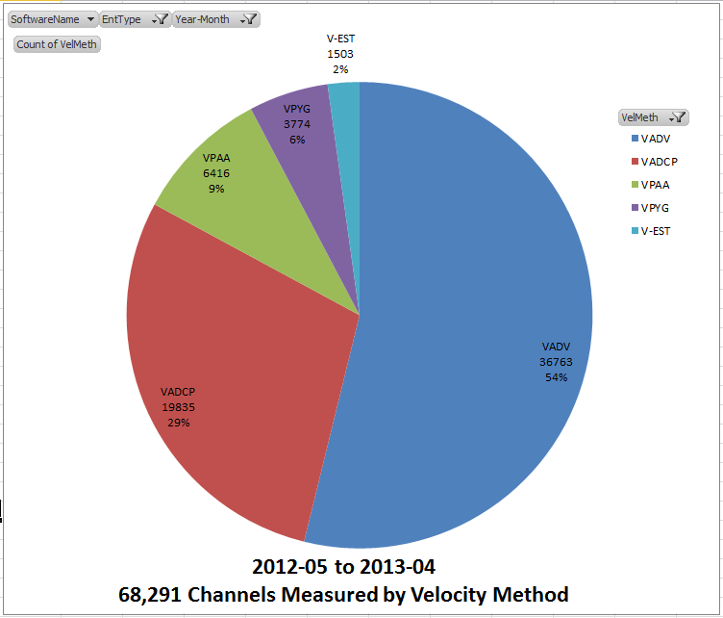
Notes:
The previous slide showed statistics on all site visits and now I’d like to move the focus to discharge measurements. Here is another pie chart showing all channels measured in the past year, regardless of how they were collected. As you can see, ADV measurements account for 54% of these channels, with ADCPs accounting for 29%. This use of acoustics seems fairly consistent over the last few years, with around 75% of all measurements in the USGS made with acoustics.

Slide 6
From May 2012 to April 2013
Of 36, 760 ADV Qms – 25,280 (~69%) collected with SWAMI or SWAMI_PC
Of 19,835 ADCP Qms – 13,026 (~66%) collected with SWAMI or SWAMI_PC
For ADVs – SWAMI used 72% of the time, SWAMI_PC ~28% of the time
For ADCPs – SWAMI and SWAMI_PC used about equally
ADVs – imported about 50% of the time
ADCPs – imported about 72% of the time
Notes:
Now, let’s look at how SWAMI is being used with those acoustic discharge measurements over the last year. During that time period about 2/3 of all ADV and ADCP measurements are collected with SWAMI or SWAMI_PC.
For ADVs, SWAMI is used about 72% of the time, and SWAMI_PC used about 28% of the time. For those using SWAMI with ADCPs, SWAMI and SWAMI_PC are used about equally.
We are seeing that ADV users import the data into SWAMI about 50% of the time, while ADCP measurements are imported 72% of the time. Importing data into SWAMI ensures the database is populated with useful information beyond the gage height and flow and eliminates potential errors during manual entry of data.

Slide 7
SWAMI Setup - Scripts
Scripts are available to pull WSC-specific information to use with SWAMI
Scripts pull information such as active station names/numbers, current ratings/shifts, station specific sensor lists, velocity meters configured in SiteVisit, and previous site measurements
It is recommended that these scripts are run daily. The updated files should be synchronized to field devices prior to any field visits.
Notes:
[After Slide] If you would like information on how to setup these scripts, sync the files to your field device automatically, or have questions on how to configure meters in SiteVisit, visit the FCIS webpage.

Slide 8
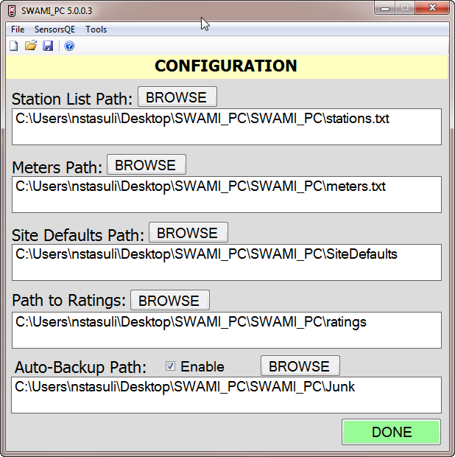
Not having up-to-date output files from the configuration scripts can lead to issues within SWAMI, but it’s more likely to create files that will fail to load into SiteVisit
For acoustic measurements- ensure the meters.txt file includes each ADCP/point-velocity meter by serial number
Notes:
Here we see the configuration dialog in the SWAMI_PC software. This is where we set the path to the folders containing the configuration files used by the software. While incorrect, out-of-date or missing configuration files may cause issues in SWAMI, it’s more likely to create HydroML files that will fail to load into SiteVisit. The data contained in the configuration files must match what’s in SiteVisit in many cases, so manually creating or editing the configuration files in the field can have unintended consequences. It’s fairly common for users to report issues with SWAMI, when those issues are actually more related to the configuration files and errors created in the HydroML that are caught when the files are loaded.
In the meter text file, ensure acoustic instruments are listed by model and serial number, each with their own entry in the meter file. This meter information must be set in SiteVisit and is then pulled into the meter text file by the scripts.

Slide 9
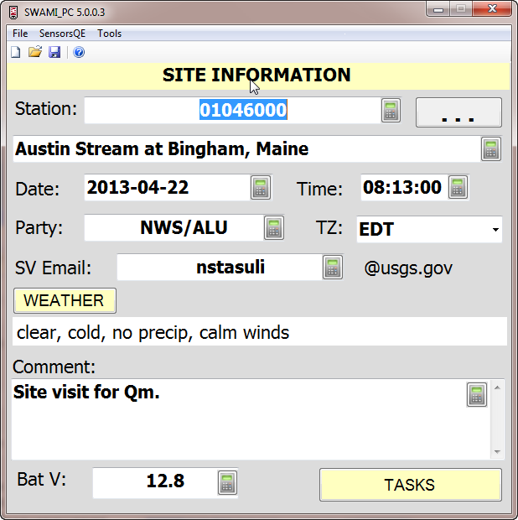
Site Information
Sites taken from stations.txt file including all active stations retrieved from NWIS or SIMS
Designated email recipient of SiteVisit loader results
Overall site visit comments; multiple comments areas throughout SWAMI at various task levels
Notes:
Here is the main page in the SWAMI_PC software. This webinar is not intended to cover every feature of the SWAMI software, only the features related to acoustic measurements. If routine parts of a site visit are skipped or features of the software not covered during this webinar, it is only because they are not in the scope of this webinar as we discuss acoustics.
The station number is selected from the station list text file by entering the number in the text field or using the button to the right to select it from the list. This station list includes all active stations from NWIS or SIMS.
SWAMI will ask if the date and time are correct when it first opens, ensure these are both correct, though they can be checked or changed here.
Filling out an email address is useful when using the loader as status updates will be sent to this address. Do not expect status updates when using the drag and drop feature.
The weather is something we will discuss in the next slide. The comment field shown here is for the site visit in general and should not be used for comments specific to the measurement, there is a separate field associated with the measurement itself. There are also numerous comment areas throughout the program related to various tasks and sensor inspections.

Slide 10
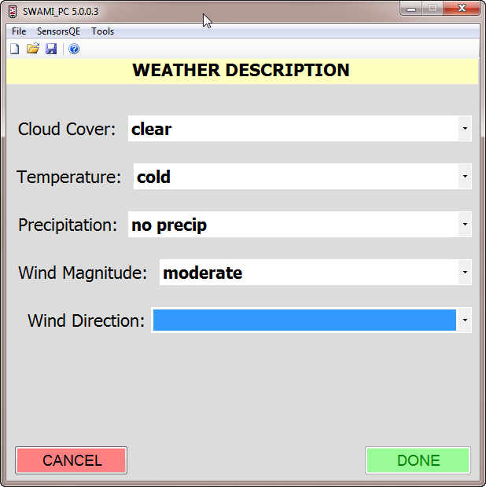
Weather Description
Wind direction required if wind magnitude is not designated as ‘calm’
For ADCP measurements, be sure this reflects the measurement location, not gage location - could support/confirm change to top extrapolation
Options:
Upstream wind
Downstream wind
Cross stream wind
Swirling/Variable wind
Notes:
The weather description page should be filled out for each site visit. When making an ADCP measurement, ensure the wind direction is filled out as it pertains to the measurement location, which may be different than the wind conditions at the gage. This wind direction and magnitude information may be useful when evaluating the extrapolation methods. Selecting a wind direction is required if the wind magnitude is selected as something other than calm.
The options for wind direction are upstream or downstream, cross stream or swirling/variable. There is some confusion about the use of upstream and downstream wind. In meteorology, the wind direction specifies the direction the wind is coming from, so in that case, an upstream wind would actually be blowing downstream. For our purposes, most users consider an upstream wind to be going upstream and a downstream wind to be going downstream.

Slide 11
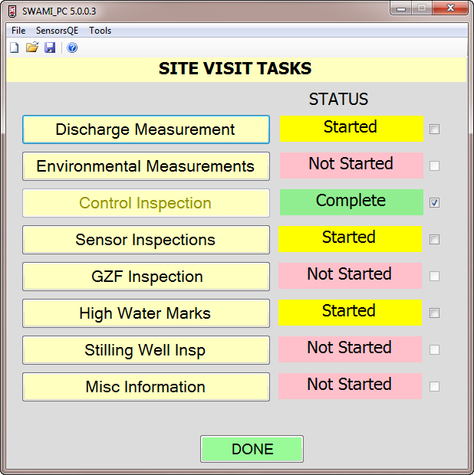
Site Visit Tasks
Notes:
After completing the information on the Site Information page, select the Tasks button, which brings you to the Tasks page in SWAMI. While they will not be covered in this webinar, ensure all tasks associated with your site are completed.
Assuming other tasks have been completed as needed, we will select Discharge Measurement here.

Slide 12
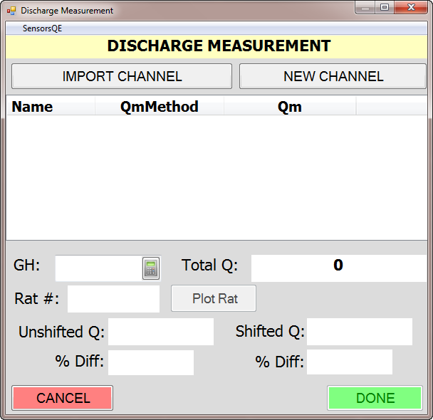
Starting a New Channel
New Channel – Measurement hasn’t started
This should be standard approach when making an acoustic discharge measurement.
Used to ‘stage’ an acoustic measurement –fill out notes while making a measurement and BEFORE importing the measurement file.
Import Channel – Measurement is complete
Can be used if SWAMI wasn’t available during measurement and it’s now finished
Use with ADCPs should be RARE and is not recommended!
Notes:
In the Discharge Measurement page we have a few options for documenting a measurement. Let’s start with New Channel, as that should be the option that’s used a majority of the time. When using ADCPs starting a new channel is the standard approach. This option will allow you stage the measurement, meaning you can fill out notes while making the measurement, before importing the measurement file.
The Import Channel option is used when the measurement is already complete, say if SWAMI wasn’t available at the time the measurement was made and you made notes on paper instead. Use of this option with acoustics should be rare as measurement notes need to be made before and during the measurement.

Slide 13
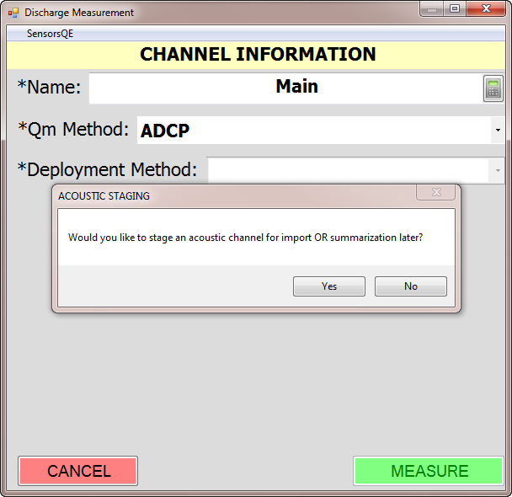
Starting a New Channel
Pop up window appears when selecting ADCP Method or Midsection > Wading > ADV
‘Staging’ a measurement allows you to fill out notes and measurement information in SWAMI during the measurement
Notes:
When starting the new channel, enter the channel name and method for your measurement. If an ADCP method is selected, you will be asked if you would like to stage a channel for import or summary later. The same option will be presented if you select a midsection measurement method with an ADV as the velocity method.
Again, staging will allow you to fill out notes and document measurement information in SWAMI while the ADCP data is being collected. Selecting yes here will allow you to stage the measurement and the differences between the import and summary options will be discussed later.

Slide 14
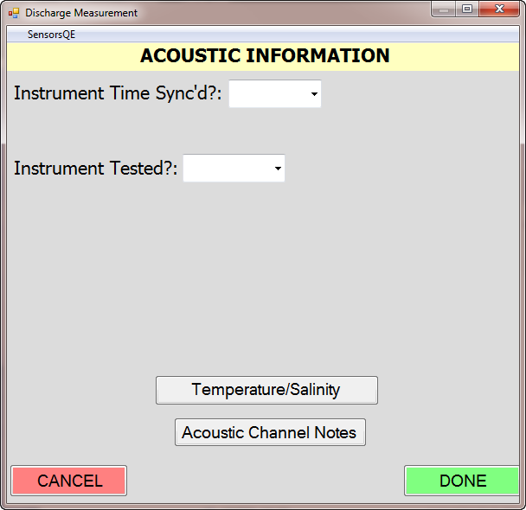
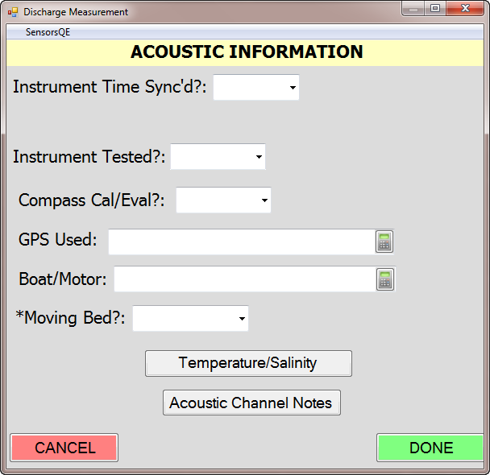
Acoustic Information
Moving Bed is the only required field
‘Moving Bed?’ asks if a moving bed was indicated (LC, SMBA) not if a moving bed test was performed
Acoustic Information can be filled out while staging the measurement or after the measurement file has been imported
Typically, this page will be active during entire measurement
Gage readings can be entered using the SensorsQE menu option
Notes:
Once you have indicated that you would like to stage your channel, the Acoustic Information page is shown. In this page, go through each field as it applies the technique you are using. Many users simply skip the fields that do not apply to the technique and equipment they are using as entering a response could be misleading. For example, selecting No for the compass calibration drop-down would indicate you had a compass, but didn’t calibrate it. If there is no compass in the unit you are using, it would be appropriate to leave this field blank. This page was intended to serve as measurement check-list, or reminder, of what may or may not be needed for the measurement you are conducting at the time.
Most of the information here is self-explanatory, though the moving bed field is a source of common error. [Click] This field asks if a moving bed condition was found, not if a moving bed test was conducted. The answer here should be yes if moving bed tests indicate moving bed is present. If you do a test that does not indicate a moving bed condition, your answer would be no. Think of it as did you apply a moving bed correction.
During most measurements, this page would be open during the measurement, allowing you to make notes in the Acoustic Channel Notes, document your temperature comparison and enter gage readings using the SensorsQE menu option.
You will notice many of the fields here do not apply to acoustic point-velocity measurements, and a different page is setup for that deployment, shown here. [Click] As you can see, this page only has the time sync and instrument test drop downs, with the temperature and acoustic channel notes buttons. When you select ADV when setting up the new channel, SWAMI will automatically show this page specific to ADVs.

Slide 15
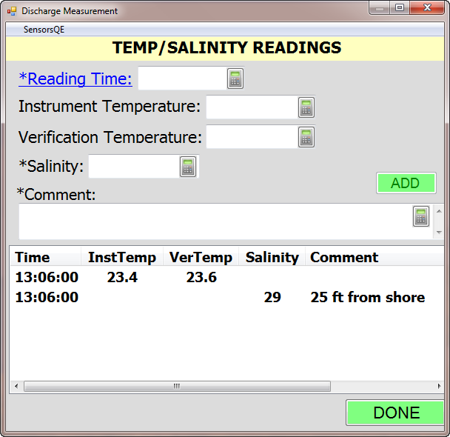
Temp/Salinity Readings
Temperature comparison readings for ADCP/ADV should be documented here and NOT in environmental measurements
Temperatures can be entered in F or C, just be sure they are consistent!
Multiple readings can be entered, which could be useful when doing salinity profiles across the channel. Distance and width can be entered in the comments.
Notes:
The temperature and salinity readings page is accessed through the acoustic information page we just saw. This page was developed to allow users to enter ADCP or ADV temperature readings against the verification sensor. Prior to this page, users were entering comparison temperatures in the environmental measurements area in SWAMI, which is no longer correct, note comparison readings here.
This temperature comparison information is not stored in Site Visit, it only exists in the SWAMI xml file, and can therefore only be viewed through the style sheet.
Many users still note the ADCP comparison temperature in the WinRiver II software as it displays on the Q measurement summary. Comparison temperatures need to be obtained with the ADCP and verification temperatures obtained at the same time in reasonable proximity to one another. When noting a temperature in WinRiver II and relying on the Q measurement summary, this is not the case. The ADCP temperature seems to be a mean from all of the transects, which is not from the exact time and location the verification temperature is taken. While noting a temperature in the Q measurement summary helps complete that document, it should not be used as the only temperature check documentation.
In this page, be sure you are noting the temperatures consistently, either in degrees Fahrenheit or Celsius. You have the option to enter multiple readings, which could be useful for documenting a salinity profile as distance and width can be entered in the comments.

Slide 16
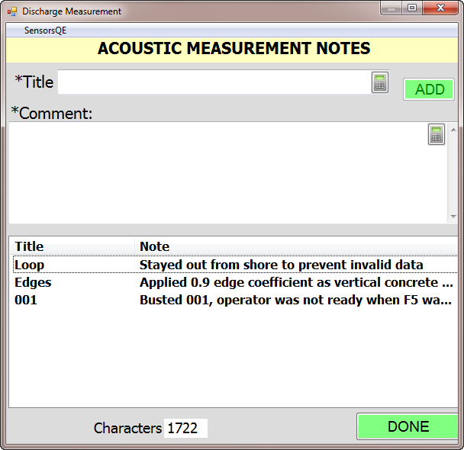
Acoustic Measurement Notes
Examples of Titles: General, 001, Transect 001, T1, LC Test, etc.
All comments entered here are put into overall measurement comment field as this is the only place available in Site Visit.
Notes:
During data collection notes can be entered in the Acoustic Measurement Notes page or in the manufacturer software. For wading acoustic point-velocity meters, it’s recommended to make all notes in SWAMI as comments entered in the FlowTracker are not imported. For ADCP data collection, notes are imported with the data files. RiverSurveyor Live offers limited space for comments, so SWAMI may be the preferred location. For WinRiver II, notes made to a specific transect or in the site information page are imported with the mmt.
Regardless of where notes are made, in SWAMI or the manufacturer software, ensure that measurements are documented properly and all notes end up in SWAMI so they are loaded into Site Visit.
Imported notes and notes entered in SWAMI for a specific channel are all moved to the overall measurement comment field in SiteVisit as there are no notes for an individual channel. [Click] Notice the characters remaining in the SiteVisit measurement comment field is shown.

Slide 17
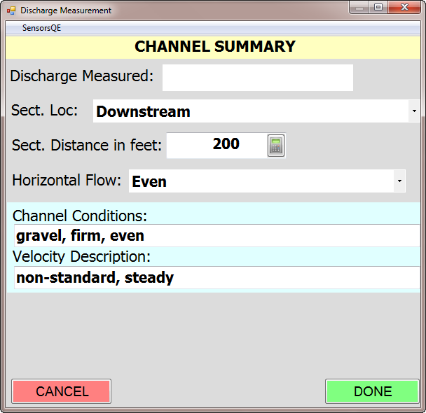
Channel Summary
Channel Summary page appears after finishing with Acoustic Information page
Discharge Measured will be populated once measurement file is imported or summarized.
Information can be filled out while staging the measurement or when the measurement file is imported.
Notes:
When the measurement is complete, selecting done on the acoustic information page will bring you to the channel summary page, where you document the measurement cross section. [Click] The discharge measured will be filled out once the data is imported and this page will be available again after importing the data.
This information can be filled out now, or after you have imported the acoustic data and are finalizing your measurement.

Slide 18
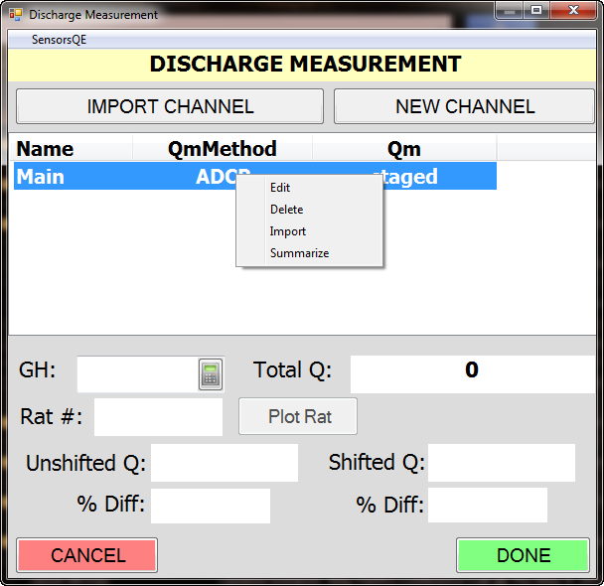
Loading Acoustic Data
Channel is staged – has notes and documentation, but no discharge.
Summarize – manually enter flow info
Useful to make notes for FlowTracker and manually enter summary if you can’t download the unit in the field
Import – load in acoustic measurement from file
Notes:
Here we see the staged channel in SWAMI. At this point, the channel has notes and documentation, but no discharge information. By right clicking on the channel we see the options to edit, delete, import or summarize. Deleting the channel will remove it from the list and information will be lost. Editing a channel at any point allows you step through the channel information and make changes as needed.
Summarizing a channel allows you to enter basic information about the measured flow, but is usually only used with wading point velocity meters if the data file from the unit can’t be imported. Use of summarize with ADCPs should be limited as importing is preferred. Importing acoustic data is strongly recommended as it not only populates necessary fields in SWAMI for import into Site Visit without the need for manual entry, but also documents valuable information in the SWAMI xml that is stored in Site Visit. When using SWAMI_PC particularly, little effort is required to import measurements collected on the same device.
Recent policy changes for ADCP measurements requires that measurements are processed and finished completely at the site. Given this requirement, there should be very limited situations where the ADCP data isn’t available for import. It seems some users are staging the channel, but importing back in the office, rather than in the field. While this may be a likely situation for tidal measurements, it should be rare during routine field trips.

Slide 19
Import Options
AquaCalc – CSV file
FlowTracker, RiverSurveyor Live, RiverSurveyor Stationary Live– DIS file
WinRiver II – MMT file (preferred)
Will import transect notes, measurement notes, ADCP tests, compass cal info
WinRiver II – HydroML (not recommended)
Measurement notes, ADCP tests, compass cal info
NO transect notes
MUST create new HydroML each time configuration changes are made
SxS Pro – XML summary file
Notes:
When selecting import a dialog will appear, allowing you to select the data file for your measurement. Ensure the measurement has been completely processed and the file saved in the manufacturer software before importing! Saving the file and creating an updated output file is key to ensure the correct information is imported in SWAMI.
Currently, SWAMI will import the csv file from the AquaCalc. It will also import the dis file from the FlowTracker, RiverSurveyor Live and RiverSurveyor Stationary Live software packages. For the FlowTracker, the unit must be downloaded into the Windows software and the dis file created there.
SWAMI will import the mmt file from WinRiver II or the HydroML file from WinRiver II. Using the mmt file has several advantages, the most important being that it always contains the updated measurement information. With the HydroML there is a chance changes are made in WinRiver II and a new HydroML isn’t created. The mmt import includes the transect notes, the measurement notes in the station information page, ADCP tests, compass calibration results and the transect data. The HydroML does not include transect notes.
SWAMI will also import the XML summary file from the SxS Pro software. Using the mmt from SxS Pro was not a practical option.

Slide 20
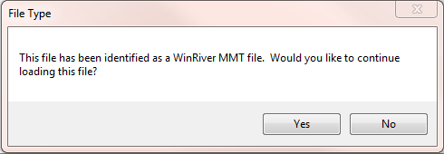
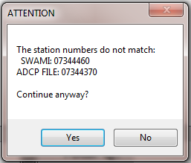
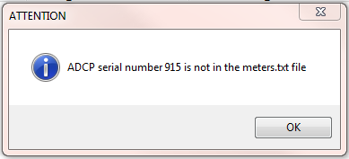
Checks During Import
Notes:
Once the file you are importing is selected, SWAMI will perform some checks on it. It will confirm the file type you are importing, check the station number in the file versus the SWAMI station number and check the meter file for the serial number of the unit you are using.
If the unit you are using can’t be found in the meter file, select a generic version of that unit, rather than selecting unspecified, and consider updating the meter after the fact in SiteVisit.
Having the correct meter associated with your measurement may not seem like something worth worrying about. A database query in 2012 revealed over 20,000 ADCP measurements with an unspecified velocity meter. While many of these may be legacy measurements, having this information populated has it’s advantages. For example, a while back there was a known issue with WM12 and a certain version of firmware. How convenient would it have been to query the database and get a list of all the measurements made with these configuration settings so they could be reviewed. This detailed acoustic information can also be used by OSW to guide resources in testing, method development and funding. So, while not having a meter in the meter list may seem like a minor issue, it does have some important uses.

Slide 21
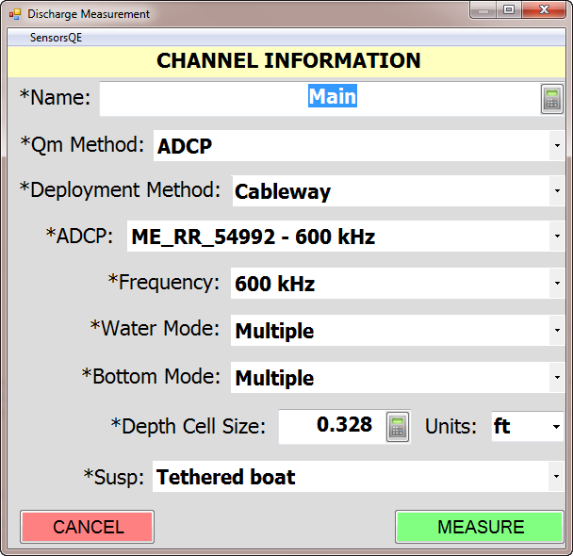
Channel Information
Fields will automatically be filled in with imported data from measurement file.
You will need to fill out Deployment Method and check the Suspension Method
Other fields may need to be populated if information is not available from the imported measurement file
Notes:
After the file has been imported SWAMI will walk you through screens that were previously filled out while staging the measurement. Take the time to make sure that all fields were correctly populated. Most information will be taken from the measurement file and will populate the appropriate field. On this channel information page, you will need to fill out the deployment method and suspension method for your measurement, though there may be other fields, like the meter used, that were not imported and will need to be filled out manually.

Slide 22
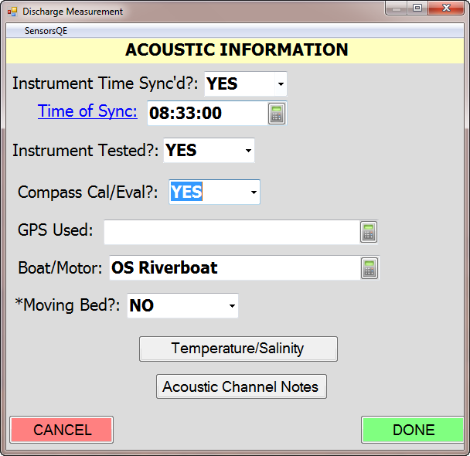
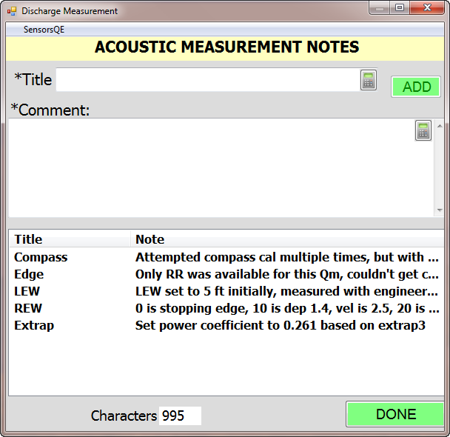
Check/Edit Acoustic Info/Notes
Notes:
Next, you are taken back to the acoustic information page. You have the option to edit or update your previous entries. For example, you might change your selection for moving bed if you didn’t know the results while collecting the transect data.
Notes imported from the measurement file will now be visible in SWAMI and can be edited/deleted as needed. Ensure measurement notes are complete and not duplicated.

Slide 23
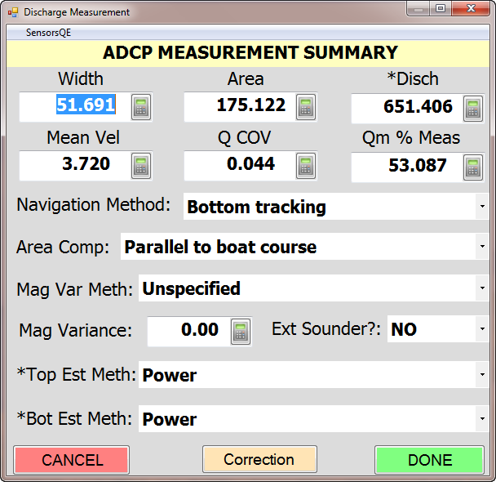
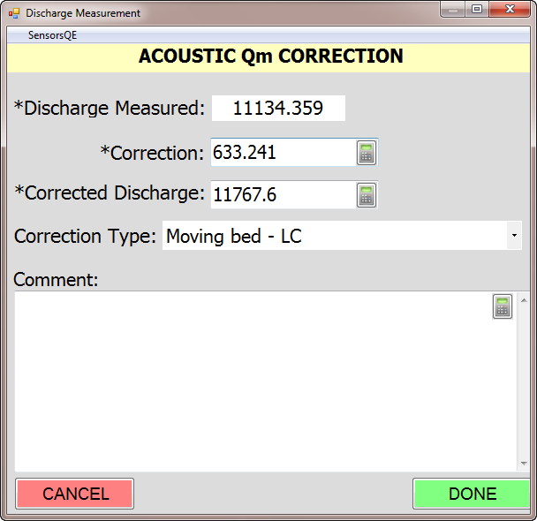
ADCP Measurement Summary
Corrections for moving bed tests
DON’T use adjustment anymore!
Notes:
Most of the data on the measurement summary page is automatically populated from the imported data. If a moving bed correction is applied, use the Correction button at the bottom of this page, do not use the ‘Adjust’ button on the measurement summary page. In the correction page, the correction can be entered as a number or a percentage. It is important to note that correcting discharge for moving bed conditions will affect your mean velocity and you will need to compute the mean velocity and change it on the measurement page if corrections are being manually entered into SWAMI.
When using WRII 2.10 the moving bed corrections can be applied directly in the software. If this is the case, SWAMI will import the corrected discharge and populate the correction information for you, based on the method you used in the software.
This functionality will be added for SonTek measurements collected in RS Live, as well.

Slide 24
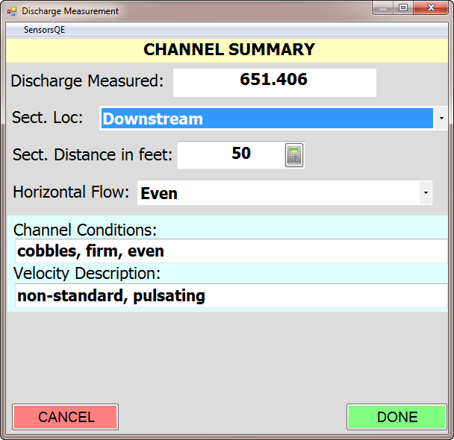
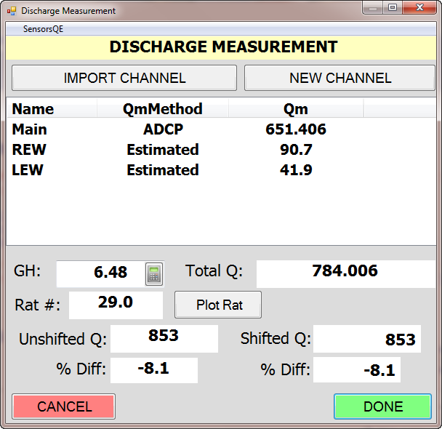
Notes:
As we move on to the channel summary page, you will notice the discharge measured will now be populated and you can fill out any remaining information. Once you hit done, the channel is complete.
On the discharge measurement page additional channels can be added as needed. In this case, the main channel was collected using an ADCP and the two edges estimated using manual depth and velocity readings and entered separately.
Gage height information can be entered here to check the measurement versus the shifted and unshifted Q. If this gage height is entered, the results are stored in the SWAMI file and displayed on the latest style sheets, acting as a way to document if the measurement was checked against the rating in the field.

Slide 25
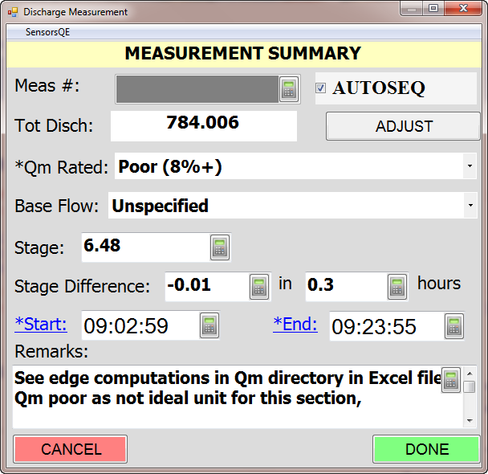
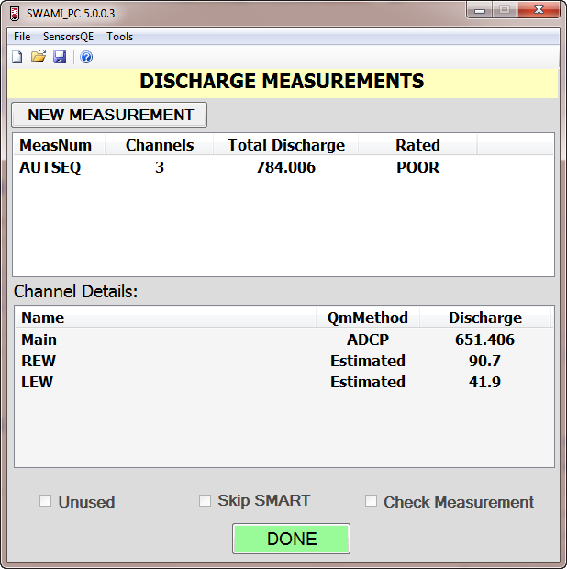
Don’t adjust discharge for moving bed conditions here.
Use correction in previous window!!
Notes:
Once your channels are complete, you are brought to the measurement summary page. Again, as a reminder, don’t use the Adjust button here for moving bed corrections. Here, you rate your measurement, fill out the gage height information and note your start and end time. Clicking on the start and end labels will populate the times from the imported data files, though you should ensure these times were imported correctly.
The remarks here are made in addition to those made in the acoustic notes page. Those notes were specific to one channel, while these comments apply to an entire measurement, which may consist of many channels.
Once the measurement is complete you are brought to the summary of the discharge measurements for that site visit. Here, you have the option to make additional measurements or edit the measurements listed.

Slide 26
New Acoustic Fields
Many of the new acoustic fields – like the temp/salinity readings, the moving bed correction info, etc – do not have a place to be stored in the NWIS database, so they are only viewable using the style sheet applied to the SWAMI file
Notes:
Now that the SWAMI file is complete, let’s talk about some of the logistics of handling that file and how the data is stored.
It’s important to point out that several of the fields specific to acoustic measurements do not have a place to be stored in the database. This includes the temperature and salinity comparisons and the moving bed correction information, among others. These fields can only be viewed using the SWAMI file and style sheet.
There has been some talk of efficiently merging the information in SiteVisit, which is current and up to date, with the SWAMI file, which has some information not in SiteVisit. This would allow us to create one xml file that could be used to view all of the measurement information together.

Slide 27
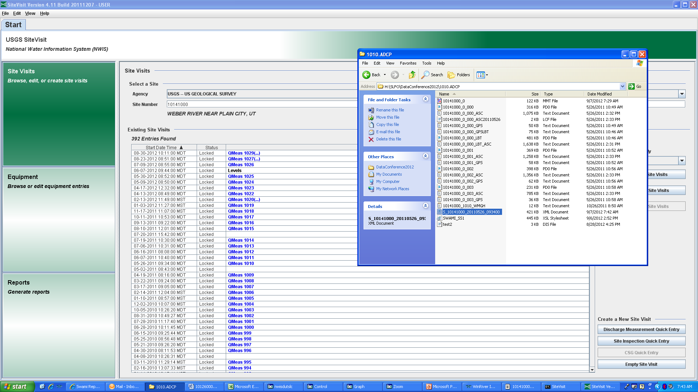
Importing into SiteVisit
Notes:
Once you are back in the office, you need to get the SWAMI file into the database and there a few options to do this. The first is to open SiteVisit and use the drag and drop method. It’s as simple as selecting your SWAMI file and dropping it into the SiteVisit program [Click]
You will have the option to import, import and overwrite or cancel. Importing should be the primary selection, but import and overwrite may be useful if the same site visit already exists and you would like to replace it. It’s important to note that you can drag and drop multiple files at once.

Slide 28
Locking Down Files in SiteVisit
Address any warnings in SiteVisit
For example, may need to calculate velocity if moving bed correction was applied
Save and lock SiteVisit
Notes:
When files are imported using drag and drop they open in individual windows. Address any warnings in SiteVisit, for example, you may need to calculate the velocity if moving bed corrections were applied. Or perhaps the meter you specified in the field is not recognized in SiteVisit.
Once it’s complete, save the site visit and lock it as needed.

Slide 29
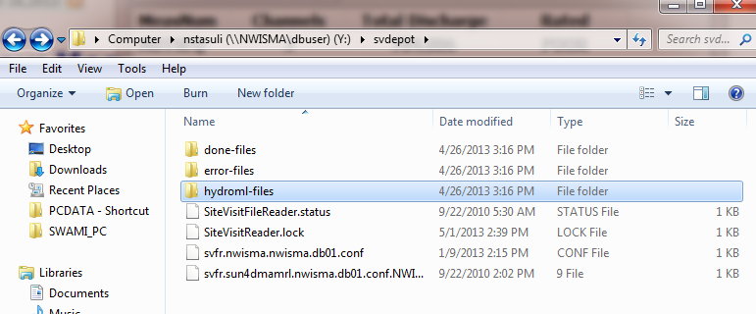
Using the Loader
Another option is the ‘submitsvfr’ command in a Unix terminal window.
For help setting up the loader:
http://nwis.usgs.gov/nwisdocs5_0/SiteVisit/SV.user.book.html
Notes:
The loader is another option for getting SWAMI files into the SiteVisit. Here, we see the svdepot directory on our NWIS server. A symbolic link in my Unix home directory allows to me to directly access the svdepot without logging into NWIS. More information on the setting up the loader can be found on the NWIS webpage, using the link shown. In the svdepot, there are three folders, one for done files, one for error files and one for hydroml files.
Using the loader is as simple as copying the SWAMI files to the hydroml files folder. Once processed, they will be moved to either the done or error folder and an email sent to the address you entered into SWAMI.
It’s always good practice to ensure every file you put into the loader makes it into the database.

Slide 30
Making updates to a Site Visit
Now that the SWAMI data are in Site Visit – where are updates made?
Two common ways to handle changes
Update the SWAMI file, delete what’s in the database and re-load the updated file
Leave the SWAMI file as the ‘field’ copy and update Site Visit with the current information
Either way, any changes should be well documented!
Update SWAMI
SWAMI file and SV match
Can lose info added to SV
Recommend saving original SWAMI file, creating new edited SWAMI file
Update Site Visit
Preserves ‘field’ data
Preserves any changes to the visit in SV
SWAMI file and SV don’t match
Notes:
A common issue when using SWAMI is what to do when a SWAMI file is loaded into SiteVisit and an error is found in the measurement during review. The new, updated measurement information needs to be entered into the database, but the debate starts on how those updates should be made.
There are two common ways users handle this issue. The first is to update the SWAMI file in the office, delete the site visit in the database, and re-load the new SWAMI file. Another option is to leave the SWAMI file as the field copy of the site visit and update site visit with the current information.
There are advantages and disadvantages to both approaches. If the SWAMI file is updated then that file and site visit will match, though you may lose any data added in Site Visit when deleting the visit, say for a sensor inspection. If this approach is used, be sure that there was no additional information added in SiteVisit that would be lost if the visit is deleted. It’s also recommended to save the original SWAMI file and create a new, edited SWAMI file.
If site visit is updated, it preserves the original field data in the SWAMI file and also preserves any changes made to the site visit after it was loaded since it’s not being deleted. In this case, though, the SWAMI file and the site visit won’t match.
Regardless of which method is used, be sure to document the changes made in the record station analysis or the site visit remarks. Again, be sure any new site visit comments are preserved if site visits are being deleted and re-loaded.
Based on my experience it seems the more common approach is to leave the SWAMI file alone, as a copy of the field data, and to make updates in Site Visit, noting any changes in the site visit or measurement remarks. In this approach, the information in Site Visit is treated as the final product, not the SWAMI file, as the publication reports are pulled using the information in Site Visit.

Slide 31
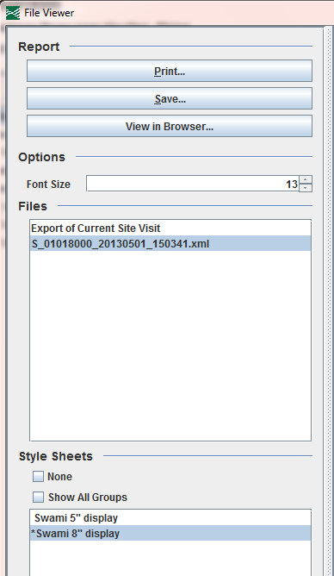
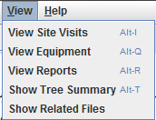
Viewing SWAMI Files – In SiteVisit
Notes:
The use of style sheets and knowing what SWAMI file to view can be confusing, depending on how your office treats this electronic data.
For those wanting to view the updated Site Visit information on a printable style sheet, there is an ability to export the current site visit to xml and apply it to a style sheet. You will also notice the original SWAMI file that was imported is available for viewing/export as well, allowing the two to be compared for changes. This capability is also useful to view acoustic related information that is not stored in Site Visit and is only available in the SWAMI file. Be aware, though that if a file is imported and then updated on a local server and not re-imported, it will not match the original SWAMI file that was imported and stored in SiteVisit here.
Using Site Visit to view the original SWAMI file and export the current Site Visit information is ideal because it ensures all users are using the same style sheet and getting the most recent information for that visit. Again, this assumes that all edits made to the visit were made in SiteVisit after import.
To view the site visit, select View > Show Related Files, which brings up a dialog showing the original SWAMI xml and the export of current site visit option. After selecting an option, pick the size of the style sheet you would like to use and select view in browser, print or save.

Slide 32
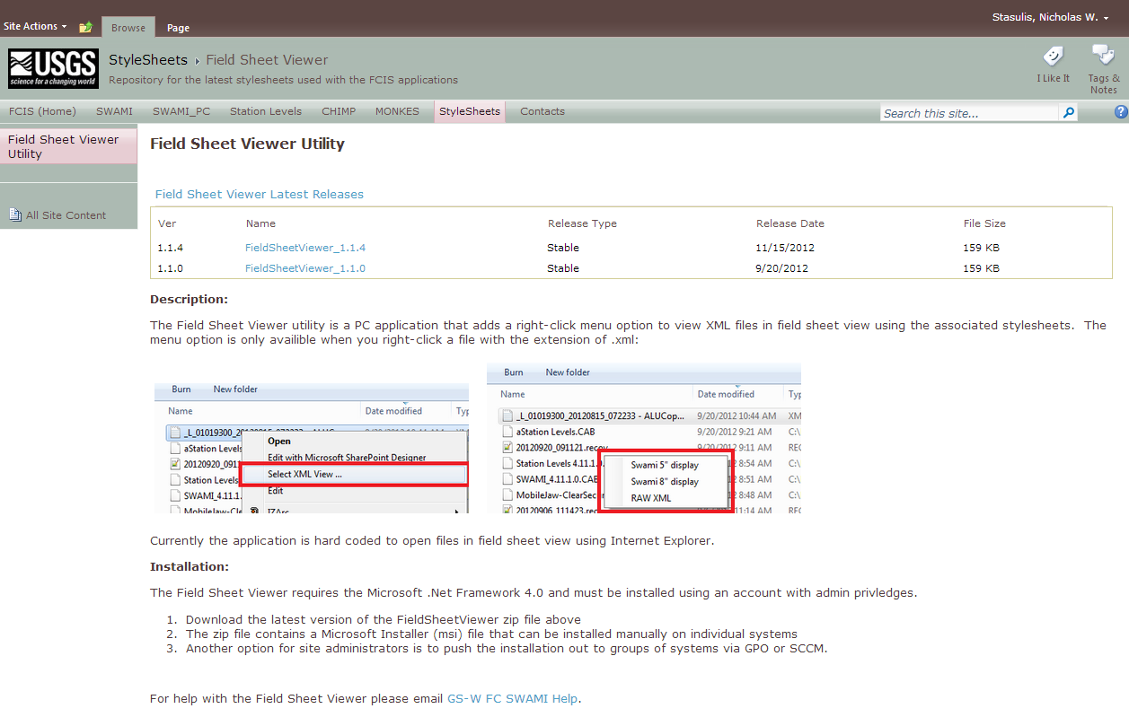
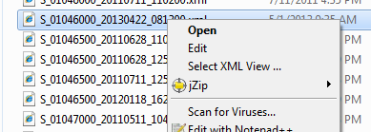
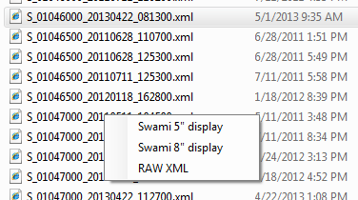
Viewing SWAMI Files – Field Sheet Viewer Utility
https://collaboration.usgs.gov/wg/FCIS/Stylesheets/SitePages/Field%20Sheet%20Viewer.aspx
Notes:
For those viewing SWAMI files from a local directory outside of Site Visit there is a field sheet viewer utility that will ensure all users are viewing the data using the same style sheet. This utility will use the current style sheet in the site visit repository.
The install files and install instructions can be found on the FCIS Sharepoint website, shown here. Once installed, simply right click on any SWAMI file and click Select XML View, then select the format you would like to view the file. Updates are being made to the field sheet viewer to allow users to select a locally made style sheet, as well.
A common issue when using SWAMI files on local directories is the use of incorrect style sheets, which leads to discrepancies in what data is displayed and the format of that data. Viewing files in Site Visit, or using the field sheet viewer utility, are two ways to prevent such issues. [Click]
The most current style sheet information can be found on the FCIS website, using the address shown here.

Slide 33
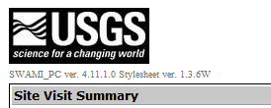
Style Sheet Features – v 1.3.6W
Notes:
The most recent style sheet, version 1.3.6W, has some added features, many related specifically to acoustics. This style sheet is the version used both in Site Visit and the Field Sheet Viewer.
The first feature is the rating information which shows the rating information for the measurement as it was checked in the field, including the gage height used, and the percent difference from the shifted and non-shifted rating. [Click]
This style sheet also includes a few new fields for measurement review, including the estimated 95% base uncertainty, presented by David Mueller in a recent measurement review webinar, and the percent of discharge in each edge. [Click]
In the ADCP configuration details we see what tests were conducted on the ADCP and if moving bed was detected. These fields are set based on the user response in the acoustic information page in SWAMI. [Click]
Lastly, we see the results of the temperature comparison conducted in the field.

Slide 34
Archiving Acoustic Data
All data associated with a measurement must be stored and archived so the original data and final discharge are preserved
Includes:
Archiving electronic and/or paper notes and summaries
Archiving data files
Entering measurement information into the NWIS database
Best Practices
All measurement data should be moved from field computer/backup media to office server within 48 hours of returning from field
Once the measurement is finalized, store it permanently in a manner that prevents accidental modification/deletion
All ADCP data (including compass cal/ADCP test) associated with individual measurement should be stored in a folder unique to that measurement
Notes:
In recent years there has been little guidance on archiving acoustic measurement in the paperless world. Here, I will present some information that will published in an update of the ADCP T&M scheduled for later this year.
This slide presents some best practices for all acoustic measurements.

Slide 35
Archiving Acoustic Data
When using electronic field notes:
A summary of the final discharge must be stored in either NWIS (such as importing the final measurement information into SWAMI) or saving the measurement summary from the processing software to a pdf file and storing it with the ADCP data
The output from any utility programs used (LC, SMBA, Extrap, etc) should also be stored electronically with the ADCP data
An ADCP-specific style sheet has been discussed to standardize the output format of the data stored in Site Visit
Ensure the original SWAMI file is archived on the local project directory once imported

Slide 36
Still no policy on SWAMI?
“…we are still figuring this out and are going to be doing so for awhile to come as we implement AQ and continue to develop our field apps…(there are) some people who feel we should have it all figured out, but it is important to be honest about (that it may be a while before we figure it out)”
“Folks don’t want a solution that HQ ‘figures out’ in any case. We remain a field driven organization and we work these things out collectively over time. It’s messier than we want and frustrates us at times, but in the end we get to a much better final answer. The important thing in all cases is to understand the principles involved, which have not changed. We’re just continuing to learn how to apply those principles to new types of instrumentation and in a fully electronic environment”
“..there comes a time when it is important for HQ to take the best of what we have collectively learned and develop a uniform policy or practice. I’d like to think we are getting close to that with SWAMI, archival, etc. (is past due no doubt in the minds of many).”
Notes:
As SWAMI use increases I am personally still surprised about the lack of policy from the OSW and the USGS on use of paperless field notes, not just for surface water, but also for ground water and water quality.
Joe Nielsen recently shared some comments with me, and I thought I would share them here as it was a perspective I hadn’t really considered.
[After Slide] Many of us have been using SWAMI in our data programs and have adapted it to our local office policies and made decisions on how it will be used on the local level. These decisions were based on our knowledge and the principles of the data we collect and our increasing knowledge of collecting data in a paperless world. These slight differences from office to office seem to be particularly true when it comes to the handling of files and management of data back in the office. As Joe mentioned, now it’s time to take the best of what we’ve learned collectively and develop a uniform policy or at least some well documented best practices. As a member of the Hydroacoustic Work Group, I have been encouraging the OSW at every opportunity to move forward with it’s involvement with SWAMI.

Slide 37
Resources
Field Computing Integration and Support (FCIS) Website:
https://collaboration.usgs.gov/wg/FCIS/SitePages/Home.aspx
Email: GS-W_FC_SWAMI_Help@usgs.gov
For ADCPs-
HaWG@simon.er.usgs.gov
Notes:
It’s common to hear offices having issues with SWAMI that don’t get shared outside of the office. If you feel SWAMI isn’t working correctly or is missing some functionality, please use these resources to share that information and get the help you might need.
It’s unfortunate that we hear of offices that have been skipping certain data collection in the field because of an apparent lack of ability in SWAMI, when certain functionality does exist.
The FCIS website includes information on the latest software versions, the current style sheets, tip sheets, enhancement requests and other information. Also, you can email SWAMI help using the address shown.
ADCP related concerns can be addressed to the Hawg using the email address shown.

Slide 38
Questions??

Slide 40
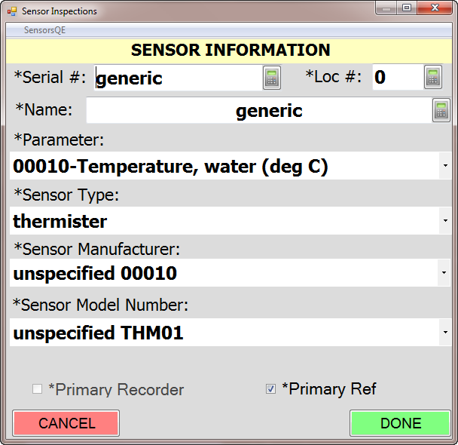
ADVM Temperature
Notes:
Many users have frustrations that SWAMI doesn’t allow them to document or perform certain tasks in the field. Sharing these frustrations or suggested improvements using the resources we will discuss later is an important part of moving the paperless world forward.
SWAMI improvements have been suggested to allow index velocity users to inspect those stations completely in SWAMI. Until those enhancements are made, there are several common issues users experience. One example of an issue users run into is documenting a temperature comparison for an ADVM. One solution is to create a sensor for those stations with a generic water temperature thermistor. If the ADVM temperature is another sensor, readings can be noted and documented in this manner.

