Slide 1
Review and Rating Discharge Measurements
David S. Mueller
Office of Surface Water
March 2010

Slide 2
Overview
Considerations in Rating a Measurement
Six Review Steps
Gather information for rating as you review
Three Examples

Slide 3
Rating Process
Quantitative assessment of measurement uncertainty
Currently being worked on
Current practice is subjective
Where we can quantify we will
Where we can’t we will make qualitative estimates

Slide 4
Rating Considerations
Variability of transect discharges
Pattern in transect discharges
Accuracy of top and bottom extrapolation
Accuracy of edge extrapolation
Quantity and distribution of missing data
Quality of boat navigation reference
Bias or noise in bottom track
Noise in GPS data

Slide 5
Spread in Transect Discharges
A coefficient of variation (COV) is computed by the software (Std./|Avg.|)
The COV represents the sampled random error in the discharge measurement.
Dividing the COV by the sqrt of the number of passes and multiplying by the correct value will provide the 95% uncertainty associated with random errors as measured
For 4 passes: 1.6*COV
For 8 passes: 0.8*COV
This does not include any bias errors
This is probably and optimistic estimate

Slide 6
Example of Random Error
95% Uncertainy (Random Error) = 0.05*0.8 = 4%

Slide 7
Patterns in Transects
Random errors should not display a pattern
A pattern in flow may indicate the need to adjust measurement procedures
Rapidly rising or falling – average fewer transects
Periodic – use more transects to capture variability

Slide 8
Top Extrapolation
Average appropriate number of ensembles
Evaluate discharge profile
Check field notes for wind effects
Try different extrapolation methods and compare change in total discharge
Little change – accurate extrapolation likely
Significant change – how good is the data on which the selection is made
Surface effects captured?
Field notes consistent with pattern?
What percentage of flow is in the top portion
Subjective judgment

Slide 9
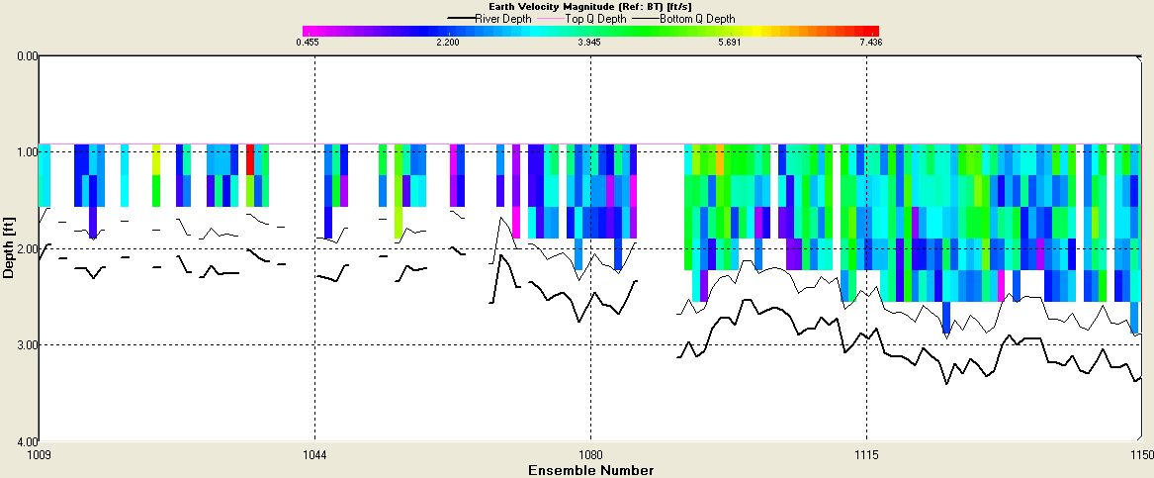
Bottom Extrapolation
Smooth streambed
Accurate extrapolation likely
Rough streambed
Extrapolation uncertain

Slide 10
Edge Estimates
What percentage of flow is in the edges?
May be small enough to disregard accuracy
Recommend no more than 5% in each edge
Subjective judgment
Large edge estimates
Irregular edge shapes
Edge Q = 25% of total

Slide 11
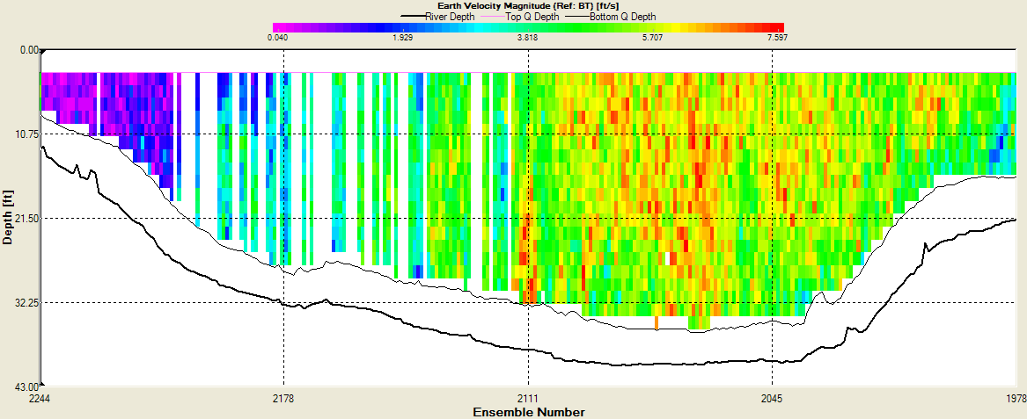
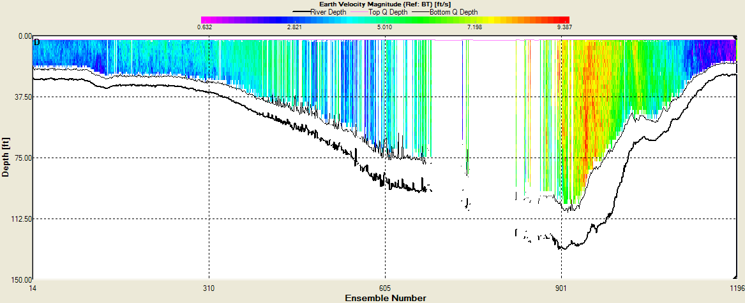
Invalid Data
Percent of invalid data
Distribution of invalid data
How well is that portion of the flow estimated

Slide 12
Summary of Rating Approach
Consider the data
Consider the hydraulics
Consider site conditions
Use statistics, if possible
Use your judgment
Pay attention to potential errors (as a percentage) as you review the data

Slide 13
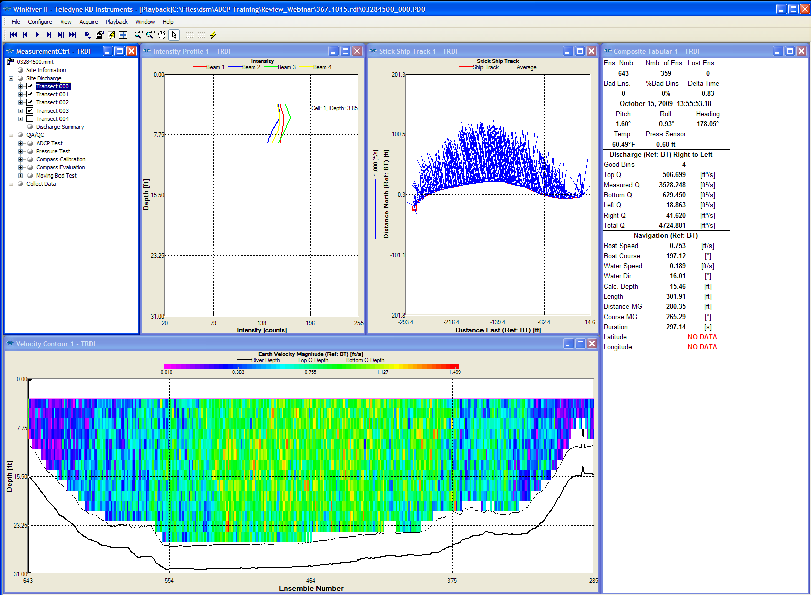
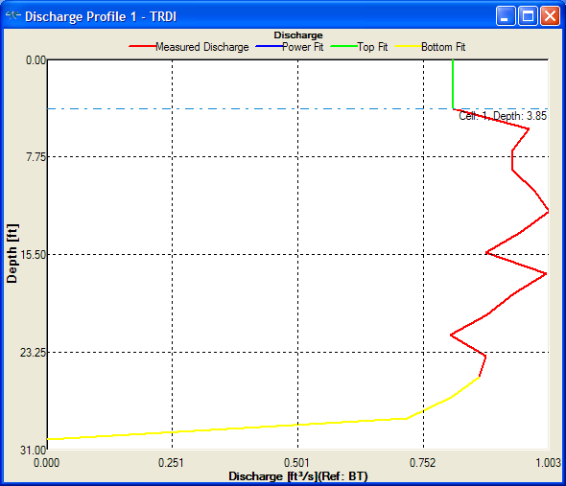
Steps of Review
QA/QC
Composite tabular
Stick Ship Track
Velocity contour
Extrapolation
Discharge summary

Slide 14
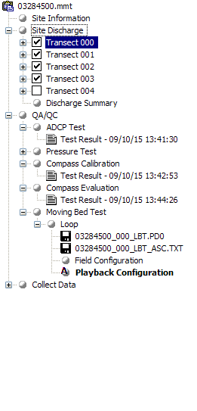
QA/QC
ADCP Test Error Free?
Compass Calibration
Calibration and evaluation completed
< 1 degree error
Important for Loop and GPS
Moving-Bed Test
Loop
Requires compass calibration
Use LC to evaluate
Stationary
Duration and Deployment
SMBA required to evaluate StreamPro

Slide 15
Composite Tabular
Number of Ensembles
> 150 ???
Lost Ensembles
Communications error
Bad Ensembles
Distribution more important than percentage
Distribution evaluated in velocity contour plot
Reasonable temperature

Slide 16
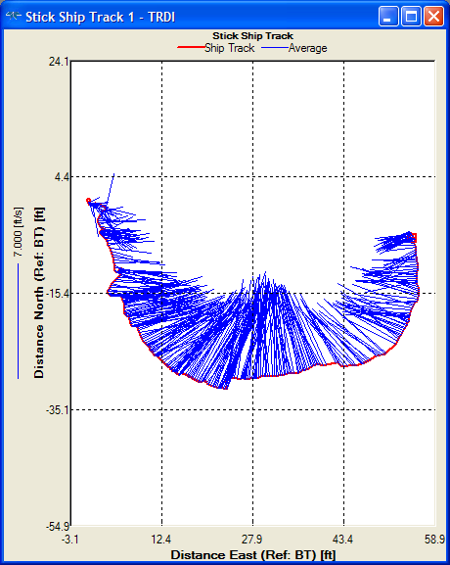
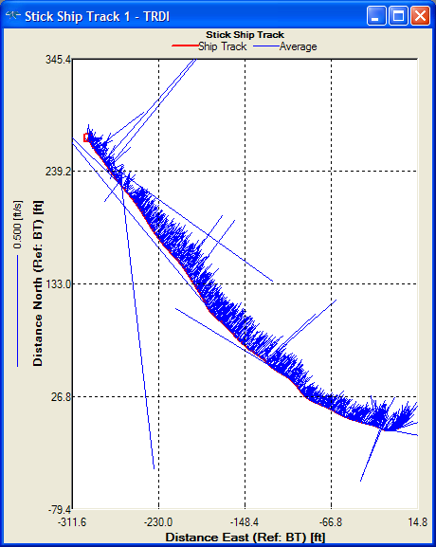
Stick Ship Track
Check with appropriate reference (BT, GGA, VTG)
Track and sticks in correct direction
Magnetic variation
Heading time series
Sticks representative of flow
WT thresholds
Irregular ship track?
BT thresholds
BT 4-beam solutions

Slide 17
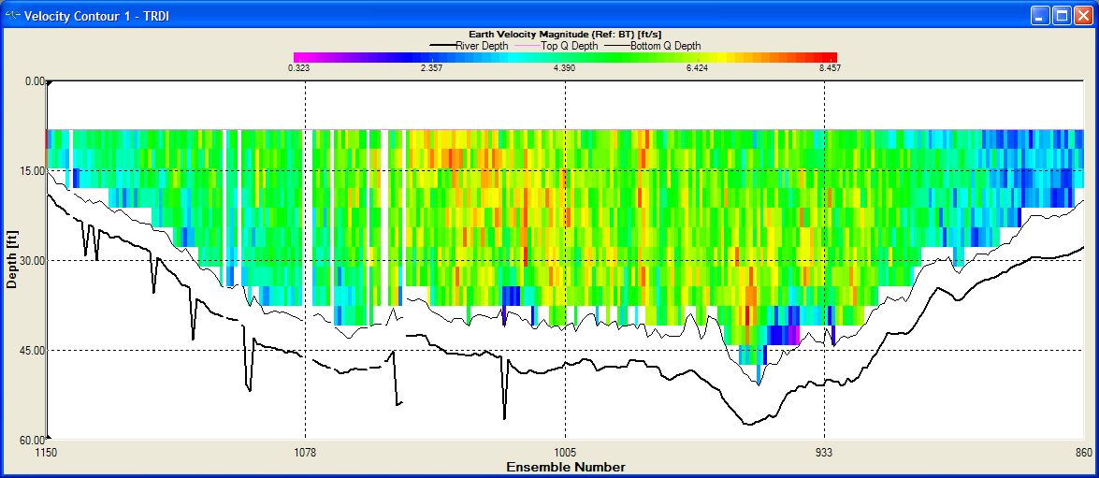
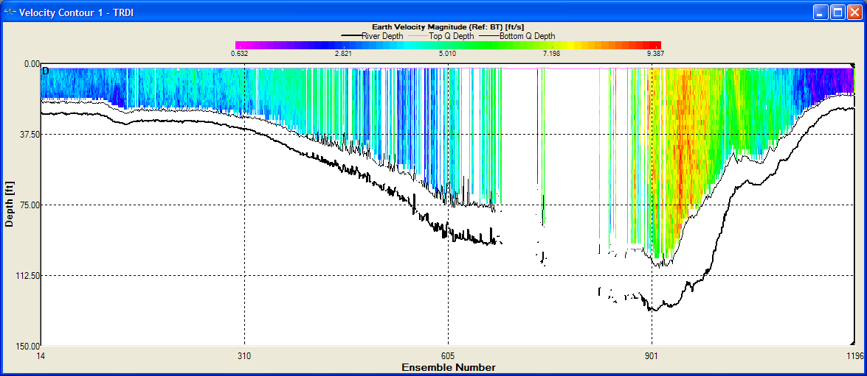
Velocity Contour
Patterns in velocity distribution
Nonuniform
Unnatural
WT Thresholds
Spikes in bottom profile
Turn on Screen Depth
Distribution of invalid and unmeasured areas
Qualitative assessment of uncertainty

Slide 18
Velocity Extrapolation
Average ensembles (10-20)
Evaluate several transects
Use Power/Power as default
Find reasons to deviate from Power/Power
Don’t waste time where there is little difference
In doubt try different options an evaluate change in discharge
Helps evaluate potential uncertainty from extrapolation
Person collecting data gets benefit of doubt

Slide 19
Discharge Summary
Transects within 5%
Directional bias
GPS used
Magvar correction
Consistency
Discharges (top, meas., bottom, left, right)
Width, Area
Boat speed, Flow Speed, Flow Dir.

Slide 20
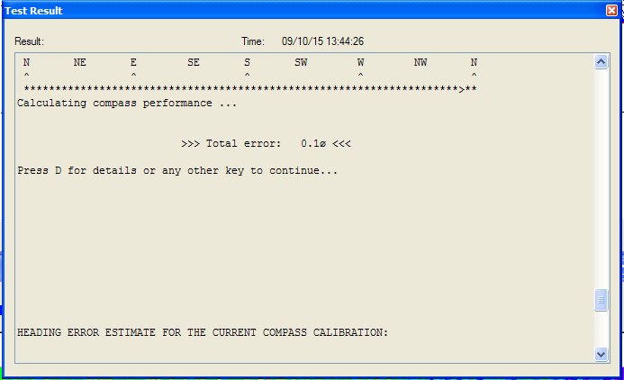
Example 1 – Compass Cal.
Compass Evaluation is Good!

Slide 21
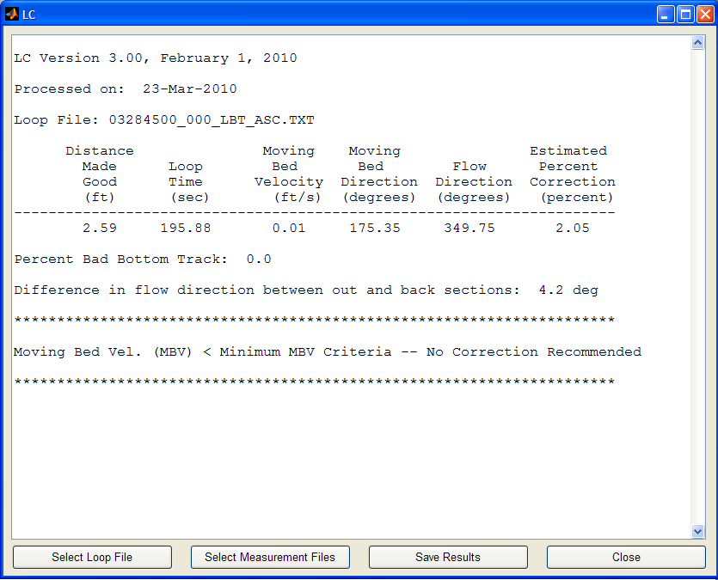
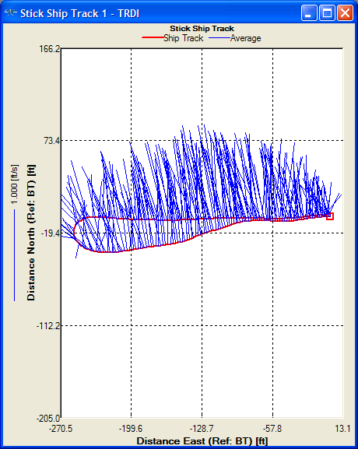
Example 1 – Moving-Bed Test
Loop looks good
LC finds no problems with loop
Lost BT
Compass Error
No moving-bed correction required

Slide 22
Example 1 – Composite Tabular
> 300 ensembles
No lost ensembles
0-1 bad ensembles
Temperature reasonable

Slide 23
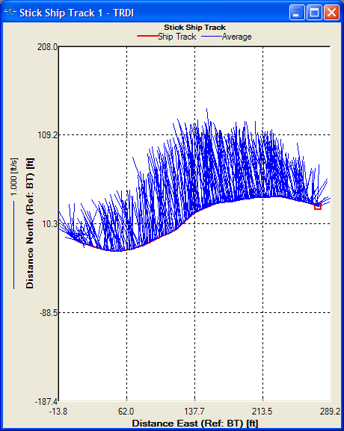
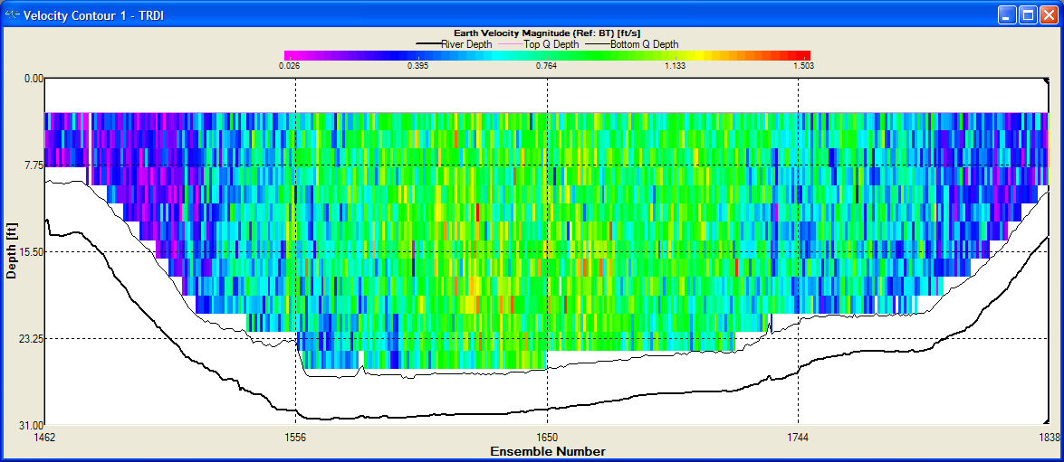
Example 1 – Ship Track / Contour
Ship track consistent
No spikes in streambed in contour plot
No hydraulically unusual patterns
Unmeasured areas reasonable in size

Slide 24
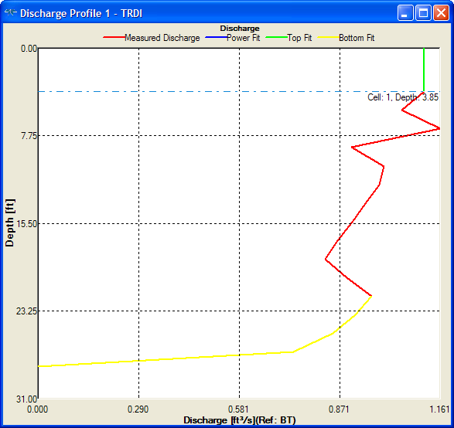
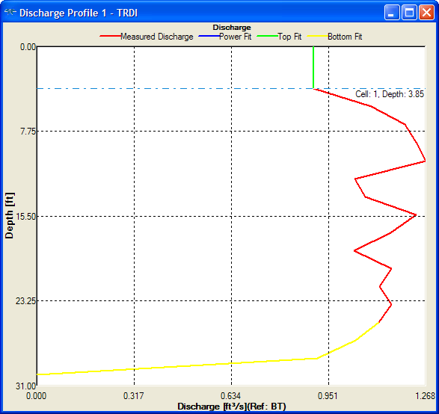
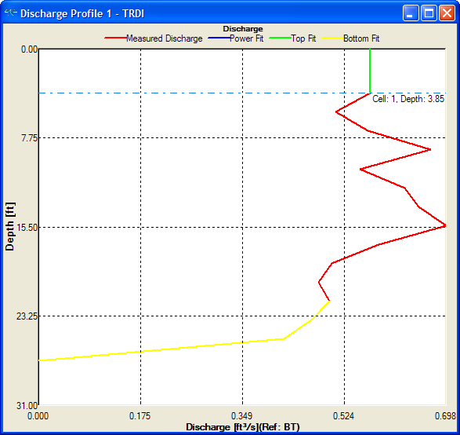
Example 1 - Extrapolation
Top extrapolation a bit uncertain
Try Power/Power
Changed Q = 0.6%
Const / No Slip = OK

Slide 25
Example 1 – Discharge Summary
All within 5%
1 negative Q in left edge
Everything else very consistent

Slide 26
Example 1 - Rating
Base uncertainty
1.6*0.01= 1.6%
Invalid Data
None
Extrapolation
0.5-1% uncertainty in extrapolation
Top is only about 10% of total
Edges
About 1% of total Q
Final assessment
Rate this measurement “GOOD”

Slide 27
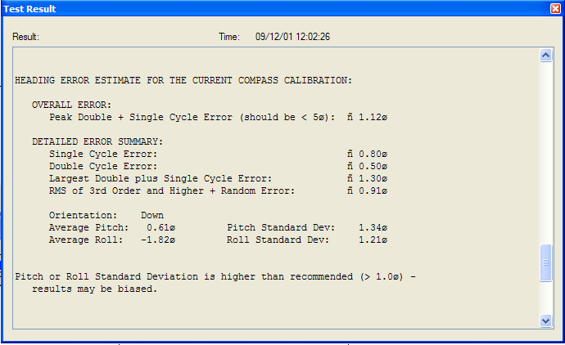
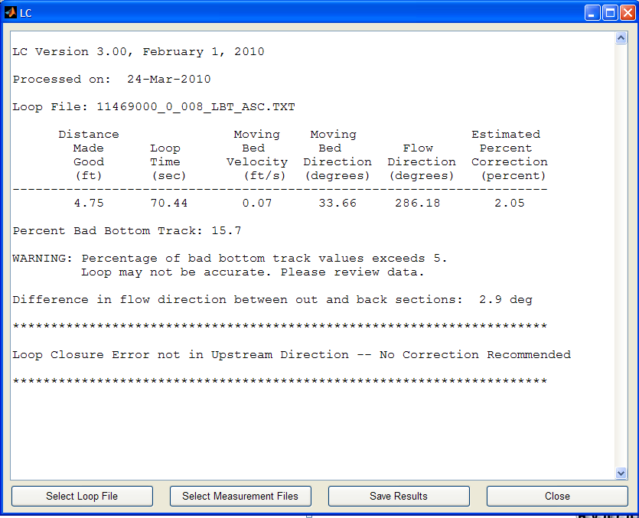
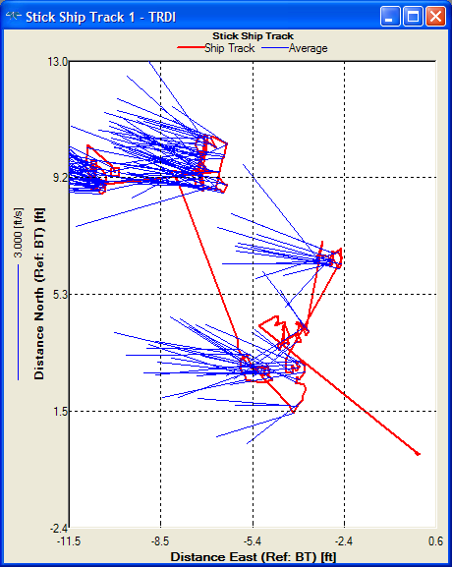
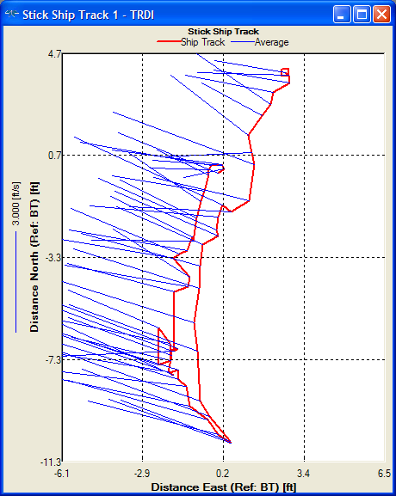
Example 2 – QA/QC
No test errors
Compass Cal
High pitch and roll
Moving-bed tests
Bottom track problems

Slide 28
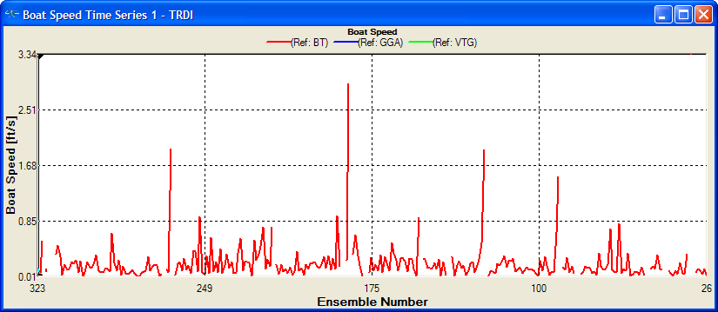
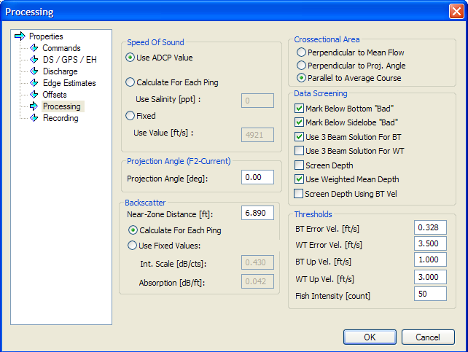
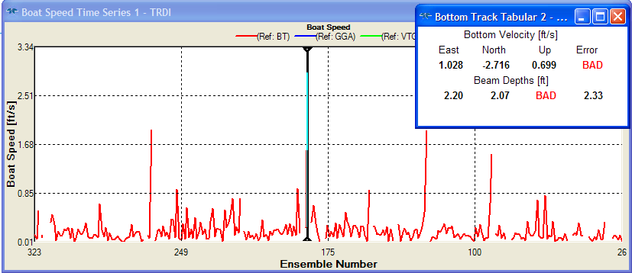
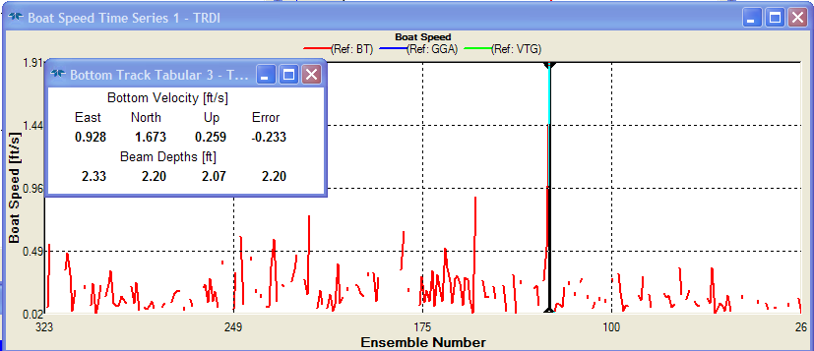
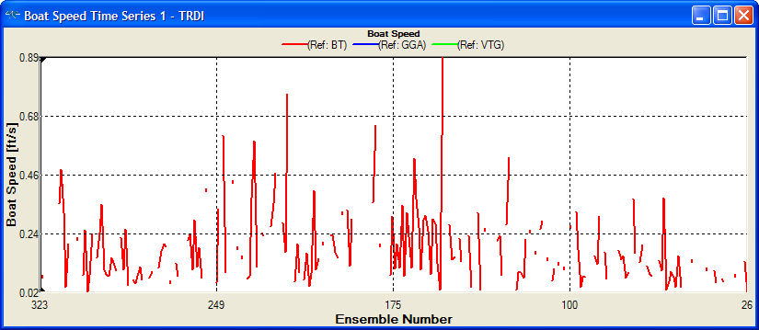
Example 2 – Bottom Track Issue
Time series plots show spikes
3-beam solution
High vertical velocity

Slide 29
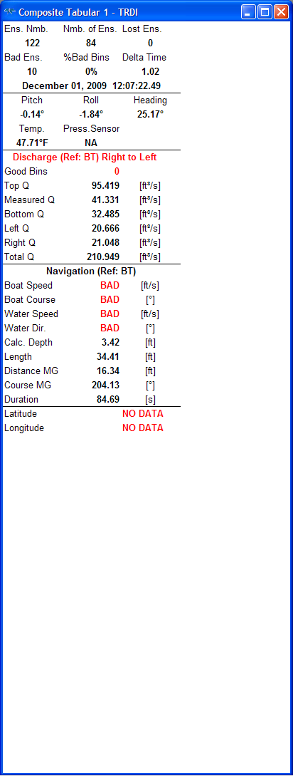
Example 2 – Composite Tabular
Too few ensembles
Short duration
Bad ensembles

Slide 30
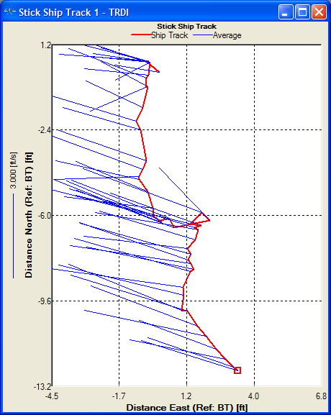
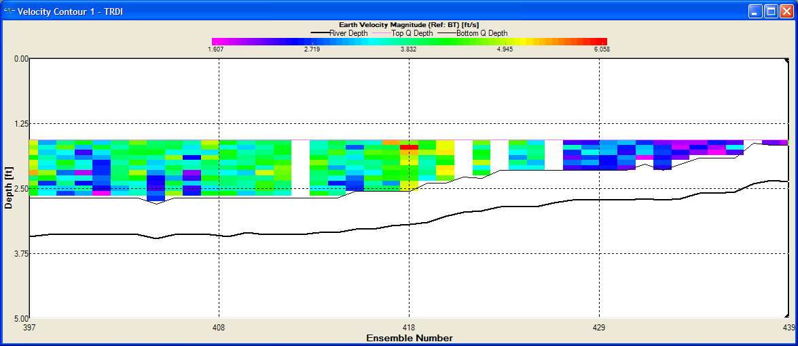
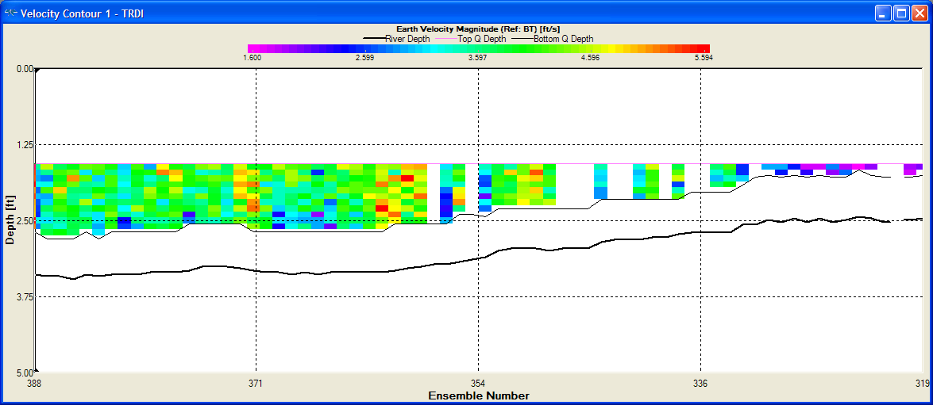
Example 2 – Ship Track / Contour
Irregular ship track
Thresholds didn’t help
No spikes in streambed
Invalid data
Not many
High percentage because of so few ensembles
Estimates probably reasonable
Large unmeasured areas
% measured < 20%

Slide 31
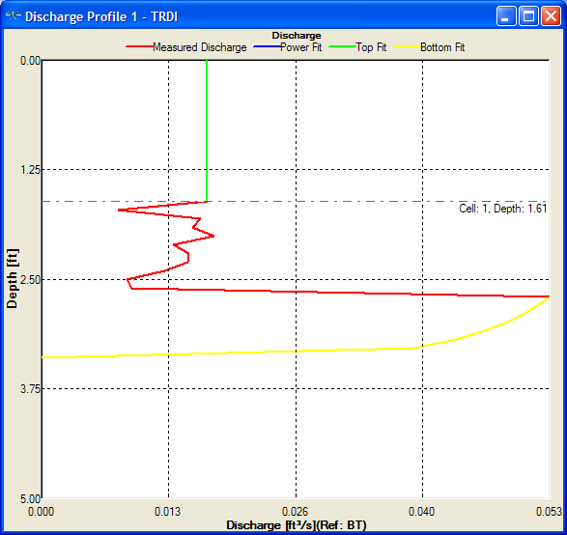
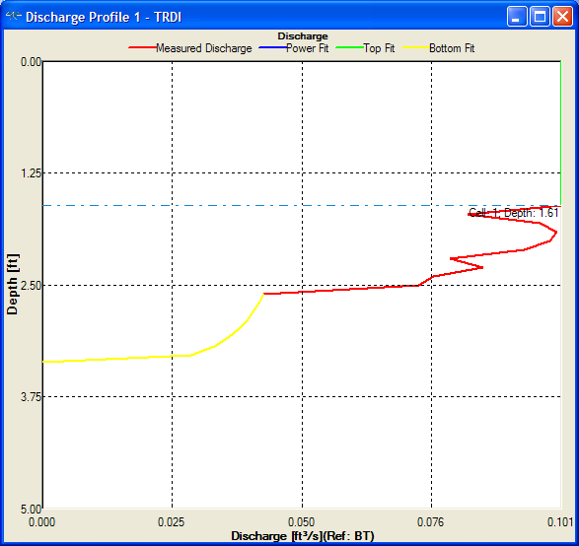
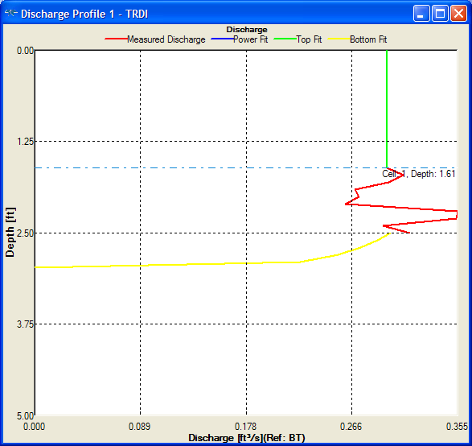
Example 2 - Extrapolation
Averaged 10
Highly variable
Difference between Power/Power and Constant / No Slip is 3.6%
Uncertain about extrapolation accuracy

Slide 32
Example 2 – Discharge Summary
Not within 5%
8 passes
Consistent edges
Inconsistent width and area
Bottom track problems
High Q COV

Slide 33
Example 2 - Rating
Base uncertainty
0.14 * 0.8 = 10%
Invalid data
Some but not significant
Too few ensembles (or too few transects)
Bottom track problems
Large unmeasured areas
Extrapolation
Power/Power to Constant/No Slip = 3.6%
Edges
Reasonable
Final Assessment
Rate this measurement “POOR”

Slide 34
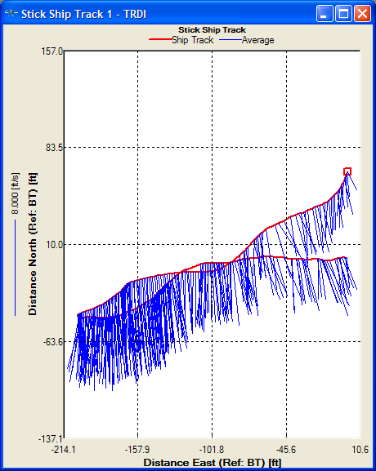
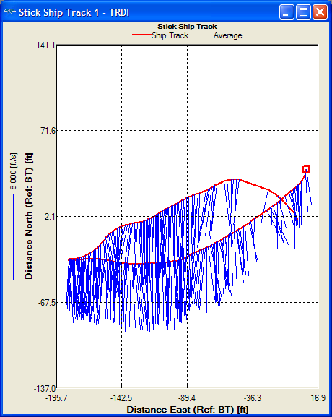
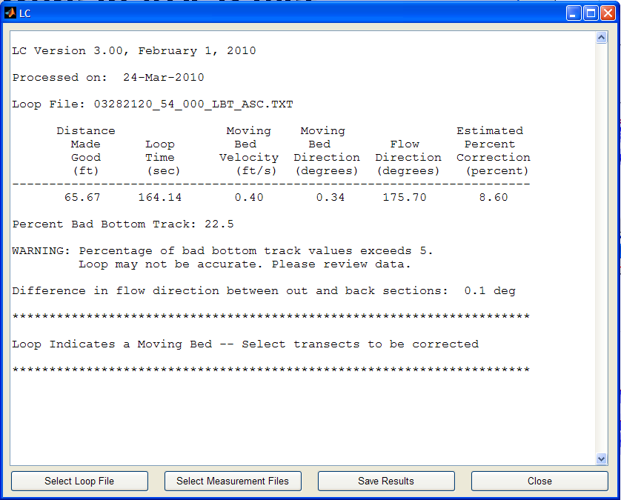
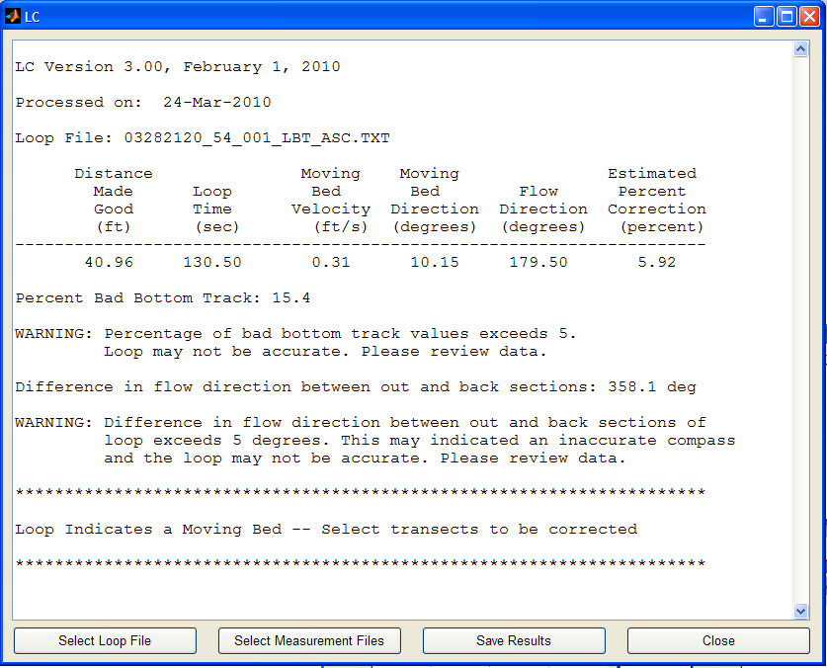
Example 3 – QA/QC
No errors in ADCP test
Good compass calibration
Two loop tests

Slide 35
Example 3 – Composite Tabular
High percentage of bad ensembles

Slide 36
Example 3 – Composite Tabular
Very few bad ensembles with reference set to GGA!!

Slide 37
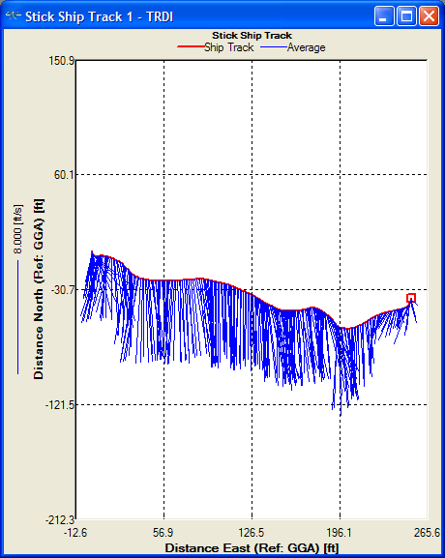
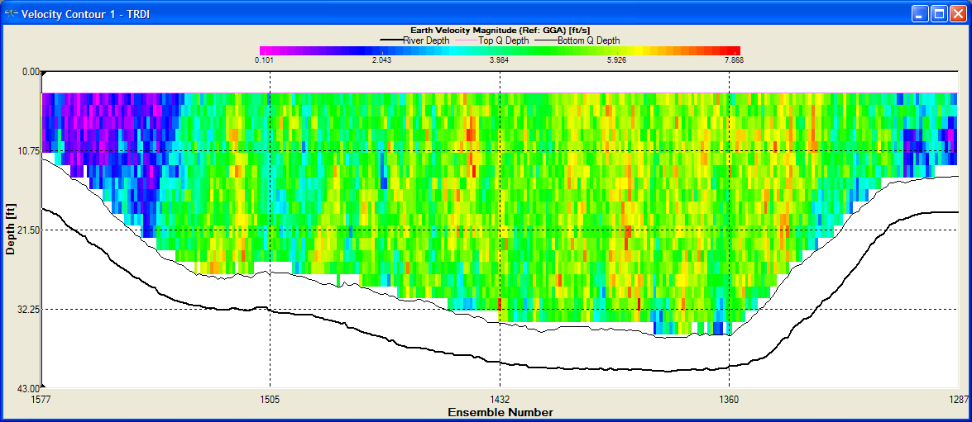
Example 3 – Ship Track / Contour
Everything looks good with reference set to GGA

Slide 38
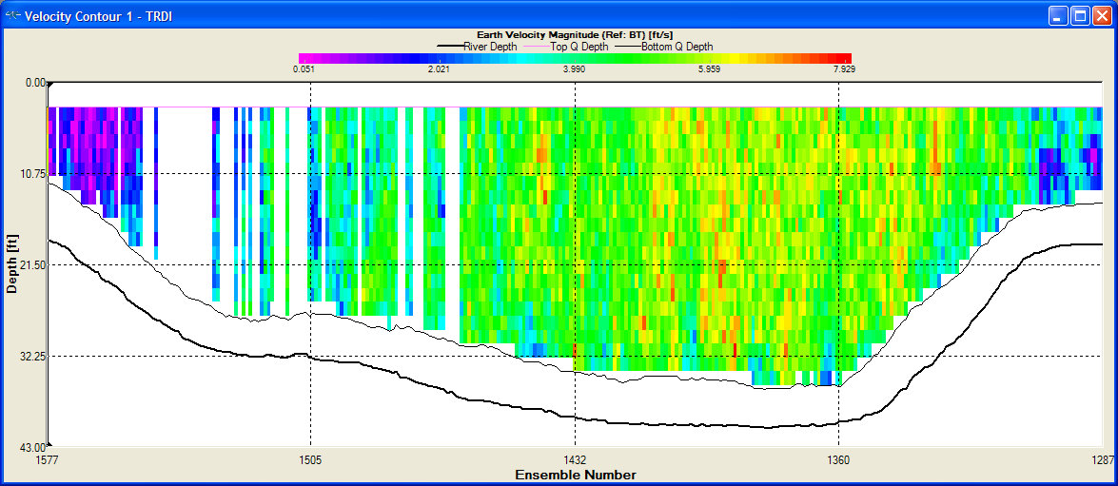
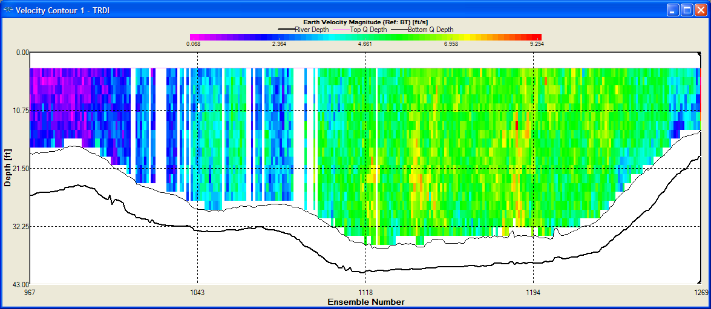
Example 3 – Ship Track / Contour
With bottom track we need to qualitatively assess the effect of the invalid data on uncertainty

Slide 39
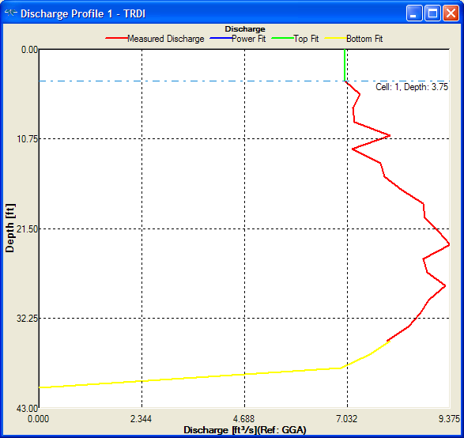
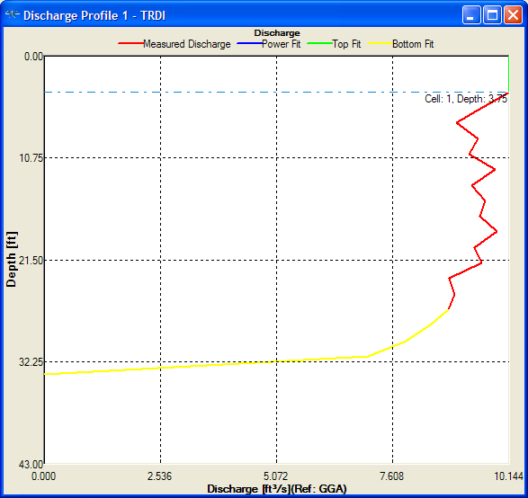
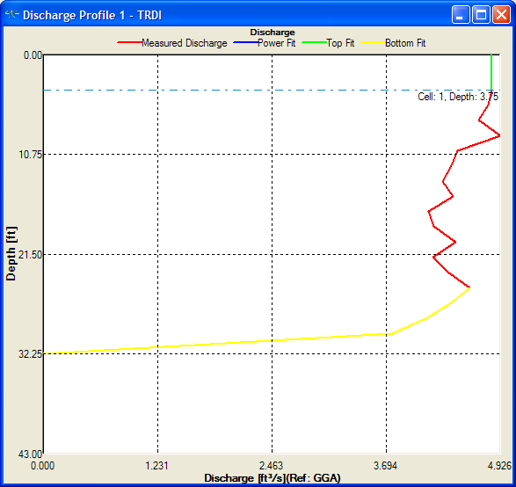
Example 3 - Extrapolation
Given the variability among the profile plots constant / no slip seems reasonable.
Changing to power / power made no difference in the final Q
Might justify power / power

Slide 40
Example 3 – Discharge Summary
Small directional bias
Typical of magvar or compass error with GPS
Adjusting magvar 2.5 degrees removed directional bias and changed Q by 1.3 cfs.
Edge discharge are inconsistent but small relative to total Q

Slide 41
Example 3 – Discharge Summary
Bottom track referenced discharge are lower indicating a moving bed was present.
Edge discharges are inconsistent but small
Would require correction with LC

Slide 42
Example 3 - Rating
GPS (GGA or VTG) should be used as the reference.
Base uncertainty
0.03 * 1.6 = 4.8%
Value inflated due to directional bias
No significant invalid data
Extrapolation and edges would make little difference
Final assessment
Could rate this measurement “Good” wouldn’t argue much if rated “Fair”

Slide 43
Example 3 - Rating
If GPS were not available and BT had to be used the rating would change.
Loops
High percentage of invalid bottom track
5-8% moving-bed bias
Base uncertainty
0.02 * 1.4 = 3.2%
Invalid data
Represent a significant percentage of the flow
Likely estimated well from neighboring data
Edges
Inconsistent
Small percentage
Extrapolation
Errors very small
Final assessment
Loop correction probably within 4% + 3.2% random error
I would probably rate this measurement “Fair”

Slide 44
Summary
Consider potential uncertainty or errors as you review the data
Keep review to a minimum unless errors are identified or suspected
Consider the percent of effect of an error or uncertainty will have on the discharge
Extrapolation uncertainty can be large in shallow streams
Use the COV in the discharge summary as the base minimum uncertainty
Contact OSW if you have unusual data or you have questions

Slide 45
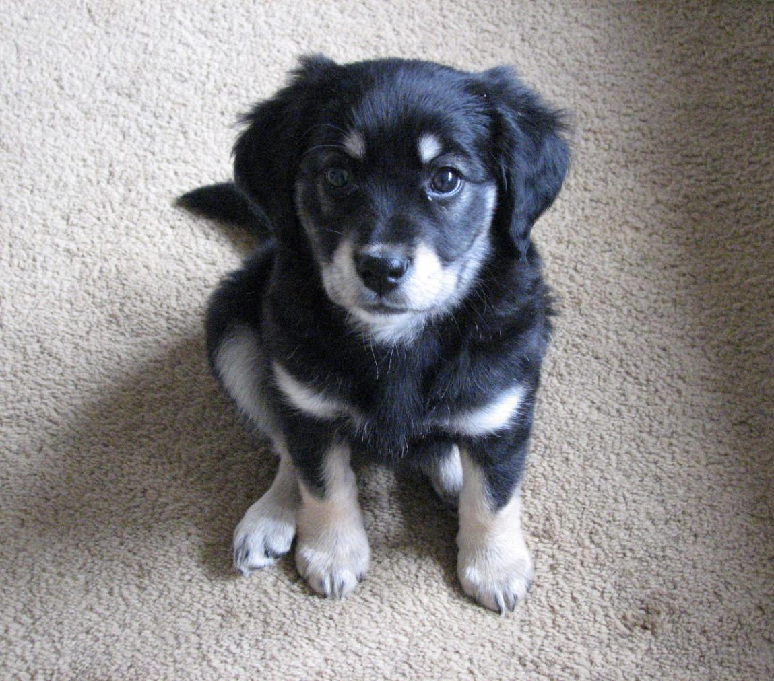
Questions???

