Slide 1
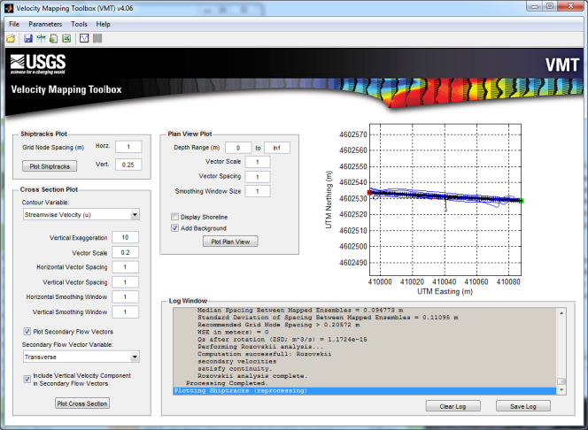
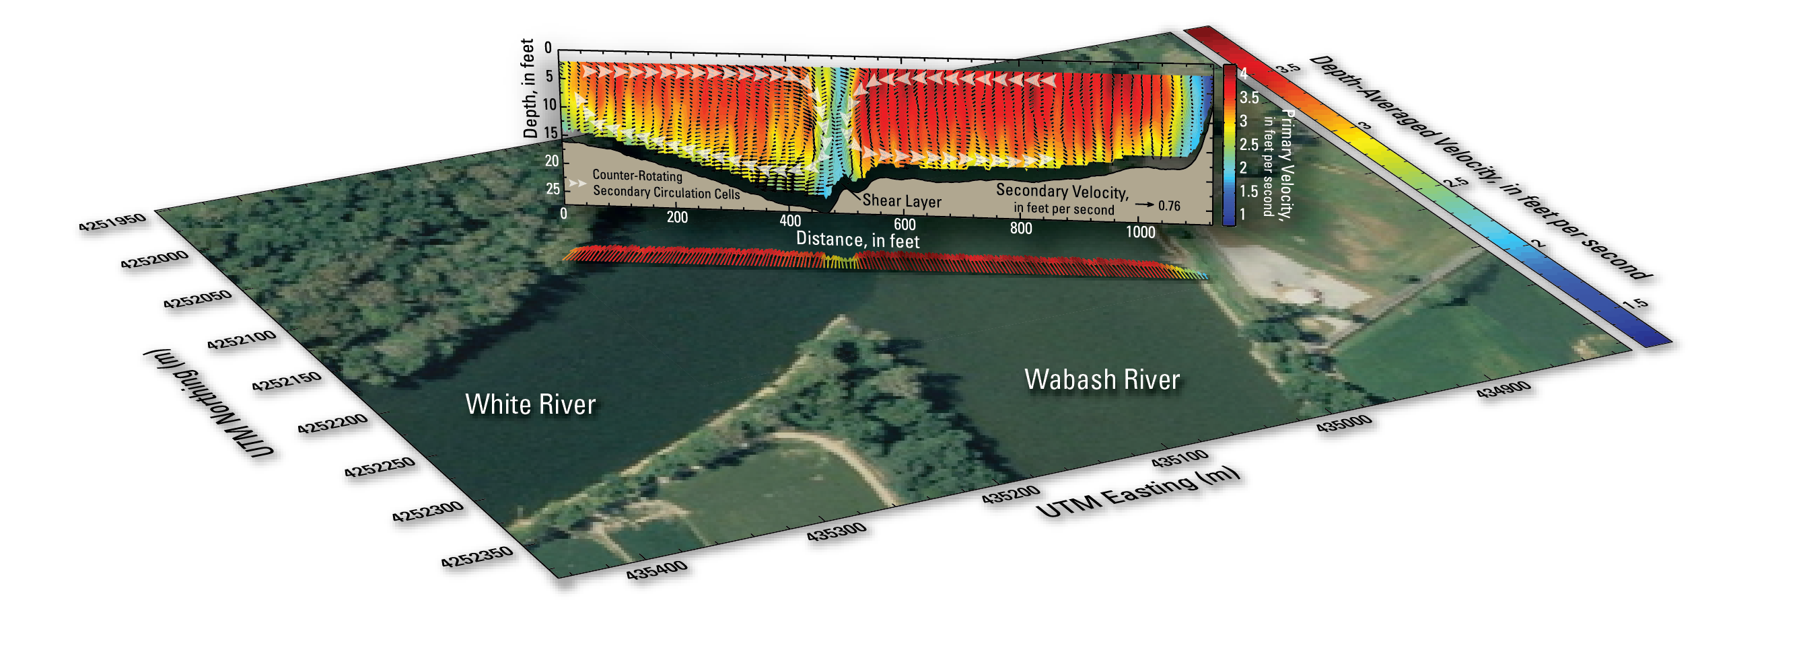
The Velocity Mapping Toolbox (VMT): Updates and Applications
Frank Engel
Ryan Jackson
USGS Illinois Water Science Center
OSW Hydroacoustics Webinar
May 20, 2014

Slide 2
Opening Demo
A quick look at VMT
  Reads TDRI ASCII files (multiple transects)
  Averages to one Mean Cross Section (MCS)
  Quickly allows for robust visualization
[VMT demo outside of presentation]
Notes:
Matlab-based ADCP Data Processing and Visualization Code (GUI)
Most appropriate for data collected with multiple transects at a single cross section and good positional control
Reads ASCII output files from WinRiver II (v4.06 will also read Sontek MAT files)
GPS required
Averages multiple transects at a single cross section
Data Processing and Visualization
Computes a mean velocity field for a given cross section
Computes velocity components
V_{north} and V_{east}, V_{streamwise} and V_{Transverse}, & V_{primary} and V_{secondary} (and vertical)
Contour plots can be constructed for numerous variables (including backscatter)
secondary and vertical flow vectors can be overlaid
Plan view plots show depth- or layer-averaged velocities (for one or more cross sections)
Additional standalone utilities provide further processing capabilities
Export Capabilities
Exports data to a variety of formats compatible with Excel®, ArcGIS®, Google Earth®, TecPlot®, and iRIC

Slide 3
Contributors to VMT
Primary Developers:
Ryan Jackson (USGS Illinois WSC)
*Frank Engel (USGS Illinois WSC)
Dan Parsons (Univ. of Hull, UK)
Jon Czuba (former USGS)
Dave Mueller (USGS OSW)
Input and support from:
Kevin Oberg (USGS OSW)
Bruce Rhoads (University of Illinois)
Kevin Johnson (USGS Illinois WSC)
Jim Best (University of Illinois)
Marcelo Garcia (University of Illinois)
Jim Riley (Eastern Illinois University)
Ricardo Szupiany (Universidad Nacional del Litoral, Argentina)
And many others!
Engel
Jackson
Mueller
Czuba
Parsons
VMT
*Current primary coder

Slide 4
Timeline
Mathworks consultation
Sep 2012
Czuba St. Claire work
ESPL paper
Summer 2008
Oct 2012
Parsons & Best Parana work
Engel begins contributing
2006
Aug 2009
VMT version 4 released
May 2013
Riley confluence work
Feb 2007
Jackson builds VMT v1
VMT fact sheet
Dec 2008
May 2013
2006
2007
2008
2009
2010
2011
2012
2013
2014
Tampa short course
2nd velocity mapping class
Mar 2011
May 2014
Santa Fe, Argentina short course
1st velocity mapping class
Sep 2009
Sep 2013
Basic Matlab codes developed by Dan Parsons
  Transect averaging
  Secondary flow computation
  Site specific
Snowbird short course
Aug 2012

Slide 5
Timeline
Mathworks consultation
Sep 2012
Czuba St. Claire work
ESPL paper
Summer 2008
Oct 2012
Parsons & Best Parana work
Engel begins contributing
2006
Aug 2009
VMT version 4 released
May 2013
Riley confluence work
Feb 2007
Jackson builds VMT v1
VMT fact sheet
Dec 2008
May 2013
2006
2007
2008
2009
2010
2011
2012
2013
2014
Tampa short course
2nd velocity mapping class
Mar 2011
May 2014
Santa Fe, Argentina short course
1st velocity mapping class
Sep 2009
Sep 2013
Jon Czuba (USGS) adapts codes for St. Claire River
  TDRI ASCII file parsing
  Basic spatial avg. and visualization
Snowbird short course
Aug 2012

Slide 6
Timeline
Mathworks consultation
Sep 2012
Czuba St. Claire work
ESPL paper
Summer 2008
Oct 2012
Parsons & Best Parana work
Engel begins contributing
2006
Aug 2009
VMT version 4 released
May 2013
Riley confluence work
Feb 2007
Jackson builds VMT v1
VMT fact sheet
Dec 2008
May 2013
2006
2007
2008
2009
2010
2011
2012
2013
2014
Tampa short course
2nd velocity mapping class
Mar 2011
May 2014
Santa Fe, Argentina short course
1st velocity mapping class
Sep 2009
Sep 2013
Jackson compiles non-site specific VMT version 1
Engel adds other secondary flow computations, export options, and more
Snowbird short course
Aug 2012

Slide 7
Timeline
Mathworks consultation
Sep 2012
Czuba St. Claire work
ESPL paper
Summer 2008
Oct 2012
Parsons & Best Parana work
Engel begins contributing
2006
Aug 2009
VMT version 4 released
May 2013
Riley confluence work
Feb 2007
Jackson builds VMT v1
VMT fact sheet
Dec 2008
May 2013
2006
2007
2008
2009
2010
2011
2012
2013
2014
Tampa short course
2nd velocity mapping class
Mar 2011
May 2014
Santa Fe, Argentina short course
1st velocity mapping class
Sep 2009
Sep 2013
Consultation with Mathworks leads to major redesign (speed, features, workflow enhancement)
Paper on VMT published in ESPL
VMT Fact Sheet
Snowbird short course
Aug 2012

Slide 8
Timeline
Mathworks consultation
Sep 2012
Czuba St. Claire work
ESPL paper
Summer 2008
Oct 2012
Parsons & Best Parana work
Engel begins contributing
2006
Aug 2009
VMT version 4 released
May 2013
Riley confluence work
Feb 2007
Jackson builds VMT v1
VMT fact sheet
Dec 2008
May 2013
2006
2007
2008
2009
2010
2011
2012
2013
2014
Tampa short course
2nd velocity mapping class
Mar 2011
May 2014
Santa Fe, Argentina short course
1st velocity mapping class
Sep 2009
Sep 2013
There have been many short courses on VMT starting in 2009
In 2013, OSW created SW2782 “Velocity Mapping and Bathymetry with ADCPs”
Snowbird short course
Aug 2012

Slide 9
Overview of Basic Workflow
WinRiverII
VMT
Processing Engine
Visualization Engine
ASCII Files
Configure Parameters
Collect ADCP Data
Export Graphics
VMT *.mat File(s)
Preprocess
Compute Mean Cross Section
Plot Shiptracks
Process & QA/QC
Map data to MCS
Plot Plan View Map
PNG or JPG
Export ASCII
User EPs
Interpolate data to grid
Plot Contour Map
VMT *.mat File
Similar
Process for
Sontek
(uses MAT file)
Shore
line
Average transects to grid
Various File Types
Save Processed Results
Imagery
Compute (u,v,w)
Export Results
Compute ZSD
VMT Utilities
Compute Roz
ASCII2GIS
ASCII2KML
Batch Mode
Flat-file Builder
Notes:
Green = User set/controlled
Grey = Internal
Yellow = Special

Slide 10
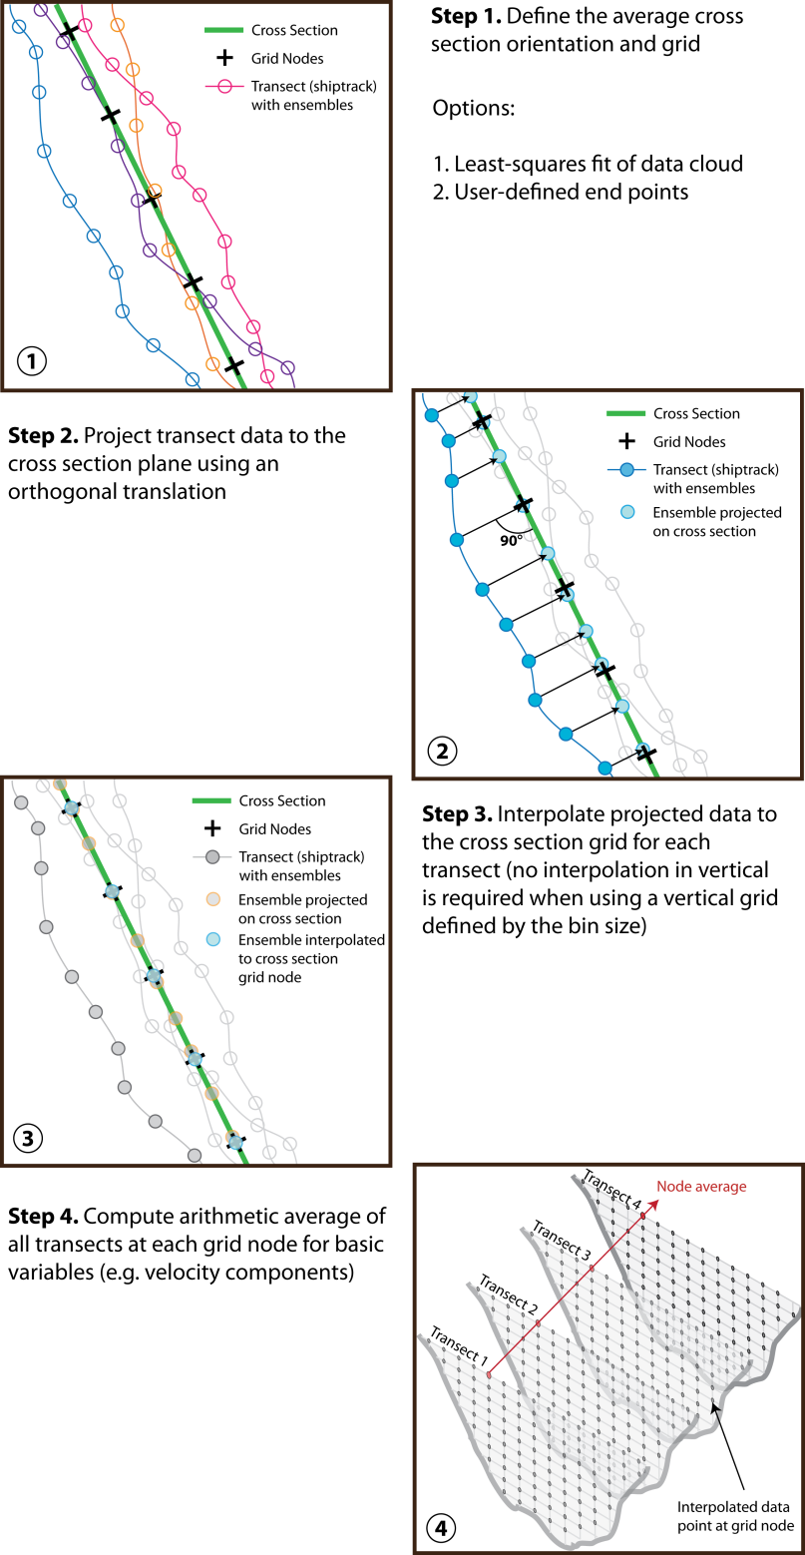
Averaging Multiple Transects
Processing Engine
Compute Mean Cross Section
Map data to MCS
Data mapped to a mean, linear cross section
(required for secondary flow computations)
If data along a curvilinear path is required, use ASCII2GIS utility
Interpolate data to grid
Average transects to grid
Compute (u,v,w)
Compute ZSD
Compute Roz

Slide 11
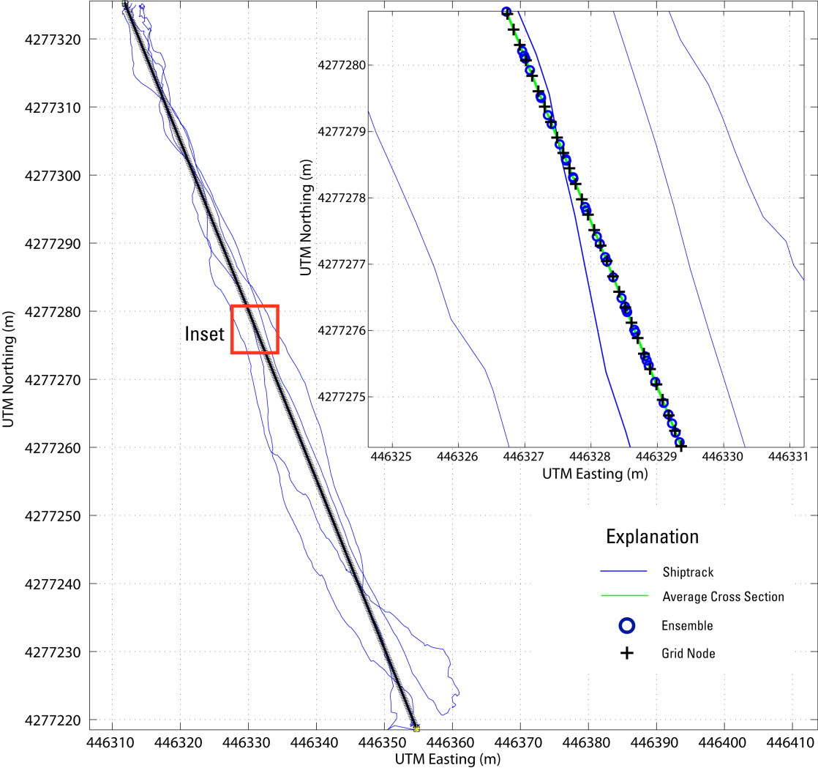
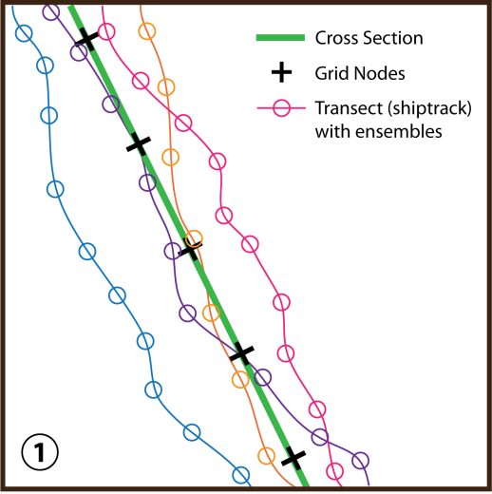
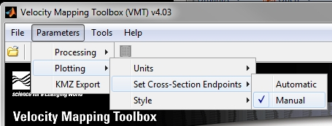
Mean Cross Section
Compute Mean Cross Section
Fits a line to all GPS points
User can override with endpoint file

Slide 12
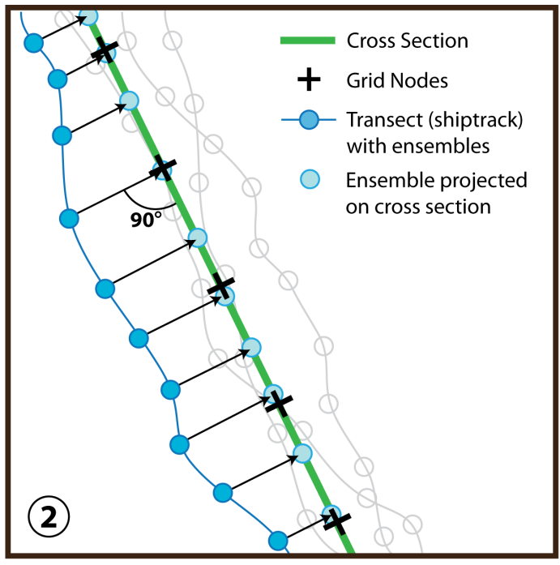

Project Data to Mean XS
Map data to MCS

Slide 13

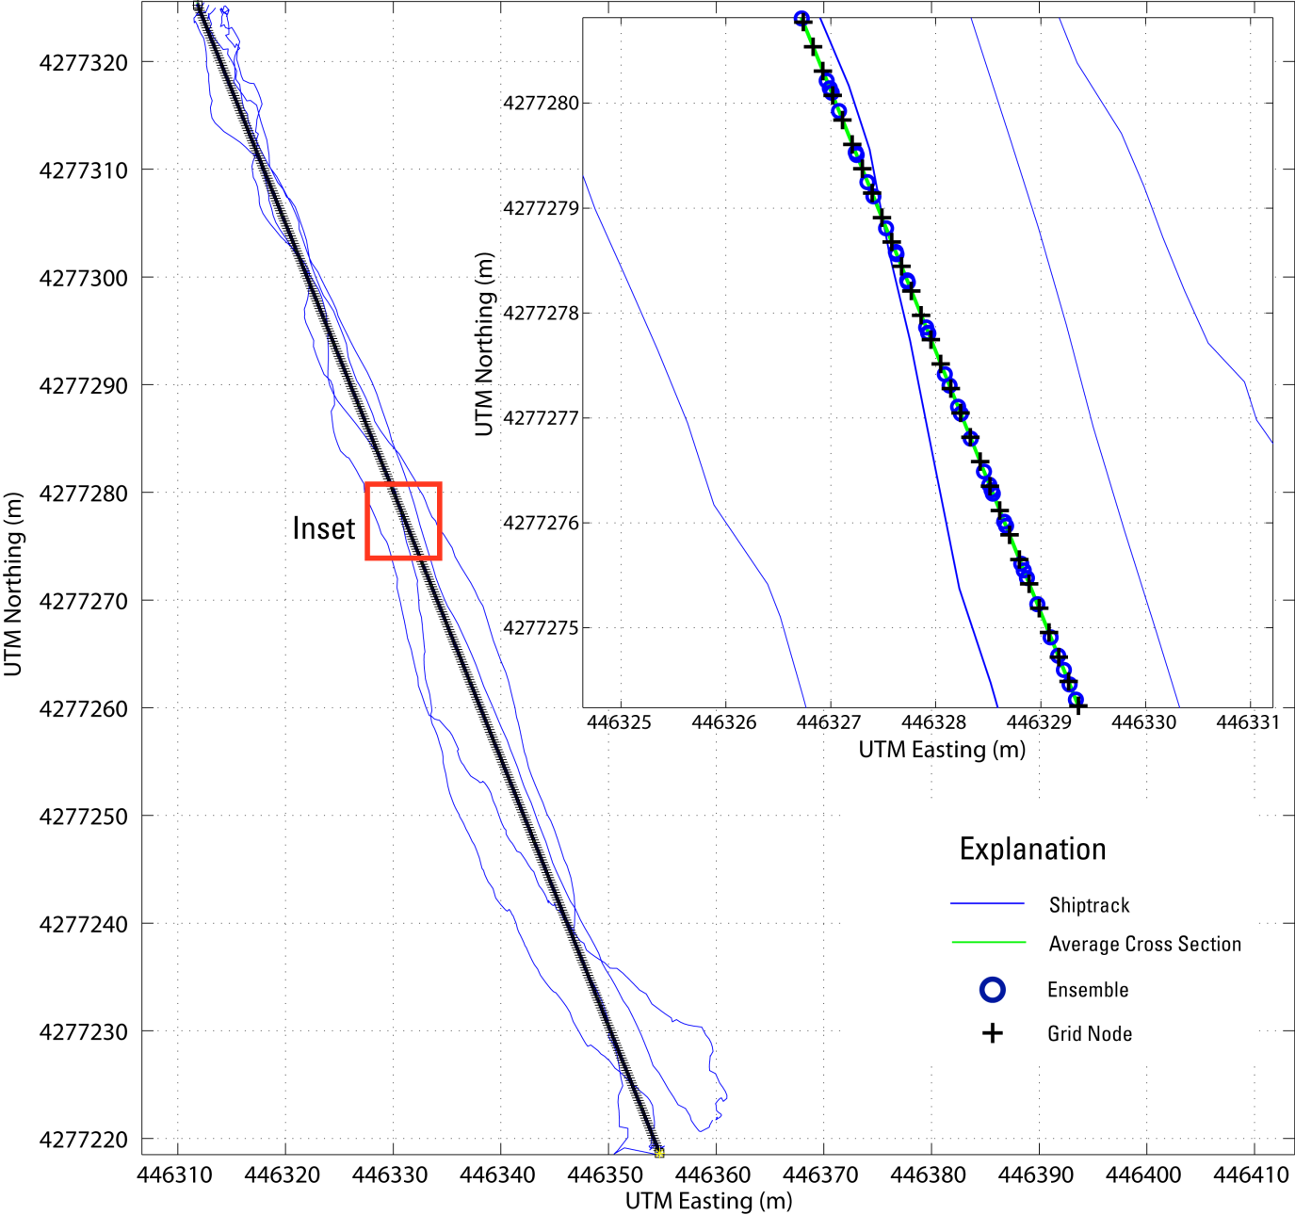
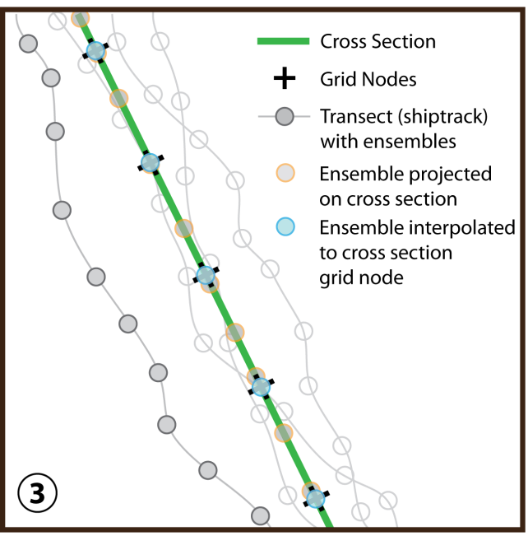
Interpolate to Uniform Grid
Interpolate data to grid
Interpolates data to user
specified grid
X grid node spacing user defined
Z grid node spacing user defined
(TRDI default: ADCP binsize)

Slide 14
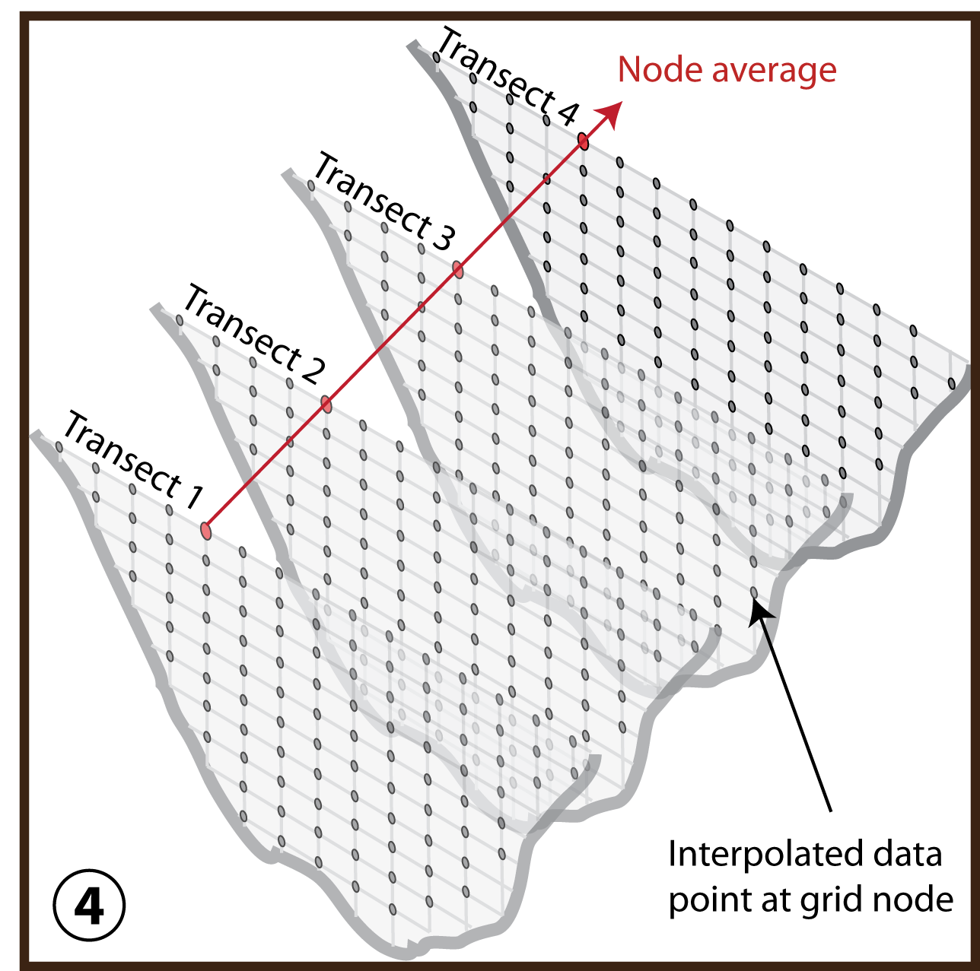
Average Multiple Transects
Average transects to grid
Averages basic variables at each node
  Velocity Components (East, North, Vertical, Error)
  Backscatter & Depth
  Velocity magnitude & direction are recomputed from averaged components

Slide 15
Live Demo
VMT allows users to visualize many different variables
Several secondary circulation computation schemes to suite your needs
Variable list continues to grow…
[Demo of VMT outside of presentation]

Slide 16
Ongoing & future work on VMT
VMT is evolving on a daily basis
VMT already includes additional functionality that is “hidden” including:
  Support for TRDI RiverRay and SonTek data with dynamic bin sizing
  Routines to compute longitudinal dispersion coefficients
  Shear velocity and roughness height based on log-law fits
  Stationary profile analysis tools (STA tool, Boldt)
  Batch processing and custom file builder tools

Slide 17
Ongoing & future work on VMT
We have recently worked with Mathworks to provide feedback on improvements to the code
The improvements to date will allow future expansion of VMT to be much easier
Expansions currently in development include:
  A suspended sediment concentration calibration and computation plug-in (J. Boldt, KY WSC)
  A GeoViz tool for expanded visualization capabilities (F. Engel, IL WSC)

Slide 18
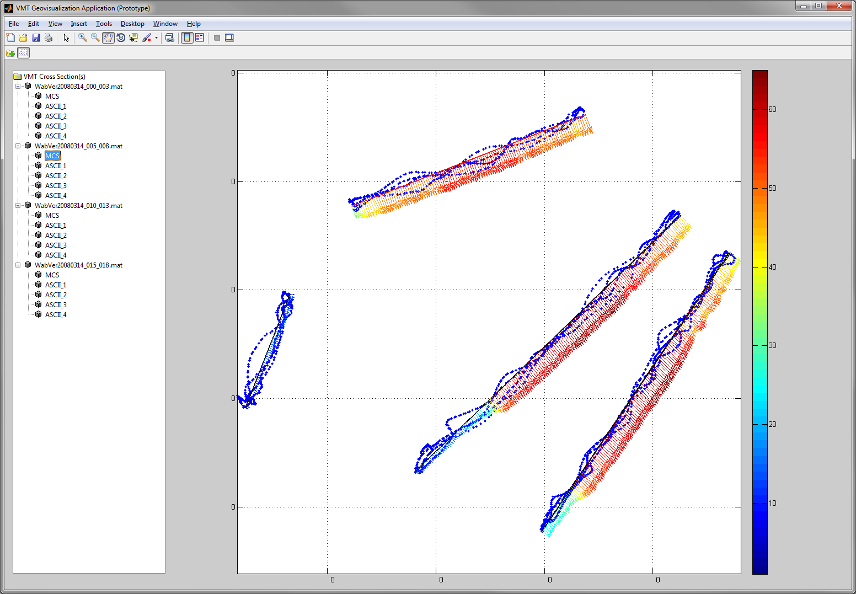
Geo-Viz “Teaser”
“GIS-like” interface allowing processing of large multi-transect sites
Survey planning tools
  Transect layout
  Bathymetry interpolation/mapping toolset

Slide 19
Other future applications & features
Continued efficiency tweaks
Index-Velocity site evaluation toolkit
  Across-channel velocity distribution analysis
  Standard section guidance
Model validation suite
  Output to fixed grid and/or input model results to compare
Survey planning tools
  Transect layout tool and bathymetry interpolation application
GPS.TXT added support (RTK elevations, filtering)
New ideas typically come from YOU—user base feedback is invaluable!!

Slide 20
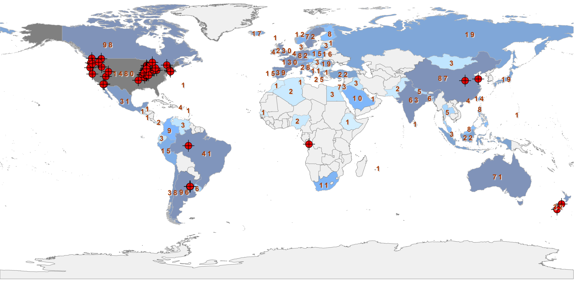
User Base
The VMT user base is active and dynamic
  Over 3,100 visitors to the webpage since December 1 2012 from 88 countries
  VMT v4.05 has been downloaded over 1,000 times (EXE and source code)

Slide 21
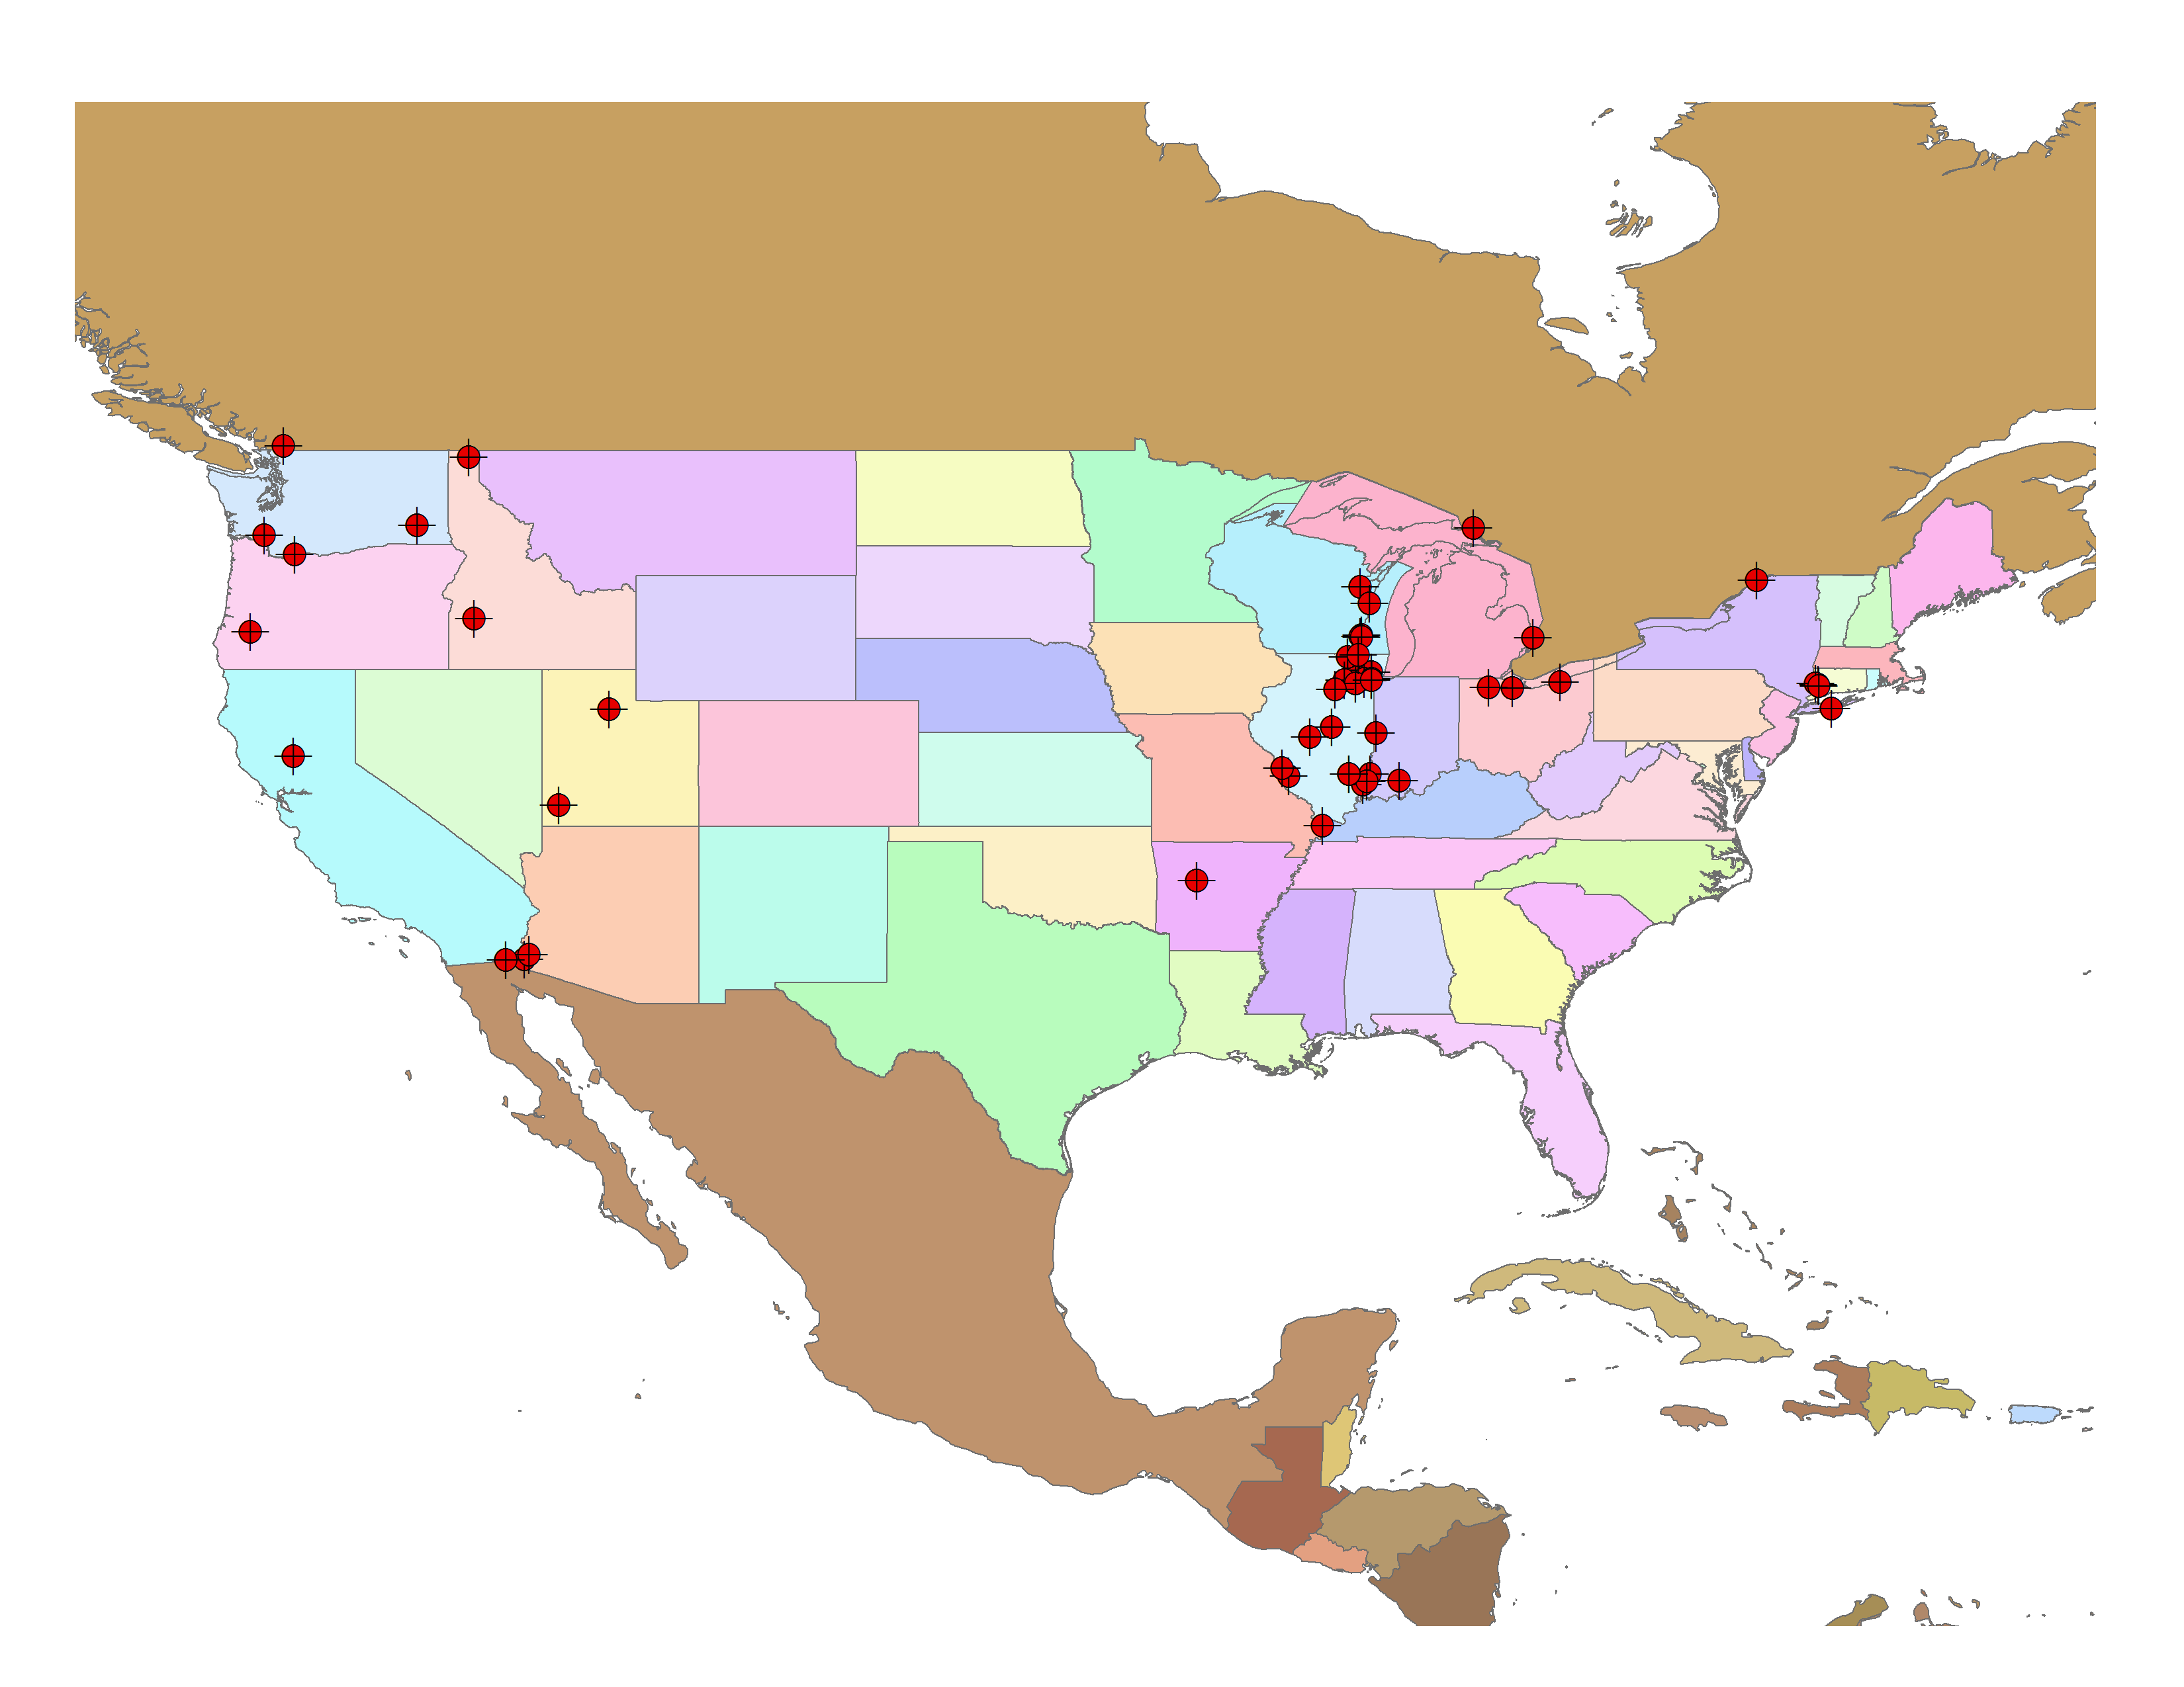
Known Applications in North America
States with trained users
(attended a class)
VMT is being used outside
of the west and midwest, but we have little feedback
If you have applications of VMT, we want to know about them!

Slide 22
Example Applications of VMT
Geomorphology
Morphodynamics of large river meanders
Fluvial dynamics of stream confluences/bifurcations
Sediment transport
Hydrodynamics near Structures
Hydrodynamics near locks and dams and bypass structures
Pier scour
Characterization of flow/bathymetry near channel training structures
Contaminant Transport
Plume tracking
Mixing characterization
Limnology & Nearshore Circulation
Rivermouth hydrodynamics and mixing
Secondary flows in submarine bends
Nearshore circulation
Biological/Ecological Studies
Hydrodynamic requirements for fish spawning
Habitat characterization
Gaging
Evaluation of flow structure and secondary flows at index velocity gages
Locating surface radar gages
Modeling
Collection of model calibration/validation data
Model development (bathymetric mapping)

Slide 23
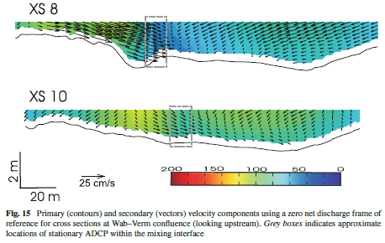
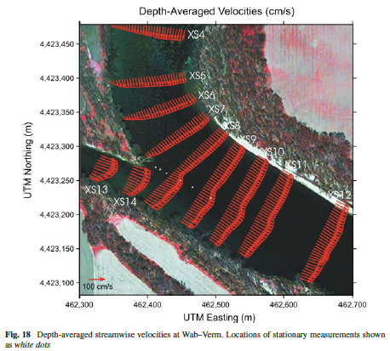
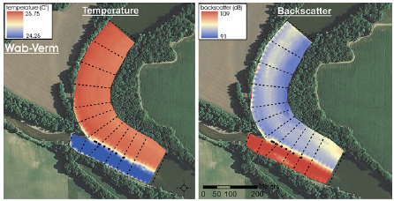
Geomorphology
Wabash-Vermillion Confluence
Konsoer, K. M., & Rhoads, B. L. (2011). Spatial–temporal structure of mixing interface turbulence at two large river confluences. Environmental Fluid Mechanics, 1-28.

Slide 24
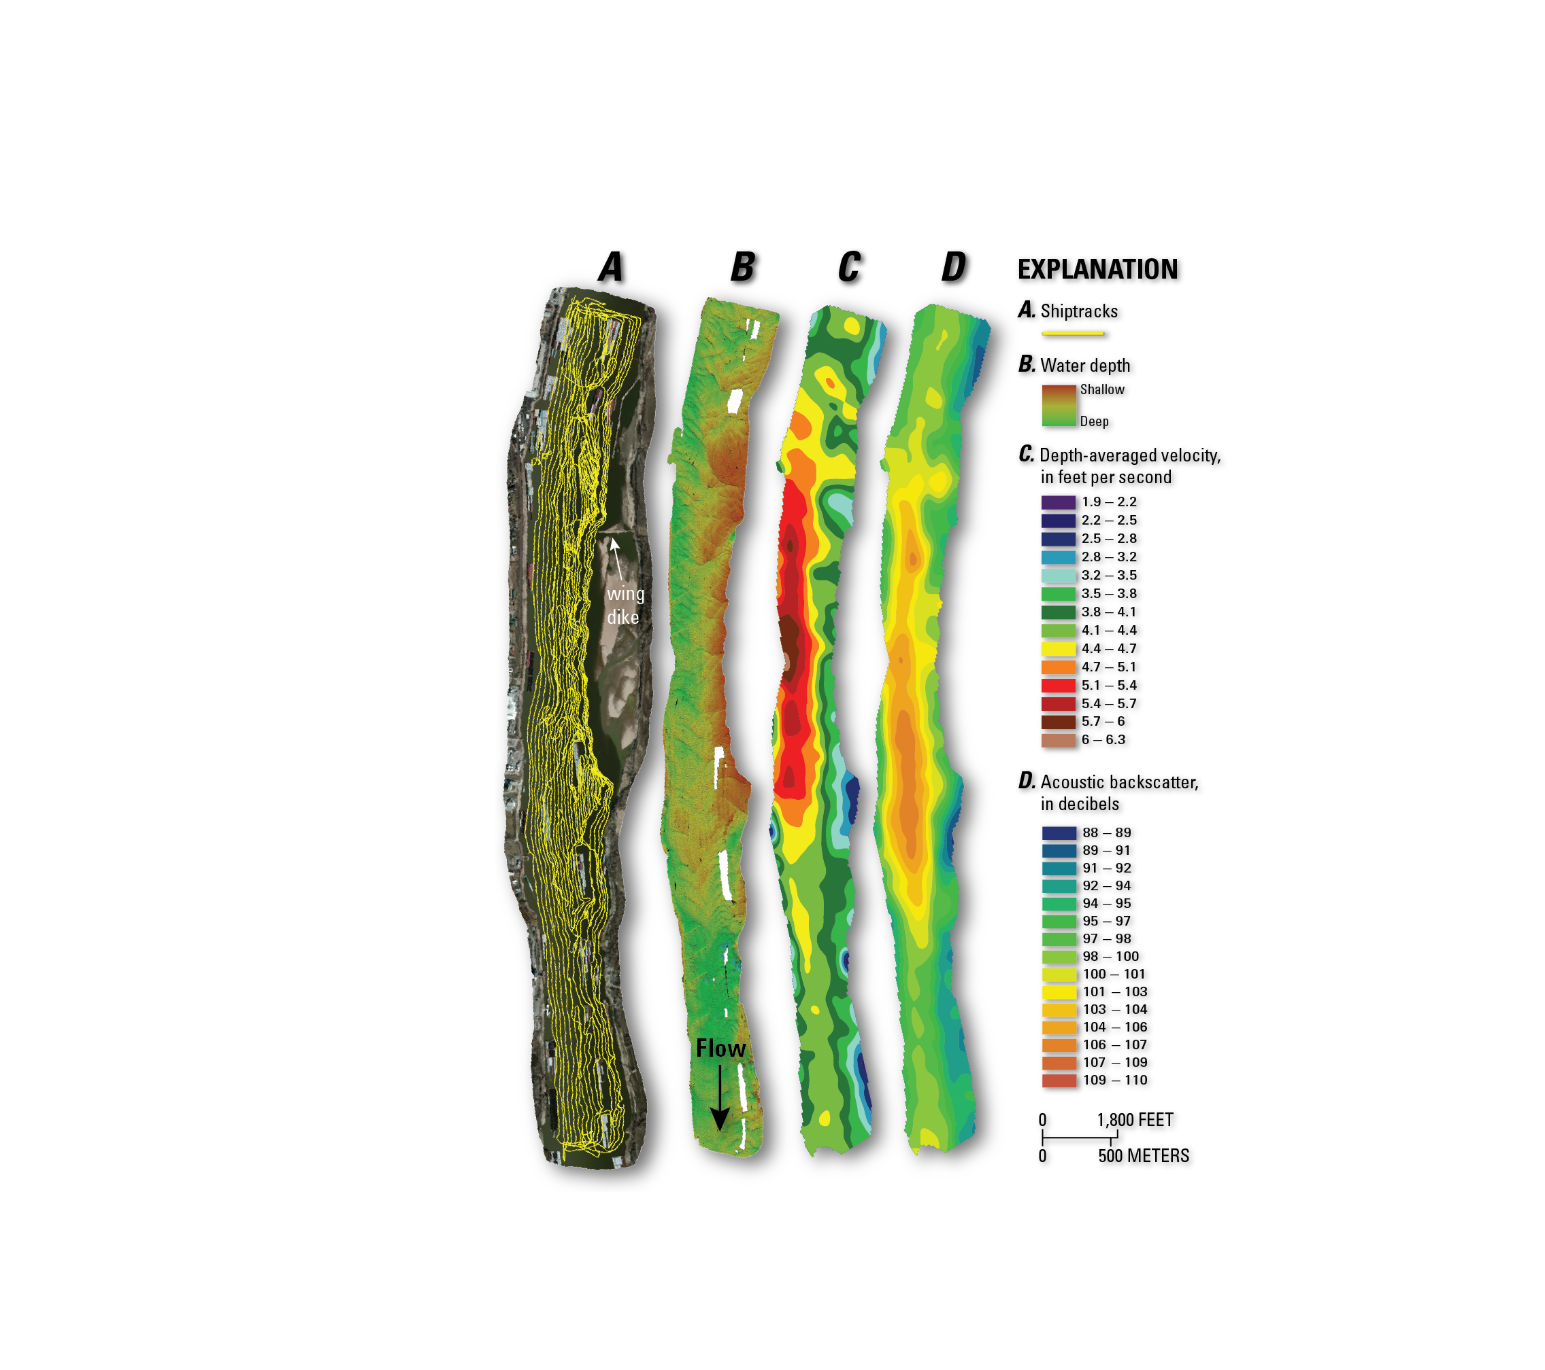
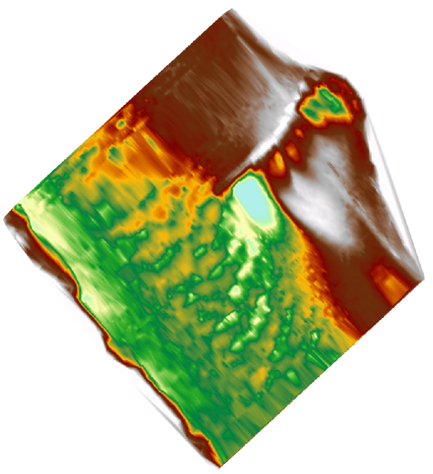
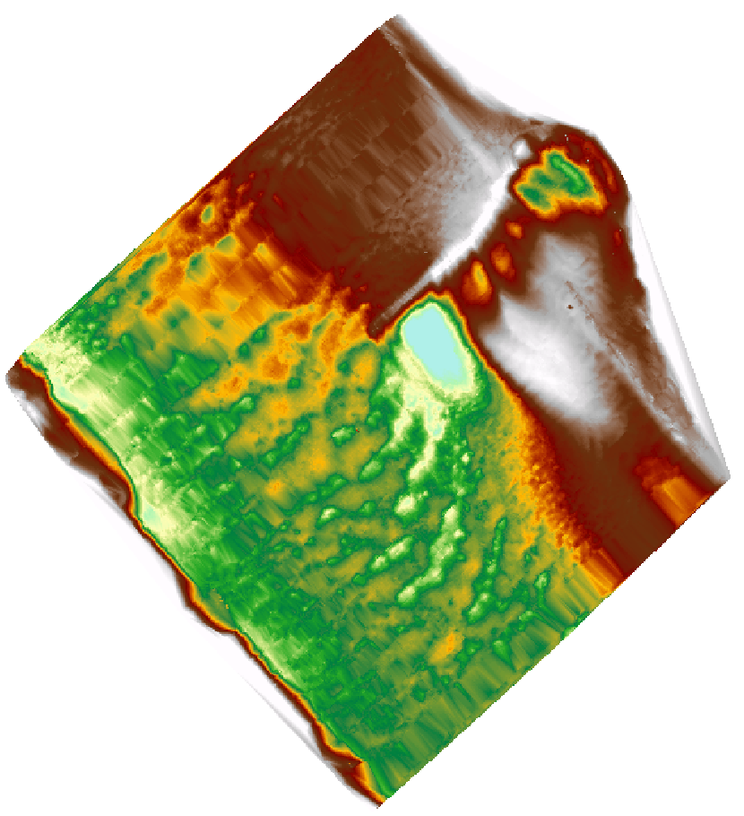
Flow and Bathymetry near Structures
Mississippi River near St. Louis, MO
Missouri River near Columbia, MO
Single beam echo sounder
bathymetry
ADCP bathymetry
Data courtesy of E.C Jamieson, C.D Rennie, and R.B. Jacobson
From Jackson (FS 2013-3028)

Slide 25
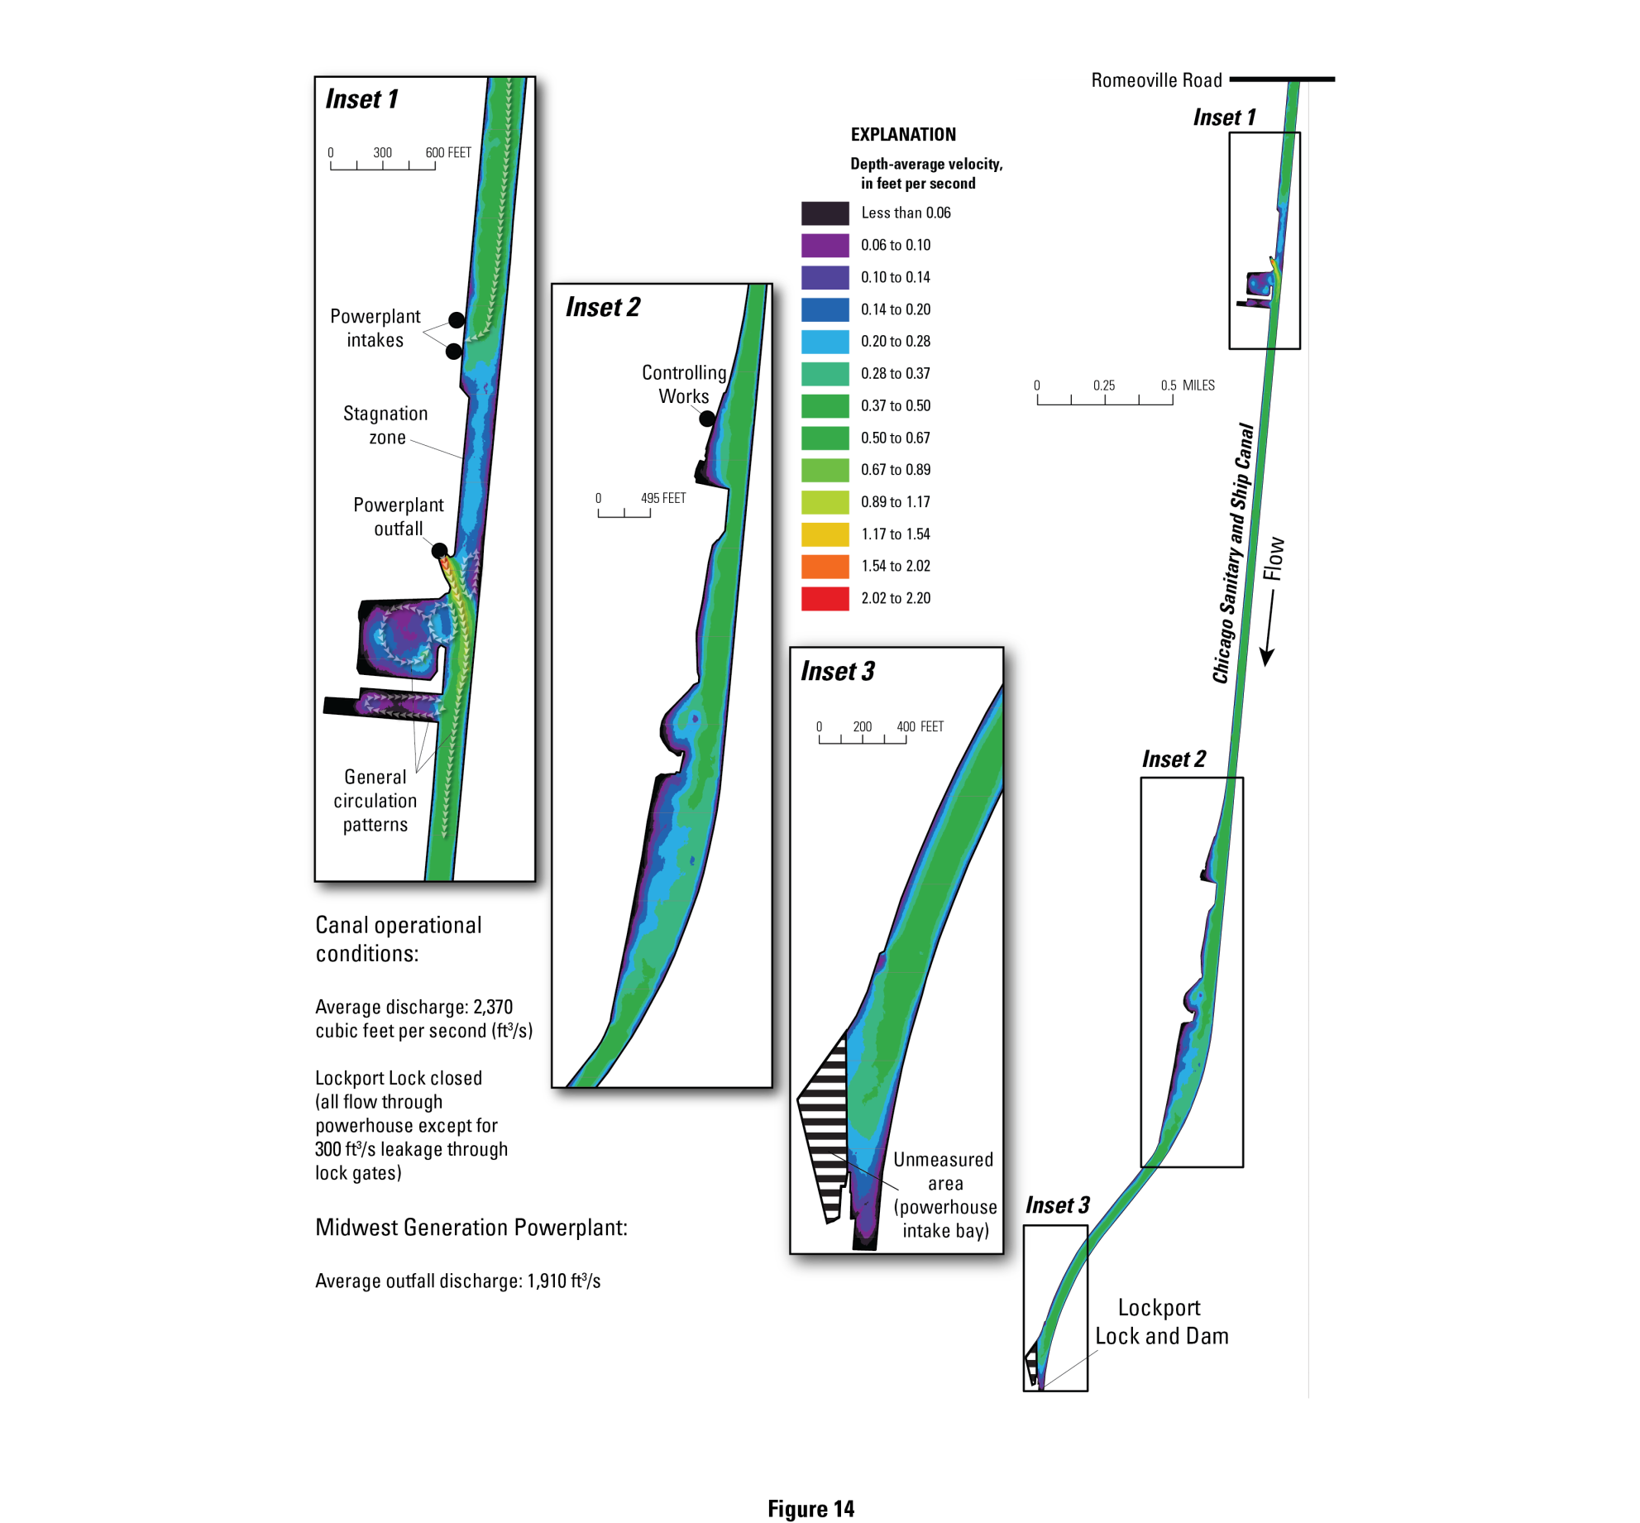
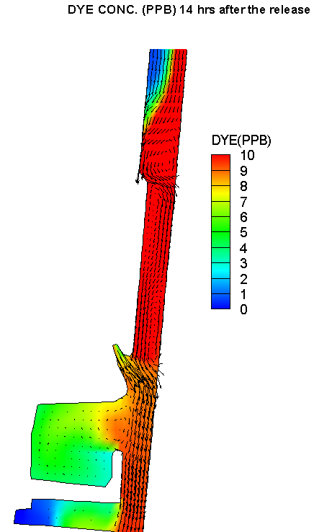
Contaminant Transport
ADCP Data
Chicago Sanitary and Ship Canal
Plant Intake
Power Plant
Plant Outfall
Model results from the Univ. of Illinois
(M.H. Garcia)
Jackson, P.R., Lageman, J.D., 2014, Real-time piscicide tracking using Rhodamine WT dye for support of application, transport, and deactivation strategies in riverine environments: U.S. Geological Survey Scientific Investigations Report 2013–5211, 43 p., http://dx.doi.org/10.3133/sir20135211.

Slide 26
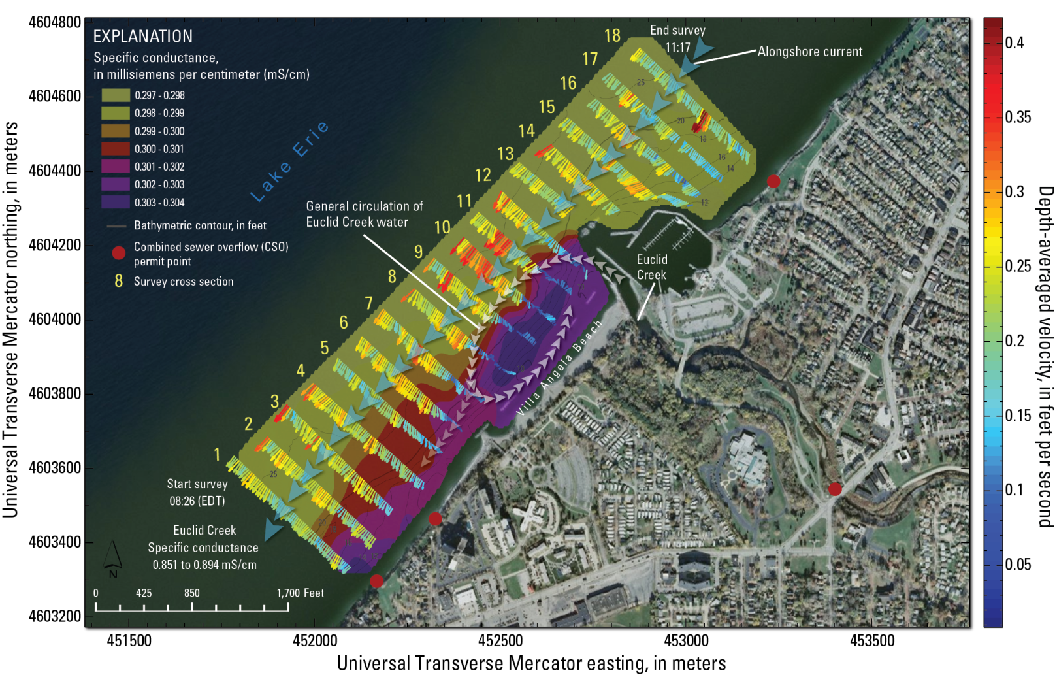
Limnology and Nearshore Circulation
Jackson, P.R., 2013, Circulation, mixing, and transport in nearshore Lake Erie in the vicinity of Villa Angela Beach and Euclid Creek, Cleveland, Ohio, September 11–12, 2012: U.S. Geological Survey Scientific Investigations Report 2013–5198, 34 p., http://dx.doi.org/10.3133/sir20135198.

Slide 27
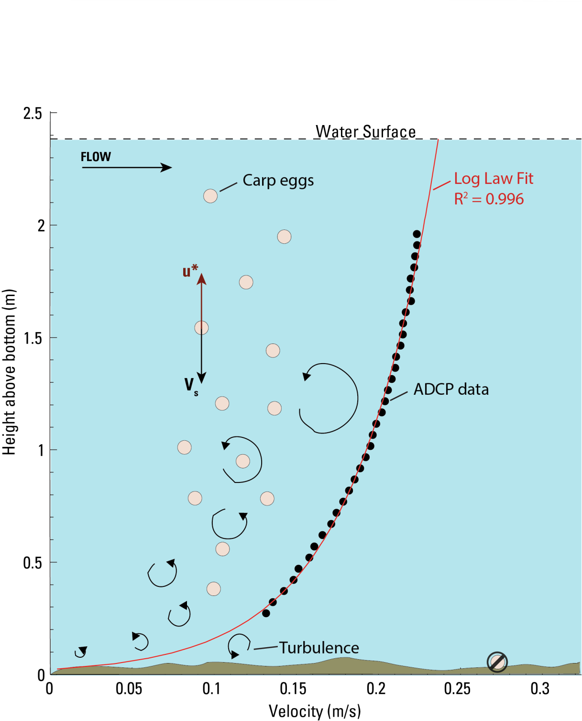
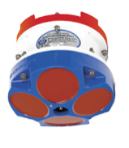
Biological Studies
V_{s} = settling velocity
u* = shear velocity
If u* > V_{s}, eggs should remain in suspension
Eggs that settle on the bottom are thought to perish
u* ≈ 2.1 cm/s

Slide 28
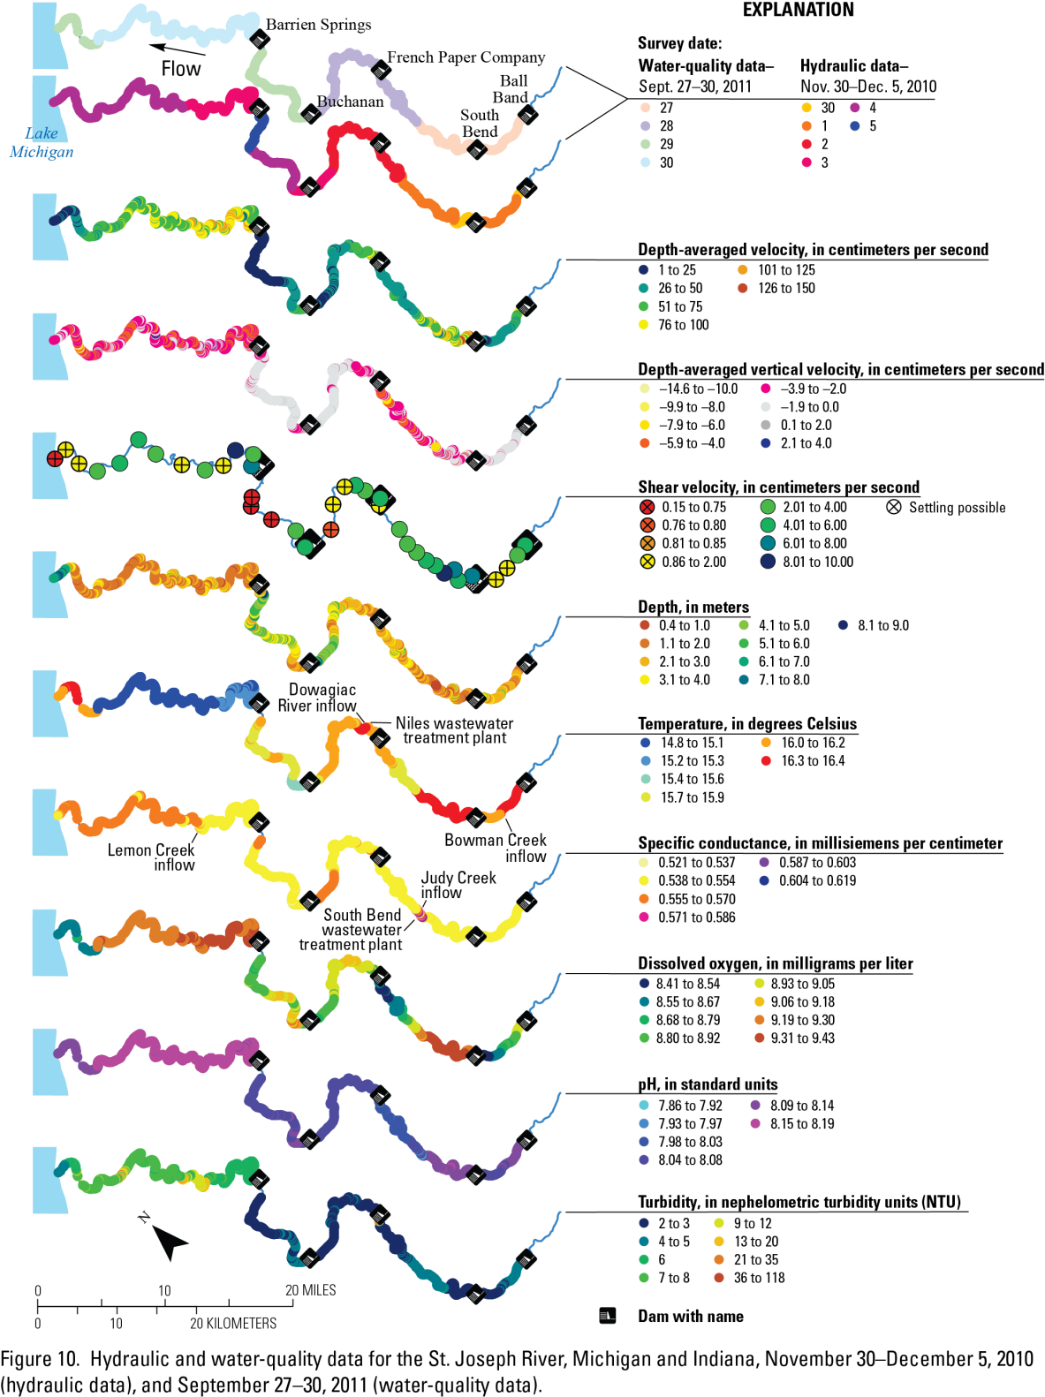
Biological Studies
Velocity magnitude
Vertical velocity
Shear velocity
Depth
Temperature
Specific conductance
Dissolved oxygen
Murphy, E.A., and Jackson, P.R., 2013, Hydraulic and water-quality data collection for the investigation of Great Lakes tributaries for Asian carp spawning and egg-transport suitability: U.S. Geological Survey Scientific Investigations Report 2013–5106, 30 p., http://pubs.usgs.gov/sir/2013/5106/.
pH
Turbidity
From Murphy and Jackson (SIR 2013-5106)

Slide 29
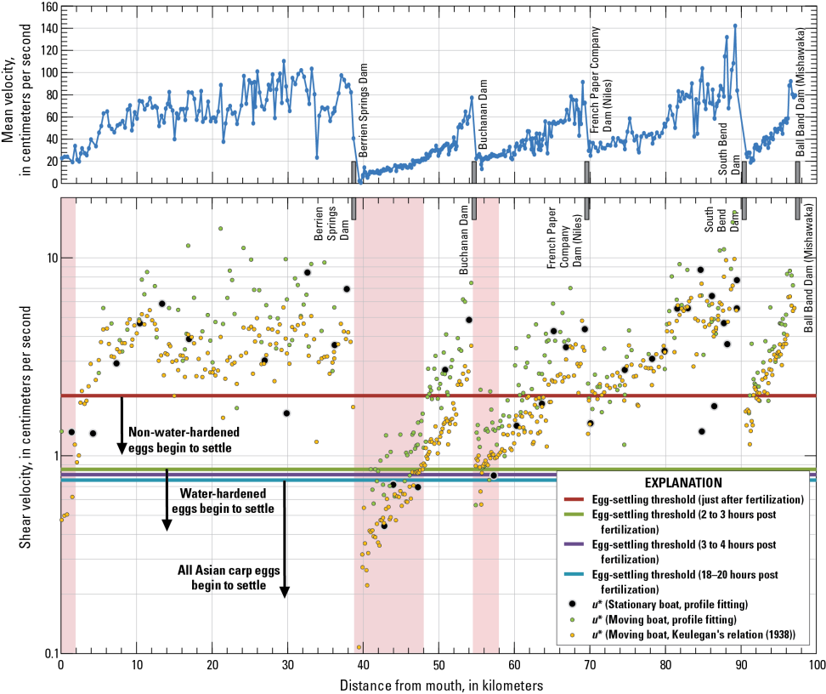

Biological Studies
From Murphy and Jackson (SIR 2013-5106)

Slide 30
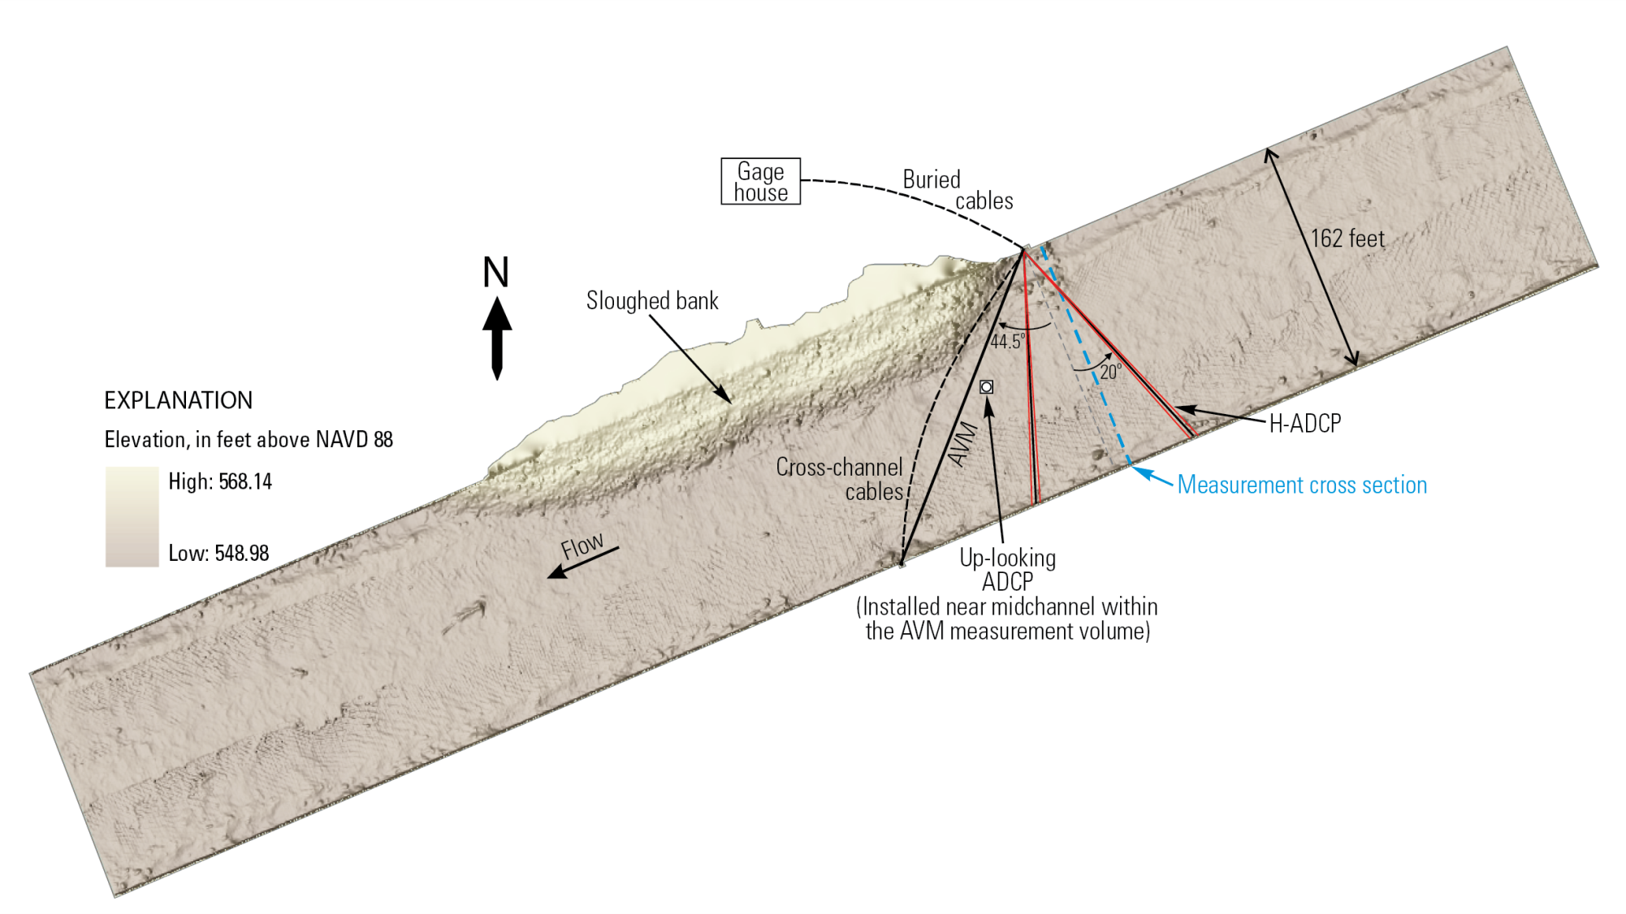
Streamgaging
Jackson, P.R., Johnson, K.K., and Duncker, J.J., 2012, Comparison of index velocity measurements made with a horizontal acoustic Doppler current profiler and a three-path acoustic velocity meter for computation of discharge in the Chicago Sanitary and Ship Canal near Lemont, Illinois: U.S. Geological Survey Scientific Investigations Report 2011–5205, 42 p.

Slide 31
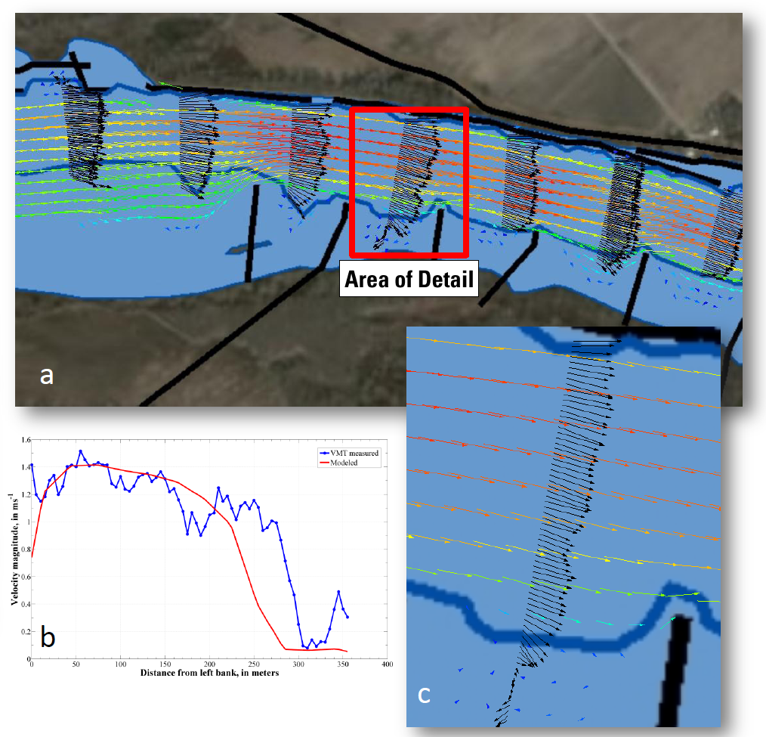
Model Calibration/Validation
Missouri River near St. Charles, MO
Data collected as part of SW2782 Velocity Mapping and Bathymetry with ADCPs
(modeled in iRIC with FaSTMECH)

Slide 32
VMT Classes
2009—3 day course (Santa Fe Argentina)
2011—1/2 day short course (Tampa)
2012—1 day short course (HMEM, Utah)
2013, 2014—1 week USGS training course SW2782 Velocity Mapping and Bathymetry with ADCPs (St. Louis)
98 trained
4 agencies (USGS, USACE, USDA, Environment Canada)
25+ academics
7 industry reps
6 countries (US, Canada, Brazil, Belgium, Argentina, Italy)
http://hydroacoustics.usgs.gov/training/register.shtml

Slide 33

Questions?
VMT Webpage:
http://hydroacoustics.usgs.gov/movingboat/VMT/VMT.shtml
Contact Info:
Frank Engel (fengel@usgs.gov); (217) 328-9774
Ryan Jackson (pjackson@usgs.gov); (217) 328-9719

Slide 34
Additional Information

Slide 35
An Incomplete List of Application Sites
1 Congo River (DRC, Africa)
2 Mississippi River (IL, MO, LA, MS)
3 Missouri River (MO)
4 Ohio River (IL, KY)
5 Chicago Sanitary and Ship Canal (IL)
6 Chicago Lakefront (Lake Michigan) (IL)
7 Lake Erie at Villa Angela Beach (OH)
8 Milwaukee River (WI)
9 Menomonee River (WI)
10 Kinnickinnic River (WI)
11 Green Bay (WI)
12 Manitowoc River (WI)
13 Sandusky River (OH)
14 Maumee River (OH)
15 Clinton Lake (IL)
16 Wonder Lake (IL)
17 Wabash River (IL, IN)
18 Embarras River (IL)
19 Hurunui River (New Zealand)
20 Clutha River (New Zealand)
21 Vermillion River (IL)
22 Boise River (ID)
23 Kootenai River (ID)
24 White River (IN)
25 Cal-Sag Channel (IL)
26 Lake Calumet (IL)
27 Yellow Sea (China)
28 Yellow River (China)
29 Parana River (Argentina)
30 Rio Coronda (Argentina)
31 Madeira River (Brazil)
32 Fox River (IL)
33 Arkansas River (AR)
34 Cowlitz River (WA)
35 Umqua River (OR)
36 St. Lawrence River (Canada)
37 Des Plaines River (IL)
38 Illinois River (IL)
39 Little Calumet River (IL)
40 Fraser River (BC, Canada)
41 St. Clair River (MI, Canada)
42 Big Muddy Creek (IL)
43 Little Wabash River (IL)
44 Yuma Canal (AZ)
45 Sacramento River (CA)
46 New Castle Reservoir (UT)
47 St. Marys River (MI, Canada)
48 Jordan River (UT)
49 All American Canal (AZ)
50 Coachella Canal (AZ)
51 Sangamon River (IL)
52 Columbia River (WA, OR)
53 Snake River (WA)
54 Shepaug River (CT)
55 Susquehanna River (CT)
56 Lake Lillinonah (CT)
57 Patoka Lake (KY)
58 Rasmussen Lake (IL)
59 Colastine River (Argentina)
60 Fire Island Breach (NY)
61 Sugar Creek (IL)

Slide 36
Known Projects Using/Citing VMT

Slide 37
Projects Citing VMT Continued

