Slide 1
Get Acquainted with the Latest Versions of LC & SMBA
USGS, TRDI, and SonTek Versions
David S. Mueller, OSW
April, 2013

Slide 2
Outline
Collecting Data in Moving-Bed Conditions
Versions available for LC and SMBA
Brief review of LC basics
New LC quality assurance checks
Brief review of SMBA basics
Using TRDI versions of LC and SMBA
Using SonTek version of LC and SMBA
Summary

Slide 3
Collecting Data in Moving-Bed Conditions
Use DGPS if possible
LC & SMBA are NOT substitutes for using GPS
Webinar recorded last month on use of GPS
When to use LC Correction
GPS use is not valid or possible
BT and accurate compass heading can be maintained
When to use SMBA Correction
GPS use is not valid or possible
Accurate compass headings cannot be maintained through cross section
BT is invalid intermittently
When to use Mid-Section technique
Criteria for GPS, Loop Correction, or Stationary Correction not met

Slide 4
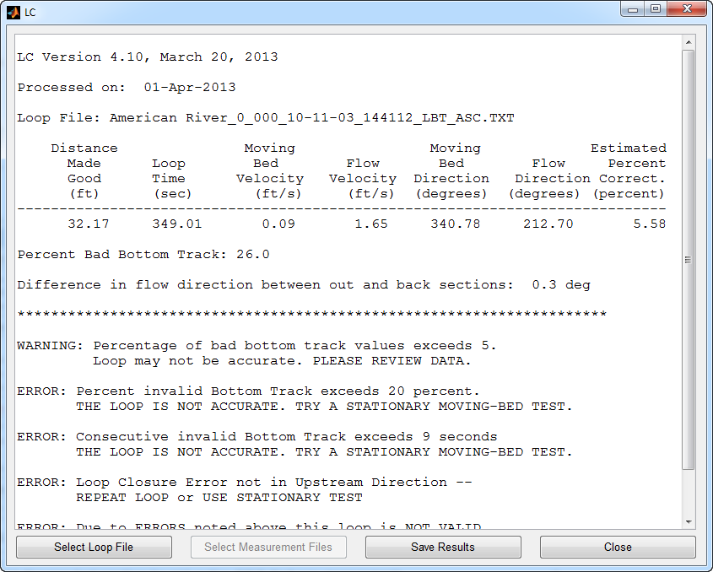
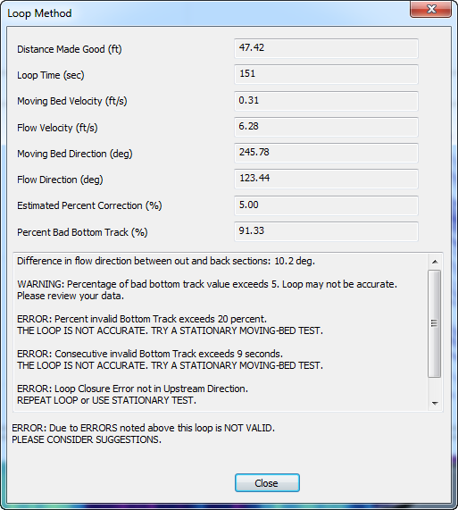
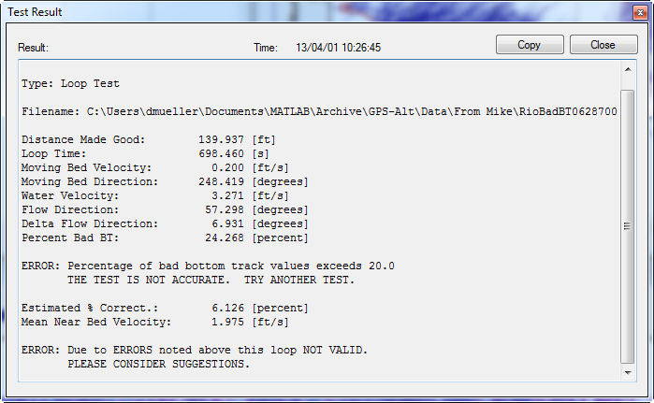
Available Versions of LC & SMBA
SonTek RiverSurveyor Live
USGS
TRDI WinRiver 2

Slide 5
Review of Loop Basics
Flow
Distance moved upstream
D_{UP}
Compass calibration and accuracy throughout the cross section is critical
Bottom track must be maintained
Uniform boat speed
Don’t loiter at edges
Return to the exact starting position
Loop duration should be 3 minutes or greater (longer=better)
May not be accurate for water velocities less than 0.8 ft/s

Slide 6
Previous Criteria in LC
Moving-bed velocity > 0.04 ft/s
Closure error must be in upstream direction
Water direction +/- 135 degrees
Moving-bed velocity / Mean water velocity > 0.01
Warnings provided for:
Percent bad bottom track
Potential compass error
Determination of loop validity left to the user

Slide 7
New LC Quality Assurance Checks
Navigation must be set to Bottom Track
Message: “DATA FILE NOT REFERENCED TO BOTTOM TRACK. Reprocess file with reference set to bottom track.”
RSL: Composite tracks must be turned off
Message: “Composite tracks are on. The composite tracks feature in RiverSurveyor should be disabled and the Matlab file recreated in RiverSurveyor and then reloaded in LC.”
Slow water velocity warning
Message: “WARNING: The water velocity is less than 0.8 ft/s and could cause the loop method to be inaccurate. CONSIDER USING A STATIONARY TEST TO CHECK MOVING-BED CONDITIONS.”

Slide 8
Invalid Bottom Track
Invalid bottom track > 5%
Message: “WARNING: Percentage of bad bottom track values exceeds 5. Loop may not be accurate. PLEASE REVIEW DATA.”
Invalid bottom track > 20%
Message: “ERROR: Percent invalid Bottom Track exceeds 20 percent. THE LOOP IS NOT ACCURATE. TRY A STATIONARY MOVING-BED TEST.”
Consecutive invalid bottom track > 9 seconds
Message: “ERROR: Consecutive invalid Bottom Track exceeds 9 seconds. THE LOOP IS NOT ACCURATE. TRY A STATIONARY MOVING-BED TEST.”

Slide 9
Compass Evaluation
Find apex of loop
Compute mean and standard deviation of flow direction for each leg
Difference reported to user
Compute uncertainty associated with difference in flow direction
95% uncertainty ~ stdDev1 * 2 + stdDev2 * 2
Compute potential error caused by compass error
Compass ERROR reported
Difference flow directions > 3 degrees
Difference in flow directions > 95% uncertainty
Potential error > 5%
Difference in flow direction
Width
Closure error
due to compass
Vmb due to compass

Slide 10
Compass Error Message
ERROR: Difference in flow direction between out and back sections of
loop could result in a 5 percent or greater error in final discharge.
REPEAT LOOP AFTER COMPASS CAL. OR USE A STATIONARY MOVING-BED TEST.

Slide 11
Closure & General Errors
Downstream closure & moving-bed velocity > 0.04 ft/s
Message: “ERROR: Loop Closure Error not in Upstream Direction -- REPEAT LOOP or USE STATIONARY TEST.”
No error message if moving-bed velocity <= 0.04 ft/s
Errors have been identified
Message: “ERROR: Due to ERRORS noted above this loop is NOT VALID. PLEASE CONSIDER SUGGESTIONS.”

Slide 12
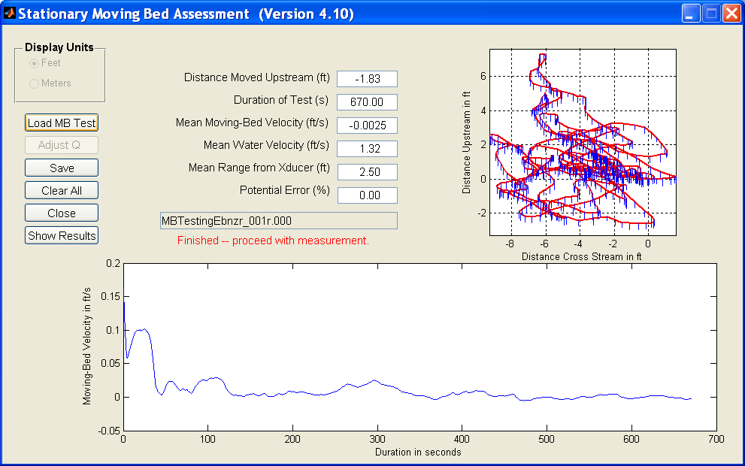
Review of SMBA
Initially developed for StreamPro
False moving-bed when swimming
Applicable to all ADCPs
Uses mean velocity direction to determine upstream movement on an ensemble by ensemble basis

Slide 13
Correction Methods
LC: The moving-bed velocity from the loop moving-bed test is distributed to each ensemble based on the ratio of the near-bed water speed in each ensemble to the mean of near-bed water speeds for the whole transect.
WinRiver II calls this the distributed method
SMBA: Computes a linear coefficient (C) relating the near-bed water speed to moving-bed speed from the stationary tests (Vmb=C*Vnb). This equation is then used to distribute the moving-bed correction to each ensemble in the transect.
WinRiver II calls this the proportional method

Slide 14
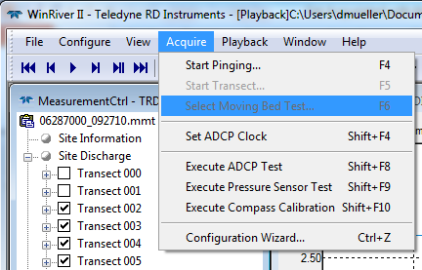
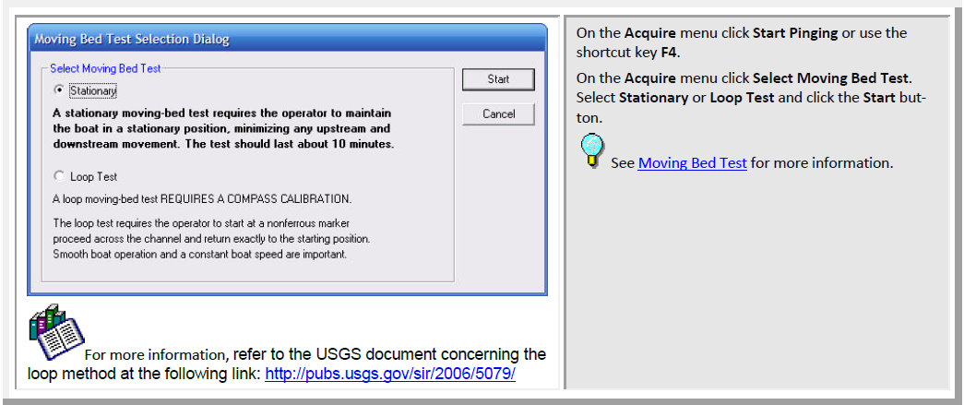
Collecting MBT in WinRiver II

Slide 15
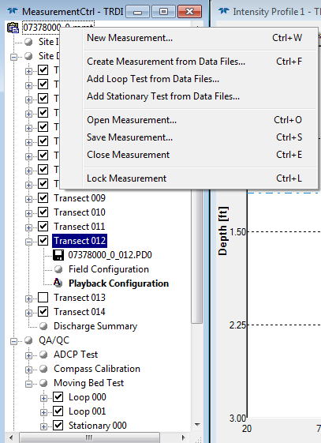
Add a File as Moving-Bed Test
Right Click on the mmt filename
Select desired type of test
From file dialog select file to add
This must be done for MBTs collected using the StreamPro with a PDA

Slide 16
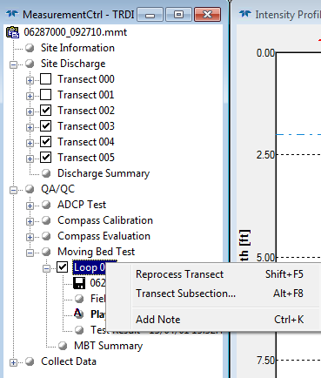
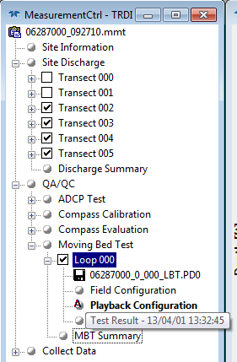
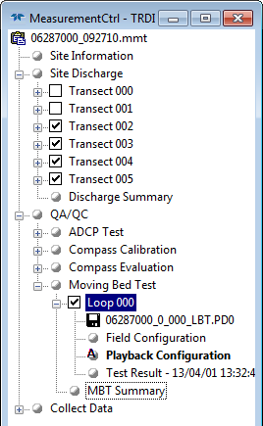
Processing MBT
MBTs are located under the QA/QC – Moving Bed Test node
Reprocess / Evaluate
View Results
View Summary

Slide 17
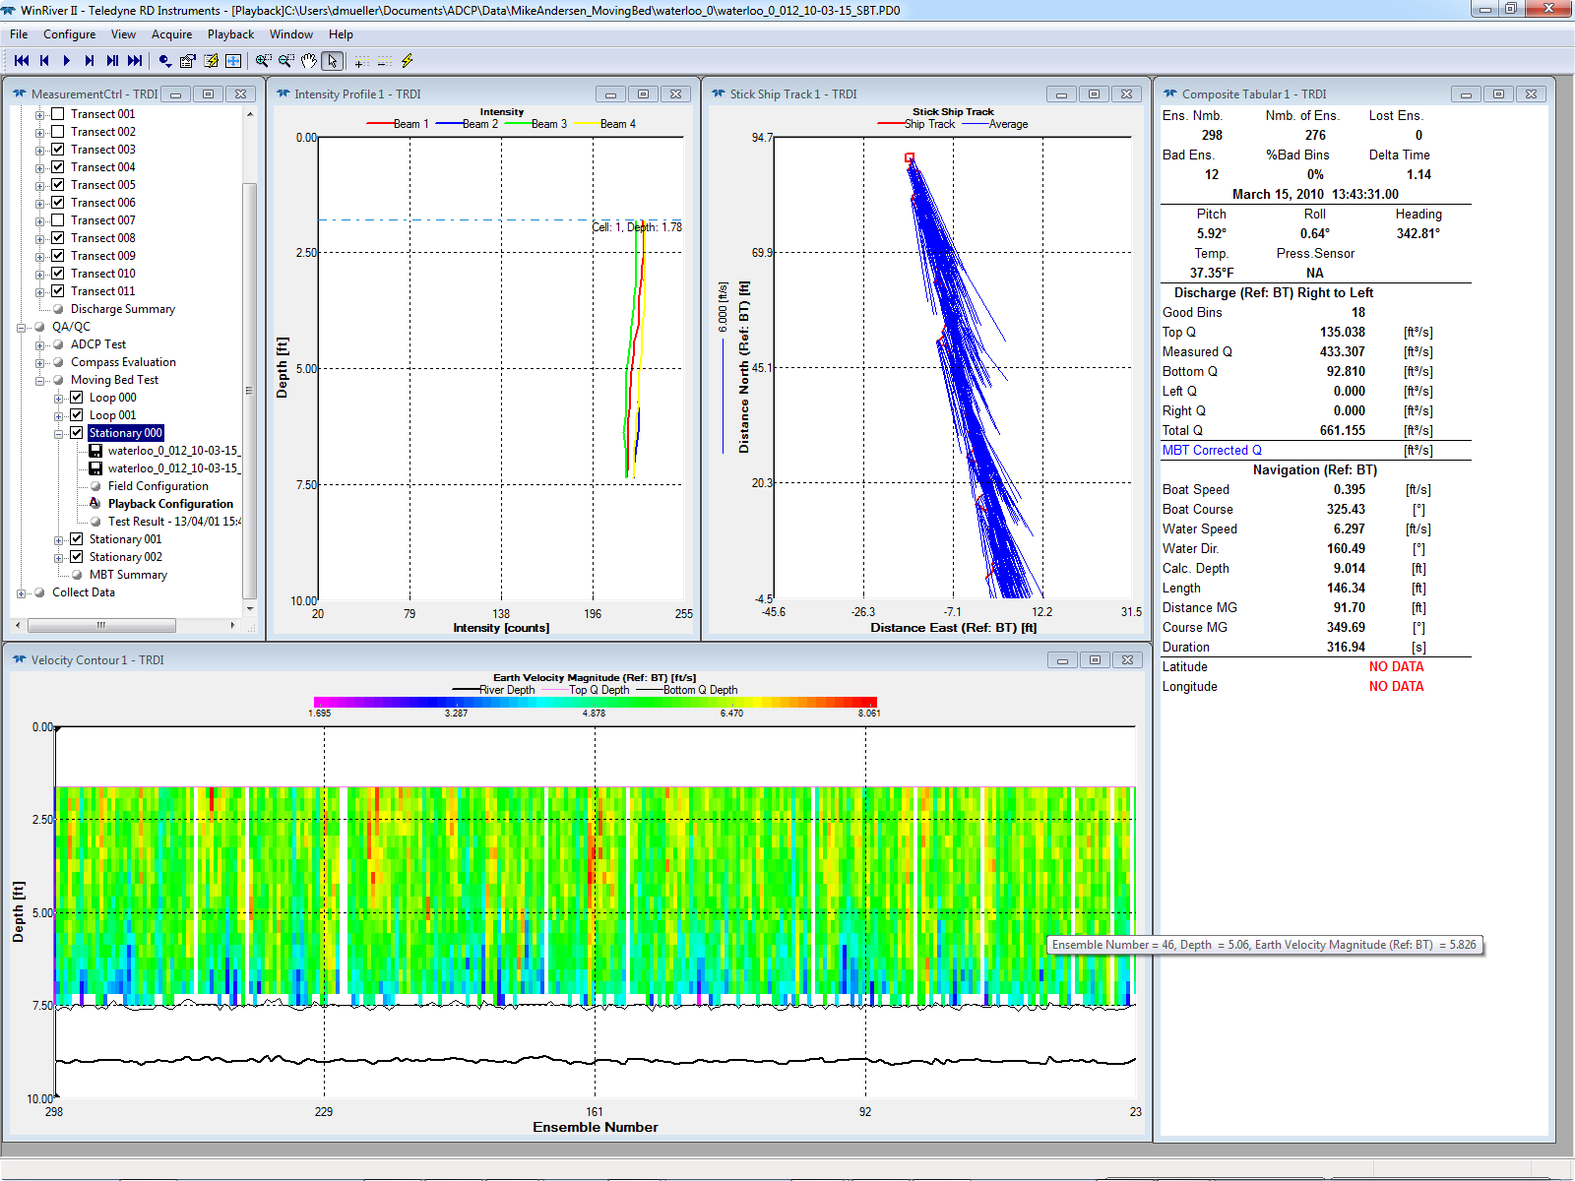
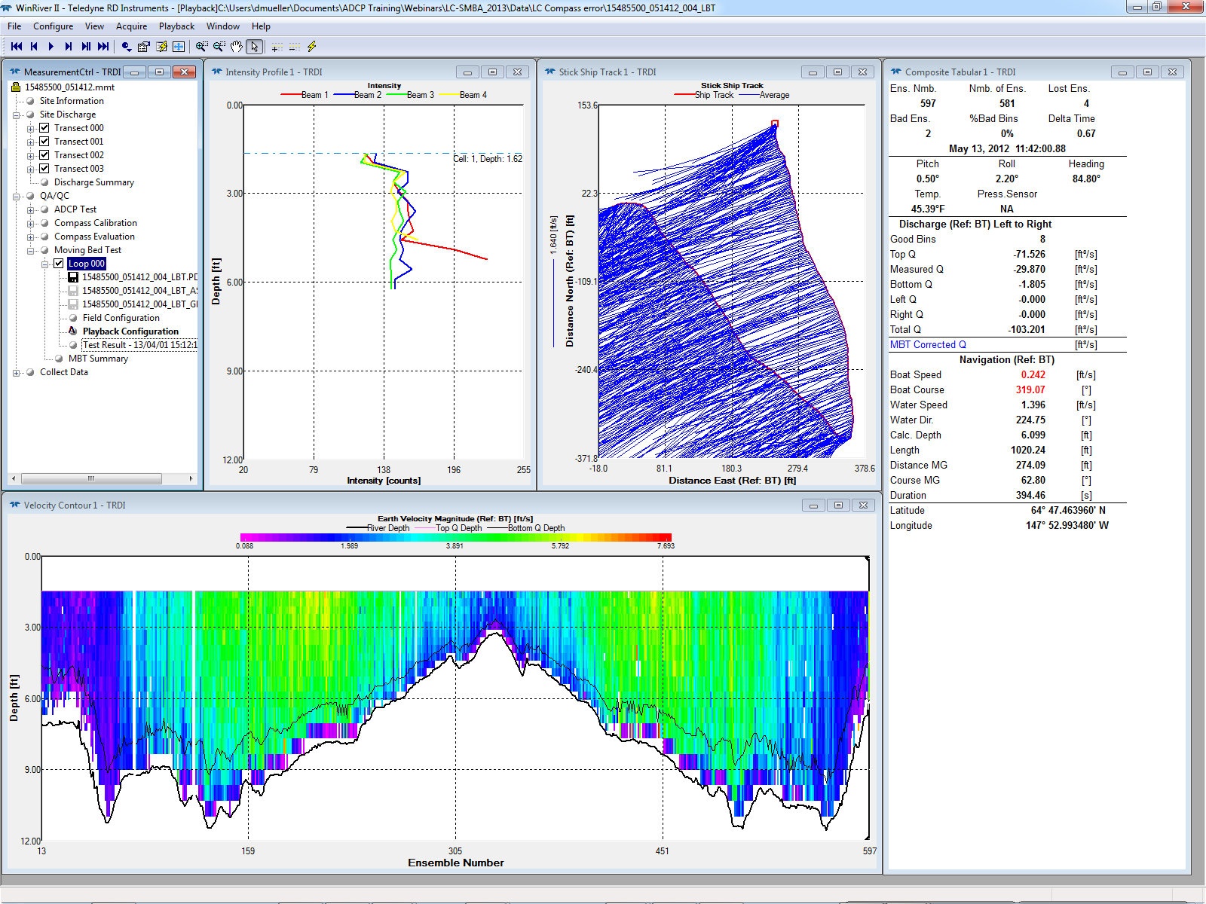
Reprocess to Manually Evaluate Data
Loop
Stationary

Slide 18
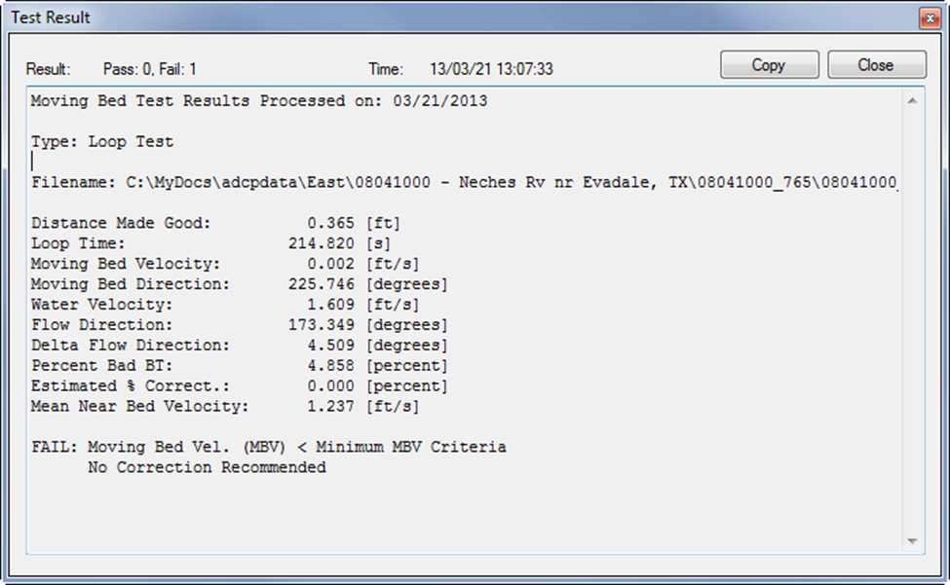
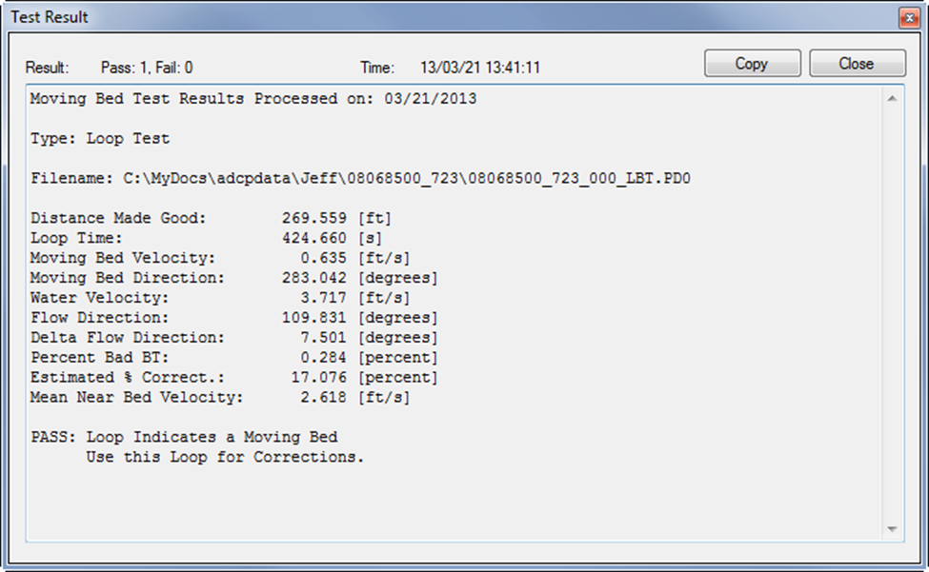
FAIL / PASS – Still valid Loop MBT

Slide 19
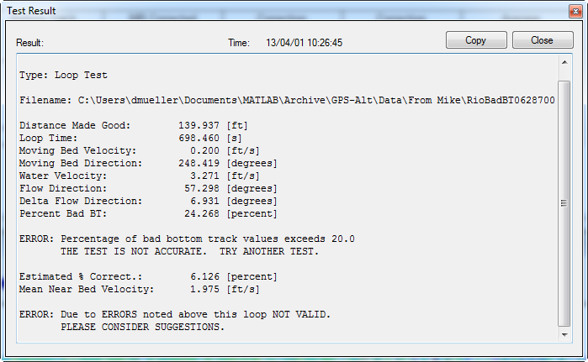
Test Result with Error

Slide 20
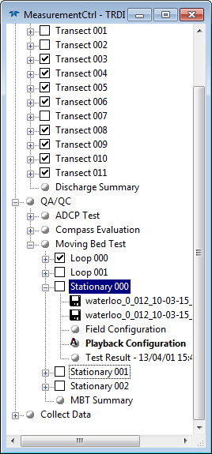
Select Tests
Check to use
Uncheck to not use
If test is invalid (ERROR), WR2 will not use the results even if checked
Only loops that meet the criteria for a moving-bed condition will be applied.
All positive stationary test will be applied even is less than 1% of mean velocity.

Slide 21
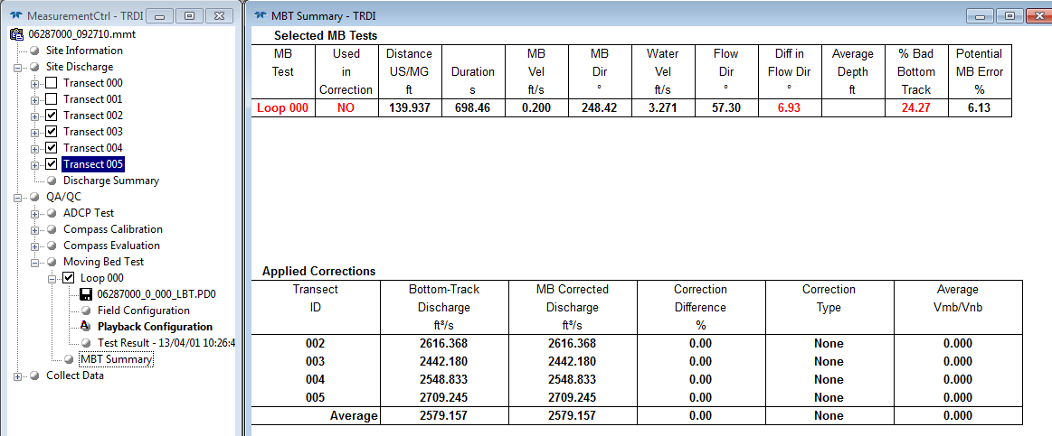
MBT Summary with Error

Slide 22
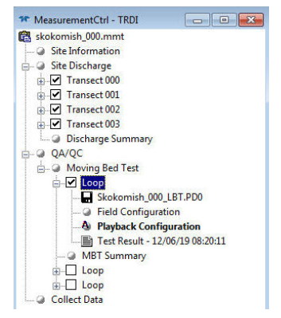
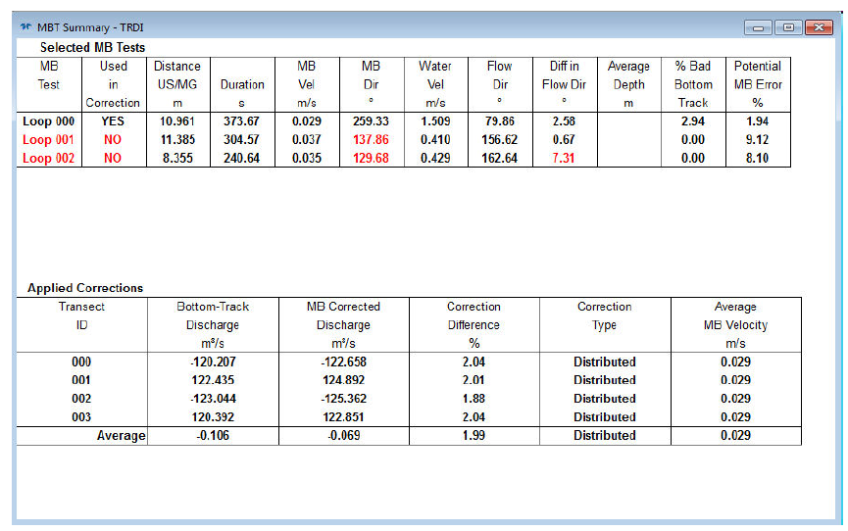
MBT Summary with valid MBT
Multiple loops can be used.

Slide 23
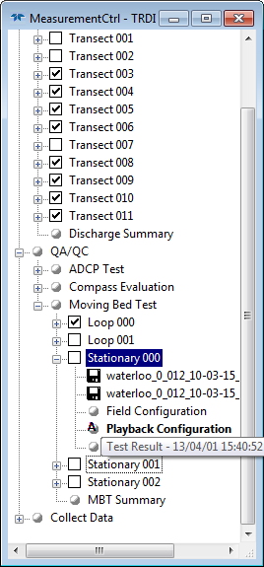
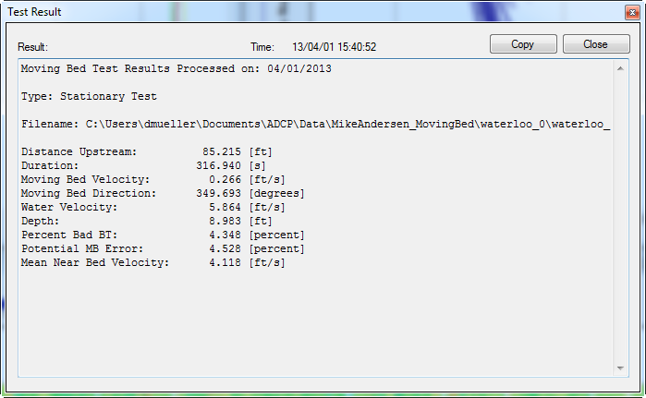
Stationary MBT Result
If Stationary is checked it is applied even if less than 1% error.

Slide 24
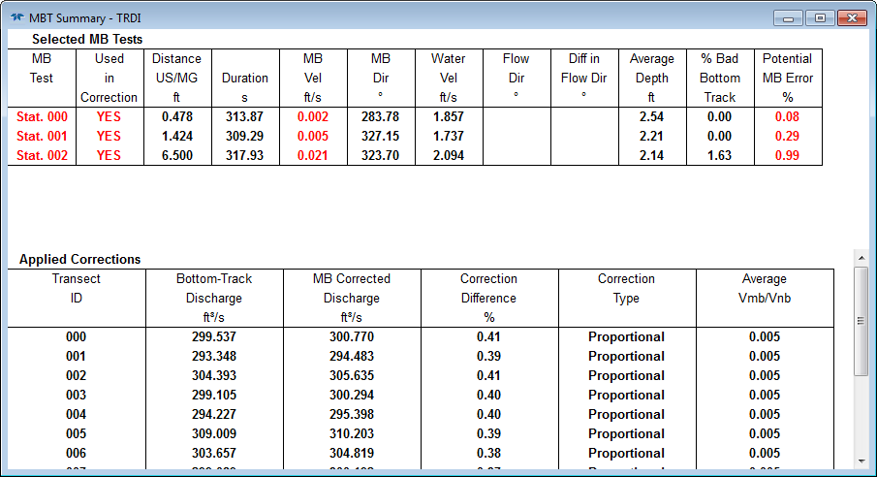
Example of Stationary MBT < 1%

Slide 25
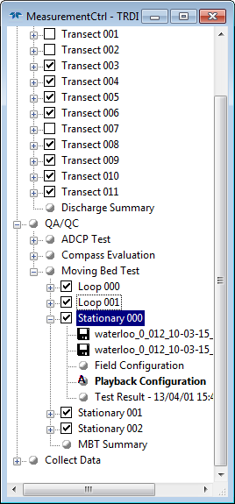
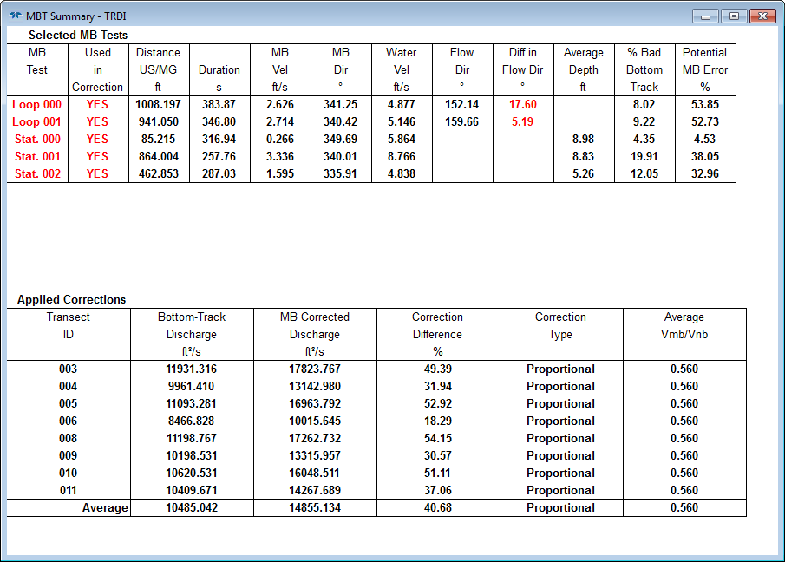
Multiple Tests

Slide 26
Correction Type
Distributed
Same as USGS LC
With multiple Loop MBTs average of results is used
Proportional
Similar to USGS SMBA
No negative corrections are applied
Correction is always applied even if less than 1%
Used with Stationary or mix of Stationary and Loop

Slide 27
Where are Corrections Applied
Discharge corrections based on the results of moving bed tests are only applicable when Bottom Track is the selected navigation reference.
The corrected discharge is displayed in the MBT Summary and in the Composite Tabular display, the Discharge Summary, the Total Discharge Time Series, Q Measurement Summary, and in HydroML output.
Moving bed corrections are NOT applied to any other parameters or outputs such as velocity and discharge contour, profile, and time series plots, or the Classic or Generic ASCII outputs.

Slide 28
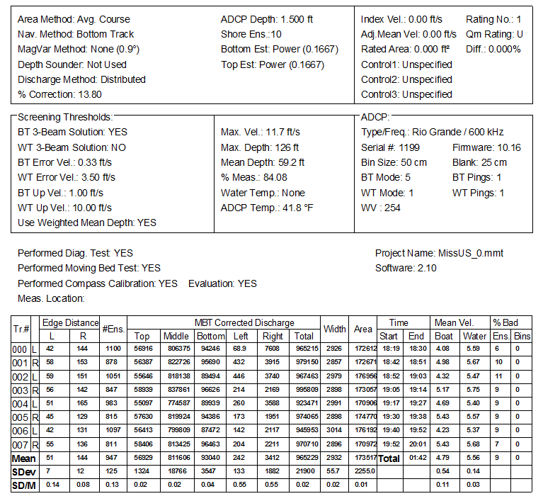
BT with Loop Checked

Slide 29
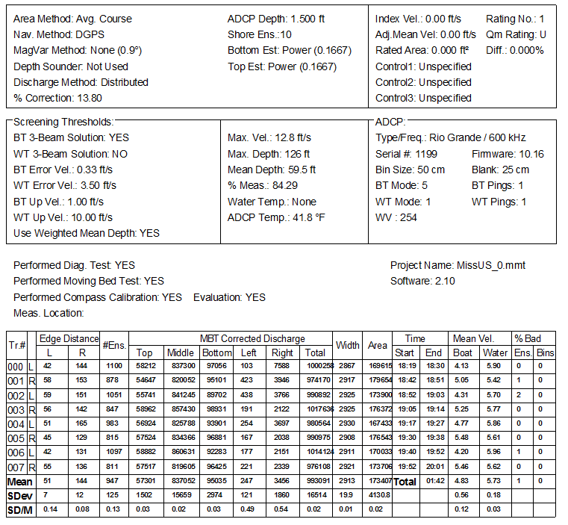
GPS with Loop Checked (Bug?)
Discharge is referenced to GPS correctly!!

Slide 30
Differences with USGS LC & SMBA
Rounding in ASCII output file may result in small differences in resulting computed discharge (< 1%)
WinRiver II behavior not in USGS codes:
Multiple loops can be averaged
Loops and stationary tests can be applied together
Stationary test is always applied even if correction is < 1%
Negative stationary tests are ignored in WR2

Slide 31
Loop MBT with RiverSurveyors
Due to potential compass calibration and accuracy issues associated with the RiverSurveyor M9/S5 ADCPs, use of the stationary moving-bed test will be consistently more accurate than the loop test and is recommended as the preferred moving-bed test for RiverSurveyors until the compass calibration issues can be completely resolved (http://hydroacoustics.usgs.gov/movingboat/pdfs/Best_Practice_for_Calibrating_SonTek_RiverSurveyor.pdf)
The OSW is working with SonTek to try and resolve the compass accuracy issue.
This webinar will show how to use RiverSurveyor Live with the loop MBT so that it can be properly applied when the compass issue is resolve.

Slide 32
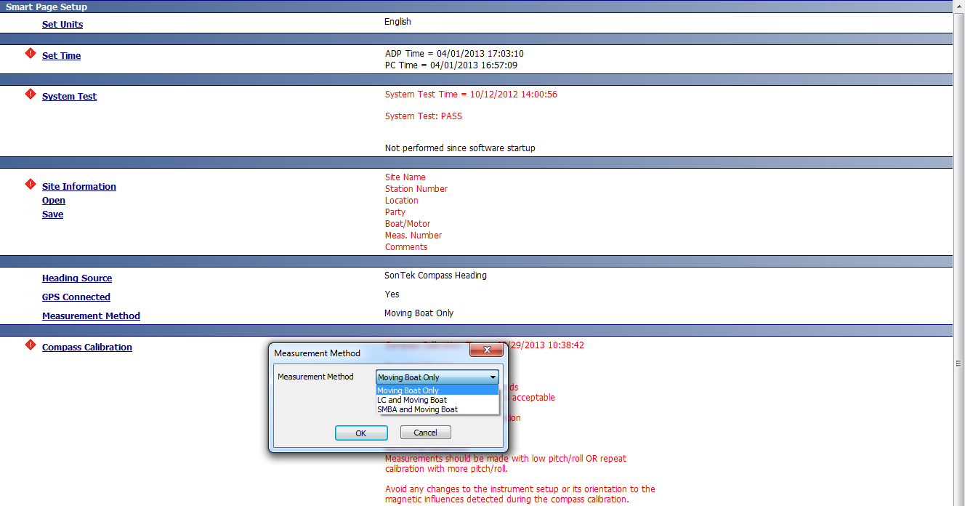
Collecting MBT in RiverSurveyor Live

Slide 33
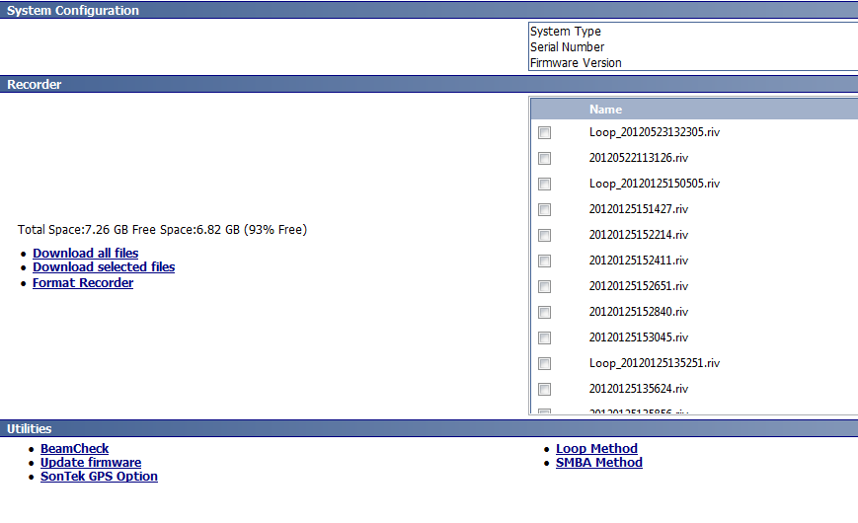
System Tab

Slide 34
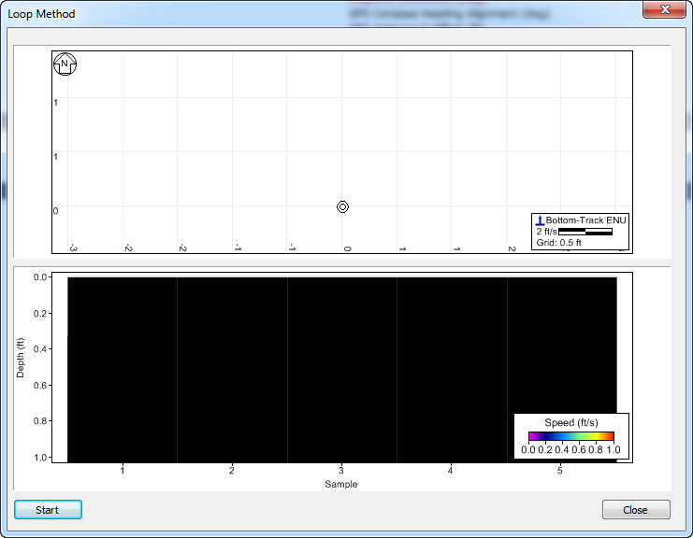
Loop MBT Collection Dialog

Slide 35
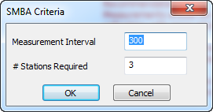
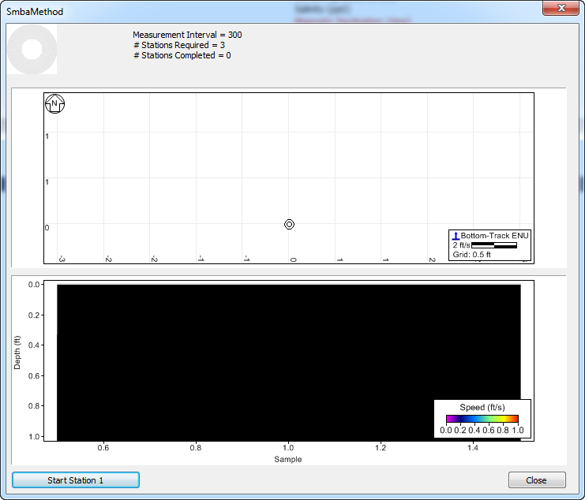
Stationary MBT Collection Dialog

Slide 36
Loading MBT
First open your transect files
Then open your MBT
Only 1 loop can be open at a time
Multiple stationary tests can be opened

Slide 37
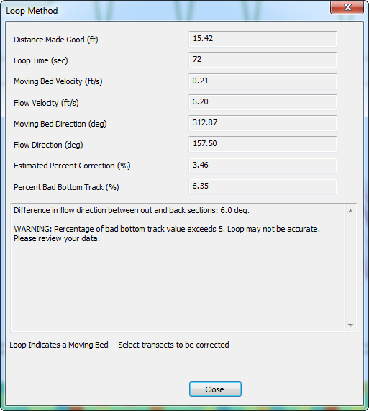
Dialog for Loop MBT

Slide 38
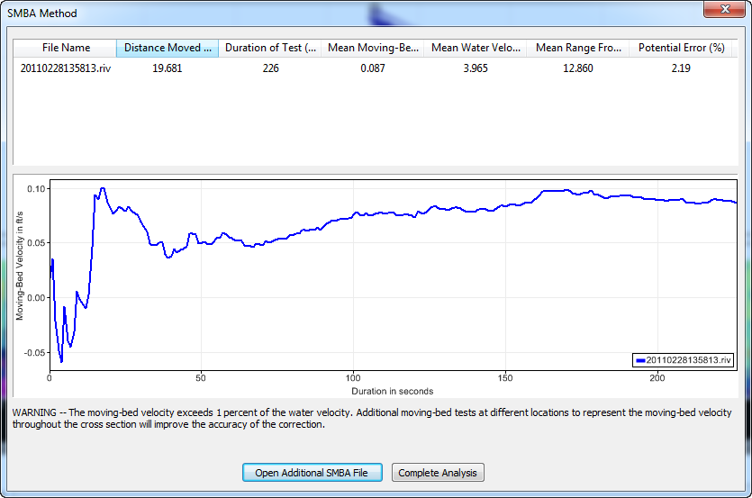
Dialog for Stationary MBT

Slide 39
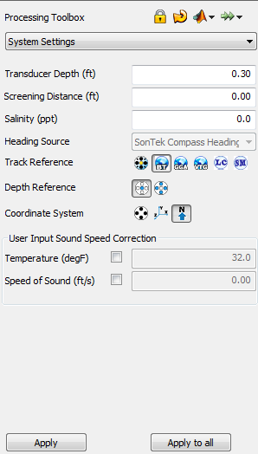
Applying MBT for Q Correction
Stationary MBT Correction
Loop MBT Correction

Slide 40
Results of Apply MBT Correction
If these columns are not present right click on heading and select them from the list

Slide 41
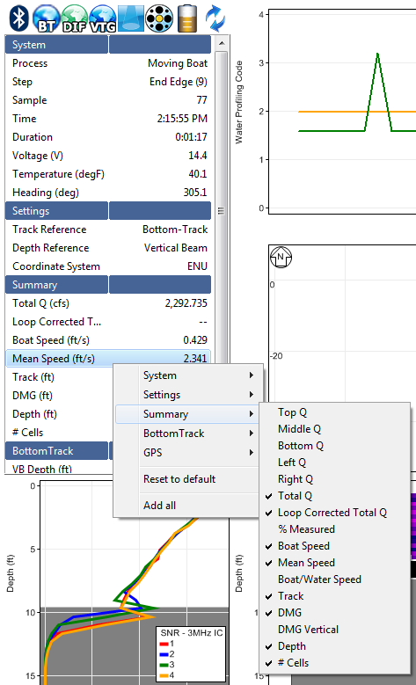
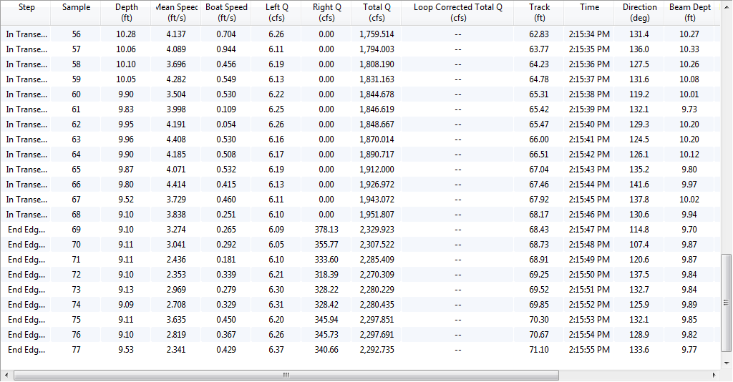
SMBA Correction not Displayed (bug?)
Samples Tab

Slide 42
Composite Tracks
Composite Tracks should be turned off when using LC or SMBA
Bug in RSL
Uncheck composite tracks in Processing Toolbox – Thresholds and click Apply All
Return to Processing Toolbox – System Settings and with LC or SM selected click Apply All

Slide 43
RSL’s LC & SMBA
Follows USGS code very closely
Corrections computed using USGS LC & SMBA formulas
May be some differences in final Q due to rounding differences
Potential issue:
Invalid BT is identified by repeated identical BT East Velocity
Recent data showed valid BT with identical BT East Velocity
USGS LC 4.10 (Beta) has fixed this problem
Issue will be reported to SonTek
Only causes error in reported % bad BT, actual results of loop are unaffected

Slide 44
Latest Versions
USGS
LC 4.04 available to public
LC 4.10 being test by HaWG
Speed improvements
Fixed invalid BT identification for RSL data
SMBA 6.13
Speed improvements
TRDI
WinRiver II 2.10
SonTek
RiverSurveyor Live 3.60

Slide 45
REMEMBER: LC & SMBA are not substitutes for using GPS

Slide 46
Summary
Use GPS, if possible, for moving-bed conditions
Use Stationary MBT when compass is not accurate throughout the cross section
Evaluate and set extrapolation prior to creating files for use by USGS LC or SMBA
Use any of the implementations of LC & SMBA (WinRiver II, RiverSurveyor Live, or USGS)

Slide 47
COMMENTS & QUESTIONS

