Slide 1
Effective Review of FlowTracker Measurements
OSW Webinar Mike Rehmel
August 27, 2013
(Please Mute your phones!)

Slide 2
Overview
FlowTracker Basics
The Midsection Discharge Measurement
The FlowTracker Discharge Measurement Summary Output
DatView
Documenting Potential Quality Issues
Rating Measurements

Slide 3
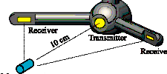
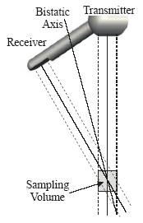
Basics of How it Works
Transmitter generates a narrow beam of sound
Pulse travels through the sampling volume and is reflected in all directions by particles in the water
Receivers sample the reflected sound at the time corresponding to the return from the sample volume
Measures the change in frequency (Doppler shift) between the transmitted and received signals
Doppler shift is proportional to the velocity of the particles
2D or 3D water velocities are calculated
Notes:
Let’s now review the basics of an individual velocity measurement… <CLICK>
The transmitter generates a short pulse of sound which begins traveling through the water. <CLICK> When this sound pulse reaches the sampling volume, <CLICK> a portion of the reflected energy travels back along the receiver transducer axes. The reflected signal is sampled by the acoustic receiver transducers <CLICK> and the FlowTracker measures the change in frequency (Doppler shift) for each receiver. <CLICK> This Doppler shift is proportional to the velocity of the particles moving towards are away for each receiver. Knowing the relative orientation of the transducers allows the calculation of 2D or 3D water velocity. <END OF SLIDE>

Slide 4
Signal-To-Noise Ratio (SNR)
Measure of the strength of the acoustic reflection from the particles in the water
If water is “too clear”, the return to the receiving transducers will be low
Low SNR can reduce the quality of your data
Ideally, SNRs > 10 dB
The FlowTracker should not be used when SNR drops below 4 dB
If you are unsure whether a stream will be “too clear” for a FlowTracker, place it in the water to check SNR values.
Notes:
SonTek, the FlowTracker manufacturer, states that SNR’s greater than 10 dB are recommended. It is USGS policy that the FlowTracker NOT be used when SNR’s drop below 4 db. If you are unsure whether a stream will be “too clear” for a FlowTracker measurement, check the SNR values with the FlowTracker in a few locations across the channel prior to attempting a discharge measurement.

Slide 5
Temperature and Salinity
An error in Temperature or salinity will result in a velocity error
OSW policy that an independent temperature measurement be made and verify FlowTracker temperature with 2 degrees C
Common sources of temperature issues
  Not allowing the FlowTracker to equilibrate to water temperature
  Thermistor failure (typically caused by internal connection issue)
5 degree C or 12 ppt salinity change results in approximately 2% error in velocity

Slide 6
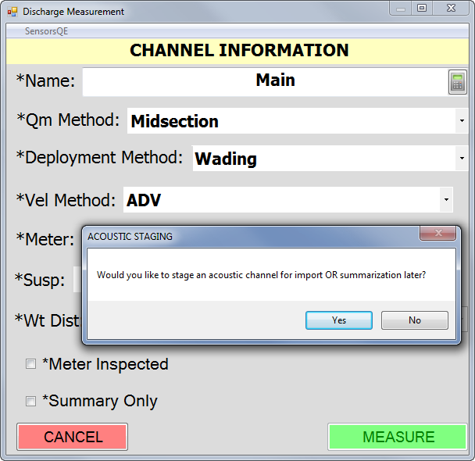
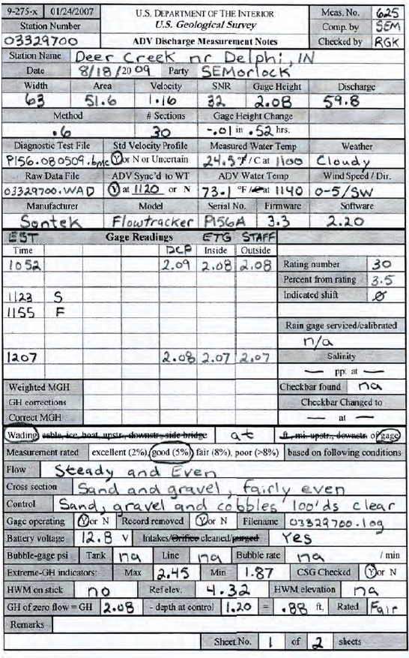
Documentation

Slide 7
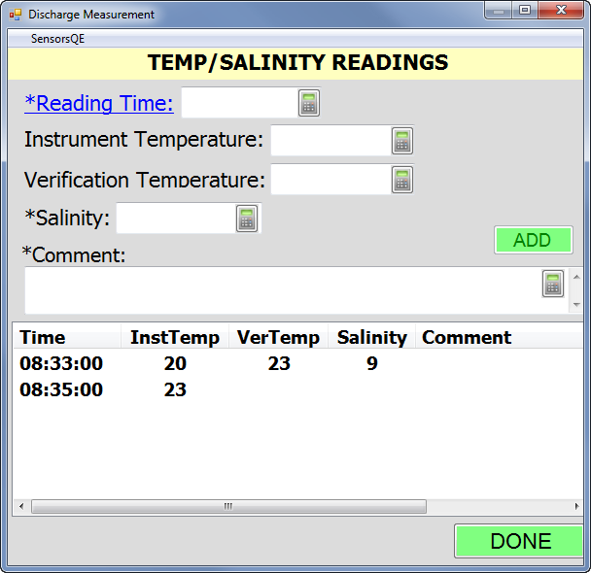
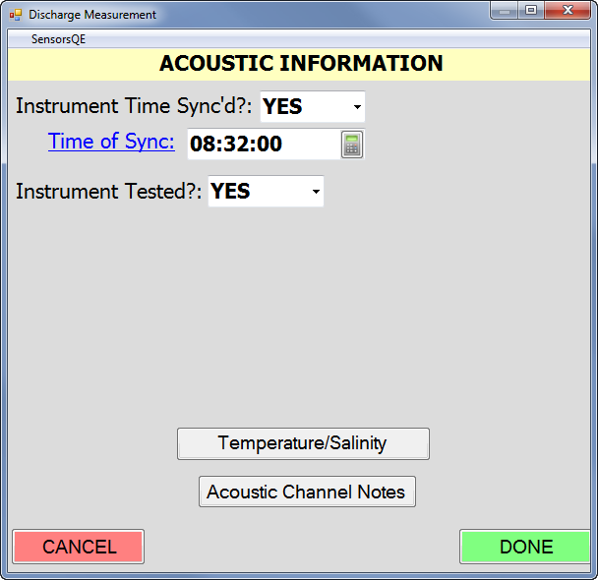
Recording Temperature and Salinity in SWAMI
Store under Acoustic Information

Slide 8
Site Selection
Site selection is just as important when making a Q measurement with a FlowTracker as any other method
A good measurement site is:
  Within a straight reach with parallel streamlines
  A uniform streambed relatively free of boulders, debris or aquatic growth
  Relatively uniform flow free of eddies, slack water, and excessive turbulence

Slide 9
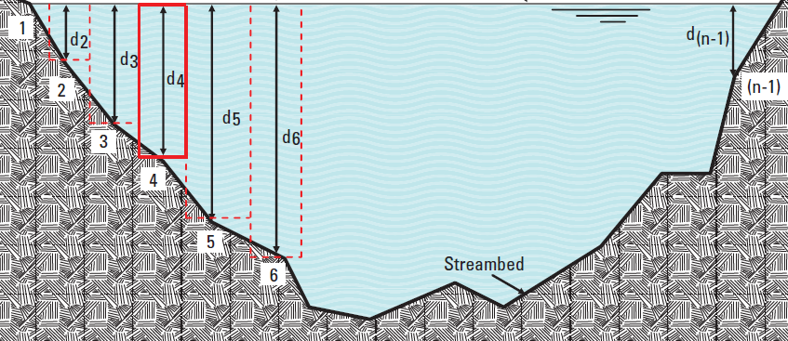
Mid-Section Method
Assumes that each measured velocity and depth is representative of the mean for that section

Slide 10
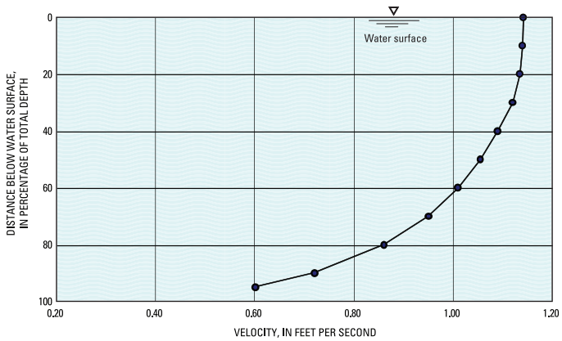
Velocity Depth Method
Two-point Method is
the preferred method
for midsection
measurements
  Use in depths > 1.5 ft
Six-tenths depth Method
  Use depths between .25 and 1.5 ft
Three-Point Method
  Used in abnormally distributed velocities
    0.2 (top) > 2X 0.8 (bottom)
    0.8 (bottom) > 0.2 (top)
    0.8 affected by turbulence or obstruction
Notes:
The Velocity Depth method is where we sample our velocities that are used to represent the mean velocity for a vertical. The preferred method is to use the two-point method making measurements at 20% and 80% from the surface. For flowtracks we use this in depths > 1.5 feet.
Six tenths depth modeth

Slide 11
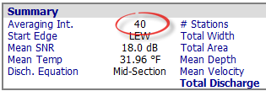
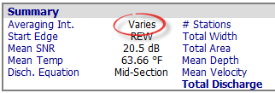
Velocity Sample Time
Under normal measurement conditions, each point velocity measurement should be sampled for a minimum of 40 seconds
Under extreme conditions, such as rapidly changing stage, a shorter sample time may be used to lessen the measurement time

Slide 12
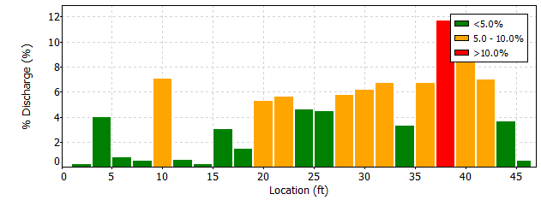
Number of Verticals
The # of verticals and their placement significantly affect the measurement quality
Collect 25 – 30 verticals
No vertical should have more than 10% of the flow
Ideally no subsection contains more than 5%

Slide 13
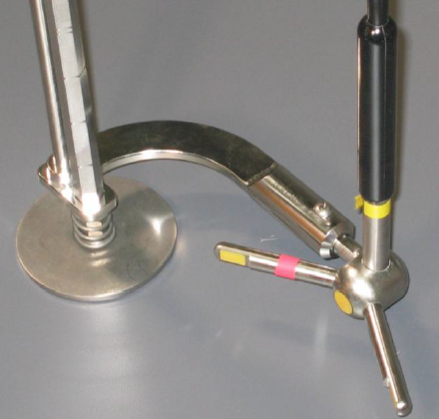
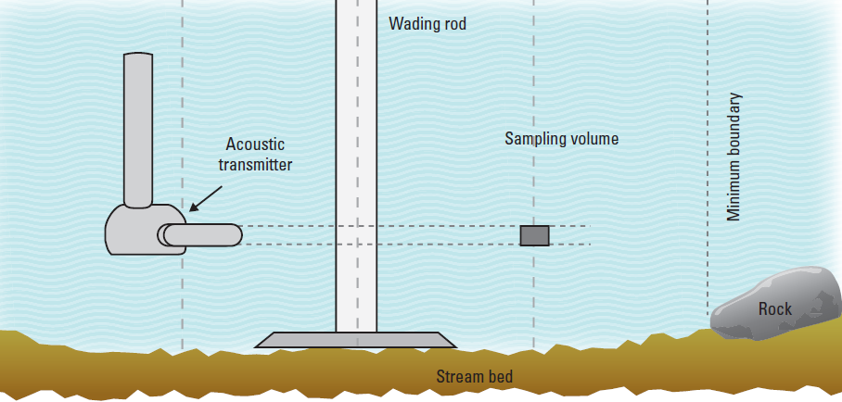
Sampling Volume Location
Bracket offsets the sample volume so that it is approximately 2 inches past the wading rod

Slide 14
Boundary Issues
There is potential for acoustic interference from reflections on underwater objects.
Reflections can occur from the bottom, the water surface, or from submerged obstacles such as rocks or logs.
The system attempts avoid this interference with an automatic boundary adjustment.
Notes:
There is potential for acoustic interference from reflections on underwater objects. The system tries to automatically avoid this interference with a boundary adjustment. Reflections can occur from the bottom, the water surface, or from submerged obstacles such as rocks or logs. To help minimize boundary issues, always try to keep the sample volume at least 2 inches from any boundary. If the sample volume is on top of or beyond an underwater object, the velocity data will be meaningless.

Slide 15
Boundary Adjustment
The Boundary variable may have one of following values:
  0 (Best) - No adjustment necessary or minimal impact on performance
  1 (Good) – Moderate impact on system performance
  2 (Fair) – Notable impact on system performance
  3 (Poor) - Major boundary adjustments necessary, maximum velocity < 4 ft/sec
NOTE: If a boundary condition is not correctly detected by the FlowTracker the boundary flag may be 0 (Best), but the data will be poor!
Notes:
The boundary variable reported will have one of the following values:
0 (or Best) if no adjustment was necessary or minimal impact on performance
1 (or Good) if Moderate impact on system performance
2 (Fair) if notable impact on system preformance
3 (Poor) Major boundary adjustments necessary, and the maximum veocity measurable will be 4 ft/sec
Please note: This variable only indicates that data quality has been degraded because a boundary condition was detected and the instrument attempted to make changes to compensate for this problem. If a boundary condition exists but is not correctly detected by the FlowTracker, the boundary flag may be 0 (Best), but the data will be POOR!

Slide 16
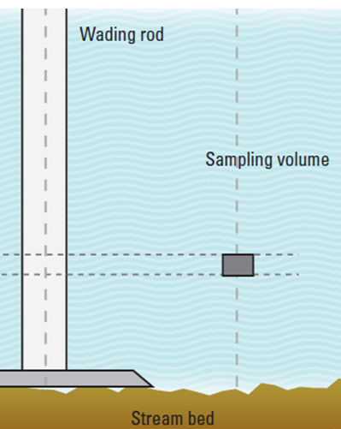
Minimum Section Width
OSW has no policies on minimum section width for midsection measurements
For pygmy meters .3 ft is a common rule-of-thumb and is reasonable for a FlowTracker
Can go less but consider
  Offset between rod and sample volume
  Is midsection method appropriate?

Slide 17
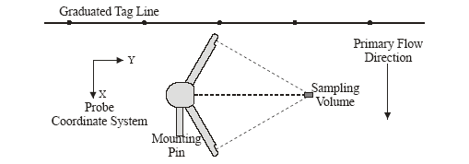
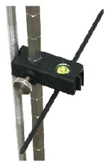
Wading Rod Alignment
Probe/wading rod orientation is VERY important when making a measurement!
The wading rod should always be held perpendicular to the tag line, so that the pulse generated by the transmitter is parallel to the tagline

Slide 18
Flow Angles
Velocities measured in the Y direction by the FlowTracker means there is angled flow
Angled flow:
  Flow not perpendicular to the tagline
  Wading rod not being held perpendicular to the tagline
Small variations are normal, but if large fluctuations of flow angles are reported, a more uniform cross section should be located for the measurement

Slide 19

Wading Rod Alignment and Flow Angles
For a given rod-alignment error, the resulting velocity is higher when true flow is at an angle to the cross section
Flow perpendicular to tag line
  7 degree alignment error = < 1% error in velocity
Flow 25 degrees from perpendicular
  7 degree alignment error = > 4.5% error in velocity
Minimize errors by
aligning tagline
FLOW

Slide 20
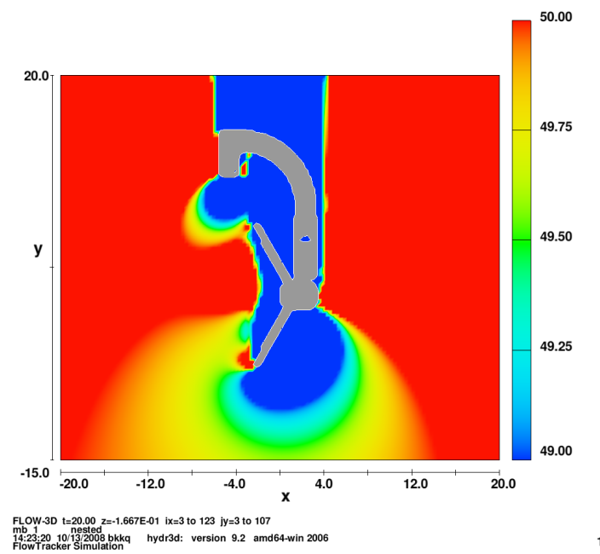
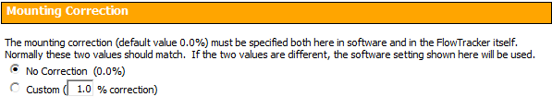
Mounting Correction
While there may be some flow disturbance from wading rod, mount, and probe, simulations indicate that the effect of the hydrographer in the stream is greater
Use of mounting correction factor in FlowTracker not recommended

Slide 21
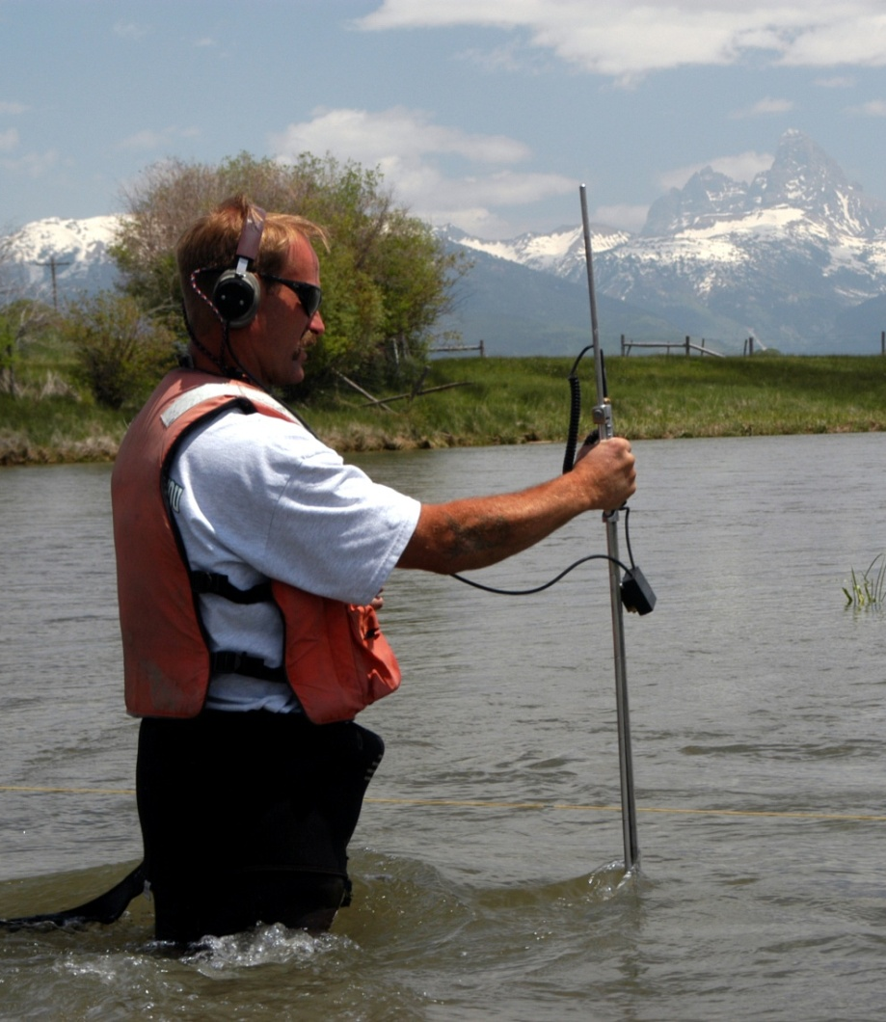
Effect of Hydrographer
Stand in position that least affects the velocity of the water passing the FlowTracker sample volume
Hold wading rod at tag line
Stand 1-3 inches D.S. of tagline and 1.5 ft or more way from wading rod
Avoid standing in water if feet and legs would occupy a considerable percentage of the cross section

Slide 22
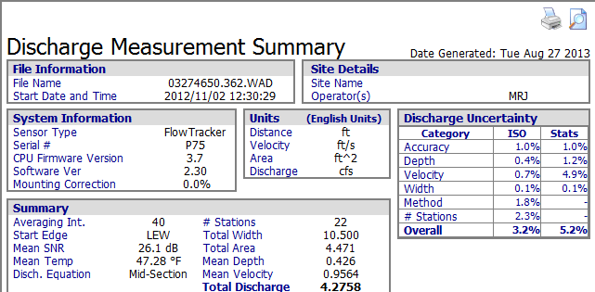
FlowTracker Discharge Measurement Summary

Slide 23
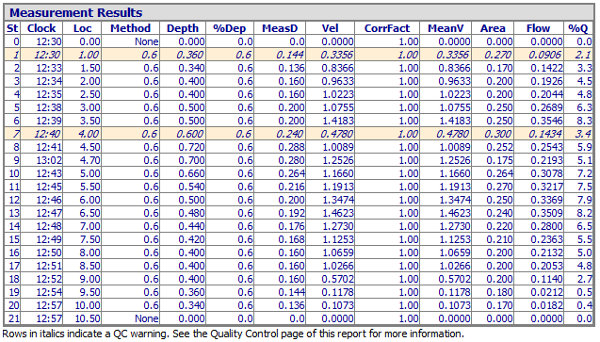

Discharge Measurement Summary

Slide 24
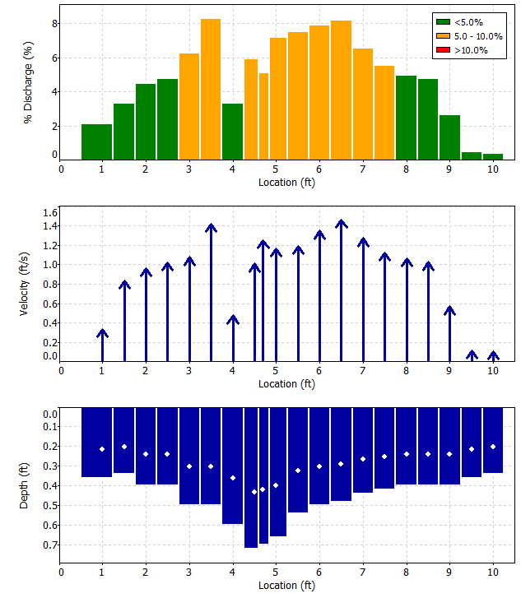
Discharge Measurement Summary

Slide 25
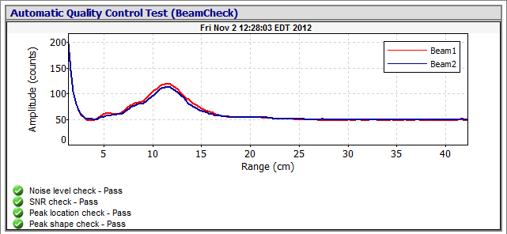
Discharge Measurement Summary

Slide 26
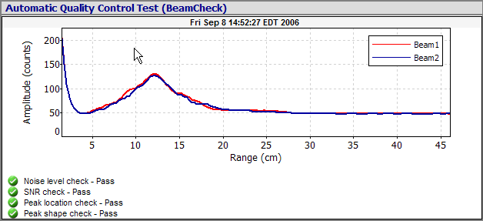
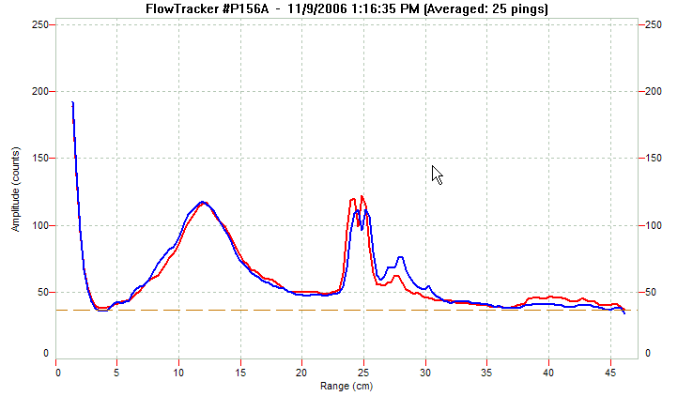
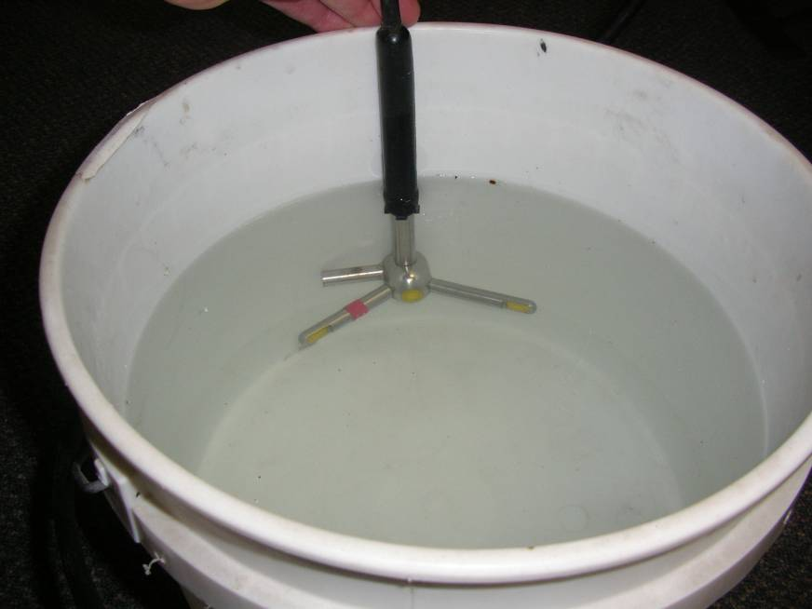
QC Tests
Bucket test – new/repaired instruments or failed QCTest
Auto QC Test with each measurement
Complete in moving water
Away from any boundaries

Slide 27
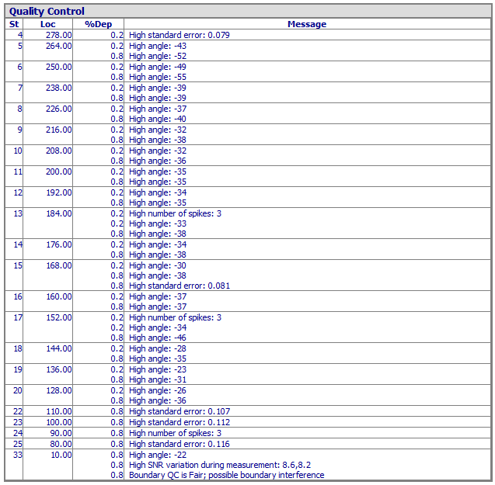
Any Quality Control Issues Should Be Considered
Document any considerations given

Slide 28
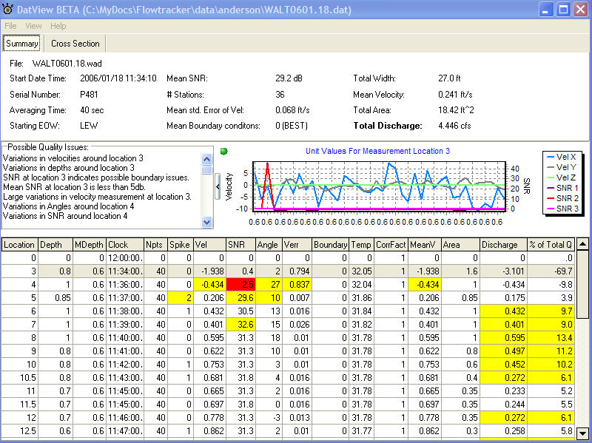
DatView Software for Review of Questionable Measurements
Useful to determine source of issues with stations flagged in the quality control section of the SonTek Software
Does not need to be used on measurements without any issues
Available at: http://hydroacoustics.usgs.gov/midsection/software.shtml

Slide 29
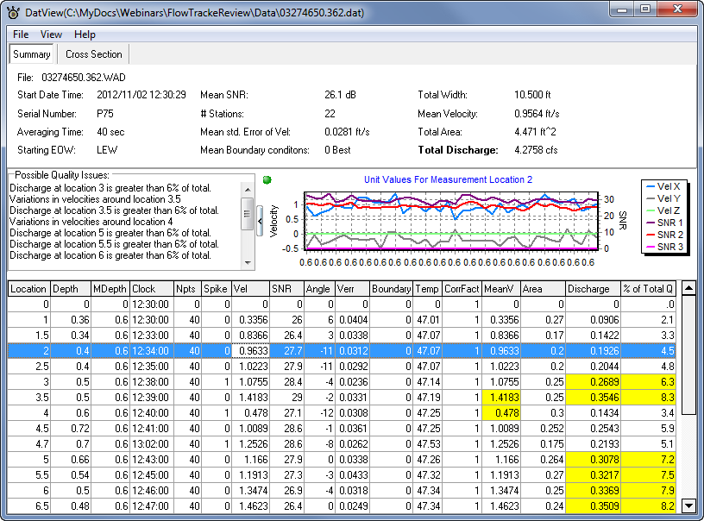
Measurement Loaded in DatView

Slide 30
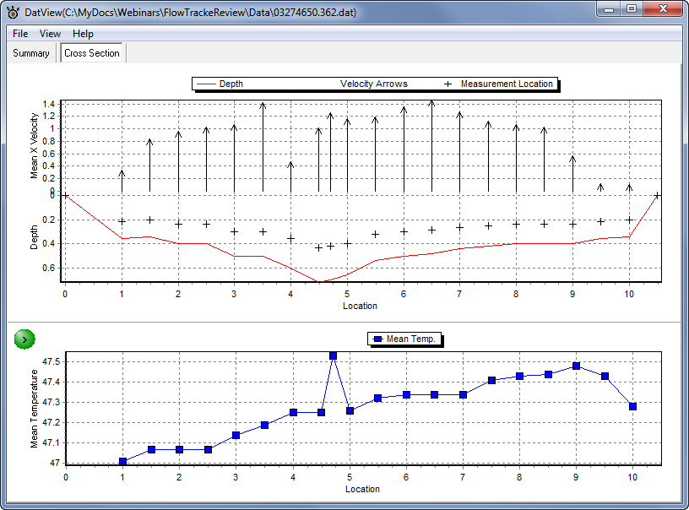
DatView Cross Section Tab

Slide 31
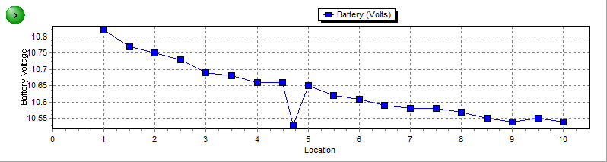
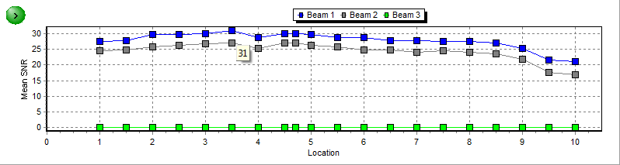
DatView Cross Section

Slide 32
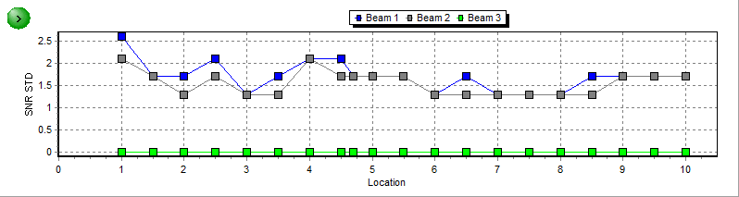
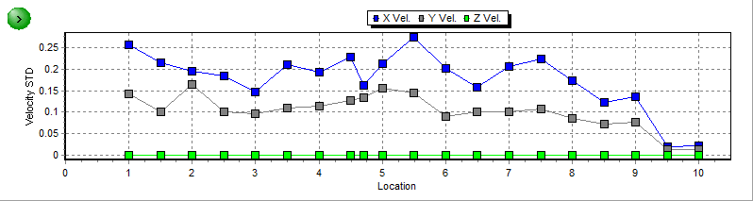
DatView Cross Section

Slide 33
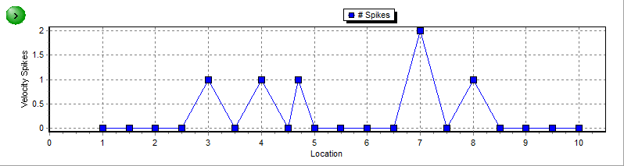
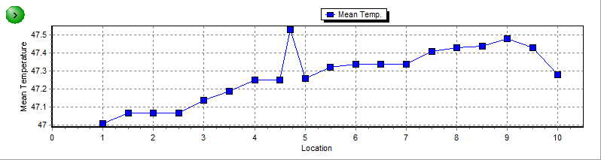
DatView Cross Section

Slide 34
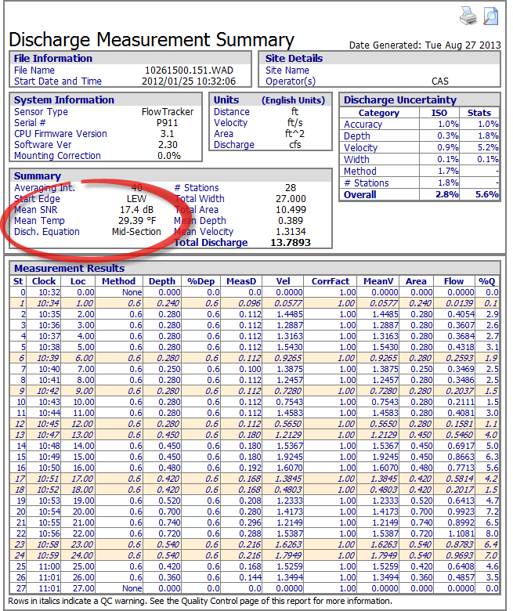
Failing Thermistor

Slide 35
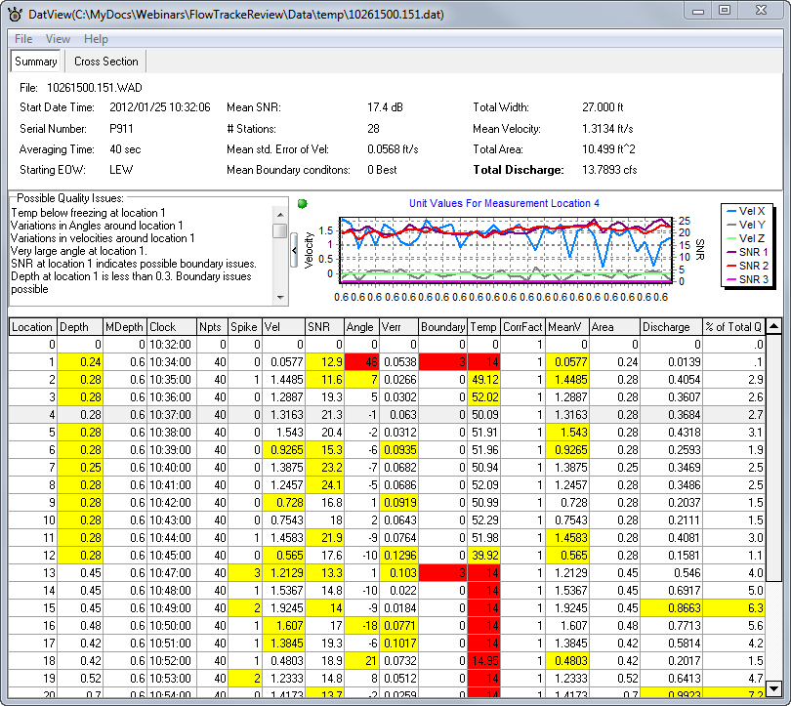
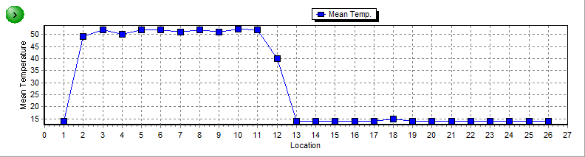
Same Measurement in DatView

Slide 36
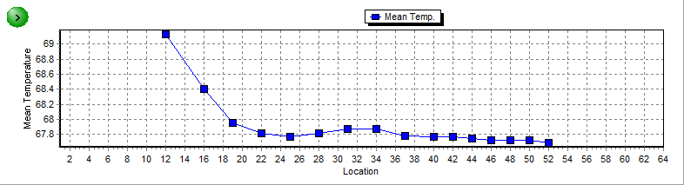
Probe Temp Not Equilibrated
Viewed in DatView – Cross Section – Mean Temperature

Slide 37

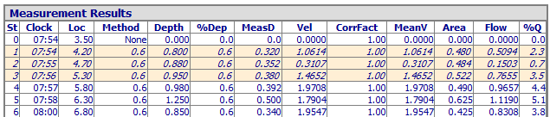

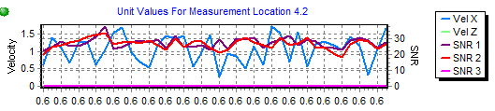
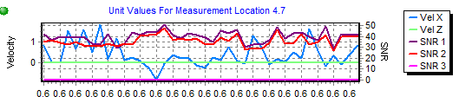
Boundary SNR Issue

Slide 38


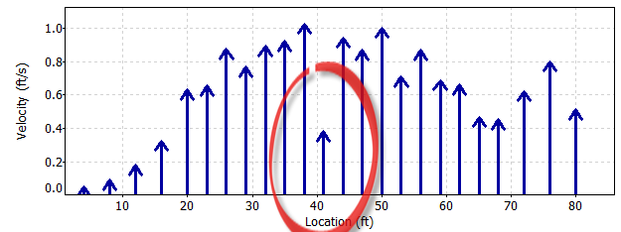
Another Example

Slide 39
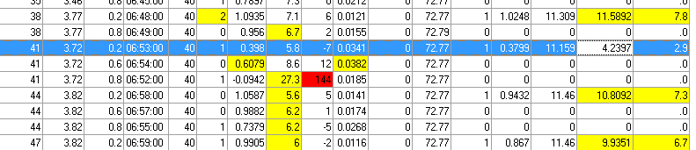
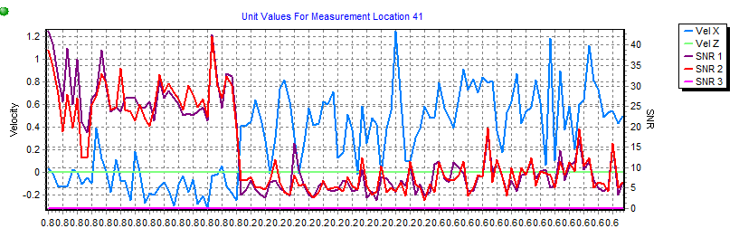
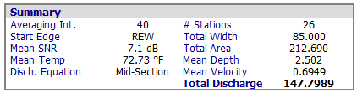
Example in DatView

Slide 40
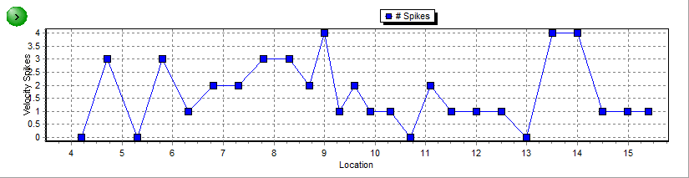
Spike Filtering
FlowTrackers automatically filter velocity “spikes” out of the data.
A value is considered a spike if both:
  Velocity is at least 3 standard deviations from the mean
  Velocity is at least 0.1 ft/second from the mean
A few spikes are OK. If a vertical contains a large number of spikes, verify sample location and redo vertical
Notes:
FlowTrackers automatically filter velocity “spikes” out of the data. A value is considered a spike if BOTH…. The velocity is at least 3 standard devations from the mean AND the velocity is at least 0.1 ft/second from the mean.
The number of filtered spikes is displaye and recorded at the end of each measurements.

Slide 41
FlowTracker in Fast Flow
FlowTracker maximum velocity = 14.7 ft/sec
  When flow perpendicular
  Maximum velocity that can be measured in the direction of a transducer is only 3.7 ft/sec
  Velocities towards or away from the transducers > 3.7 ft/sec will cause erroneous velocities
  Can occur in fast, turbulent flow with angles
  Typically appears as velocities with wrong magnitude and sign
Notes:
The FlowTracker is only capable of measuring at the manufacturer’s maximum-velocity specification of 4.5 m/s if the flow is perpendicular to the transmitting transducer face and the hardware is configured to measure velocities only in a range of ± 4.5 m/s. If the water velocity exceeds this range, it will report erroneous velocities. The receiving transducers can measure a velocity range of only ± 1.15 m/s; because of the geometric arrangement of the transmitting and receiving transducers, a velocity of 4.5 m/s flowing perpendicular to the transmitting transducer face results in a velocity towards a receiving transducer of 1.15 m/s. A velocity component directly toward or away from the receiving transducers larger than 1.15 m/s will cause errors even when the total velocity magnitude is below the maximum.

Slide 42
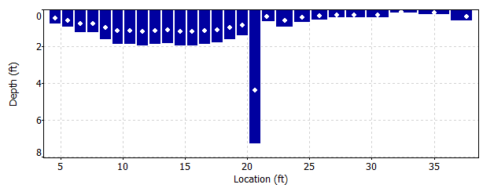
Adjusting Errors
If an error is found after ending the measurement, such as a location or depth entered incorrectly, there is no way to make the adjustment in software
Must adjust and recompute discharge by hand
Carefully document any changes!

Slide 43
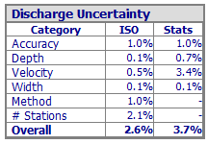

Discharge Uncertainty
Two types reported
  ISO
    Based on “typical” errors
    Heavily influenced by # stations
  Stats
    Follows IVE method developed by USGS
    Based on data collected
    Captures random sources of errors
    Does not capture systematic errors
      Non standard profile
      Hydrographer technique

Slide 44
Qualitative Rating
Excellent 2%, Good 5%, Fair 8%, Poor >8%
  Consider reported uncertainty
  Typically should not rate
  better than the reported
  uncertainty
  Lower rating for any
  additional potential
  systematic bias
    Non-standard velocity profile
    Consistent high flow angles (tag line at angle)
    width issues (tag line sagging)
    etc

Slide 45
Summary
Site selection is a limiting factor
It is important to understand how and what the FlowTracker is measuring
  SNR
  Flow angles
  Sample volume location
  Wading rod orientation
Consider all Quality Control issues highlighted and document their potential affect on the final discharge
Rate measurements considering the reported discharge uncertainty values

Slide 46
Questions!
Recorded version will be placed on:
http://hydroacoustics.usgs.gov/

Slide 47
Standard Error of Velocity
Indicates the variations in 1 second velocities - Standard deviation divided by the square root of the number of samples
Typically dominated by real variations in flow
Shown at the end of each velocity measurement
High standard error of velocity values are an indicator of a poor measurement section (turbulent flow)
Notes:
Standard Error of Velocity, as reported by the FlowTracker, is calcuated by dividing the standard deviation of the raw one-seond velocity samples by the square root of the number of samples. Typically the standard error velocity is dominated by real variations in flow, and will vary depending on the measurement envirnment. The standard error of veolicty is show at the end of each velocity measurement.

