Slide 1

OTT ADC
Acoustic Digital Current Meter: Description of meter and Results of USGS testing
Dan Wagner
Hydrologist
Arkansas Water Science Center
Hydroacoustics Webinar
May 24, 2010

Slide 2
Outline
Description of ADC
Results of USGS Testing
New USGS Firmware / enhancements
Notes:
In this presentation, I’ll describe the ADC, discuss results of USGS testing of the ADC, and show enhancements that have been made to the ADC with a new “USGS Firmware,” currently in Beta testing.

Slide 3
ADC History
Released in USA December 2007
Testing by HIF, HAWG, and WSCs from 2008-2010
New USGS Firmware currently in Beta Testing
Notes:
USGS testing was performed by HIF, HAWG, and Pennsylvania, Illinois, Florida, Arkansas, Alaska, Oregon, and Maine WSCs.
New Firmware version

Slide 4
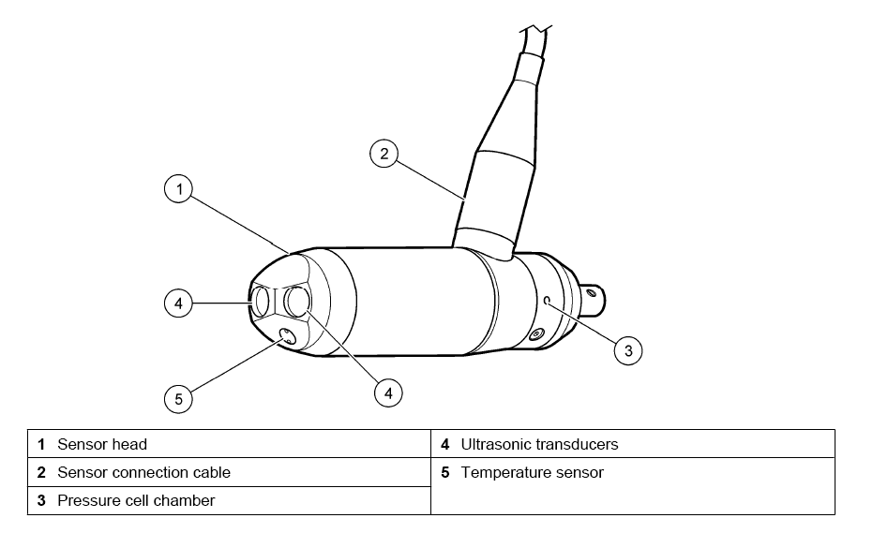
System Components
Figure courtesy of OTT
Notes:
2 6 MHZ transducers
Thermistor
Pressure sensor- 0 to 5m (16.4 ft) depth
Meter will work in 0.15’ of water (2”)

Slide 5
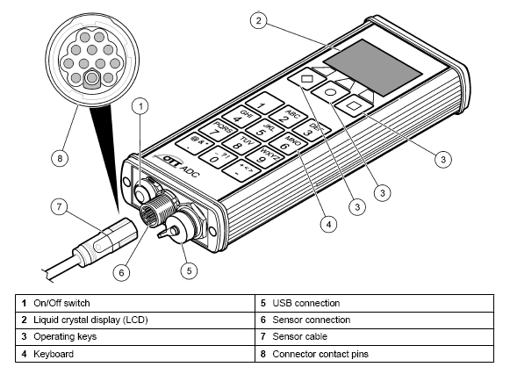
Handheld Display
Figure courtesy of OTT
Notes:
Mini-USB to USB cable for downloading w/ PC (no serial cables!)
Robust sensor cable connection
Big keys, beep when key pressed
Separate function keys for toggling through menus
Sealed, battery accessible only by opening case (send to factory)
Rechargeable battery not accessible unless sent back to factory-still a concern amongst some users, would like to see an accessible battery compartment like with a laptop, where the rechargeable battery could be replaced. Battery life should be 20+ hours of use, 500 charging cycles (basically, days without charging and several years’ worth of charges)

Slide 6
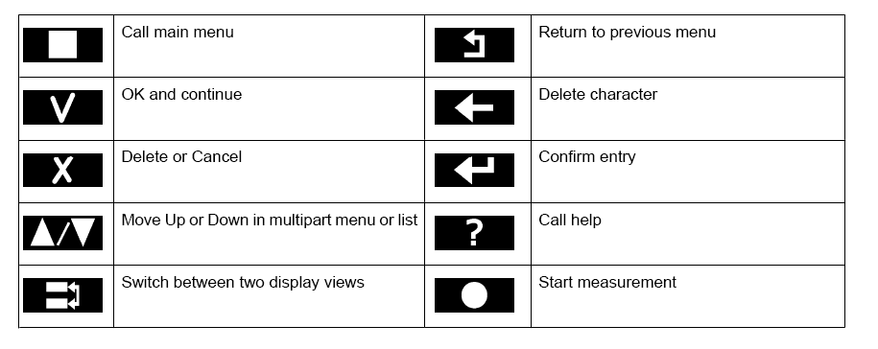
Handheld Display Operation
Figure courtesy of OTT
Notes:
Depending on the display screen, commands appear above the function keys-press the appropriate key to enter the command

Slide 7
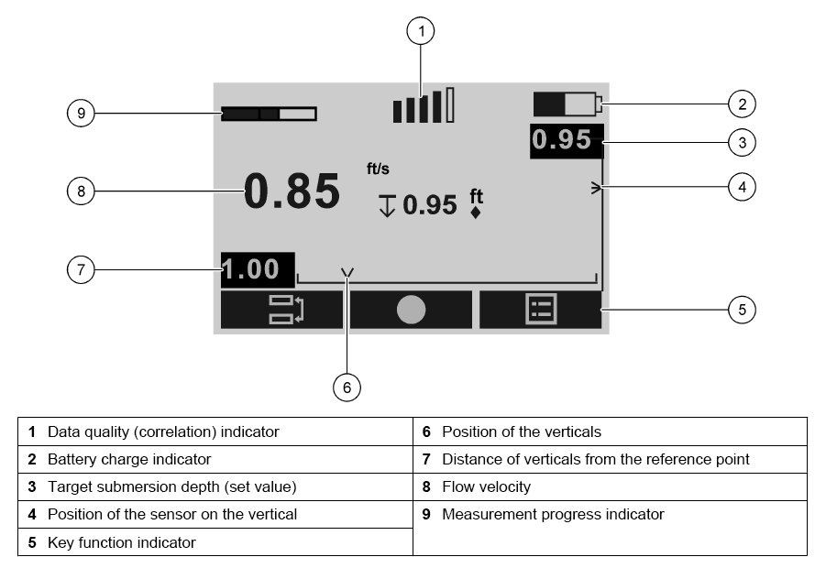
Display Screen
Figure courtesy of OTT
Notes:
Note the use of familiar symbols—PC-like progress bar, cell-phone like “signal quality” bars for correlation, battery symbol (9,1,2)
Note that the ADC tells you a target depth and the actual depth so that the user can position the sensor at the appropriate position in the vertical without even having to look at the wading rod (3,4)
Also the ADC tells you the distance of your vertical from the start point and shows a graph of the same (6,7)
Velocity is in live streaming mode unless you turn that off…it’s nice for checking for QA/QC probs behind cobbles and boulders

Slide 8
Location of Sample Volume
ADV
ADC
Notes:
Sample volume still 10 cm away from transducers, but in front of meter instead of to the side. Sample volume much larger than that of the FlowTracker…this coupled with the higher acoustic frequency means the ADC should have much less SNR issues in low backscattering environments.

Slide 9
Measuring Principle
Two 6 MHz acoustic transducers
Large sample volume located in front of sensor
  Large sample volume reduces potential signal-to- noise (SNR) issues, reduces error with flow angles
Two sample volumes
  Improves data precision
  Internal cross correlation calculation verifies measurement accuracy and identifies potential boundary issues
4 in
2 in
Sample volume 1
0.4 in
Sensor head
Sample volume 2
Figure courtesy of OTT
Notes:
Each transducer works both as a transmitter and receiver
Large sample – which is controlled by the receiving time window of the timing controller
Large sample volume reduces signal to noise issues because scatters, or particles in the water column, contribute a stronger echo
Two sample volumes – velocity measurement from the sample volumes are averaged together to produce a single in-line velocity measurement.
Using two sample volumes improves precision by averaging measurements collection from each and makes it possible to offset the sample volume from the centerline of the probe
Robust design that reduces mechanical impact

Slide 10
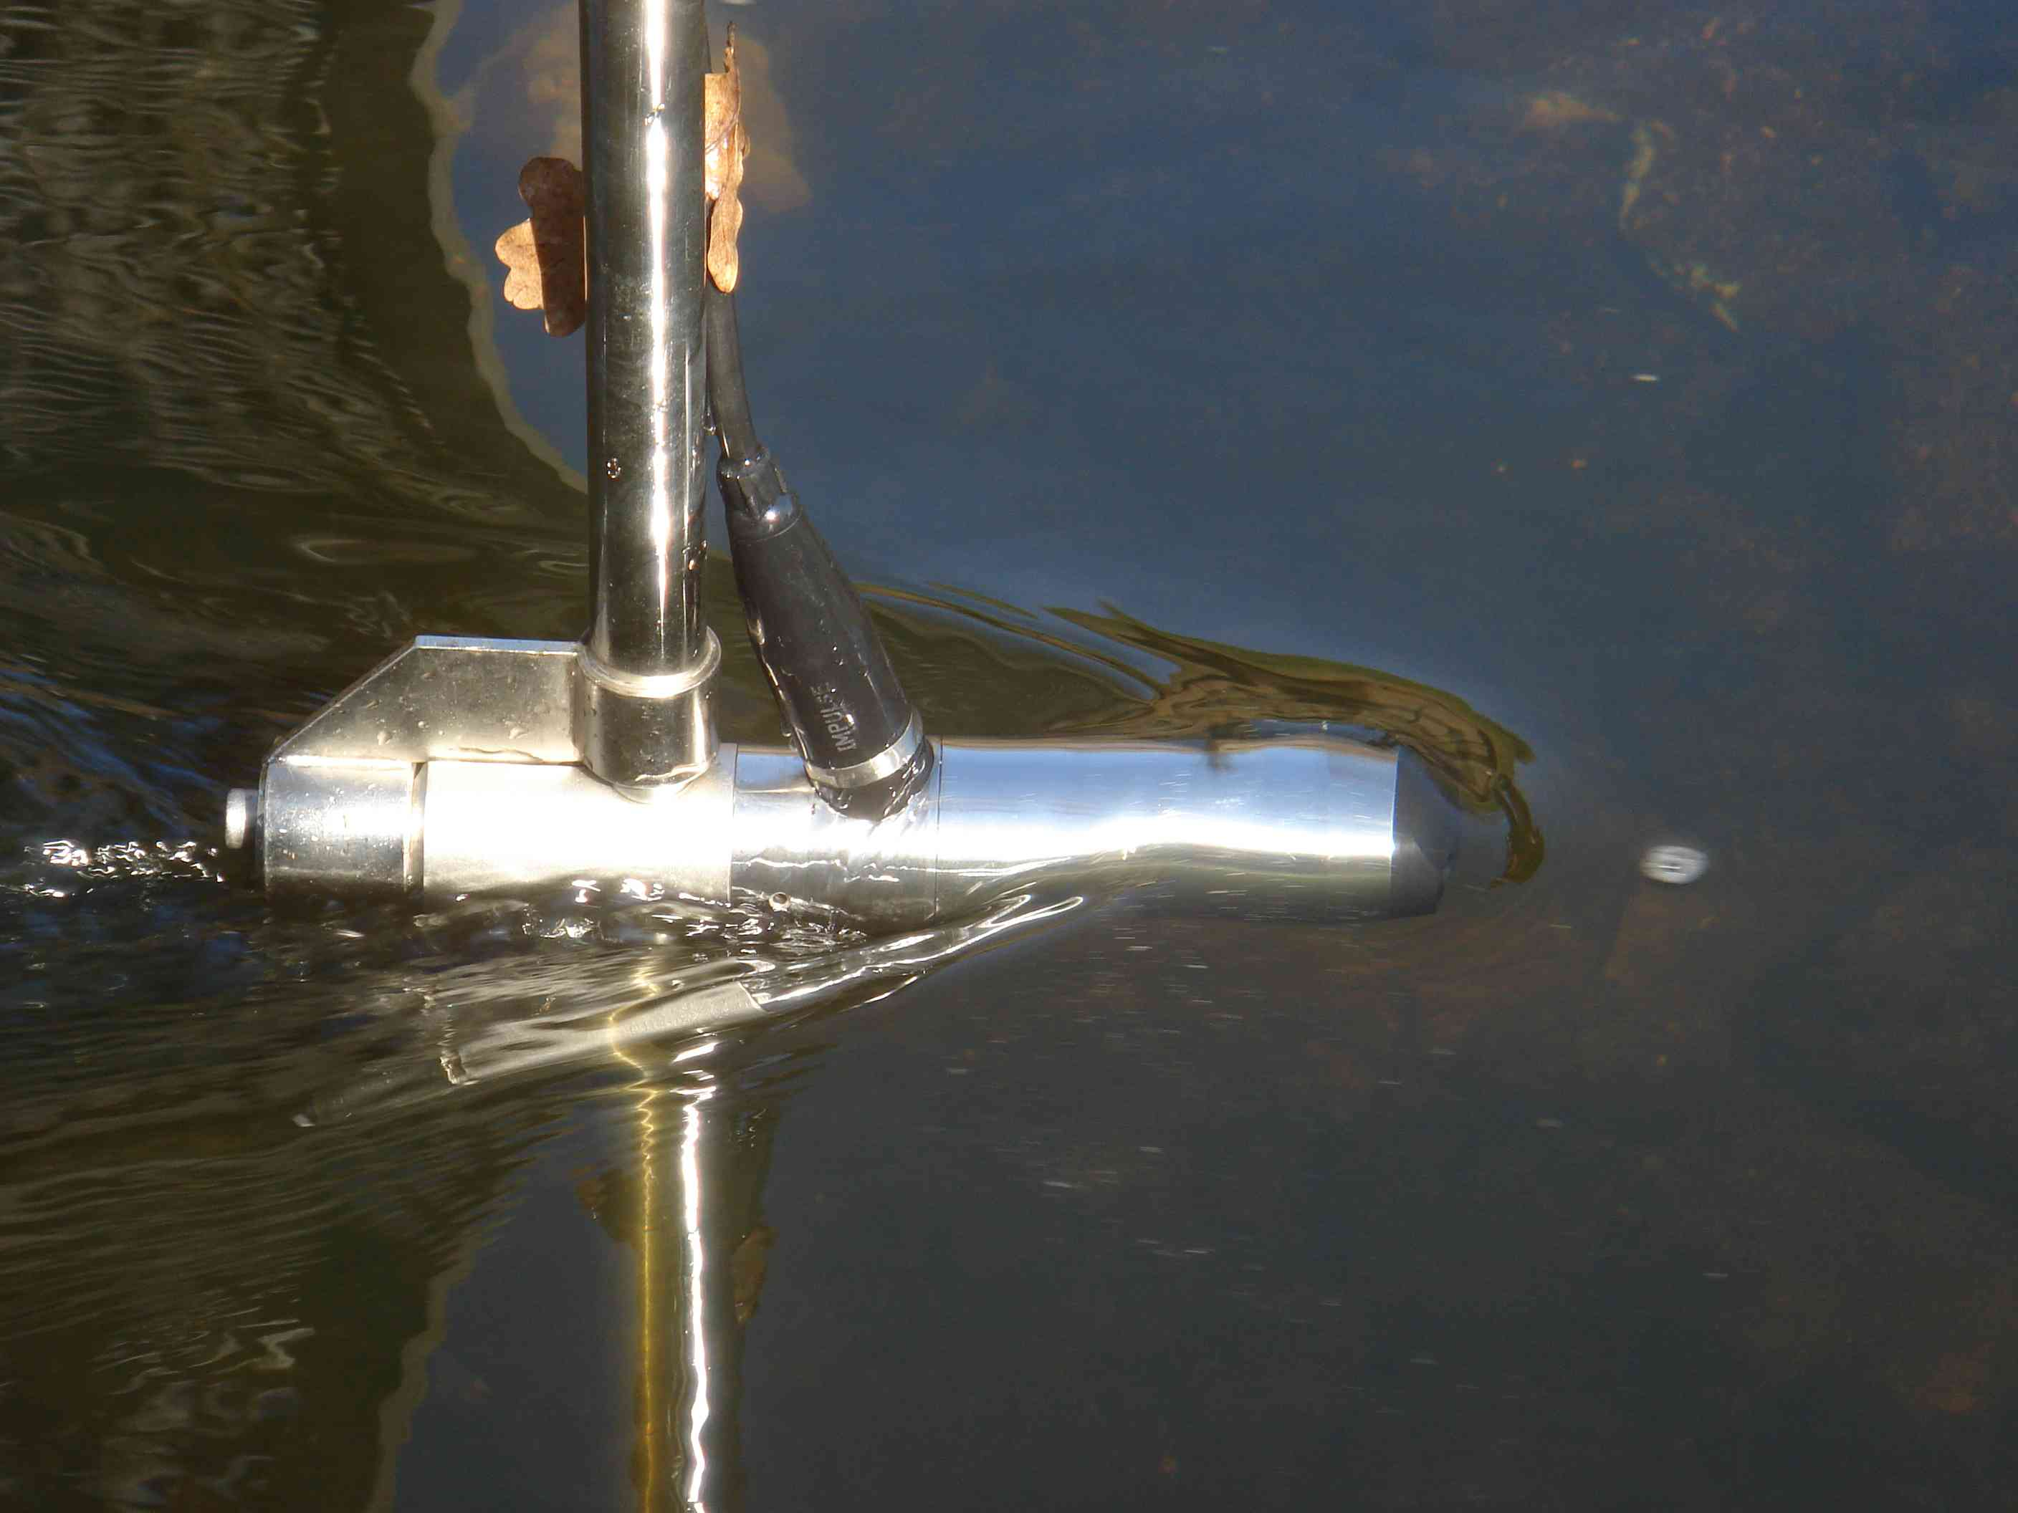
Measuring Principle
1. Transmit – Receive - Digitize
3.93 in
1.97 in
Break
0.4 in
2. Transmit – Receive - Digitize
Cross Correlation
Check for similarities
Calculation of time shift
Δt
Calculation of flow velocity
Slide courtesy of OTT
Notes:
An ultrasonic burst is sent into the media from beam 1 and beam 2 simultaneously
All particles in the measurement path reflect a small amount of the ultrasonic signal
Depending on the shape and size a particular signal results
The multitude of the reflected signals result in a reflection pattern which is then saved to the DSP
After a certain amount of time a second burst is sent into the medium
A second reflection pattern is generated. This pattern is distorted due to slightly different reflections. This is because some particles have been turning around and have another reflection or some particles are no longer in the measurement range.
The DSP checks both received reflection patterns for similarities using the cross correlation method
All existing signal differences are rejected so that two similar but offset signal patterns are left for velocity evaluation

Slide 11
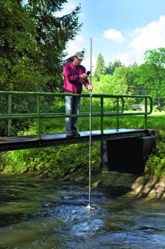
Depth Sensor
Calibrate by zeroing to atmospheric pressure on site (raise out of water to calibrate)
Get depth for each vertical by first lowering meter to bottom, rod offset computed automatically
Hand-held display shows target depth and actual depth for velocity measurement in vertical depending on the velocity method selected by the user.
Depth sensor can be turned off with new firmware
Notes:
The depth sensor is easy to use, but some testers didn’t like it, and wanted to be able to enter the depths manually as they do with other current meters. The new USGS firmware allows the user to turn off the depth sensor prior to starting the discharge measurement.
One application of the depth sensor is in making mid-section measurements from a bridge with a long rod (see picture). While not commonly used in the USA, this practice is common in Europe.

Slide 12
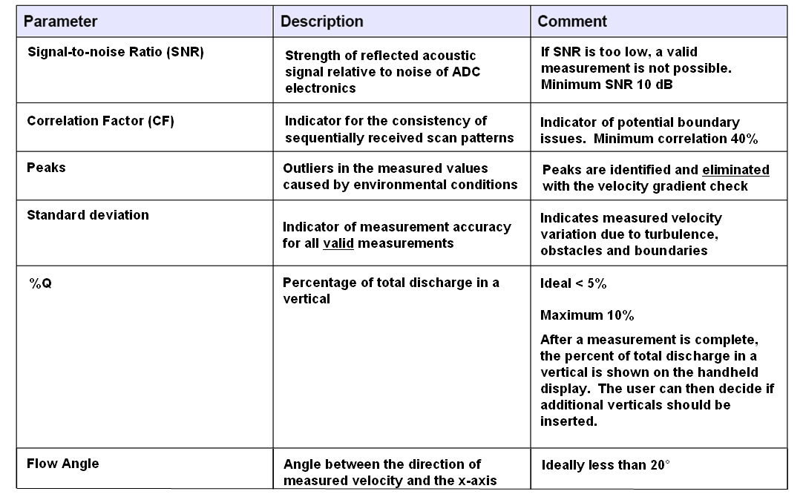
QA/QC
Figure courtesy of OTT

Slide 13
QA/QC checks
With new USGS firmware, a Quick QA/QC check is performed in office (similar to ADV beam check, can print results)
Pre-measurement QA/QC check is logged with measurement file and appears on printout
Notes:
Prior to the recent release of the new USGS firmware, the ADC had no logged QA/QC check.

Slide 14
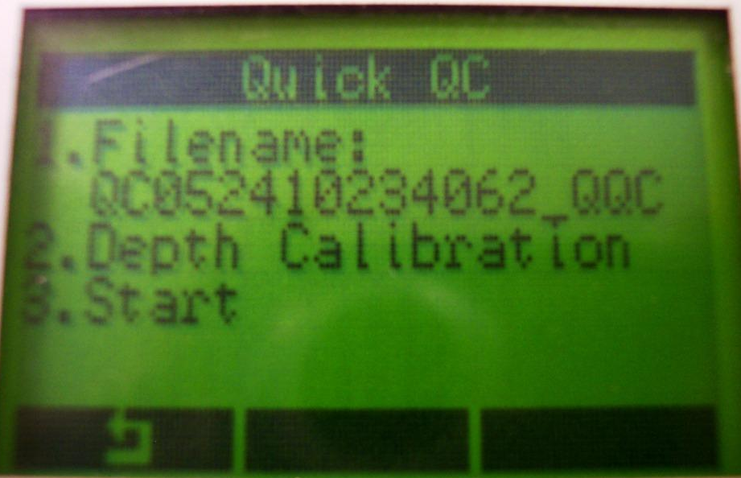
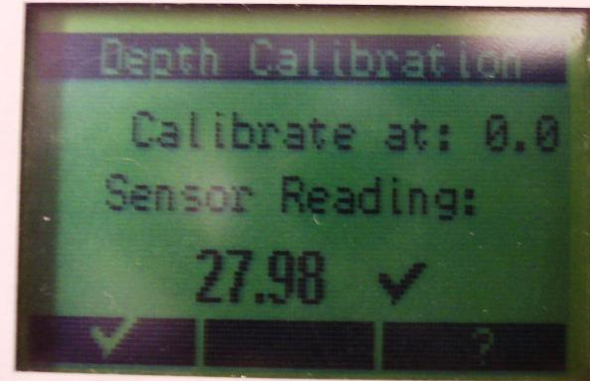
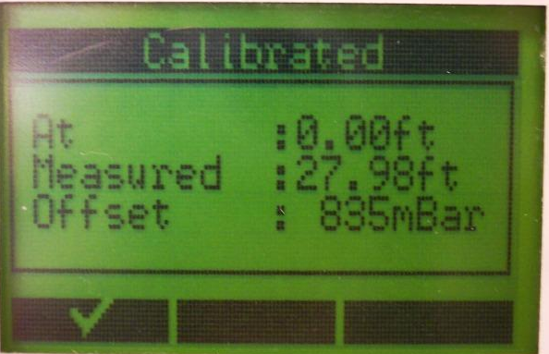
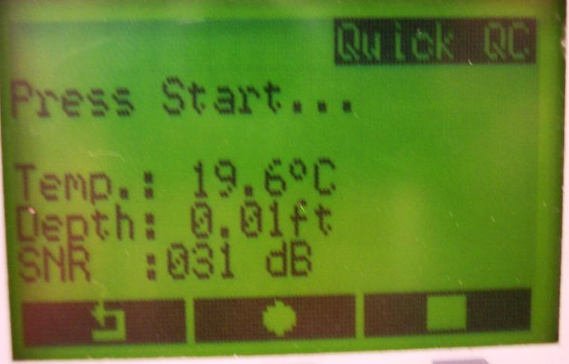
Notes:
Screen shots of the handheld display during QA/QC and depth sensor calibration procedures

Slide 16
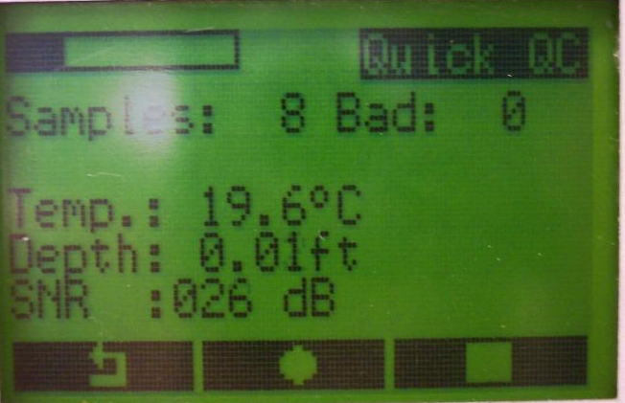
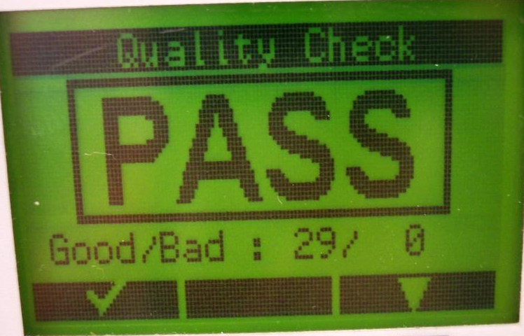
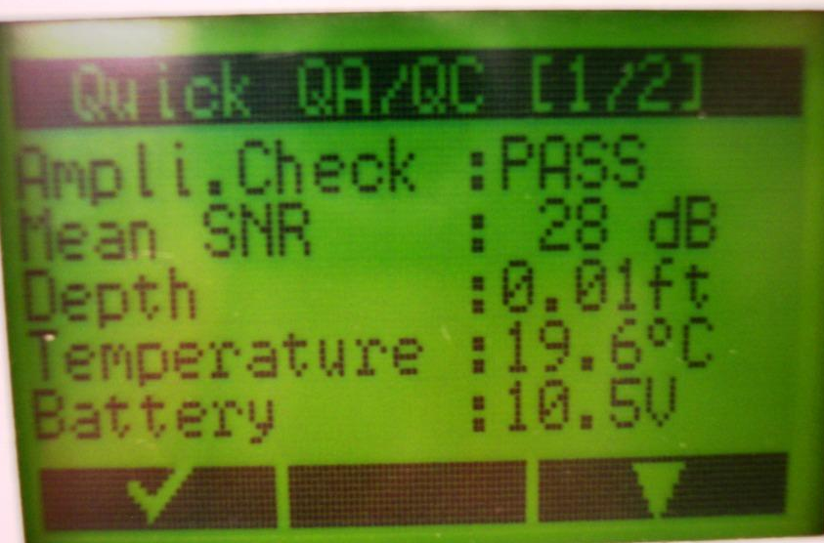
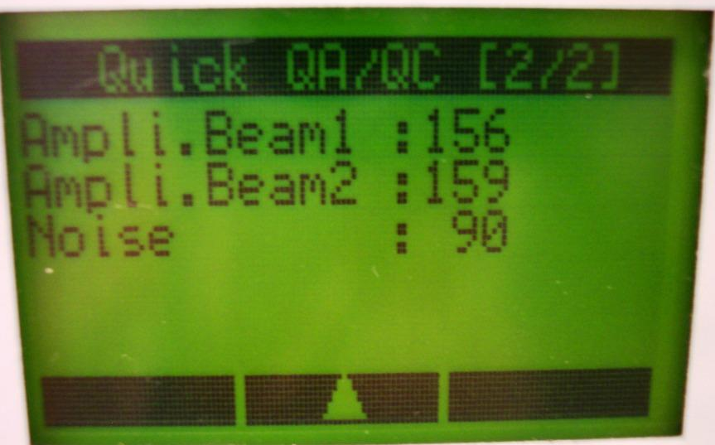

Slide 17
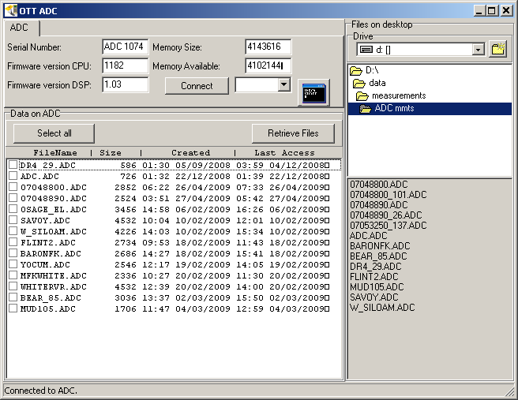
Qreview Software-Data Download
Notes:
Select from files on ADC on left hand side…right hand side shows ADC files currently in selected directory in PC. Nice windows format

Slide 18
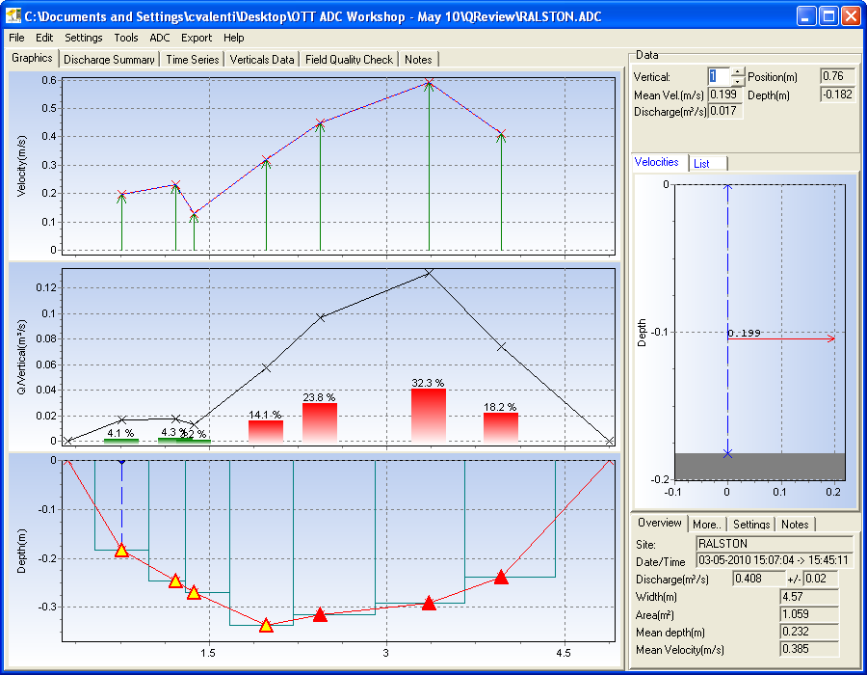
Measurement Review
Notes:
This is the new & improved look of Qreview…note the color-coded %Q/vertical and the QA/QC coloration on the Depth window.
Use the edit function to delete verticals, change vertical depths (if they were incorrectly entered)

Slide 19
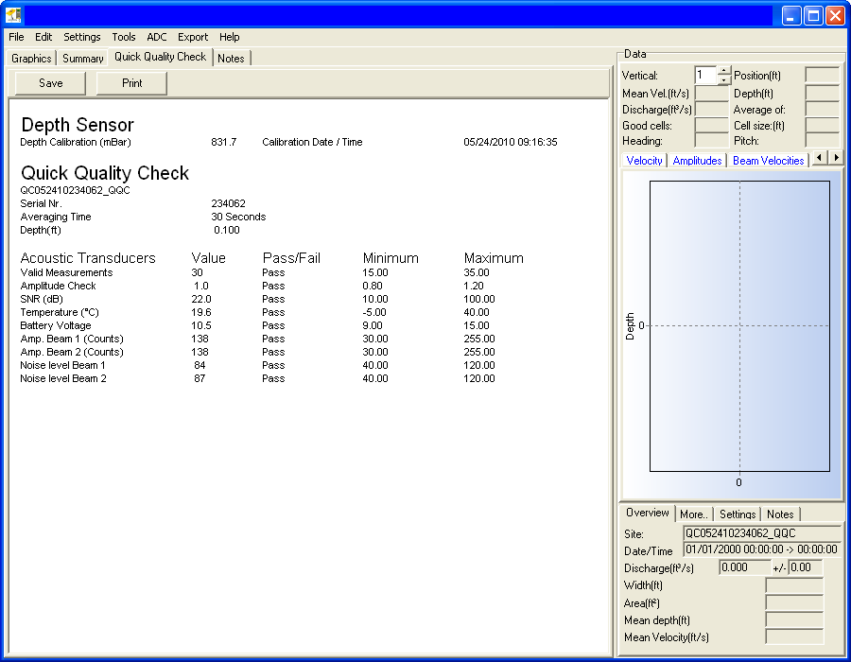
Notes:
QA/QC check as it appears in QReview

Slide 20
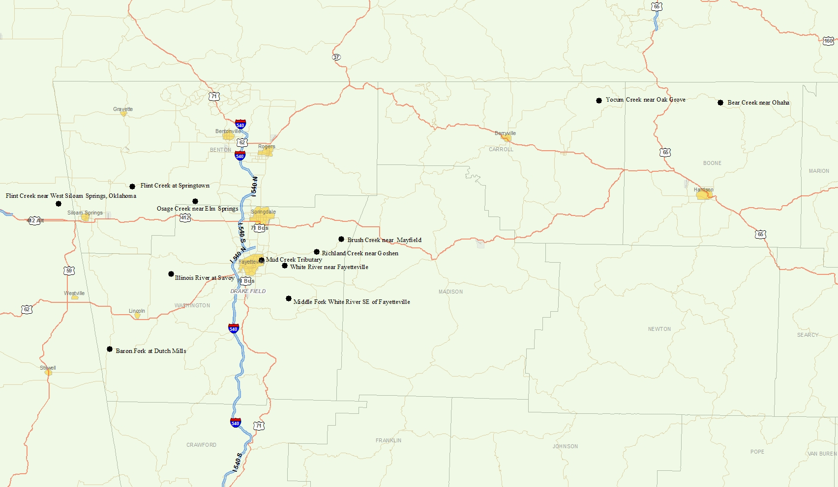
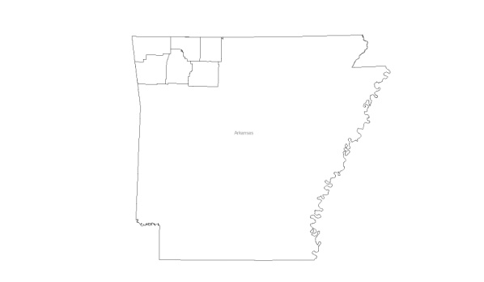
Arkansas Test Sites
N
Notes:
Location of Arkansas’ test sites, in the NW part of the state. Waters typically clear with low suspended solids (and typically low SNRs when measured with ADV), bedrock lined channels w/ boulders, cobbles, gravel.

Slide 21
V_{mean}, Test Measurements
Site | V_{mean,ADV} | V_{mean,ADC} | % error
Mud Creek | 0.03 | 0.014 | -53.3
Richland Creek | 0.39 | 0.45 | +15.4
Brush Creek | 0.46 | 0.42 | -8.7
Baron Fork | 0.49 | 0.44 | -10.2
Flint Creek nr. West Siloam Springs | 0.60 | 0.58 | -3.3
Flint Creek nr. Springtown | 0.80 | 0.77 | -3.3
Notes:
The largest percent differences in Arkansas’ test measurements were at low velocities…and the absolute differences were small.

Slide 22
V_{mean}, Test Measurements
Site | V_{mean,ADV} | V_{mean,ADC} | % error
Illinois River nr. Savoy | 0.84 | 0.90 | +7.1
Bear Creek | 0.85 | 0.84 | -1.2
Middle Fork White River | 1.22 | 1.14 | -6.6
Osage Creek | 1.47 | 1.45 | -1.4
Yocum Creek | 1.97 | 1.95 | -1.0
White River nr. Fayetteville | 2.04 | 2.05 | +0.49

Slide 23
Percent Difference of Velocity Measured with ADC Relative to Velocity Measured with ADV
Notes:
Plotting percent difference of mean velocity measured with the ADC relative to that measured with the ADV versus the mean velocity measured with the ADC for Arkansas’ test measurements produces a trend similar to other tests (see next slide)

Slide 24
Figure courtesy of Kevin Oberg, OSW
Notes:
Same as previous slide but for all test measurements. Keep in mind that most of the measurements were compared with measurements made with SonTek FlowTracker ADVs, and as with most comparisons, we don’t really know the “TRUE” velocity or discharge.

Slide 25
Figure courtesy of Kevin Oberg, OSW
Notes:
Basically, the same plot as previous slide but showing % difference of ADC from ADV vs. Discharge instead of velocity.

Slide 26
Figure courtesy of Kevin Oberg, OSW
Notes:
Regressing the mean velocities from ADC test measurements against those from reference measurements produces a very linear relationship, as we would expect.

Slide 27
Figure courtesy of Kevin Oberg, OSW
Notes:
Depths measured with the ADC’s depth sensor often differed slightly from those recorded by technicians in ADV or Pygmy meter measurements.
Keep in mind that wading rods have error and sometimes bases are not screwed on all the way…also the technician is making a judgement call on anything less than a 0.1’ resolution in depth, possibly introducing error.

Slide 28
Notes:
Initial HIF tow-tank testing indicated that at low velocity, measurements with the ADC were biased low. OTT has since put much effort into correcting the low velocity bias with new firmware fixes and recent tests at HIF indicate that these fixes have improved the low velocity comparisons.

Slide 29
Notes:
Notice that the percent error of ADC velocity doesn’t exceed 5% between -50 and +70 degrees…the ADC handles flow angles well!

Slide 30
Figure courtesy of Kirk Thibideaux, HIF
Notes:
Same as previous slide, but horizontal angles. Point is,

Slide 31
ADC Pros/Cons-prior to USGS firmware
Pros:
Cons:
Depth Sensor
Sample volume in front of meter
Rugged Construction, cabling
Rechargeable battery
2 beams-improved performance in environments with low SNR, angles
Live velocity reading-can help with meter placement
Depth Sensor
Sample volume in front of meter
Rechargeable battery (?)
Can’t edit erroneous stations until reviewing the measurement in Qreview
Lack of beam check (“bucket test”) and/or quick field QA/QC check that is logged with measurement
Lack of QA/QC warnings during measurement (i.e., for 0.2/0.8 velocity discrepancies, bad correlation resulting from bad boundary conditions
Notes:
-The depth sensor was welcomed by some users, despised by others. The new USGS firmware allows it to be turned off.
-The rechargeable battery seems to perform very well. Some users remain skeptical of its long-term performance and the fact that the ADC has to be sent to the OTT factory in Loveland, Colorado for battery replacement.
-The sample volume being in front of the meter was helpful in some stream bottom conditions but faces the same issues as a FlowTracker does when placed less than 10 cm from an obstruction or a vertical wall.
-The new USGS firmware didn’t address the issue of being able to delete an erroneous station (i.e., technician enters the wrong depth for a vertical, with the ADV, they can toggle back to that vertical and make the change during the discharge measurement; with the ADC, these changes can only be made in Qreview)
-Prior to the new USGS firmware, the ADC had no pre-deployment beam check or field QA/QC check that was logged with the measurement. Also, the old firmware lacked QA/QC warnings during the discharge measurement that would alert the technician to possible QA/QC issues.

Slide 32
Software Enhancements
Enhanced quality assurance
  Including pre-deployment quality check and field quality check
Ability to enter rated Q
Expanded character limits for station name and number and addition of measurement number
Computation and recording of averaged flow angles
On-screen warning messages, a.k.a., Measurement Guidance
  Provide user with options to improve measurement results
Option to turn off depth sensor
Enhanced measurement review
  Detailed discharge and quality check reports
  Warning and potential quality issue logs
  One-second time series data
Notes:
OSW compiled a list of desired enhancements to the ADC based on tester’s comments. This is a list of the software enhancements that are part of the new “USGS Firmware.”

Slide 33
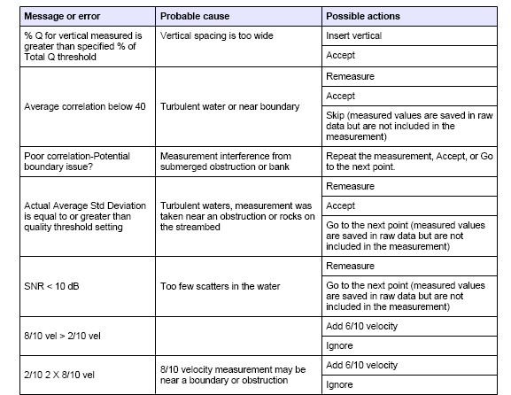
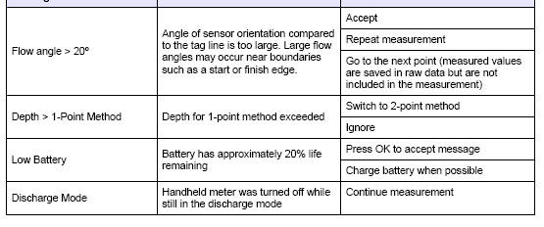
New ADC QA/QC Warnings
Figure courtesy of OTT
Notes:
The QA/QC warnings in the new firmware are similar to those provided in the familiar ADV

Slide 34
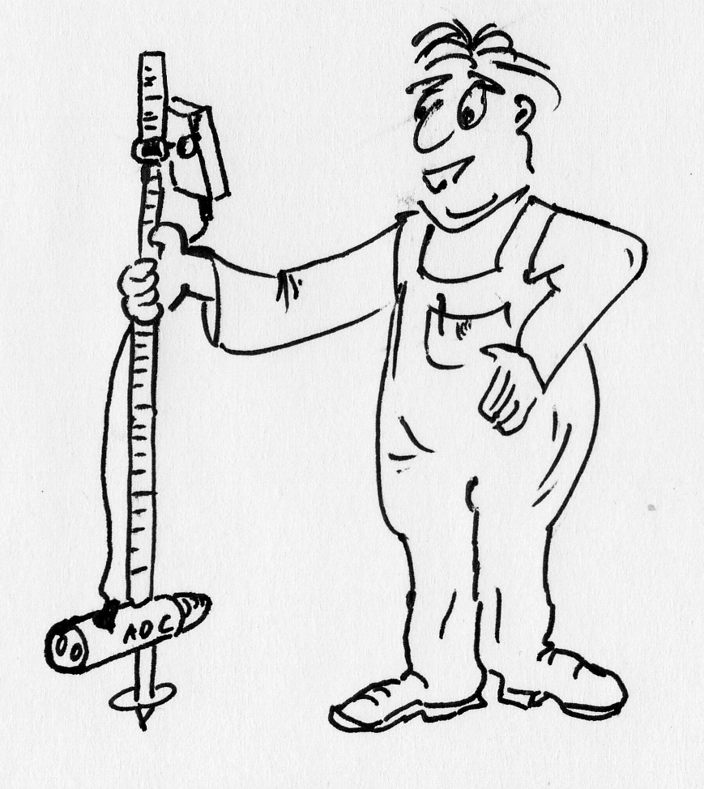
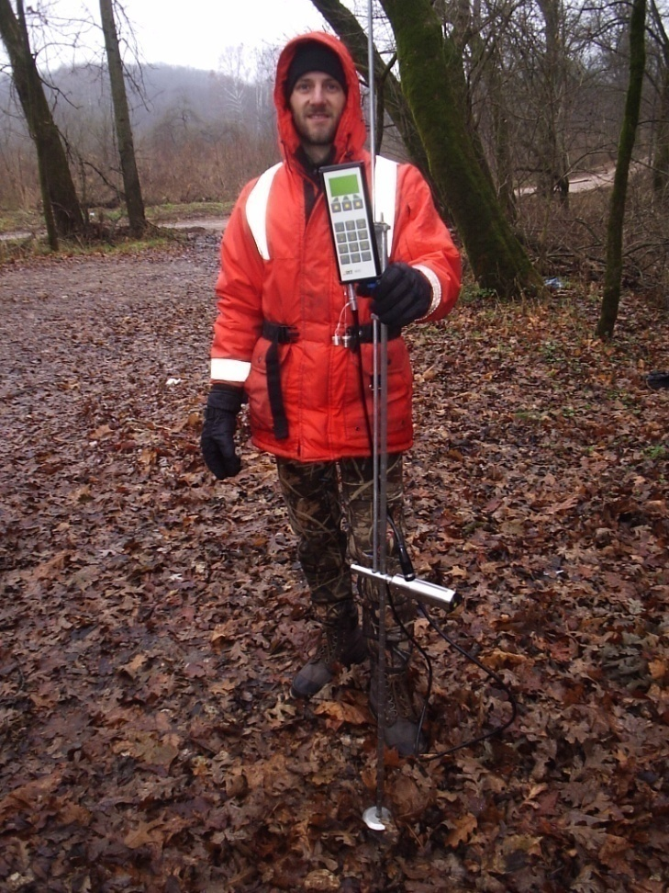
Questions?
Notes:
HIF does not currently stock the ADC, but plans to move towards carrying the ADC in their warehouse after software improvements to help low velocity bias are tested.

