Slide 1
ADCP Compass Calibrations
OSW Policies and Best Practices Webinar
October 2011

Slide 2
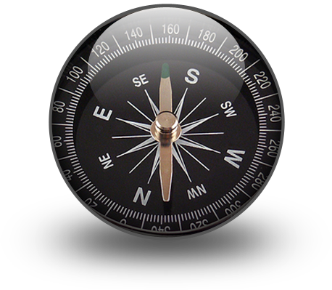
Today’s Webinar
When an accurate compass is necessary for discharge
What affects compass accuracy
Detecting errors in compass headings
Compass calibration techniques
  Rio Grande
  StreamPro
  RiverRay
  SonTek M9/S5

Slide 3
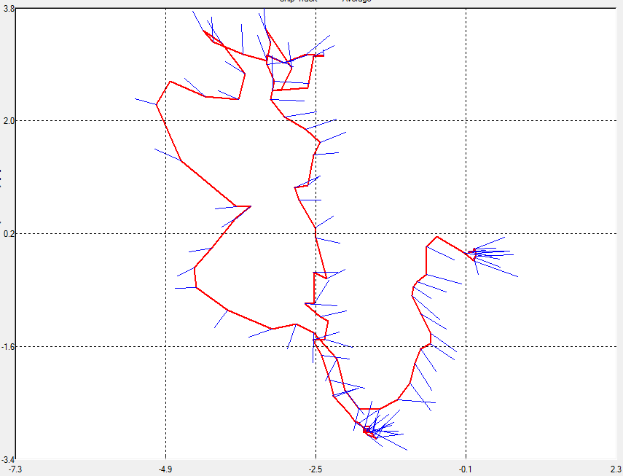
ADCP Bottom Track
When using ADCP Bottom Track and Water Track
  Boat speed and water speed are in the same coordinate system
  Valid compass headings not required for accurate discharge (compass optional on StreamPro)
  Can cause errors in velocity directions, widths areas – (inaccurate loop corrections)

Slide 4
Compass Error can cause loop closure error!
90
60
120
90
Loop
closure
error
~280
240
270

Slide 5
GPS
GPS: compass headings are used to align GPS boat speed with ADCP water speeds. Errors in heading will cause errors in discharge
  Correct magnetic
  variation for site
  Relatively free of
  magnetic interference
  Properly calibrated
  compass
True
North
Magnetic
North
Orientation
of Instrument
Boat Vector
From DGPS
ADCP Vector

Slide 6
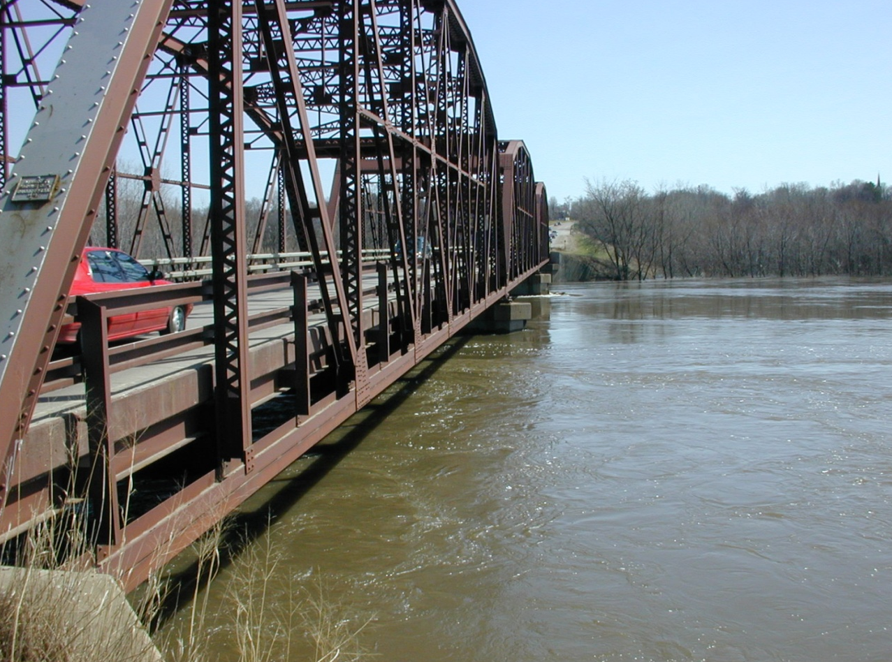
Affecting Compass Accuracy
Structures having local magnetic fields relatively large compared to Earth’s magnetic field: steel truss bridges, bridge piers (steel or concrete full of rebar) – If their orientation changes during transect, the affect can not be calibrated out
Rapid/sudden acceleration and/or deceleration
Ferrous materials and electromagnetic field interference near ADCP (ferrous parts on mount, steel toolbox on boat, etc)

Slide 7
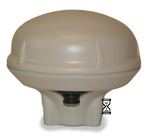
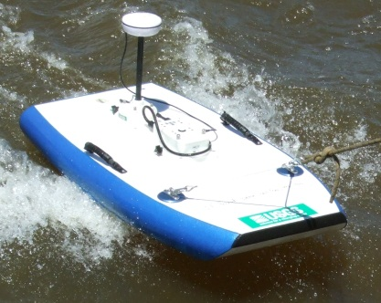
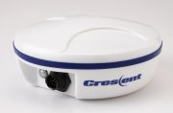
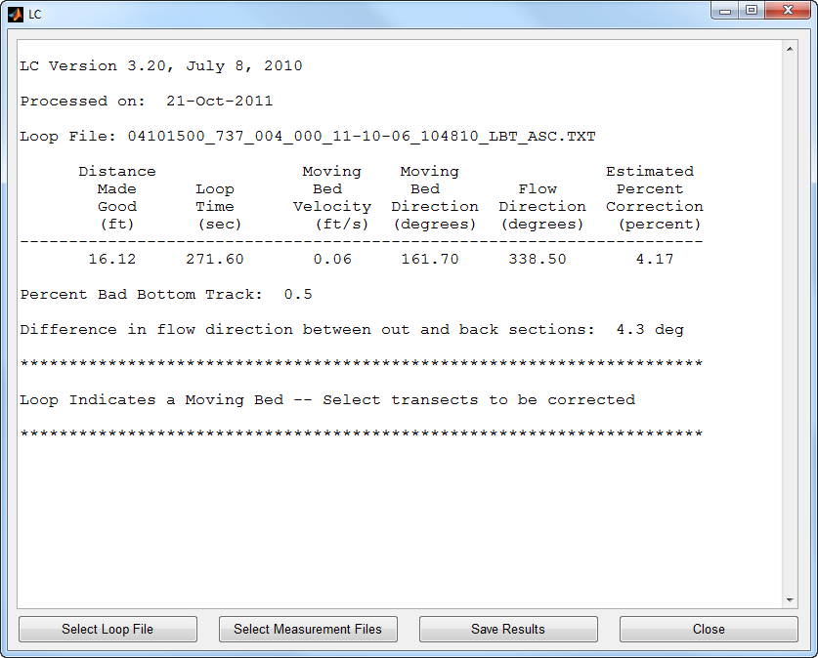
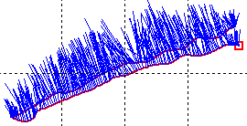
When to Calibrate Compass
Encouraged prior to all ADCP measurements
Mandatory
  Using GPS as reference (GGA or VTG)
  Using loop method (LC software) to detect and/or correct for moving bed

Slide 8
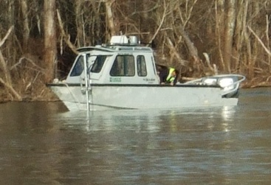
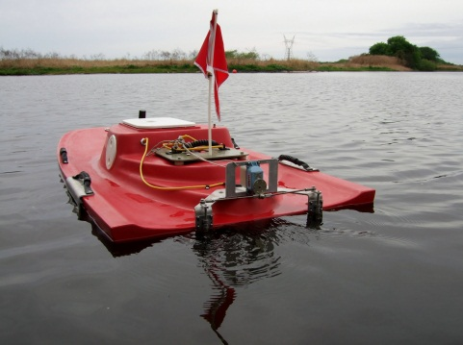
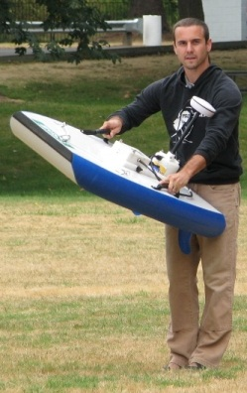
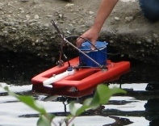
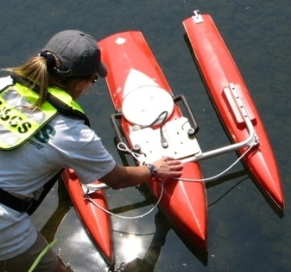
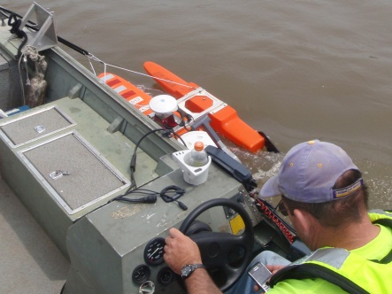
Calibrate the Deployment
Compass calibrations are an attempt to calibrate out heading errors caused by sources near the ADCP and the local area
Minimize deployments exposure to potential interference (truck, cell phones, bridge deck, etc)
Entire deployment should be moved through the calibration routine when practical
Do not simply rotate the ADCP

Slide 9
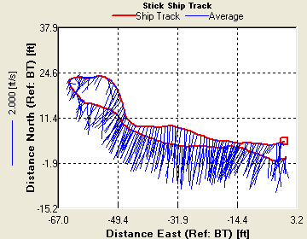
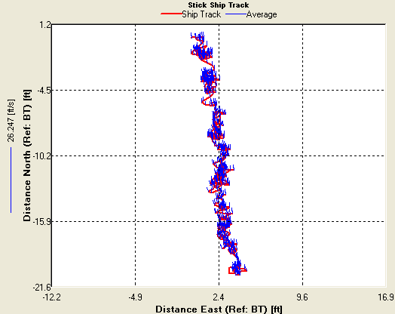
Compass and Moving Bed
Loop Method: preferred MB test – IF you have a calibrated/accurate compass AND can maintain bottom track
Stationary MB test: Pick location most likely to have moving bed, do multiple when in doubt, minimum required MB Test (Use when no compass, or compass errors)
If there is any doubt in one method collect an additional test with the other method
Use GPS or loop method if a moving bed exists. For instruments without a compass or when there are compass errors, do multiple stationary moving bed tests
Always use LC or SMBA for corrections
GPS is preferred to corrections if valid GPS GGA or VTG data is available

Slide 10
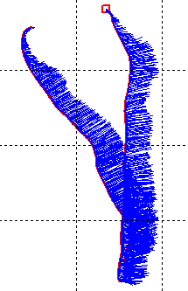
Detecting Compass Errors
Calibration errors
Watch for compass issues while collecting
data
  LC reporting heading differences warning
  Loop ending significantly downstream
  GPS – BT downstream of VTG or GGA on shiptrack
  Large variations in transect Q when using
  GPS, not there when using BT
If potential compass issue spotted try recalibrating in a different location and/or change location of transects

Slide 11
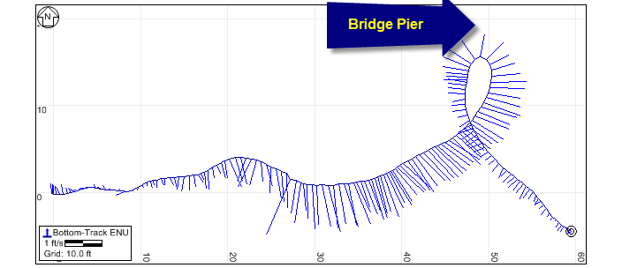
Compass Error in Shiptrack
Flow appears to change direction in shiptrack (compass locking on to steel in pier) – not a calibration issue

Slide 12
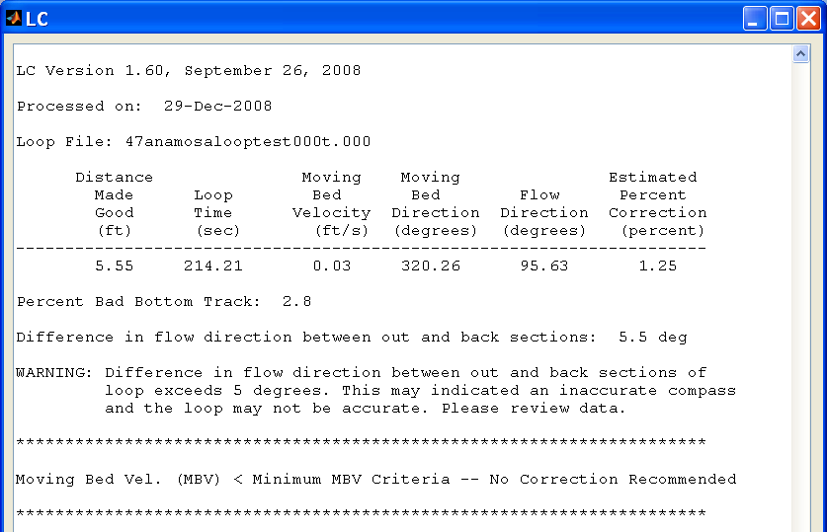
LC Compass Warning

Slide 13
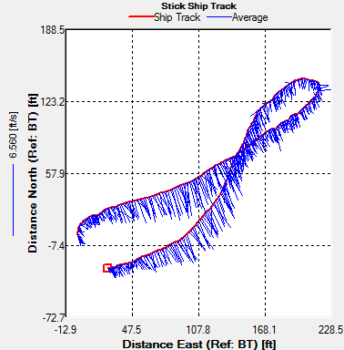
Loop Ending Downstream
Loop should not end downstream of start point (If you actually returned to start point)
Indicates BT and or compass issues
Can not be used to
determine moving
bed

Slide 14
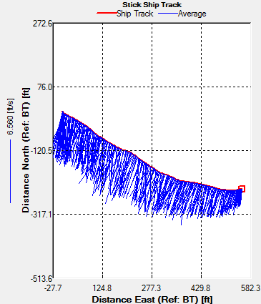
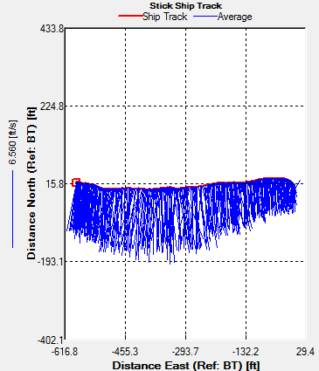
Potential Issues - Compass
directional bias in flow direction between reciprocal transects

Slide 15
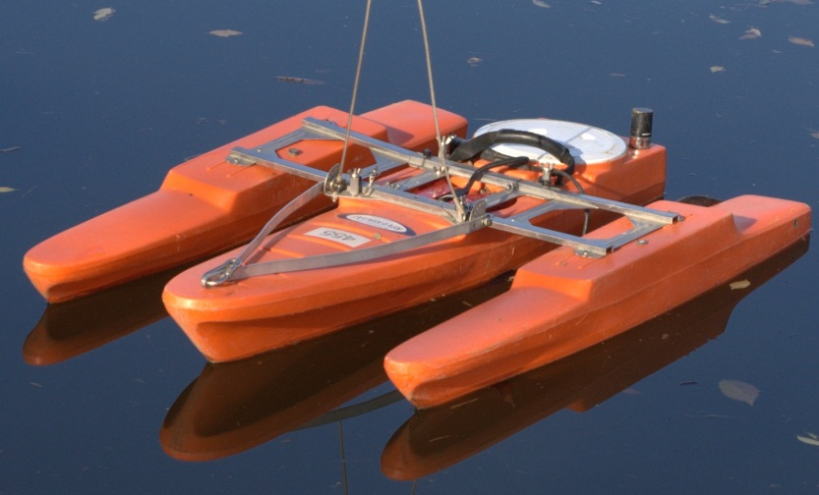
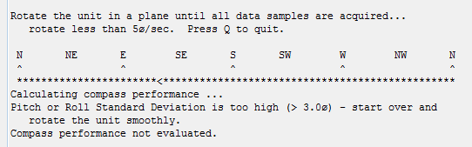
Rio Grande Compass Calibration
Designed to be completed by slowly rotating deployment 360 degrees with minimal pitch and roll (flat calibration)
Should be completed in the water or on a flat surface
Good calibration should take at least 1 to 2 minutes
Calibration reports total error correction applied
Always end with an evaluation
If total error is > 1 degree repeat calibration and evaluation
After several attempts document and proceed with measurement.

Slide 16
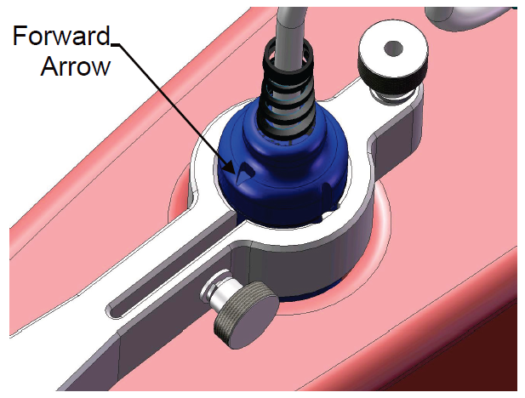
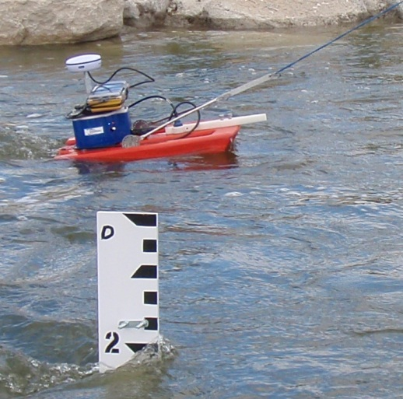
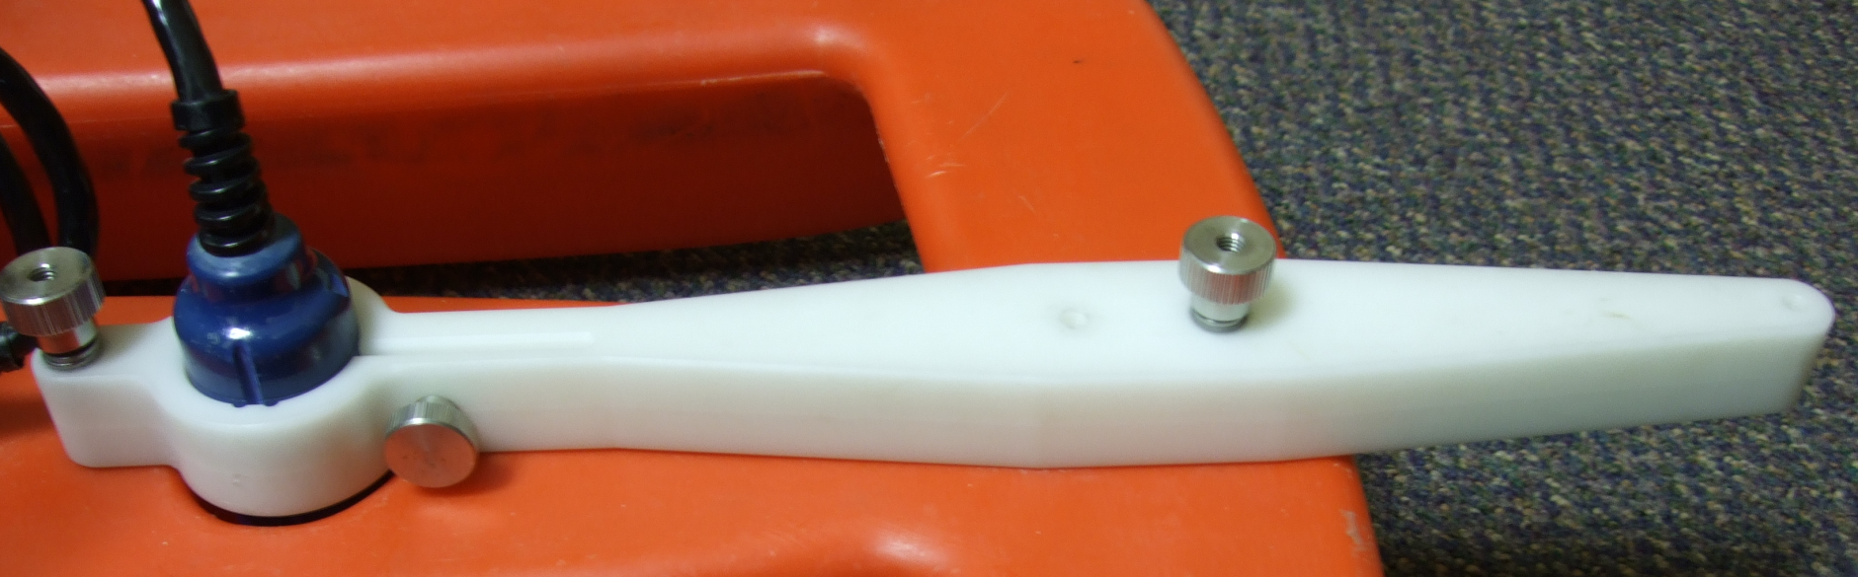
StreamPro with a Compass
Advantages
  Correct velocity directions, widths, areas, etc
  Better QA/QC of data (viewing)
  Can correct for moving bed using Loop method (LC)
  Potential to use GPS
Compass is in electronics housing so transducer must be in known alignment
Place transducer in grooves so that arrow on top point to the front of boat

Slide 17
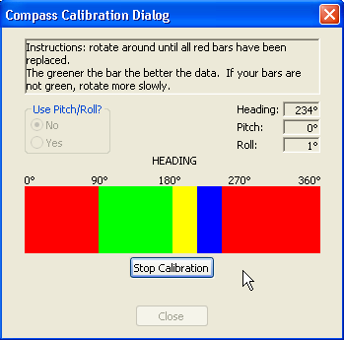
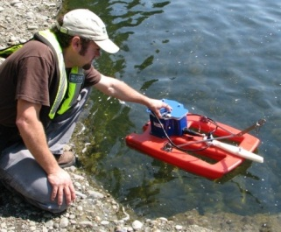
StreamPro Single Tilt Calibration
Recommend Single tilt calibration - Pitch/Roll No (Simple on PDA)
Using pitch and roll (advanced on PDA) not practical in field
Place deployment in calm water or on flat surface
Slowly rotate the boat 360
There are 12 squares that change colors as you rotate
The more Green = Good
Go slower if they are yellow or red
Evaluation immediately after calibration
Green – Good
Light Green – Acceptable
Yellow – within parameters (one or two yellow bars for the entire rotation is OK)
Orange – unacceptable (slower rotation required)

Slide 18
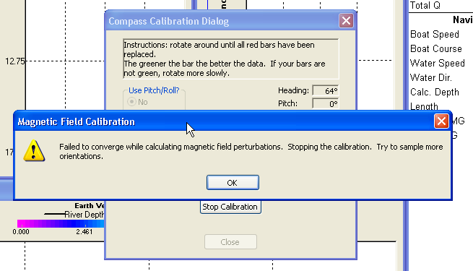
Calibration Failure
If you rotate too fast, have too much pitch/roll, etc you may get a failure
Rerun calibration

Slide 19
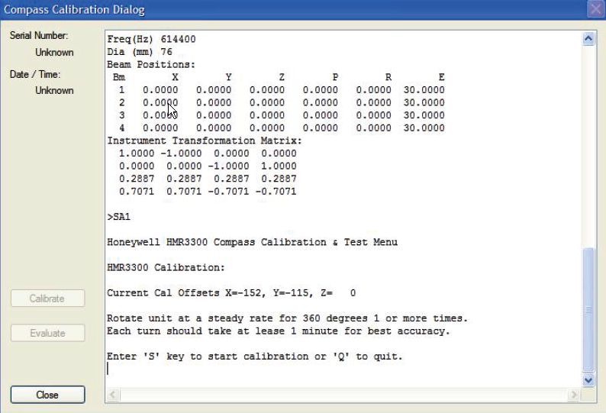
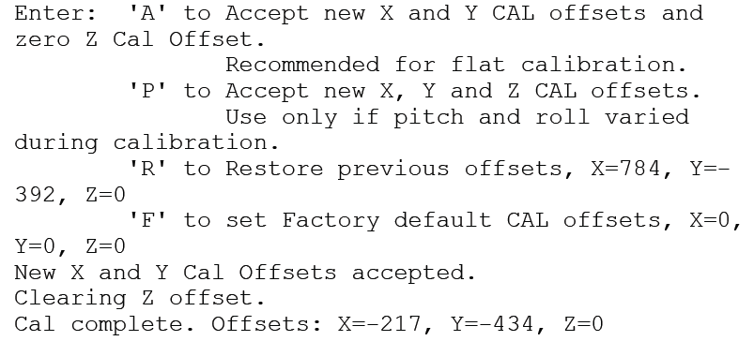
RiverRay - Compass Calibration
Compass seems more sensitive to sources of interference than previous ADCP’s
“S” to start and being slowly rotating
Smoothly rotate 360 degrees taking 2 to 3 minutes (> 40 – 50 data points on screen)
If slow rotation is not possible, do multiple rotations

Slide 20
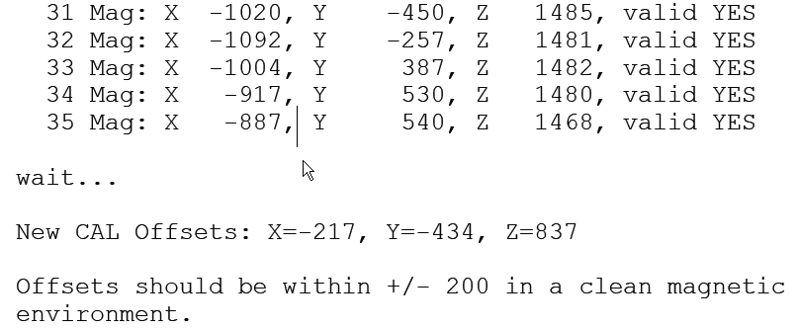
RiverRay - Complete Calibration
Press “D” after completing at least one rotation and 40 to 50 samples (2-3 minutes)
X and Y offsets should be < 200 otherwise repeat
TRDI recommends accepting X, Y and Z offsets (option “P”)
Evaluation repeats the calibration process

Slide 21
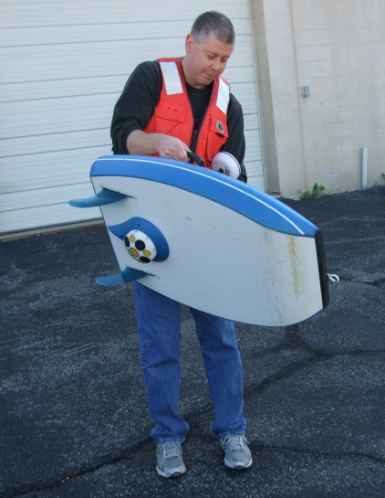
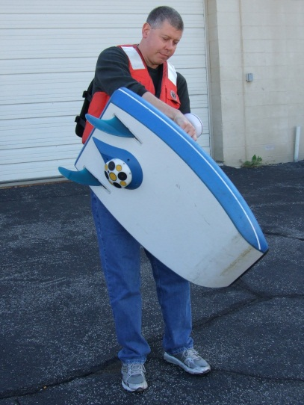
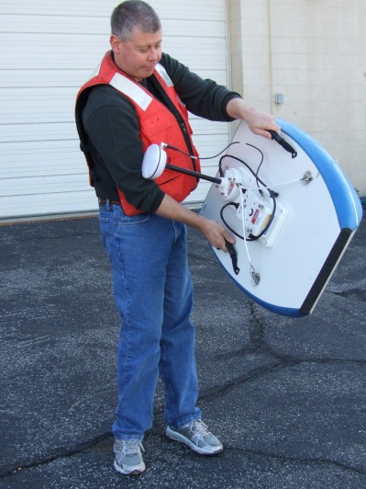
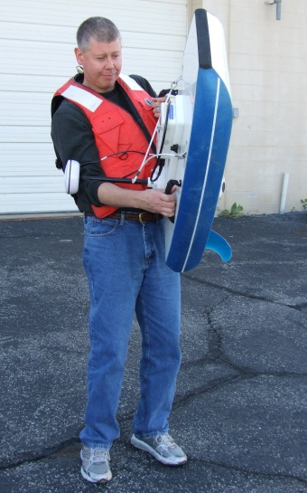
SonTek Calibration with Tethered Boat
Compass seems more sensitive to sources of interference than previous ADCP’s
Two complete circles while smoothly but significantly pitching and rolling
> 1 minute per circle, entire calibration > 2 minutes

Slide 22
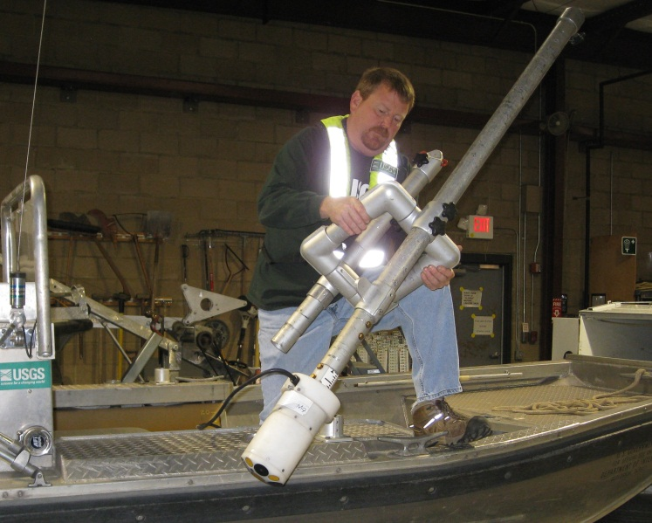
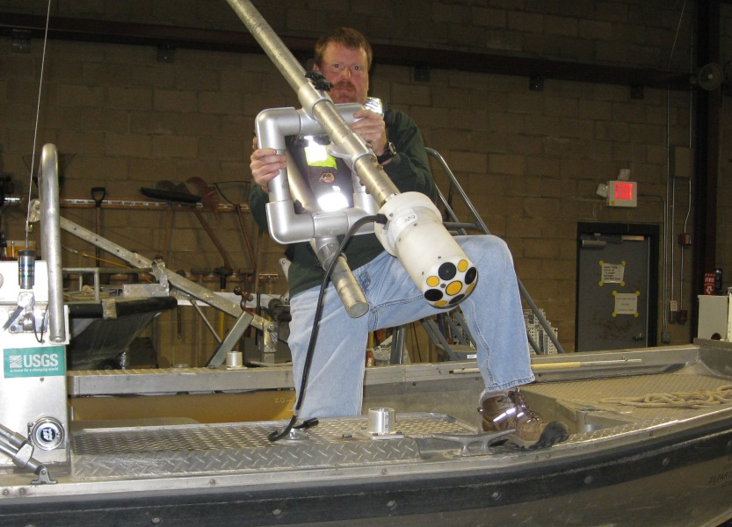
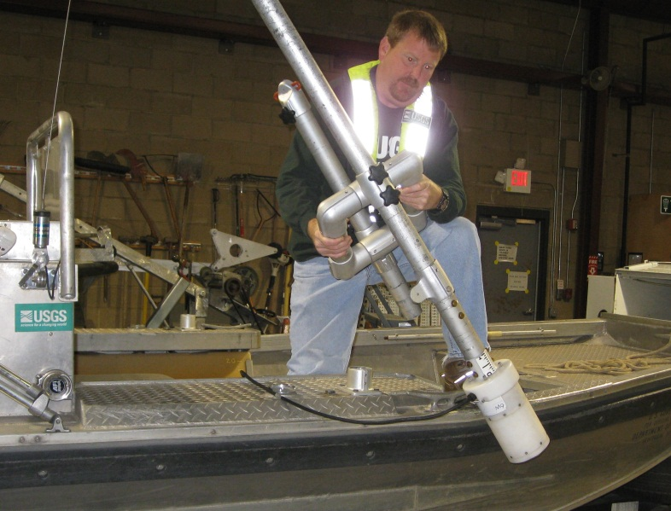
SonTek on a Manned Boat
Difficult to induce pitch/roll
Current best practice – With ADCP attached to mount, but mount detached from boat, hold over mounting point with ADCP oriented as it would be when mounted – pitch and roll as boat rotates in two complete circles

Slide 23
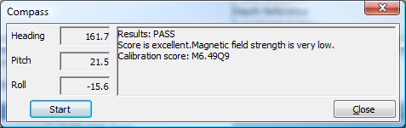
RS Live Compass Calibration
The calibration score has two parts
  M is magnetic distortion which should be very low (less than 10), may be high if there is minimal pitch and roll
  Q is a calibration score which should be > 3 (the closer to 10 the better)
No evaluation routine – repeat calibration if any compass issues noticed during data collection
Notes:
Compass Calibration
After completing two complete rotations press the Stop button.
The calibration routines will calculate a calibration score and provide brief comments on the results of the calibration.
Generally the results should say “Pass”, but the Score is often less than excellent if the pitch and roll were minimal.
The calibration score has two parts:
M is the magnetic distortion which should be very low (less than 10)
Q is a calibration score which should be very high on a scale of 1-10

Slide 24
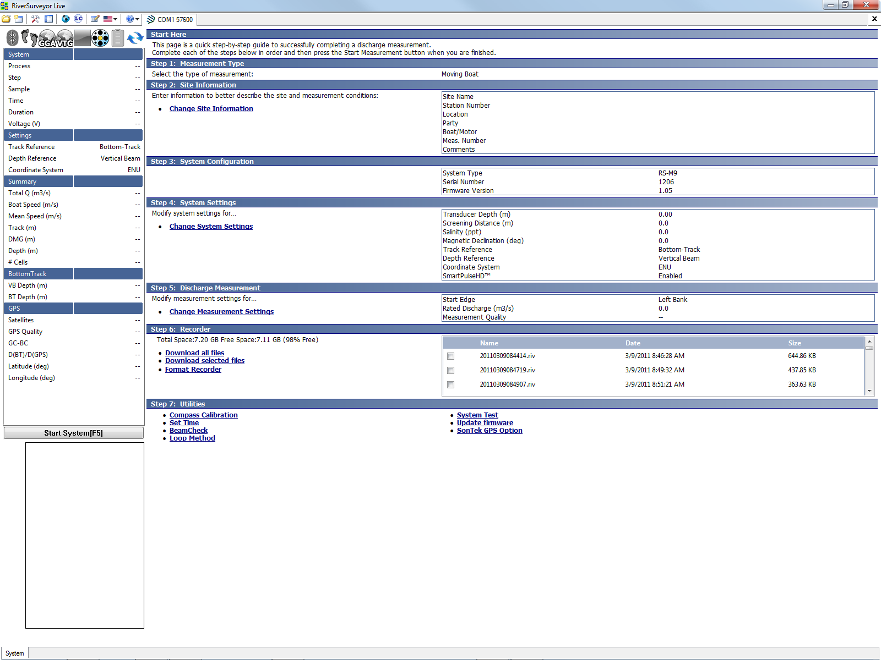
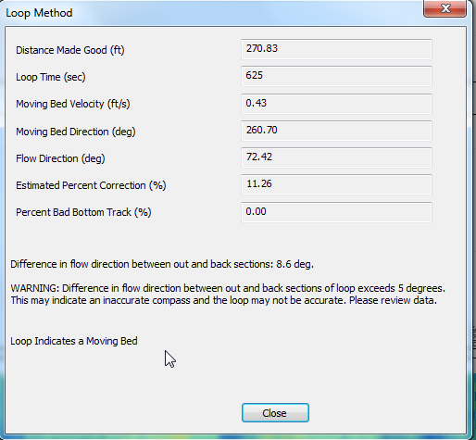
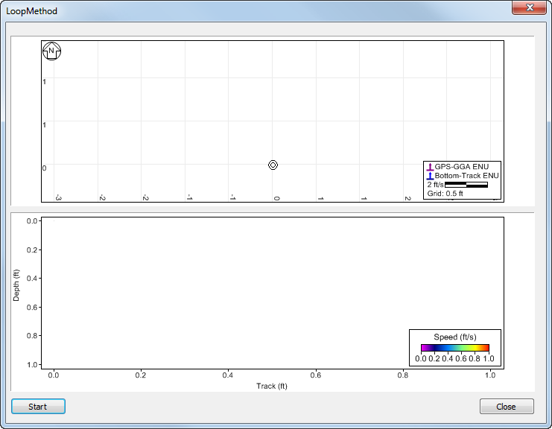
RS Live LC
Flow
D_{UP}

Slide 25
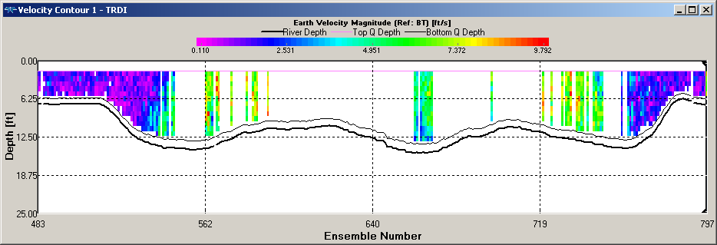
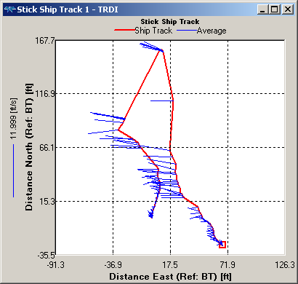
Lost BT Impacts Accuracy of Loop
Can not be used!
Notes:
25

Slide 26
Summary
Valid compass headings are critical for Loop moving bed tests and when using GPS as reference
Compass needs to be accurately calibrated (follow recommendations – duration is important!)
Even when you have a “good” calibration, there could be something in the cross section that affects your heading
Watch for compass issues while collecting
data
  LC reporting heading differences warning
  Loop ending significantly downstream
  GPS – BT downstream of VTG or GGA
  Large variations in transect Q when using
  GPS, not there when using BT
Do stationary moving bed tests when there seem to be compass issues!

